Slide 1
Nmap Scripting Engine
Florin Micu

Slide 2
Agenda
  Introduction to Nmap
    Port Scanning Techniques and Algorithms
    Service and Application Version Detection
    Remote OS Detection
  Nmap scripting engine
    Intro to Lua, NSE libraries
    Scripts
      Type
      Format
      Writing tutorial

Slide 3

Introduction to Nmap
    free, open-source port scanner
    purpose:
      discover computers and services on a computer network, thus creating a “map” of the network
    written by Gordon Lyon (a.k.a Fyodor); first release: September 1, 1997
    runs on Linux, Windows, BSD, Mac OS X, Solaris
    console and graphical versions are available
    legal issues:
      port scanning is not a crime

Slide 4
Port Scanning Basics
  six port states recognized by Nmap:
    open
      an app is actively accepting TCP connections, UDP datagrams
    closed
      accessible but no app is listening on it
    filtered
      cannot determine if it's open or closed
    unfiltered
      accessible but cannot tell if open or closed
    open | filtered
    open | closed

Slide 5
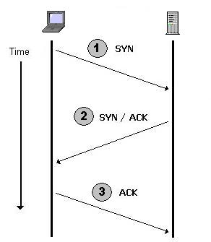
Scan type: TCP
    option: -sT
    uses connect()
    it's very easy to detect
    and logged
    example:
nmap -sT -p 30000 172.28.124.39
3-way handshake

Slide 6
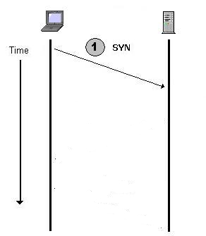



Scan type: SYN
    option: -sS (stealth)
    sends only SYN packets
    less likely to be detected
    example:
nmap -sS -p 30000 172.28.124.39

Slide 7
Other scan types
  -sF, -sN, -sX = FIN, null, XMAS
    refers to the flags set in the TCP header
    less likely to appear in logging system
    less reliable (not all systems follow RFC to the letter)
  -sP = ping scan
  -sU = UDP scan

Slide 8
Scan type: Idle scan
  option: -sI
  sends spoofed packets, impersonating another computer ("zombie")
    every IP packet has an unique ID
    host with sequential (and predictable sequence) number can be used as “zombie”
    the latest versions of Linux, Solaris and OpenBSD, Windows Vista are not suitable as zombie
      IPID is randomized

Slide 9
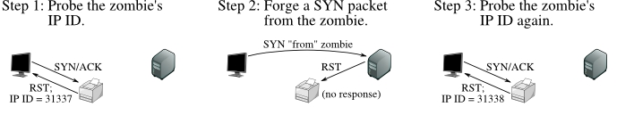
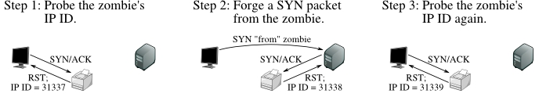

Slide 10
Service and Application Version Detection
  purpose
    detect which exploits a server is vulnerable to
    detect whether services are run on wrong ports or share the same port
  technique:
    connect TCP, listen 5 sec, get greeting banner, start UDP probes (specific port, string) etc.
  example
    nmap -A -T4 -F 172.28.124.39
      A = enables OS detection and Version detection, Script scanning and Traceroute

Slide 11
Remote OS Detection
  reasons:
    determining vulnerability of target hosts
      Rwho daemon on Solaris 7-9 is vulnerable, on Solaris 10 not
    network inventory and support
    detecting unauthorized and dangerous devices
      detect a wireless access point (WAP), webcams, game console
  technique:
    TCP/IP stack fingerprinting: send a series of valid and invalid TCP and UDP packets to the remote host and examine practically every bit in the responses
  example:
    nmap -sV -O 172.28.124.39, nmap -O 172.28.124.39

Slide 12
Nmap Scripting Engine
  automate a wide variety of networking tasks
    network discovery
    more sophisticated version detection (e.g Skype2)
    vulnerability detection
    backdoor detection
  scripts are executed in parallel
  scripts are written in Lua scripting language
  example:
    nmap -sC 172.28.124.39

Slide 13
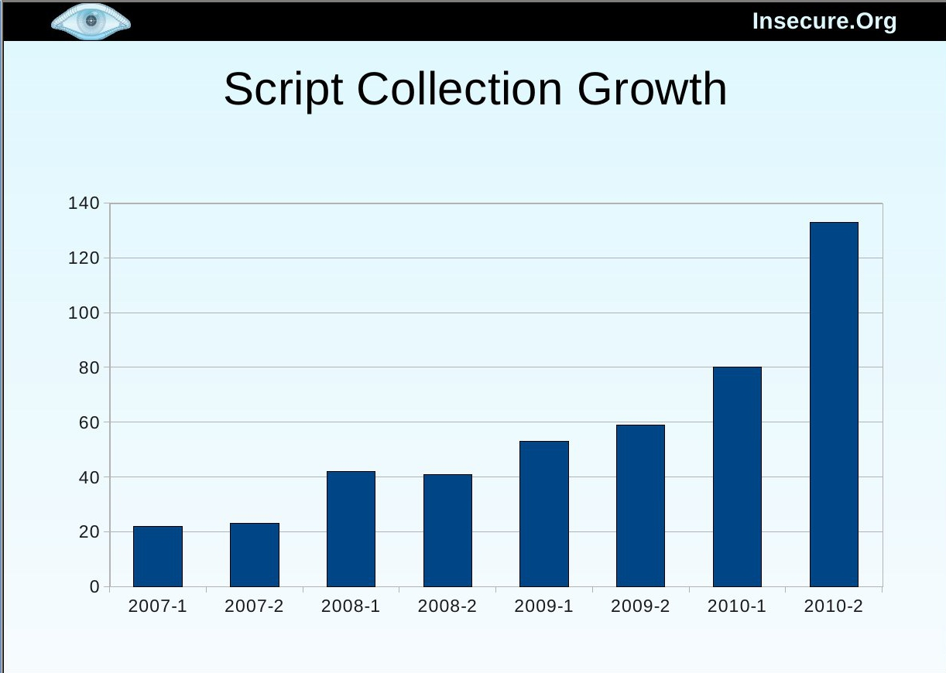

Slide 14
Why Lua?
      NSE had to be: easy to use, small in size, scalable, fast and parallelizable
  Lua is:
    lightweight programming language
      easy to learn, has minimalist syntax and features
      small memory footprint
      tiny to embed
    safe and secure
      no buffer overflows, no strings vulns
    portable
    interpreted
    used:
      In video game development (Warcraft, Mafia, FarCry etc)
      Wireshark network packet analyzer, VLC media player, Snort
    excellent documentation, actively developed

Slide 15
Components of NSE
  NSE libraries
    57 modules written in Lua
      „bit” (bitwise op on integers) and “pcre”(perl compatible regex) are written in C/C++
    make script writing more powerful and convenient
      scripts need only to require the default libraries in order to use them
  NSE Scripts
    161 scripts: http://nmap.org/nsedoc/
  Nmap API
    an interface to the Nmap's internal functions (Nsock library for efficient network I/O etc.)

Slide 16
Script categories
    every script belongs to at least one category
    auth
      try to determine authentication credentials on the target system
    default
      the default set and are run when using the -sC or -A options
    dos
      may cause denial of service (they crash a service as a side effect of testing it)
    intrusive
      the risks are too high that they will crash the target system
    safe
      scripts that don't crash services, use large amounts of network bandwidth or other resources, or exploit security holes

Slide 17
Command-line arguments
      --script <filename>|<category>|<directory>|<expression>|all[,...]
      --script-args: provides args to script
      --script-trace: for debug
  Script Selection
    supports logical operator: not, and, or
      nmap --script "http-*"
      nmap --script "not intrusive"
      nmap --script "default and safe": scripts both in "default" and in "safe"
      nmap --script "default or safe": scripts in "default" or "safe" category
    examples:
      nmap --script default,safe 172.28.124.37-45

Slide 18
Script format
  Head
    meta information
  Rules
    a rule is a Lua function that returns either „true“ or „false”
  Action
    the instructions to be executed if the script's rule is evaluated to „true”

Slide 19
Script format: Head
    description field
    catagories field:
      categories = {“default”, “discovery”, “safe”}
    author field
    license field
    dependencies field
      an array containing the names of scripts that should run before this script
      listing a script in dependencies doesn't cause that script to be run but merely forces an ordering among the scripts that are selected
        dependencies = {"smb-brute"}

Slide 20
Script format: Rules
    prerule
      script runs before any of Nmap's scan phases
      for tasks which don't depend on specific scan targets
    hostrule(host)
      runs after Nmap has performed host discovery, port scanning, version detection
      invoked once against each target host which matches its "hostrule function"
    portrule(host, port)
      the most common Nmap script type
      decides if a script should run against a service
        portrule = shortport.port_or_service(22, "ssh")
    postrule()
      runs after Nmap has scanned all of its targets
      useful for formatting

Slide 21
Script format: Action
    the instructions to be executed when the script's prerule, portrule, hostrule or postrule triggers
    NSE scripts generally only return messages when they succeed
  a script must contain one or more rules
  a „prerule“ or a „postrule“ will always evaluate to true

Slide 22
Script writing tutorial
  find IP address from SSH host key
  find IP address from MAC address

Slide 23
Final notes
  Download Nmap from: http://nmap.org/
  NSEDoc portal: http://nmap.org/nsedoc
  NSE systems docs: http://nmap.org/book/nse.html
  Q&A ?

