Slide 1
Retail Data Analysis Project
Final Project - Data Analyst Program Google and Reichman AI Tech School
Dor Thaler

Slide 2
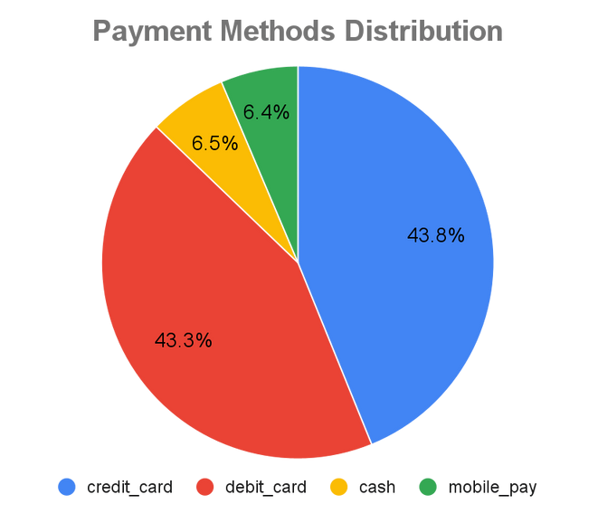
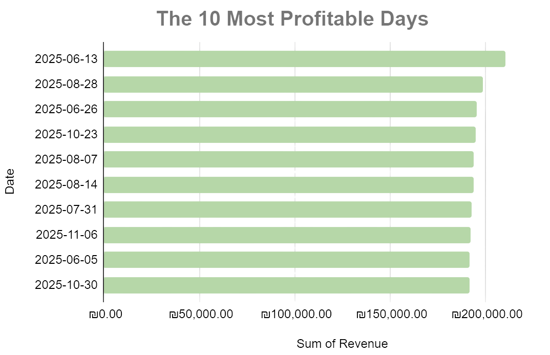
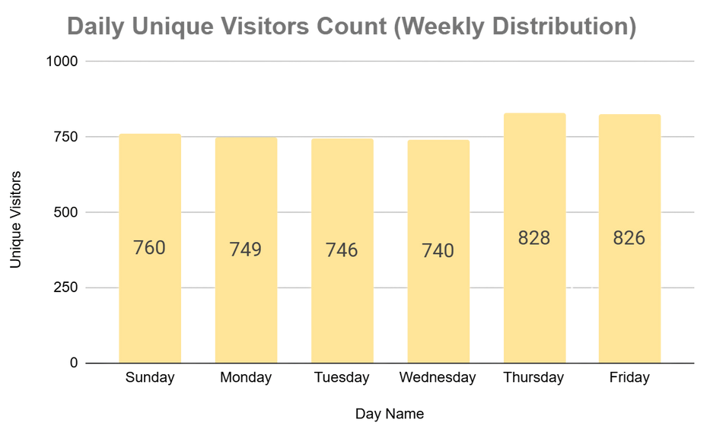
EDA
The most profitable day is 13/6/25 The day the Israel-Iran war began

Slide 3
Classification of employees and customers
Over 3 hours on average per day / presence in
?operational areas
YES
NO
Customer
Was the app used?
Employee
YES
NO
Was a purchase
?made
Customer
without an app
YES
Finding a role by common location/seniority
NO
Not Paying Customer
Seniority > 60 days Number of visits > 10
Average interval > 12
NO
One Time Customer
Repeat Customer
YES

Slide 4
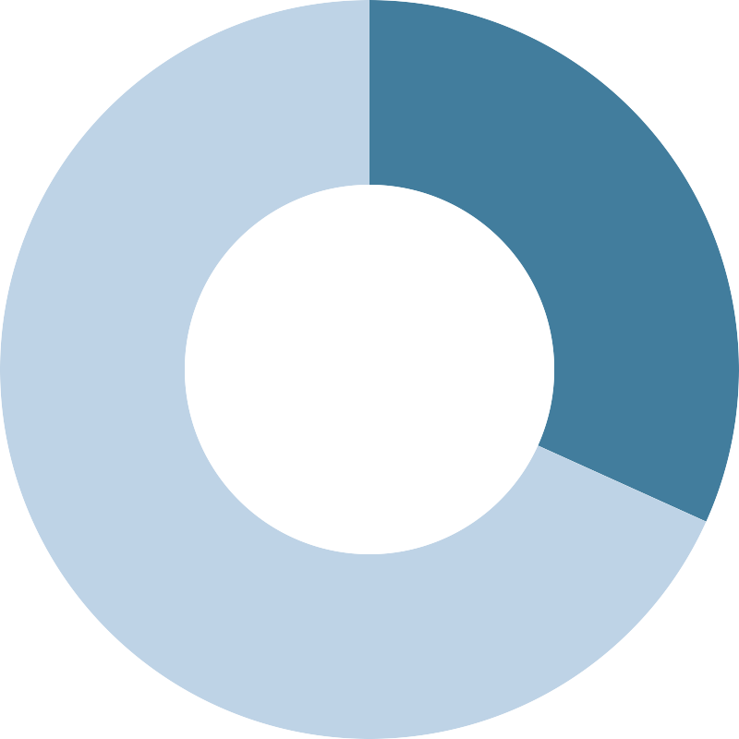
Identifying outliers with location accuracy
Main Insights:
Total signals: 1.3M, abnormal signals: 415K (over 30m).
This is an abnormal rate of about 32% (about a third of the data).
Security guards have the highest abnormal rate, with about 89% of the signals defined as having low accuracy
Abnormal signals (>30)
Data processing method:
Differential Method:
Static users (e.g. cashier, butcher): Data completion For dynamic users (customers and general employees):
In location-based analysis: Filtering and omitting exceptions
In general attendance analysis: Retention of records, even in case of incorrect location.
Healthy singles (<30)

Slide 5
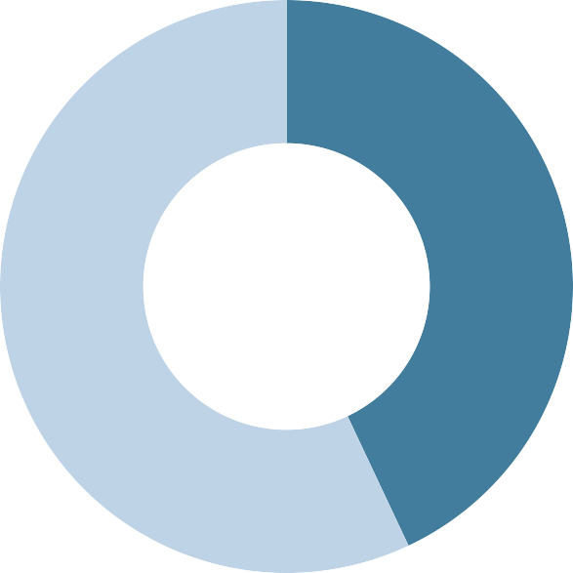
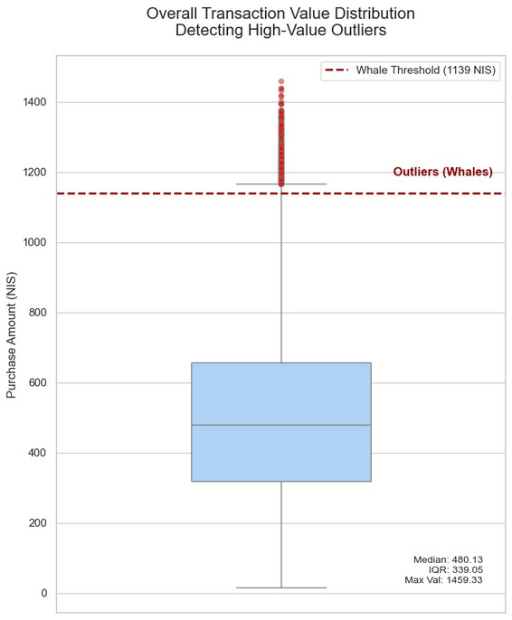
Application Performance Testing
Algorithm for daily supermarket sessions for each customer with a dedicated
app ('Sessionization').
Algorithm that isolates separate visits and calculates the net dwell time with maximum accuracy.
Weighted score is 43% - The app meets the threshold requirements
Healthy Signals 43%
Minutes Without Signals 57%
Unusual Transactions
Using an IQR statistical test, 334 transactions were identified that deviated drastically from the norm (over 1,139 NIS).
The data segmentation showed that 100% of these transactions belonged to repeat customers.
Main Insight - Proposal for further segmentation by average basket size (Small, Medium, Large)

Slide 6
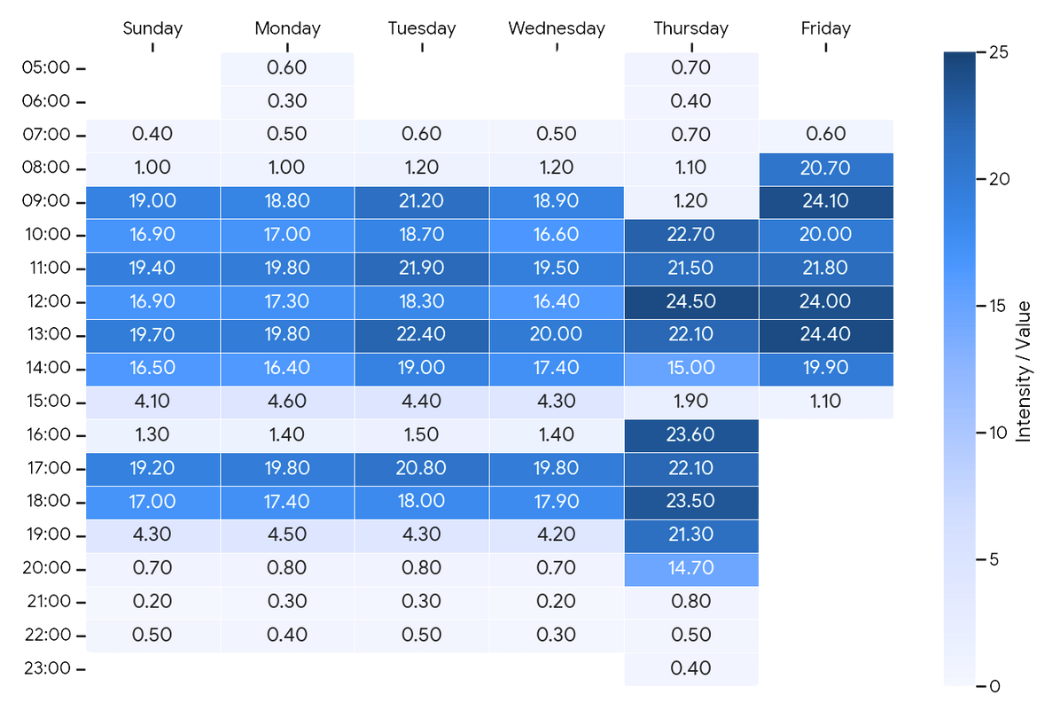
Business Recommendations
Consistent and sharp drop in activity every day around 3:00 PM
The maximum load is concentrated on Thursday evening (5:00 PM-8:00 PM) and on Friday
The almost complete dominance of the Medium segment: about 99% of sales during peak and off-peak hours are made by customers with a shopping basket of 300–800 NIS. In a homogeneous audience of families who make routine weekly purchases.
Recommendations: “Traffic light”, and Demand Shifting of the Medium segment through discounts, points in the app and promotions during off-peak hours.

Slide 7
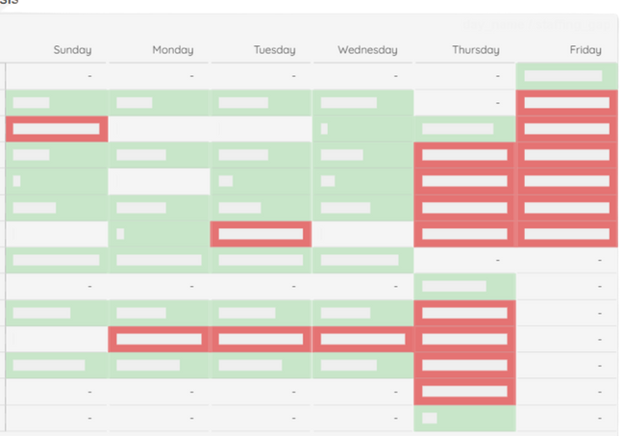


Optimization of supermarket checkouts
recommendation for further development
Gap Analysis - Calculating gaps in the number of available checkouts versus the average load at checkouts. Based on analysis of customer geolocation data and sales history.
Conclusions:
The average cashier's handling time per customer is 1.5 - 1.25 minutes.
There are gaps in peak versus off-peak times, between the number of customers and the number of cash registers available.
Recommendations:
Introducing self-service checkouts and the Scan & Go app - make it possible to cope with the high load. During off-peak hours - preventing "hidden unemployment" of cashiers (reducing shifts or efficient use of manpower).

Slide 8
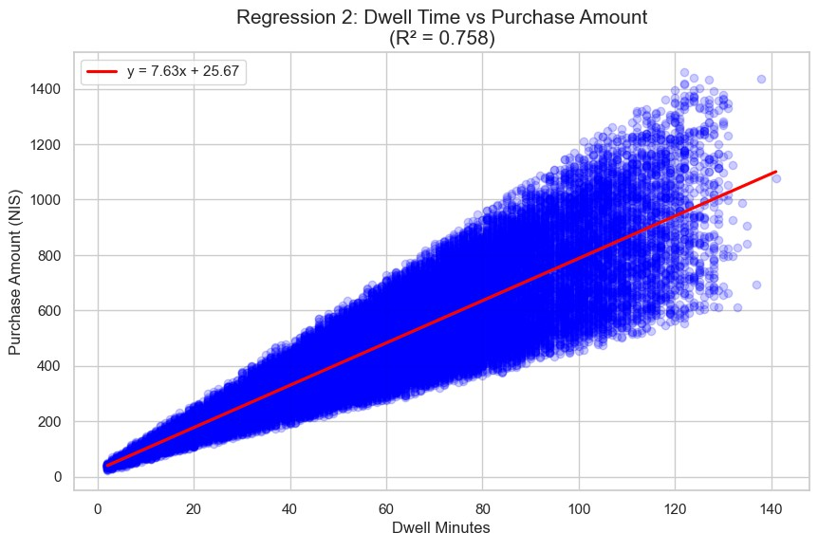
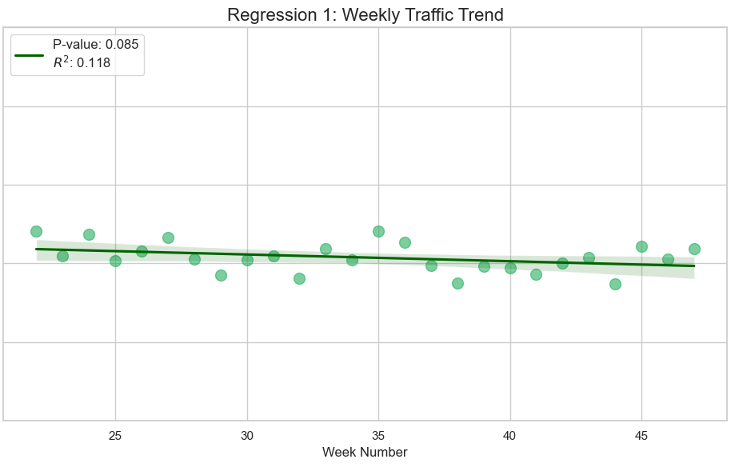
Regression Analysis 1
Visitor Trend over Time
Regression Analysis 2
Purchase amount depending on the length of stay

Slide 9
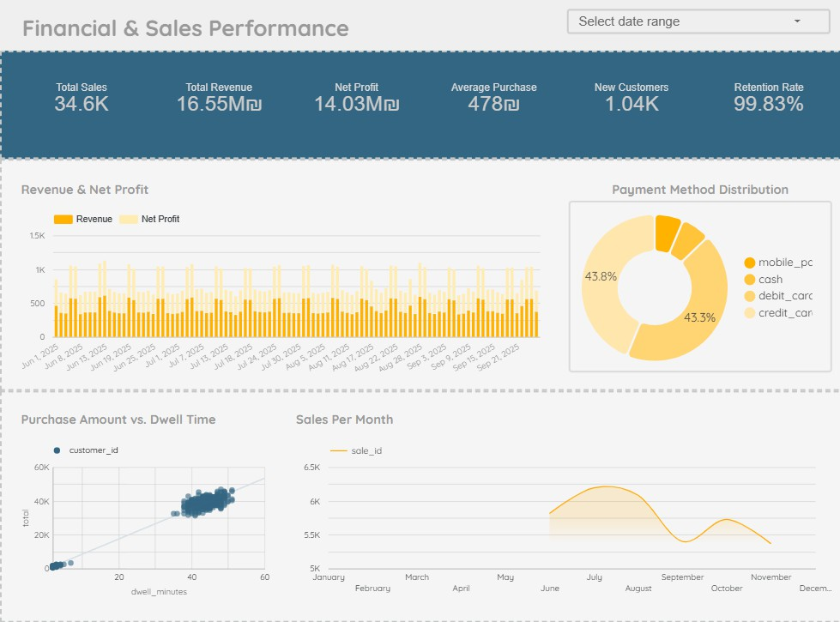

Slide 10
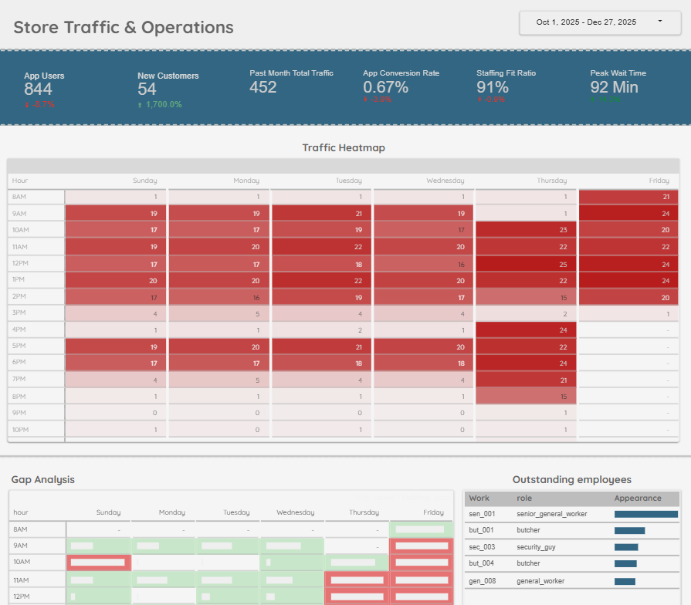

Slide 11
Thank You!

