Slide 2
Journal Site
Database
Article

Slide 3
Blockchain
Article
Journal Site
Mapping

Slide 4
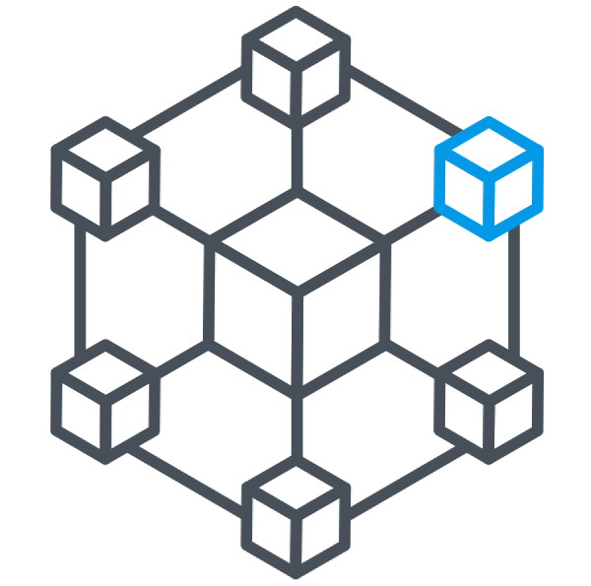


Smart
Contract
Article

