Slide 2





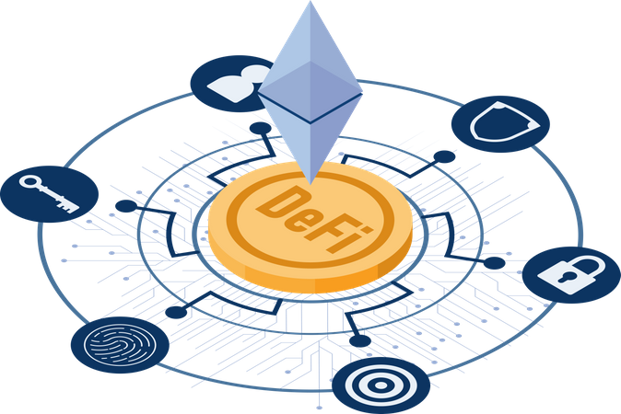
Data Sharing
Collaboration
Transparent Peer Review
Publishing Process
Intellectual Property
Protection
Identity Verification
Reputation Building
Finance
Incentive Mechanisms

Slide 3


Server
Article
Database

Slide 4



Smart
Contract
Article
Blockchain

Slide 5
Server
Article
Pay
Reader
Database

Slide 6
DeFi
Reader
Article
Blockchain

Slide 7
Off
On Chain
Author1
Author2
Principal
Corresponding
Author
Token
Token
Rating
other
Reviewer3

Slide 8
Off
On Chain
Author1
Author2
Principal
Corresponding
Author
Token
publish
Token
Publisher
Reviewer1
Token
Rating
Reviewer2
Reviewer3

Slide 9

Off
On Chain
Contribute
Token
Authors
download
Token
Reader3
Finance
$n
NFTs
Holders

Slide 10
Off
On Chain
Download
Reader
Token
Token
Cite
Reader

Slide 11
Off
On Chain
download
Reader
$a
Authors
$e
Reviewers
NFTs
$p
Publisher
$r
Readers

Slide 12
Off
On Chain
Finance
$n
$a
Authors
$e
Reviewers
NFTs
$p
Publisher
$r
Readers

Slide 13
Off
On Chain
Send
Token₁
Author
Review
Token₂
Reviewer
download
Token₃
cite
Reader
Token₄

Slide 14
Write
Off
On Chain
Author
Draft
Block Chain
Send
Reject
Review
Reviewer
Manuscript
Publish
Publisher
Article
Holder1
Download
Holder2
… …
Reader

Slide 15



DAO Framework
Holder
$a
$b
$c
Token
Finance
$$\frac{F×\$a}{\$a+\$b+\$c}$$
$$\frac{F×\$b}{\$a+\$b+\$c}$$
$$\frac{F×\$c}{\$a+\$b+\$c}$$

Slide 16
Author1
Author2
Author3
Corresponding
Author
Publisher
EIC
SE
AE
Reviewer

Slide 17
Author2
Author3
Holder
Corresponding
Author
contribute
Publisher
Token
EIC
Finance
SE
AE
Reviewer

Slide 18
……
Authors
……
Reader
Download
Token
Finance
Token
……
Reader
Cite
Finance
Token
Finance
Token
Finance
……
Reviewers
Publisher

Slide 19





On-chain
Application
Foundation
Organization
Coordination
Execution
Blockchain
DeSci
DAO
Smart Contact
Encryption
Feedback
Feedback
Submission
PCS
Governance
TSS
Consensus
DeFi
Restriction
Incentive
Restriction
Distribution
Review
Distributed
Ledger
Development-oriented
Task-oriented
Problem-oriented
Publish
Off-chain
Propagation
Article
Dataset
User
Action
Review
Decision
Publishing
Metadata
Journal
Statistics
Reward

Slide 20
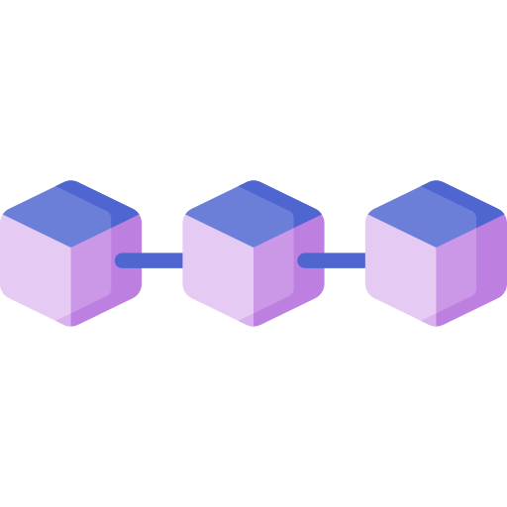
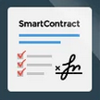






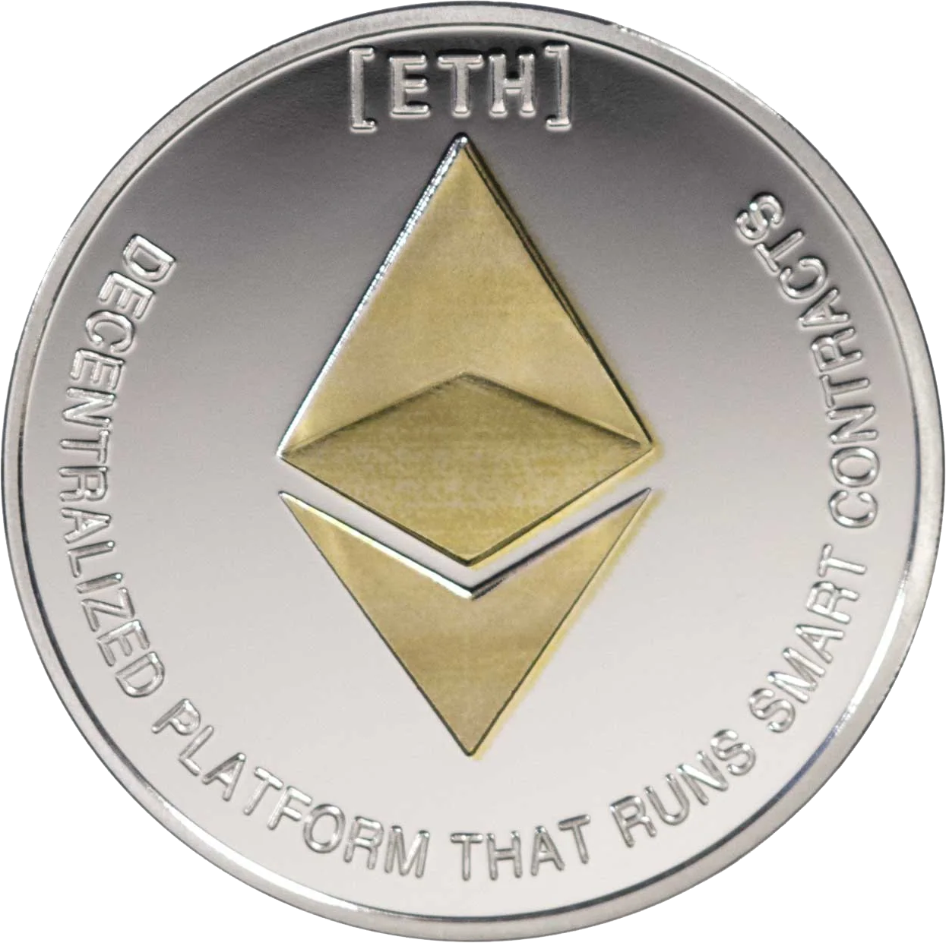
Submission
Review
Publish
Inscribe:
Proposal:
Mint:
Article
Authors
Keywords
Vote
Accept
Reject
Token
NFT
Governance & Incentive

Slide 21

Smart Contract
Draft
Inscription
ref
Author
ref
Keyword
cite
Article
Submission
reject
assign
review
accept
Publish
mint
user
Token

