Slide 2





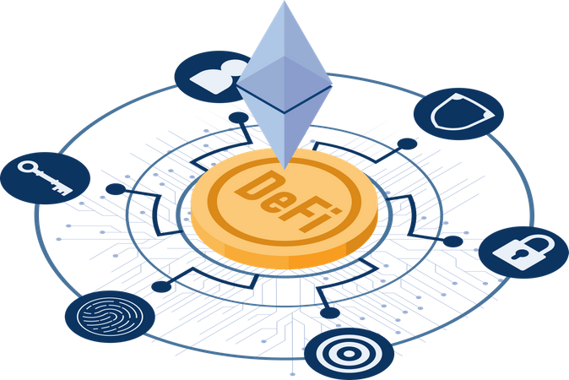
Data Sharing
Collaboration
Transparent Peer Review
Publishing Process
Intellectual Property
Protection
Identity Verification
Reputation Building
Finance
Incentive Mechanisms

Slide 3


Server
Article
Database

Slide 4



Smart
Contract
Article
Blockchain

Slide 5
Server
Article
Pay
Reader
Database

Slide 6
DeFi
Reader
Article
Blockchain

Slide 7
Off
On Chain
Author1
Author2
Principal
Corresponding
Author
Token
Reviewer1
Token
Rating
Reviewer2
Reviewer3

Slide 8
Off
On Chain
Download
Reader
Token
Token
Cite
Reader

Slide 9
Off
On Chain
Finance
Reader
$n
$a
Finance
Authors
$r
Reviewers
NFTs
$d
Download by User
$c
Cited By User

