Slide 2





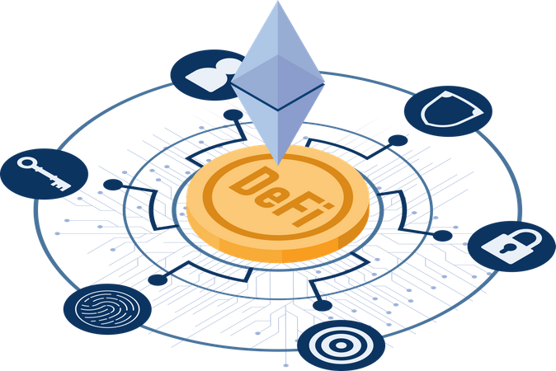
Data Sharing
Collaboration
Transparent Peer Review
Publishing Process
Intellectual Property
Protection
Identity Verification
Reputation Building
Finance
Incentive Mechanisms

Slide 3


Server
Article
Database

Slide 4



Smart
Contract
Article
Blockchain

Slide 5
Server
Article
Pay
Reader
Database

Slide 6
DeFi
Reader
Article
Blockchain

Slide 7
Off
On Chain
Author1
Author2
Principal
Corresponding
Author
Token
Token
Rating
other
Reviewer3

Slide 8
Off
On Chain
Author1
Author2
Principal
Corresponding
Author
Token
publish
Token
Publisher
Reviewer1
Token
Rating
Reviewer2
Reviewer3

Slide 9

Off
On Chain
Contribute
Token
Authors
download
Token
Reader3
Finance
$n
NFTs
Holders

Slide 10
Off
On Chain
Download
Reader
Token
Token
Cite
Reader

Slide 11
Off
On Chain
download
Reader
$a
Authors
$e
Reviewers
NFTs
$p
Publisher
$r
Readers

Slide 12
Off
On Chain
Finance
$n
$a
Authors
$e
Reviewers
NFTs
$p
Publisher
$r
Readers

Slide 13
Off
On Chain
Send
Token₁
Author
Review
Token₂
Reviewer
download
Token₃
cite
Reader
Token₄

Slide 14
Write
Off
On Chain
Author
Draft
Block Chain
Send
Reject
Review
Reviewer
Manuscript
Publish
Publisher
Article
Holder1
Download
Holder2
… …
Reader

Slide 15



DAO Framework
Holder
$a
$b
$c
Token
Finance
$$\frac{F×\$a}{\$a+\$b+\$c}$$
$$\frac{F×\$b}{\$a+\$b+\$c}$$
$$\frac{F×\$c}{\$a+\$b+\$c}$$

Slide 16
Author1
Author2
Author3
Corresponding
Author
Publisher
EIC
SE
AE
Reviewer

