Slide 2





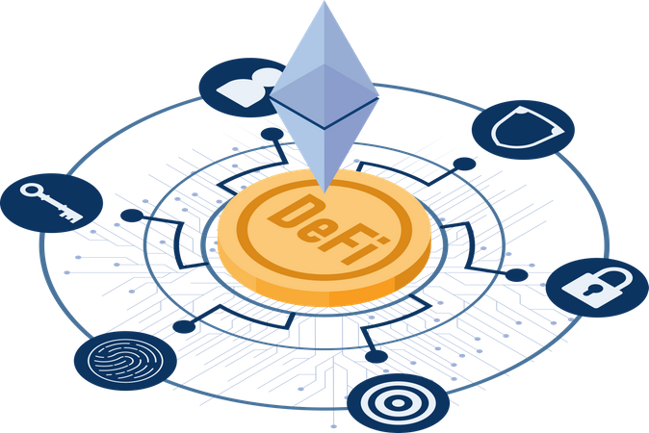
Data Sharing
Collaboration
Transparent Peer Review
Publishing Process
Intellectual Property
Protection
Identity Verification
Reputation Building
Finance
Incentive Mechanisms

Slide 3


Server
Article
Database

Slide 4



Smart
Contract
Article
Blockchain

Slide 5
Server
Article
Pay
Reader
Database

Slide 6
DeFi
Reader
Article
Blockchain

