Slide 1
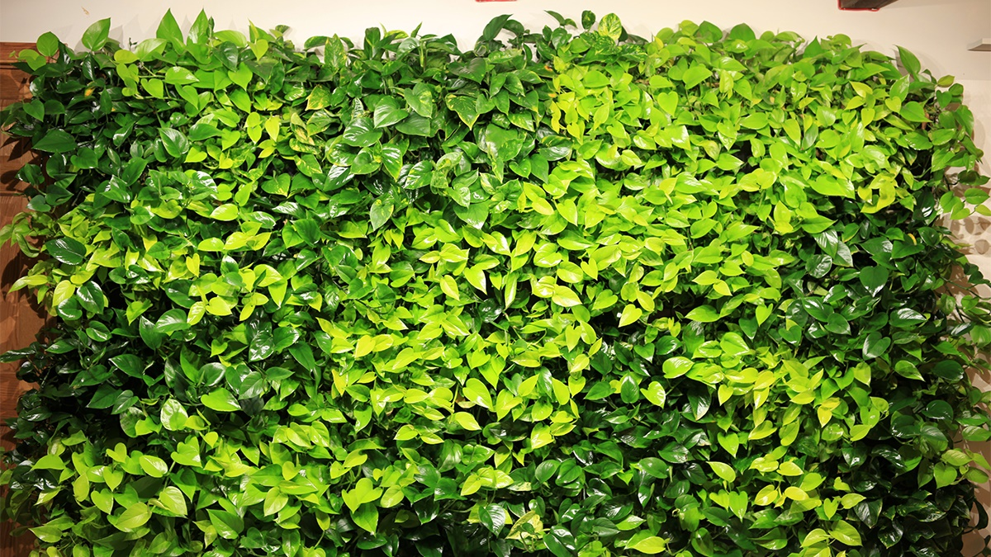
==== Plantabase ====
Thales Protopapas

Slide 2
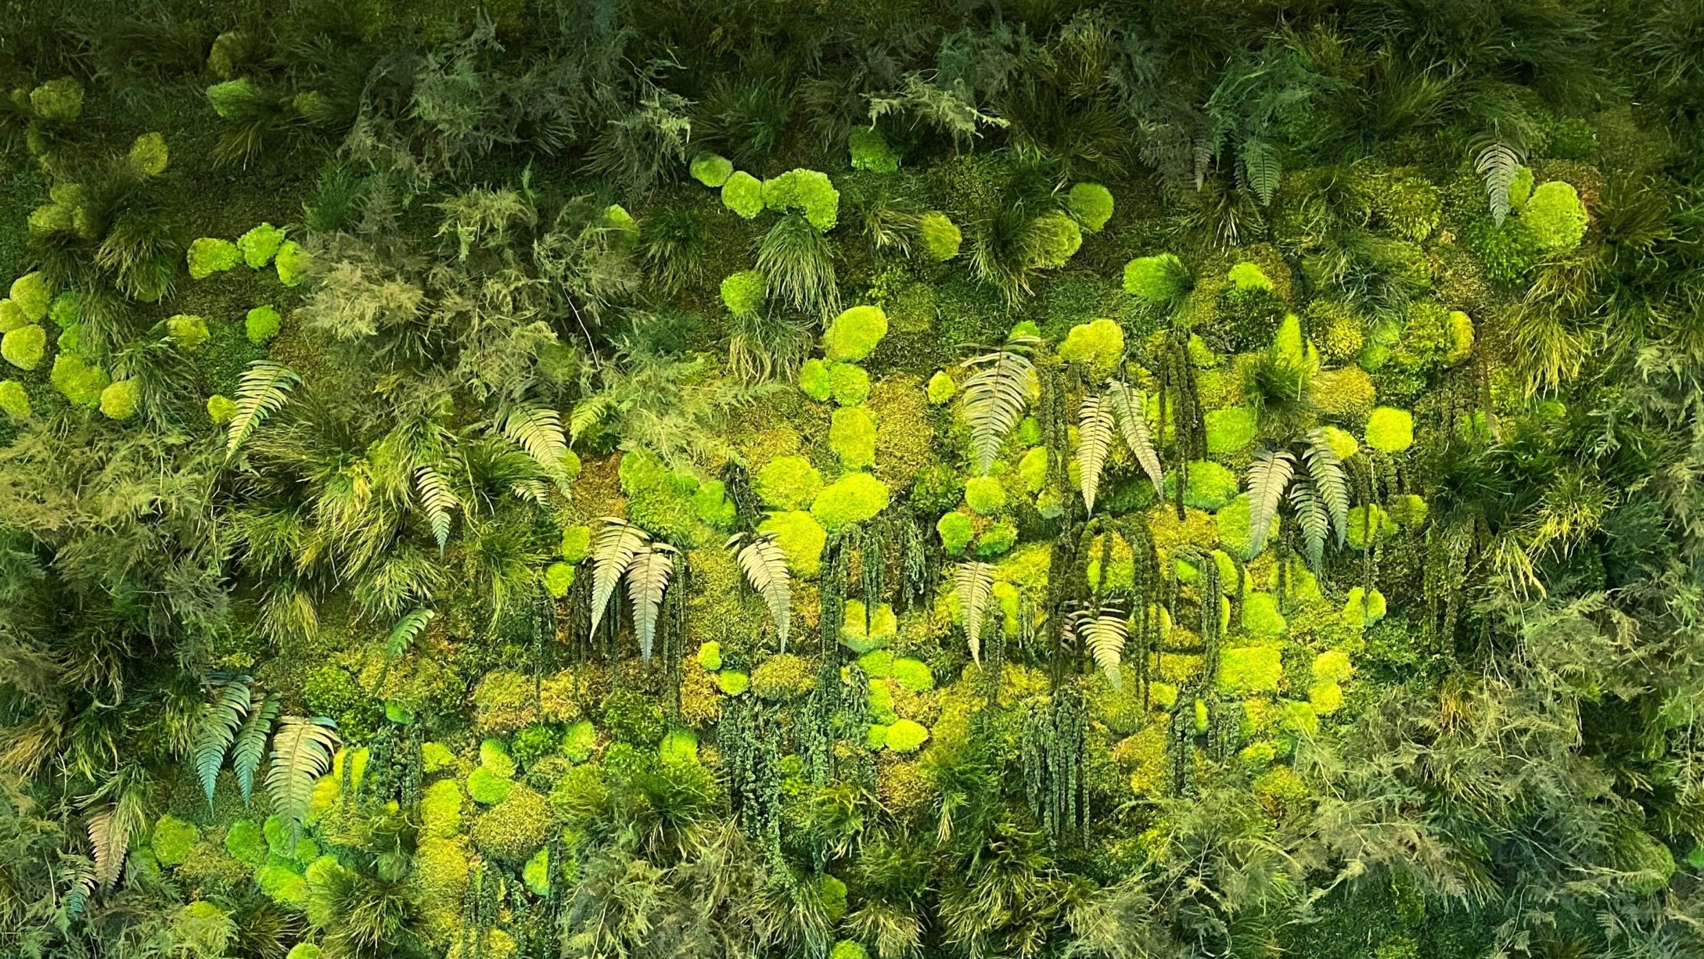
Problem: Schools are boring and depressing
Solution: Plants!
Problem: Brooklyn Tech is big and we have a lot to keep track of
Solution: Software!

Slide 3
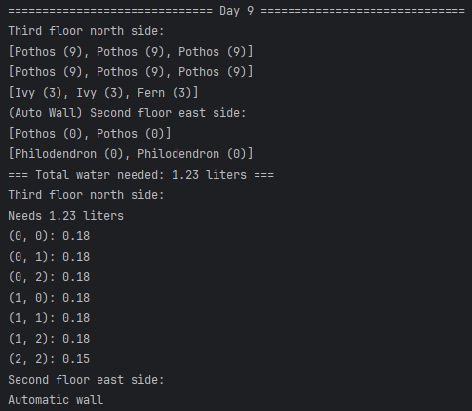
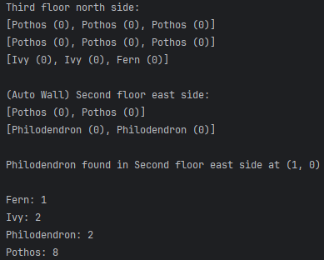

Slide 4
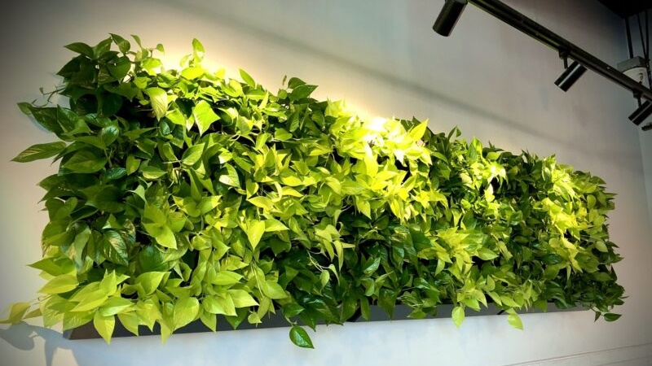
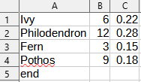
Plant Wall School
- Represents a single plant - Represents a wall - Represents the whole building
- type and waterAge - name and 2d plantArray - ArrayList of Walls
- incDay - Construct w/ height & width - Add wall
- Accesses dictionary CSV - populate - incDay
for water amount/interval - findPlant - toWater (instructions)
- incDay - waterAll (update database)
- toWater (formatted) - Alphabetical list (all Plants →
- needWater (ArrayList<int[]>) all types → number of each →
selection sort)
New code for CSV

Slide 5
AutoWall
- Waters itself
- Subclass of Wall to fit into School’s ArrayList
- incDay keeps waterAge at zero
- toWater overridden, never needs to be watered
- Wall accessors & super keyword

Slide 6
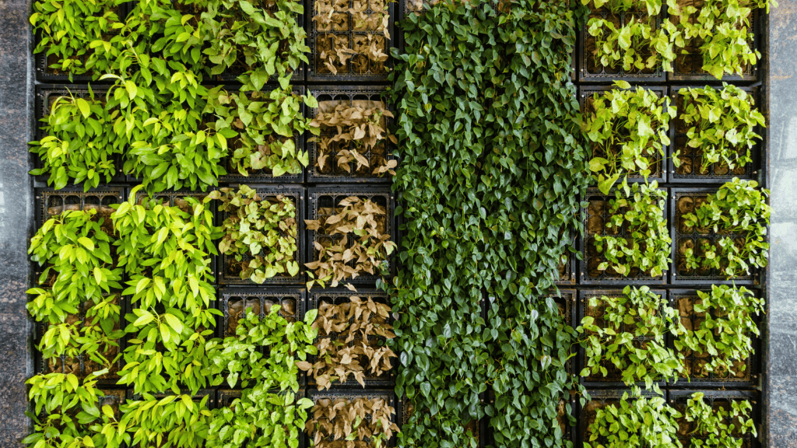
But why?

Slide 7
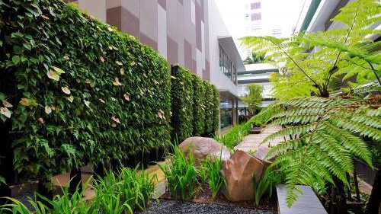
Thank you
Pls vote 5 🙏

