Slide 1
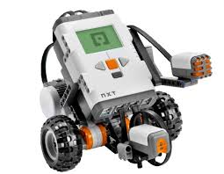
Robotics (week 2)
Introduction to Autonomous Robots and autonomous robotics

Slide 2
Autonomous Robotics
We will focus on autonomous robotics
Reminder - What is a robot?
“A robot is defined as a reprogrammable, multifunctional manipulator designed to move material, parts, tools, or specialized devices through various programmed motions for the performance of a variety of tasks.” [Robot Institute of America, 1979]
“a robot is an automatic device that performs functions normally ascribed to humans or a machine in the form of a human.” [Webster dictionary]

Slide 3
Autonomous Robotics
What is an agent?
In artificial intelligence, an intelligent agent (IA) is an autonomous entity which observes through sensors and acts upon an environment using actuators (i.e. it is an agent) and directs its activity towards achieving goals (i.e. it is "rational", as defined in economics) [Russel & Norvig, 2003]

Slide 4
Autonomous Robotics
What is Autonomy?
No remote control!
An agent makes decisions on its own, guided by feedback from its sensors; but you write the program that tells the agent how to make its decisions environment.

Slide 5
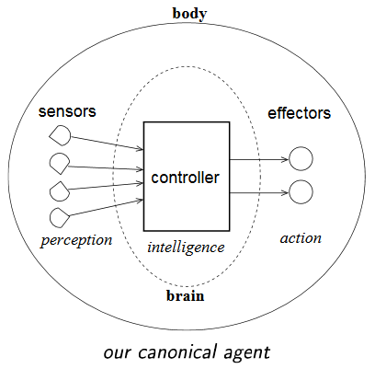
Our definition of a robot
Robot = autonomous embodied agent
Has a body and a brain
Exists in the physical world (rather than the virtual or simulated world).
Is a mechanical device

Slide 6
Robot definition (cont.)
Contains sensors to perceive its own state
Contains sensors to perceive surrounding environment
Has effectors that perform actions
Has a controller that takes input from the sensors, makes intelligent decisions about actions to take, and performs these actions by sending commands to motor

Slide 7
Robot components
All have five common components:
Control:
Human: Brain, central nervous system
Function: the brain makes decisions based on sensory input , nervous system sends signals to muscles
What is the equivalent in Robots?
Usually the brain is a computer of some kind, wires send signals
Effectors (body/structure):
Human: Bones and muscles - legs, arms, wrists, neck, etc.
Function: Allows movement
What is the equivalent in Robots?
Motors allow movement, wheels

Slide 8
Robot components
All have five common components (cont.):
Perception (sensors):
Humans: 5 senses detected by our body (what are they?)
Touch, Smell, Sight, Hearing, Taste
Robots: Touch sensor notifies robot of contact with another object, sound sensor allows robot to perceive audio.
Power source:
Humans: food and digestive system
Function: provide energy
Robots: usually batteries of some kind

Slide 9
Robot components
Communications:
Humans: voice, gesture, hearing
Function: communication with outside world
Robots: input/output functionality, expressions, wireless signals

Slide 10
Effectors
Any device that affects the environment
Include legs, wheels, arms, etc.
Actuator:
The mechanism that allows the effector to execute the action
Converts software commands into physical movements
Through electronic or hydraulic signals
Specific categories:
Manipulators: Industrial robot arms, capable of picking and placing objects, mimicking human
Mobile/humanoid robots: effectors enables moving around

Slide 11
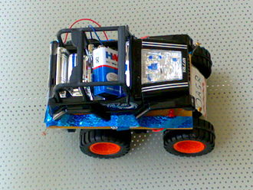
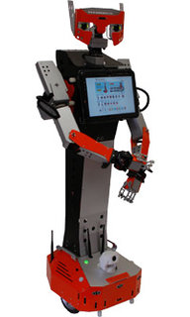
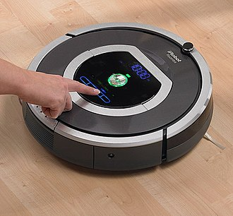
Mobile Robots
Classified by manner of locomotion:
Wheeled
Legged
Stability is important
Static stability
Dynamic stability
https://en.wikipedia.org/wiki/Mobile_robot
https://nodna.de/H20-Wireless-Humanoid-Mobile-Robot-with-Dual-Arms_1
https://en.wikipedia.org/wiki/Roomba

Slide 12
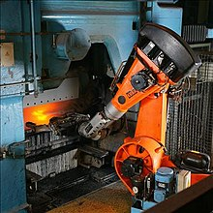
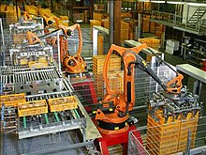
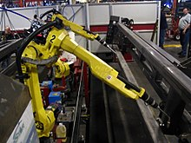
Industrial Robots
Robot system used for manufacturing
Automated and programmable
Typically stationary, include jointed arm and gripper
Typically no legs or wheels
Attached to a fixed surface
https://en.wikipedia.org/wiki/Industrial_robot

Slide 13
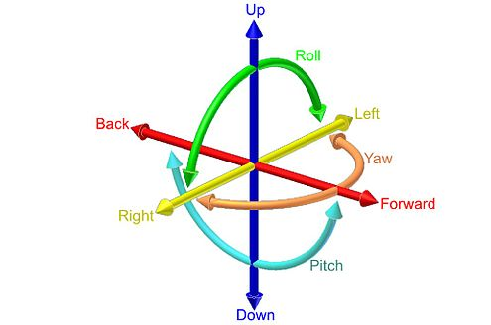
Degrees of Freedom
Number of directions in which robot motion can be controlled
Free body in space has 6 degrees of freedom:
Three for position (x,y,z)
Three for orientation (roll, pitch, yaw)
https://en.wikipedia.org/wiki/Six_degrees_of_freedom

Slide 14
Degrees of Freedom
Roll, pitch, yaw:
Degrees of freedom used for orientation:
Yaw refers to the direction in which the body is facing
i.e., its orientation within the xy plane
Roll refers to whether the body is upside-down or not
i.e., its orientation within the yz plane
Pitch refers to whether the body is tilted
i.e., its orientation within the xz plane
https://en.wikipedia.org/wiki/Six_degrees_of_freedom

Slide 15
Degrees of Freedom

Slide 16
Degrees of Freedom
If there is an actuator for every degree of freedom, then all degrees of freedom are controllable => holonomic
Most robots are non-holonomic

Slide 17
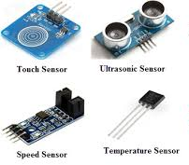
Sensors
Provide perception
Proprioceptive: measure robot’s internal values
know where you joints/sensors are
Motor speed, wheel load, battery status
Exteroceptive: Information from the environment
know where you are
Distance from objects, intensity of ambient light, etc.
Function: to convert a physical property into an electronic signal which can be interpreted by the robot in a useful way
http://www.efxkits.com/blog/various-types-of-sensors-applications/

Slide 18
Sensors
Property sensed and sensors:
Sound Level:
Microphone, sound sensor
Light:
Camera, photo cell, light sensor
Distance:
Ultrasound, radar, infra-red®
Contact:
Bump/switch, touch sensor
Inclination:
Gyroscope
Others:
Smell sensor (chemical), temperature (thermal), altitude (altimeter)

Slide 19
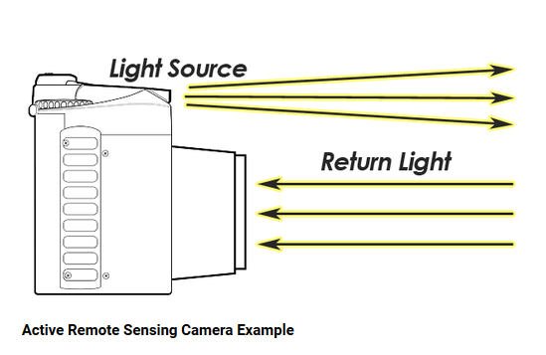
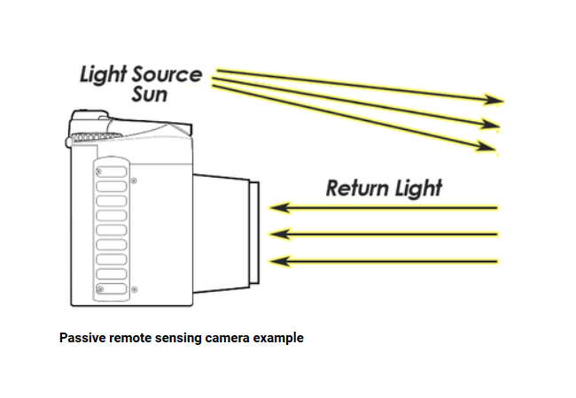
Sensors (cont.)
Operation:
Passive: read a property of the environment
Cameras when not using flash
Using naturally emitted light from the sun
Active: act on the environment and read the result
Camera when using flash
Illuminates its target and measures the energy reflected back

Slide 20
Sensors (cont.)
Are sensors always accurate?
Noise may interfere with measurements
Internal: from inside the robot
External: from the Robot’s environment
Calibration: can help eliminate/reduce noise

Slide 21

Environment
Accessible vs. inaccessile
Does the robot have access to all the information required to make decisions?
Deterministic vs. non-deterministic
Does any action that the robot undertakes have only one possible outcome?
Static vs. dynamic
Does the environment changes only due to robot actions, or does it also change by itself?
Discrete vs. continuous
Do sensors and actions have a discrete set of values?
https://www.sdl.com/about/corporate-citizenship/environment/

Slide 22
State
Knowledge about oneself and one’s environment
Kinematics == study of correspondence between actuator mechanisms and resulting motion
Relationship between robot dimensions, position and resulting velocity and acceleration
Rotary or linear motion
Combines sensing and acting
Did I go as far as I intended?
But environment is full of information
For an agent, need to pick relevant input

Slide 23
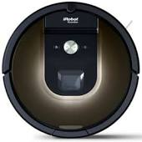
Why Robots?
Can perform dirty, dangerous or dull tasks
Where can we replace humans with robots?
Home
Roomba
Industry
Manipulator robot for building cars
Medical
Surgical robots
War
Bigdog (hw assignment next week)
Other places?

Slide 24
Homework Assignment
Read both articles about BigDog and answer the following questions:
What is BigDog (1 pt.)
Who is the sponsor of the BigDog project (0.5 pt)
What is the ultimate goal of this project (0.5 pt)
Describe the five components (controls, actuators, sensors, power source and communications) of BigDog (2 pt)
What is BigDog currently capable of? (1 pt)

Slide 25
Homework Assignment
Due: unit B.1
Submission format: You should submit hardcopy (typing is strongly recommended or writing clearly) before beginning of class time on the due date. If you have difficulty submitting a hard copy, email is acceptable. Assessment is not acceptable after we discuss it in class.

