Slide 1
Exploring Robotics – Unit C
Sensors

Slide 2
Reviews – Locomotion and Degrees of Freedom

Slide 3
Locomotion and Manipulations
Choice of effectors and actuators sets the limits on what the robot can do
Usually categorized as locomotion or manipulation
Locomotion: vehicle moving itself
Manipulation: An arm moving things
In both cases can consider the degrees of freedom in the design

Slide 4
Degrees of freedom (D.O.F.)
Definition: How many independent factors needed to specify the motion of the system?
The specific number of axes that a rigid body is able to freely move in three-dimensional space
For robots: directions of independent motions

Slide 5
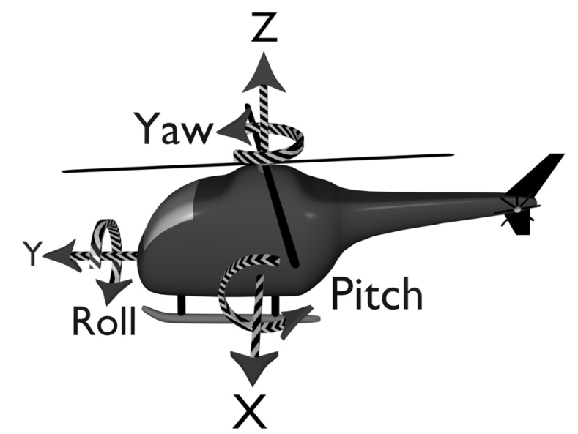
Degrees of freedom (D.O.F.)
For an object in space have:
The body can move straight in three dimensions:
Without rotation
on the X, Y and Z axes
A.K.A. Translational degrees of freedom
Also, it can change orientation between those axes though rotation
usually called pitch, yaw and roll
Rotational degrees of freedom
Total of 6 degrees of freedom

Slide 6
Controllable D.O.F.’s
If the object can move in each direction of the D.O.F., it is Holonomic
All are controllable
For this, it needs to have an actuator in each direction

Slide 7
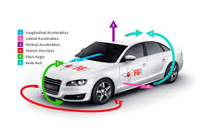
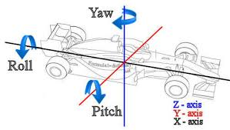
Degrees of freedom (D.O.F.)
How many D.O.F. to specify movement of a vehicle on a flat surface?
Three: X,Y and yaw (turn in x-y dimension)
How many Controllable D.O.F.’s?
In which direction can driver drive the car?
X and yaw
http://www.f6tech.com/our-solution/, http://www.formula1-dictionary.net/motions_of_f1_car.html

Slide 8
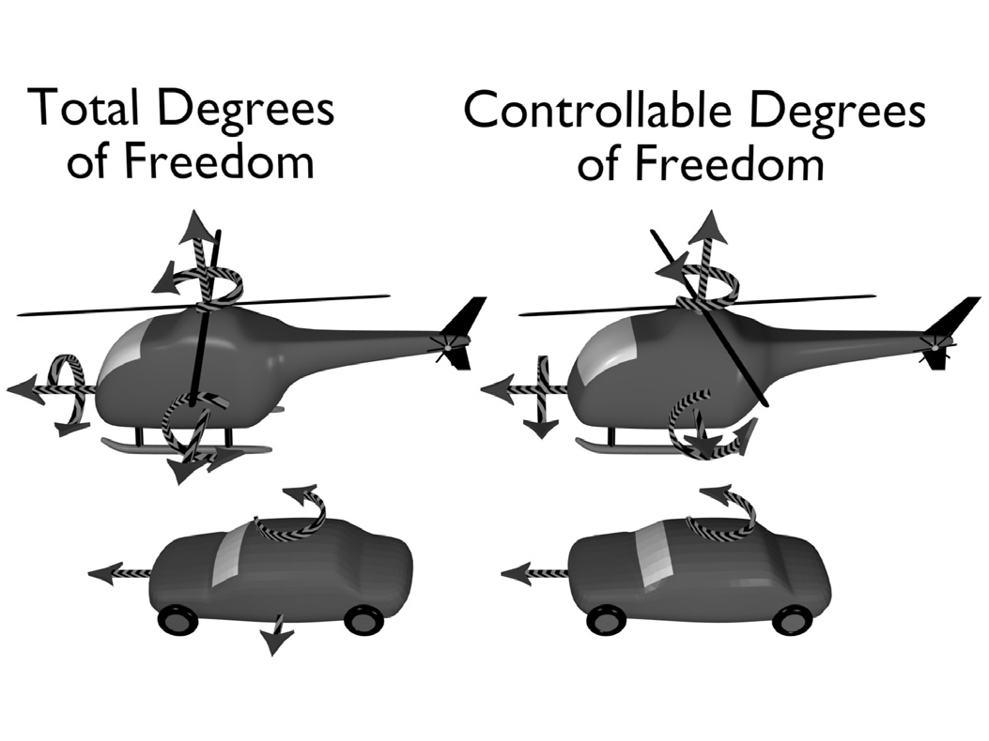
Degrees of freedom (D.O.F.)

Slide 9
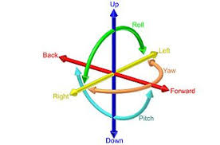
Robot’s Variables Affecting D.O.F.
Number of joints/articulations/moving parts
If parts are linked, fewer parameters needed to specify them.
Number of Individually controlled moving part
Need parameters for each to define configuration
Often described as ‘controllable degrees of freedom’
But some may be redundent
Two movements may be in the same axis

Slide 10
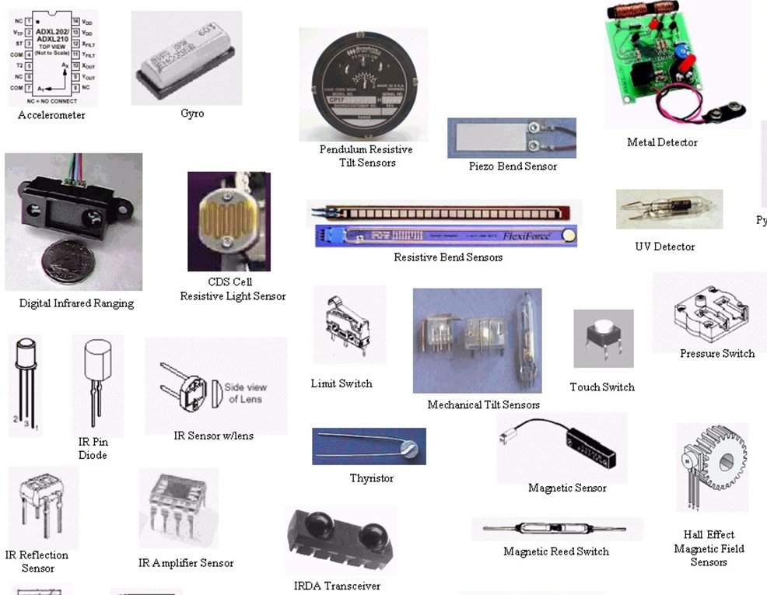
Sensors

Slide 11
Sensors are for Perception
Sensors are physical devices that measure physical quantities.
Such as light, temperature, pressure
Perceptual system of a robot includes:
Proprioception (internal) system
Exteroception (external) system
Sensors produce uncertainty challenge
Sensor noise and errors are inherent in physical measurement

Slide 12
Sensors are for Perception
Issues with Sensors:
Sensors produce signals, not symbols.
May be continuous or multi-dimensional
Signal-to-symbol problem:
How to form an intelligent response from sensor input when system requires a symbolic input form.
Such as a camera waiting for a person to smile (symbol) before taking a photo (response).
Sensor Fusion: Combining multiple sensors to get better information about the world.

Slide 13
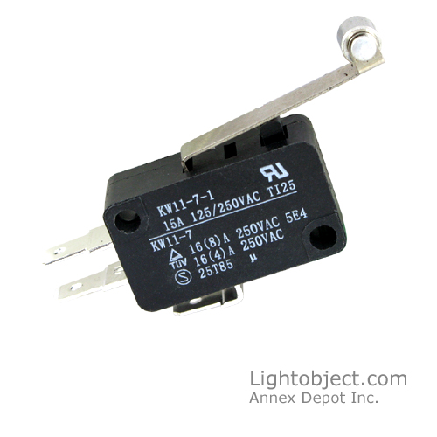
Switches
Switches measure current to detect an open or closed circuit.

Slide 14
Levels of Processing
Electronics (low level): such as measuring voltages
Signal processing (medium level): such as separating voice from noise
Computation (high level): such as recognizing an object from an image

Slide 15
Levels of Processing
Examples:
Bump Sensors (low)
Odometer (low)
Sonar (medium)
Speech (medium)
Vision (high)

Slide 16
Levels of Processing
Given the sensor input:
Both simple and complex sensors can be used to answer the question: What should a robot do? (action in the world)
Complex sensors can also be used to answer the question: What was the world like? (reconstruction of the world)

Slide 17
Locating People
What kind of sensor would you use to locate people in a room?
Camera: most obvious,
but the most complex to process the signal.
Temperature: locate objects within human body temperature.
Motion Detector: locate objects moving that are a certain size.
Color Detector: locate objects of skin color, or human clothes.
Distance: locate objects that block a previously open area
The sensors will need to be calibrated before use in the robot.

Slide 18
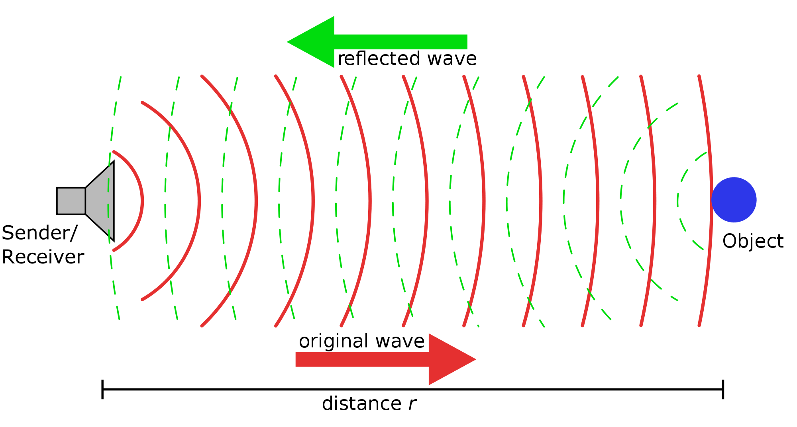
Finding Distance using Sonar

Slide 19
Sensor Types
Simple Sensors: sensors that don’t require a lot of processing.
Passive vs. Active (both simple or complex):
Passive: measures a physical property only, with a detector Ex: switches, resistive light sensors, cameras
Active: provides own signal/stimulus, with both an emitter and a detector Ex: reflectance and break beam, ultrasound and laser.

Slide 20
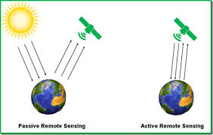
Passive vs. Active Sensors
Global satellite system
http://grindgis.com/remote-sensing/active-and-passive-remote-sensing

Slide 21
Global satellite system
Sun constantly emits light energy and is only source of natural light for earth
earth’s surface produce natural emissions
Passive sensors measure this energy or power
as a function of physical temperature, roughness and other physical characteristics related to earth
Active sensors throw their own energy source towards earth
Energy reflected from earth’s surface
Measured by active sensors

Slide 22
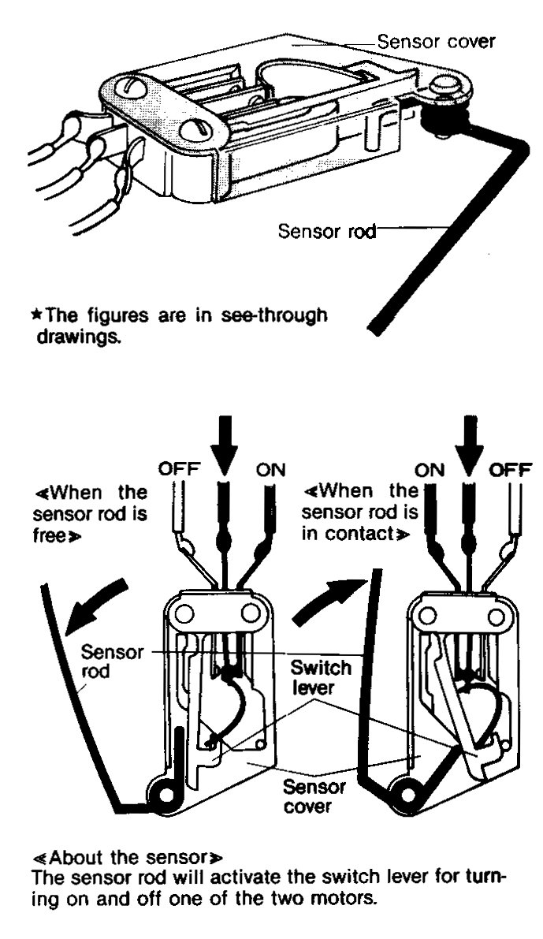
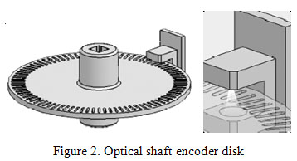
Sensor Types (cont.)
Limit sensor
Contact Sensor
Shaft encoder sensor

Slide 23
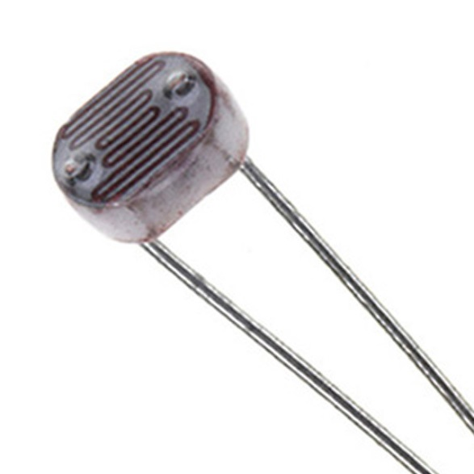
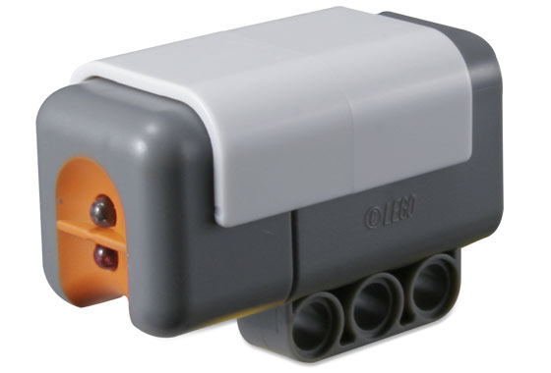
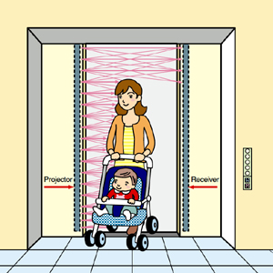
Light Sensors
Photocells convert light intensity to resistance in the circuit
Work even with invisible light (such as infrared)
Could be used for measuring intensity, differential intensity or break in continuity
Reflectance sensors: active sensors with emitter and detector side by side
Break beam sensors: emitter and detector face each other
Calibration is used to reduce noise

Slide 24
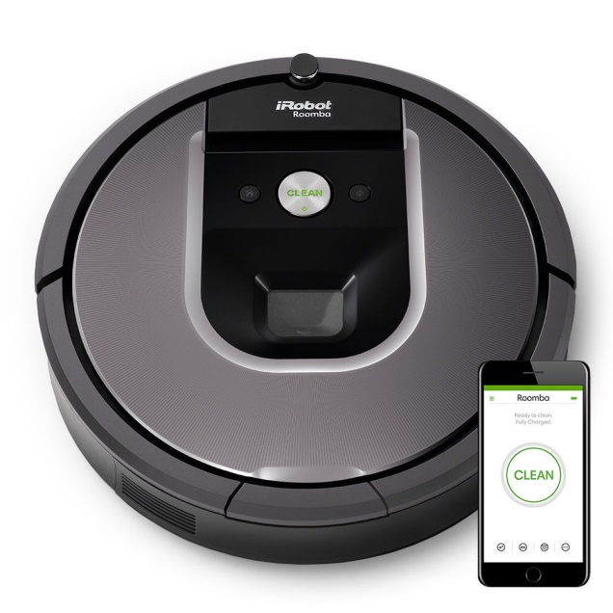
iRobot ROOMBA
The Roomba vacuums your floors and rugs at the press of a button, helping to maintain a cleaner home.
Self-navigation around corners and doors.
Combines input from smart sensors
Requires minimal human input
System Includes virtual wall units
Sends infra-red signals that cause robot to turn

Slide 25
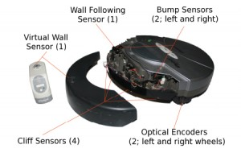
How Roomba works
The Roomba (sage) contains 10 sensors

Slide 26
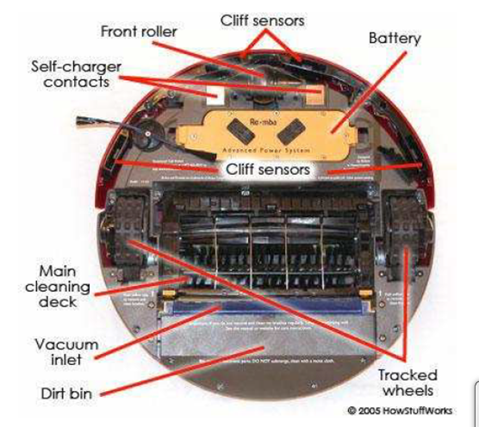
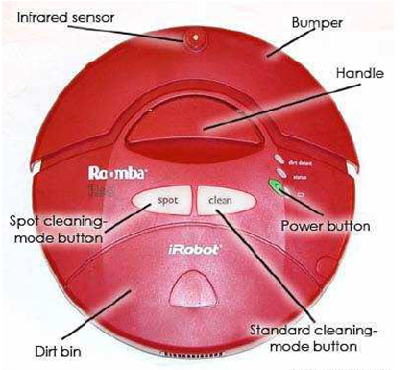
Top and bottom views

Slide 27
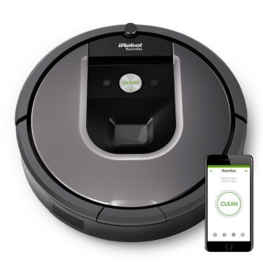
Roomba Sensors
The Roomba avoid steps by using cliff sensors.
Constantly send out infrared signals
Normally immediately bounce back
If approaching a cliff, the signals all of a sudden get lost.
Wall sensor is located on the right side of the bumper
Lets Roomba follow very closely along walls and furniture without touching them.
Object sensors activated when Roomba touches an obstacle
It then performs the sequential actions of backing up, rotating and moving forward until it finds a clear path

Slide 28

Roomba Sensors
A piezoelectric sensor used to detect dirt
Crystal that generates electrical impulses when touched
causing the robot to retrace its steps, clean a little slower and more thoroughly second time around
Newer versions use infrared cameras to create a `picture’ of the room
Result in efficient, less random cleaning paths

Slide 29

Decision Making
Sensory inputs will make the robot a little more intelligent
such as the value of the light sensor,
We need a decision-making mechanism
To enable robots to react to their environment autonomously (without a human touching it).
How can we do that?
Conditional Execution
https://www.changedlivesnewjourneys.com/decision-making-after-brain-injury/

Slide 30
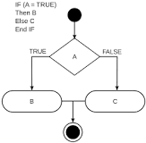
Conditional Execution
Conditional execution used in decision-making
in the programming environment.
Widely used in programming languages
Common example: If–then(–else)
https://en.wikipedia.org/wiki/Conditional_(computer_programming)

Slide 31
Conditional Execution
Basic structure of if-then else construct:
If (boolean condition) Then
(consequent)
Else
(alternative)
End If

Slide 32
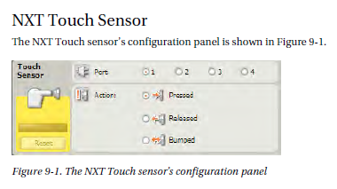
Conditional Execution
In MindStorms, implemented by Conditional Constructs (if-then-else)
allows programs to behave differently based on different values of sensor inputs.

Slide 33
Lab Time!
Let’s work with the robot!

