Slide 1

CISC1003 – Unit C Sensor Labs
http://artimusmarching.com/locomotion/

Slide 2
Sensor Labs

Slide 3
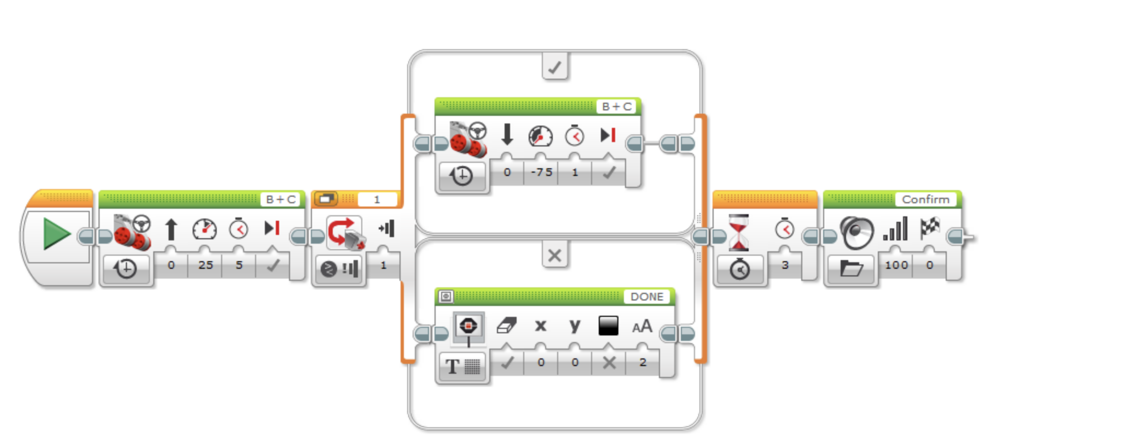
Sensor Lab
What does this program do? Write the program and see what it does if you need help. Otherwise look at the instructions and figure it out.

Slide 4
Sensor Labs With Loops

Slide 5
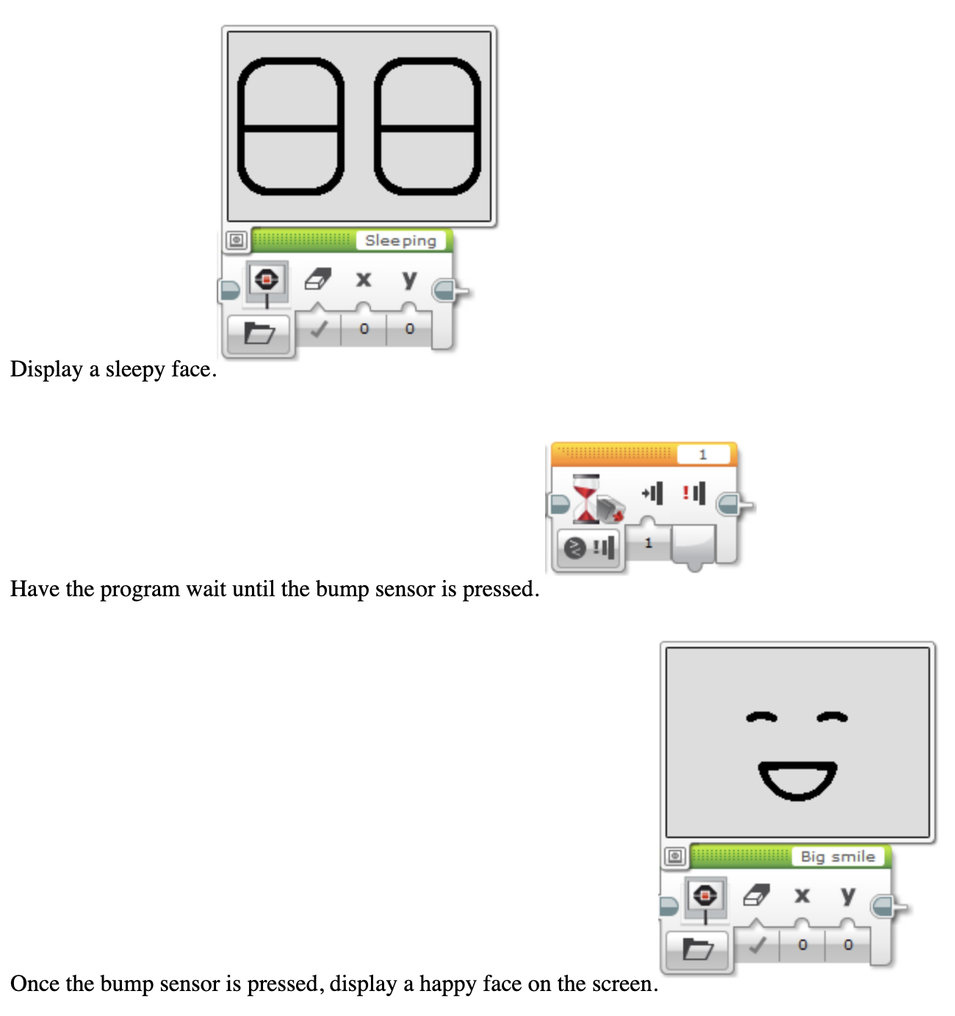

Slide 6
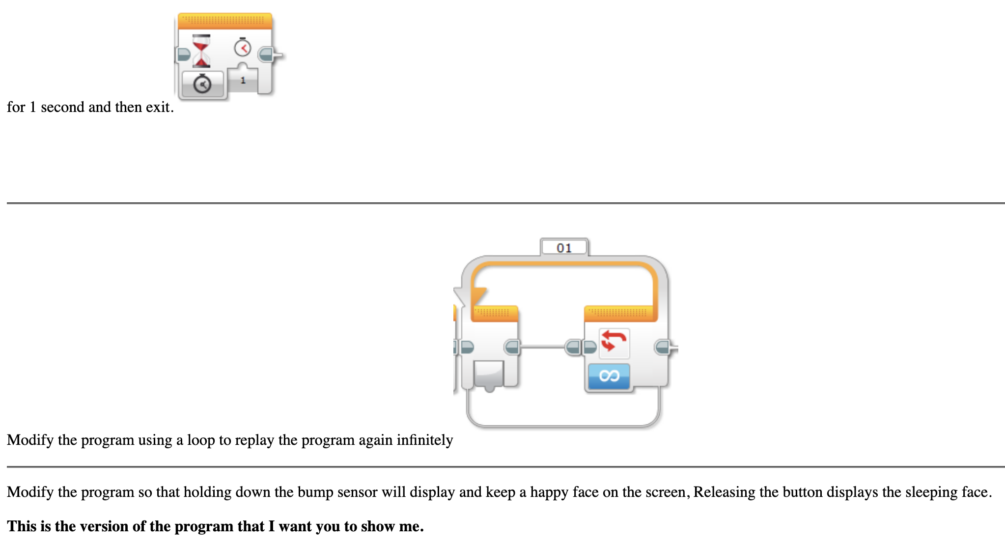
Sensor Labs With Loops

Slide 7
Lab Units/Loop

Slide 8
Program 1 - Loops
Have the robot go in a loop, displaying the eyes pinch left, pinch middle, pinch right, pinch middle, with a half of a second between images, until the bump sensor is BUMPED.
Then display crazy 1 for a half second, and then crazy 2 for a half second.
Can you add this to a My Block and then place this My Block around an infinite loop?

Slide 9
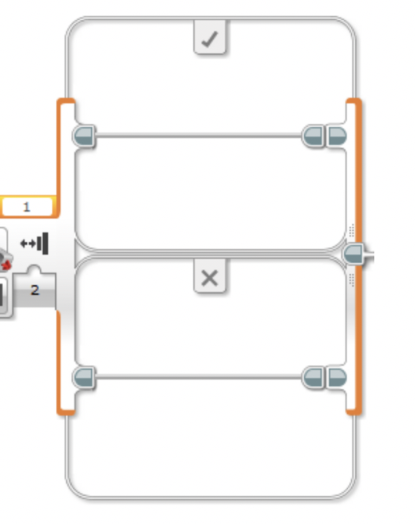
Program 2 - Loop until

Slide 10
Program 2 – loop until
Switch Block Bumped program:
Display a Neutral expression for 2 seconds.
If the bump sensor is bumped, display Dizzy
Otherwise display Disappointed
Wait 1 second and then end the program
Can you add this to a My Block and then place this My Block around an infinite loop?

Slide 11
Program 3 - Alarm Program
Display on the screen, "Place Object"
Place something to keep the bump sensor pressed. Once the button is pressed. Wait 1 second.
Display on the screen "Armed"
If the object is removed from the robot, the bump sensor is released. Have the robot play some alarm sound when this happens and display "Warning". Stop the sound and program after 3 seconds.

Slide 12


