Slide 1

Sales Insights Data Analysis

Slide 2
Special Thanks to Codebasics for providing this real dataset

Slide 3
Outline
Client requirements
Data cleaning
Generating dashboard

Slide 4
1. Client Requirement
AtliQ Hardware is a company that supplies computer hardware and peripherals to many of the clients they have. Bhavan Patel is a sales director for this company and he's facing a lot of challenges, so the challenge is this market is growing dynamically and then he's facing issues in terms of tracking the sales. He is interested in getting a simple and understandable insight.

Slide 5
The objective is to offer previously unseen visible insight to the sales team. They can use this information to direct their decisions. We also help them automate the report so that data collection takes less time.

Slide 6
2. Data Cleaning
Cleaning the data in query editor, do the data transformation and etc.

Slide 7
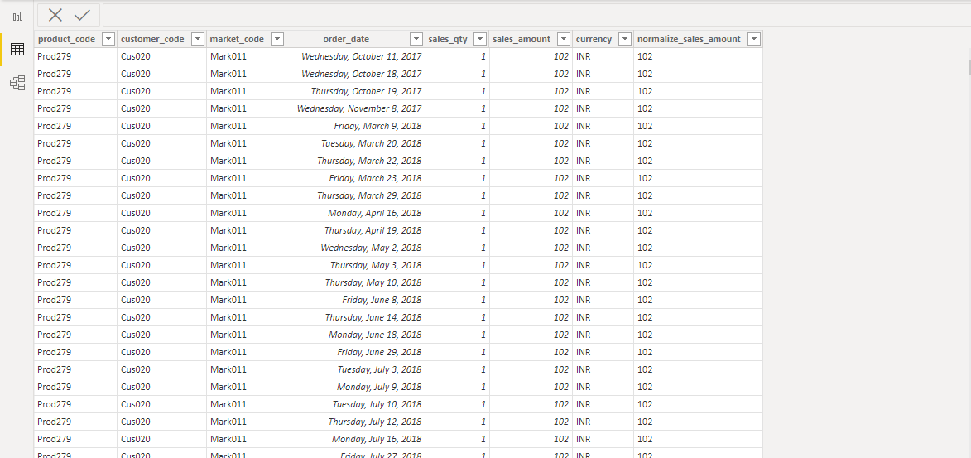
Cleaned data from query editor

Slide 8
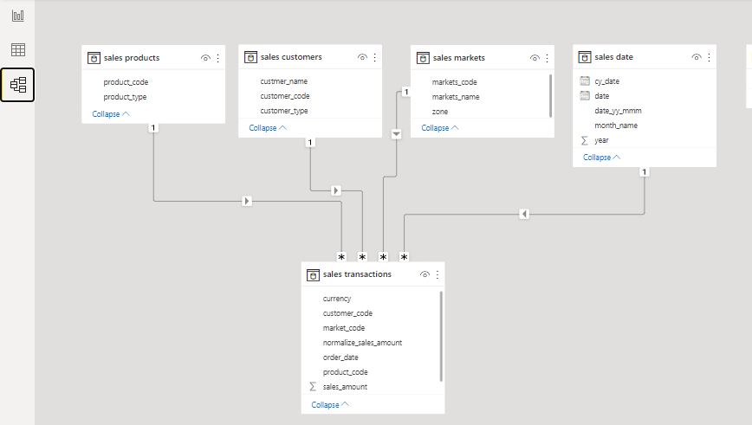
Creating the relationship between the tables

Slide 9
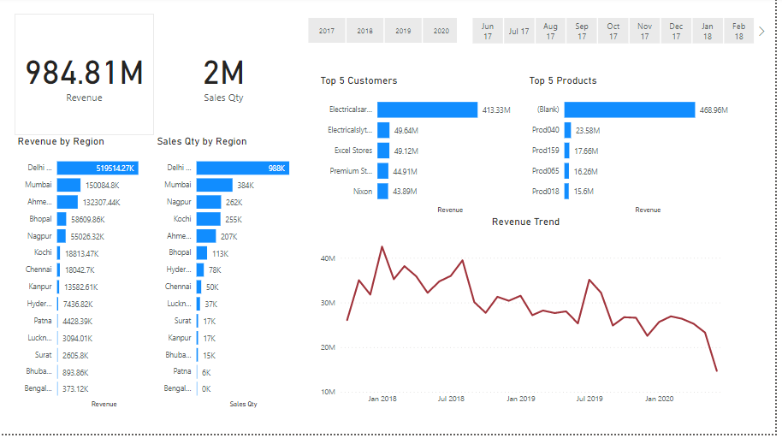
3. Dashboarding

