Slide 1

HR Analytics

Slide 2
Special Thanks to Codebasics for providing this real dataset

Slide 3
Outline
Client requirements
Data preprocessing
Creating metrics
Visualizations

Slide 4
1. Client Requirements
Find the presence insight
Get know of working preference of the employees between WFO and WFH
Understanding the reason behind people taking sick leave

Slide 5
2. Data Preprocessing
Before doing the visualizations, we perform data transform in power query to combine all sheets and take only the data that we need.

Slide 6
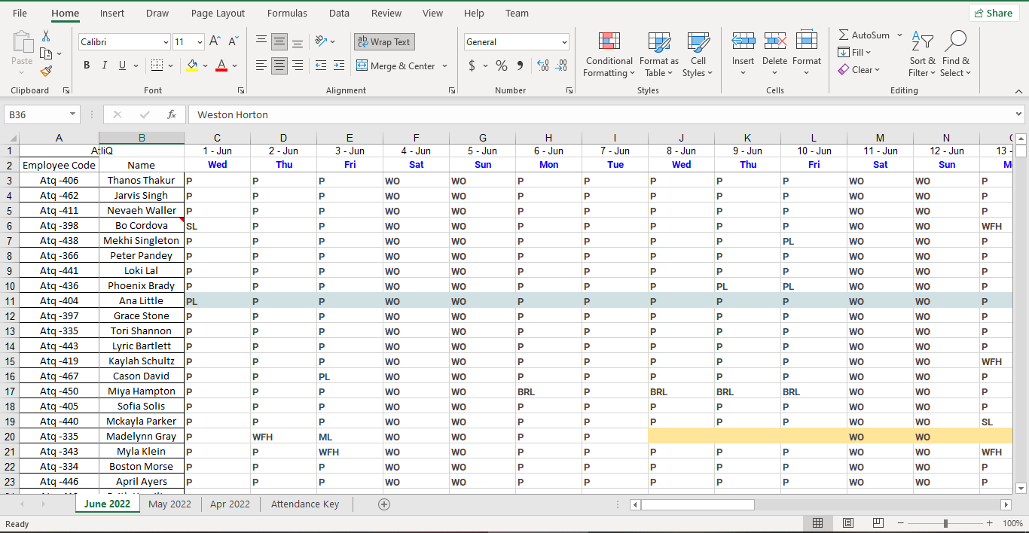
Original Data in Excel

Slide 7
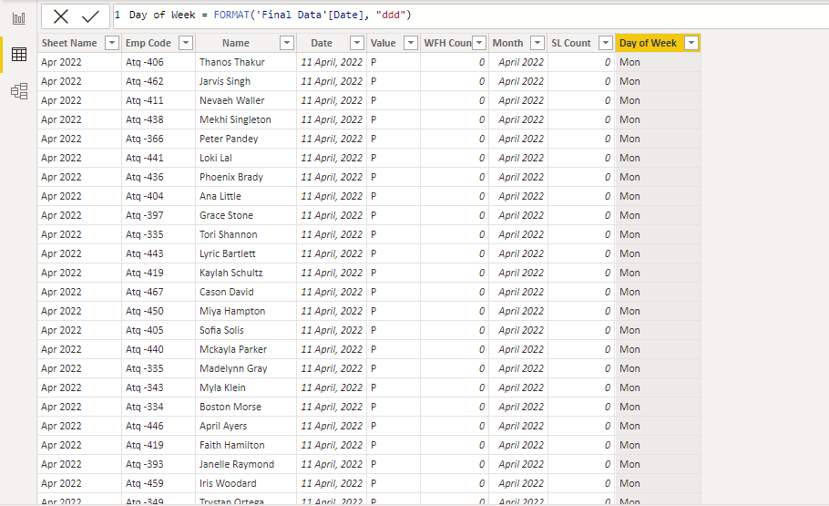
Final Data Imported in Power BI

Slide 8
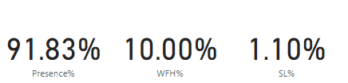
3. Metrics
Metrics is quantitative assessment that will help the client to make a decision.
Example of metrics

Slide 9
4. Visualizations
Dashboarding is process creating a visualizations of our metrics, which is an easy way for us to see the insight from our data.

Slide 10
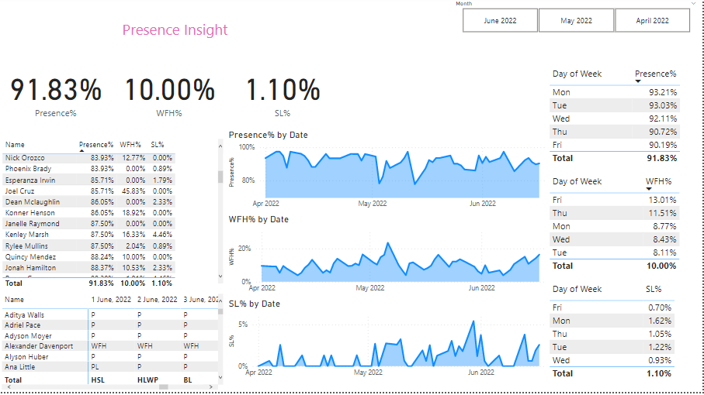
Dashboarding

