Slide 1


Data Analyst Test
By Thalibar Rifqi

Slide 2
Objective
Data Preprocessing
Gain Insight
Dashboarding

Slide 3
1. Data Preprocessing
The goal of this step is to combine all excel files into one data frame. Before doing that, I remove an unused column in every data frame (for example invoice and AWB). Then I changed the format of the column according to the data type. Then I match the column names for every data frame. Finally, we can combine all the data frames. The final_dataframe.xlsx file is the combined data frame.

Slide 4
2. Gain Business Insight
This step includes translating all of the data into a statement that other people can understand.

Slide 5
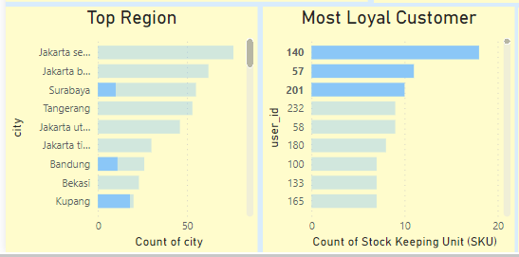
Most Loyal Customer
User 140, 57, and 201 are the most loyal customers. They currently reside in Kupang, Bandung, and Surabaya.

Slide 6
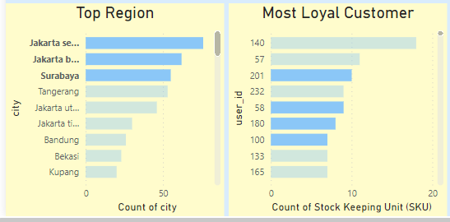
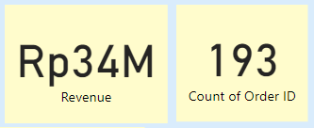
Most Loyal Customer
Despite not being the origin of loyal customers, Jakarta Selatan, Jakarta Barat, and Surabaya are the most region where customer reside with 34M revenue and 193 orders.

Slide 7
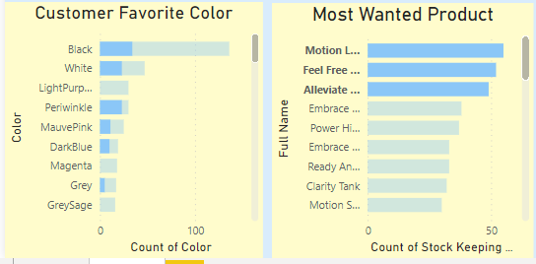
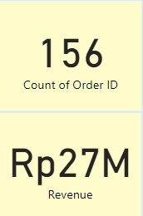
Popular Product
Customer’s favorite product are Motion Legging Full, Feel Free Basic Crop Tank, and Alleviate Bra, Support with A/B bra cup. Black is their favorite color. These three products produce 27M revenue.

Slide 8
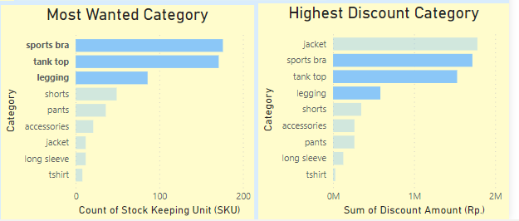
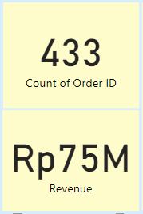
Popular Product
The top three categories are sports bra, tank top, and legging, with a total of 75M revenue and 433 orders. Giving a product a discount can significantly increase sales of the product.

Slide 9
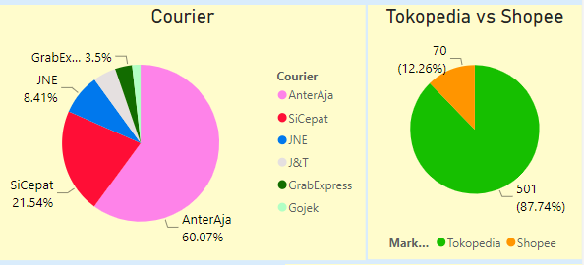
Favorite Platform
AnterAja and Tokopedia are customers favorite courier and online marketplace.

Slide 10
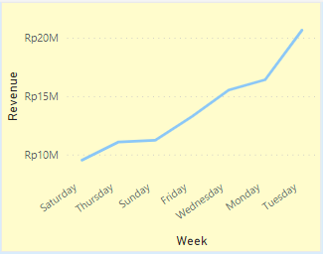
Customer Behavior
Most of the customer proceed the transaction during the weekdays.

Slide 11
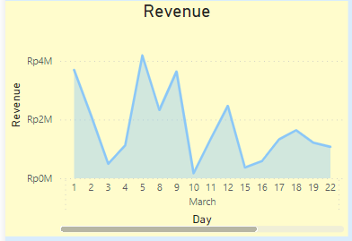
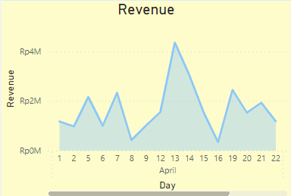
Customer Behavior
The most transactions occur during weekdays and at the beginning of the month (day1 - day15)

Slide 12
3. Dashboarding
I am unable to publish and share the report by email due to limitations in my Power BI account. So I just capture the dashboard.

