Slide 1
Predicting Heart Disease Using Machine Learning Algorithm
Team 14: Atharva Lokhande, Kevin Murphy, Riris Karolina, Shravani Thalla

Slide 2
Context for Our Model:
In the ongoing battle against heart disease, we're working to identify the factors that contribute to its prevalence, with a focus on promoting public health. Analyzing CDC's annual survey, our attention is on understanding the key indicators of heart disease among adults in the U.S.
Healthcare professionals, policymakers, and researchers are particularly interested because understanding the key indicators of heart disease is crucial for designing effective preventive measures, interventions, and public health policies.
Heart disease is a leading cause of mortality across various racial groups in the U.S., affecting approximately half of the population. Identifying and comprehending the major risk factors is essential for developing targeted health initiatives.

Slide 3
Dataset Overview
Data Source:
Our dataset is from a 2022 CDC annual survey regarding heart health nationwide. https://www.kaggle.com/datasets/kamilpytlak/personal-key-indicators-of-heart-disease
Over 260k rows and 38 unique features
Mix of Numeric and Categorical Features
Heart Disease is binary - Meaning this is a classification problem
Key Variables in Dataset:
Demographic Information
Health and Lifestyle Factors
Physical Metrics
Smoking and E-cigarette Usage
Health Status and Disease

Slide 4
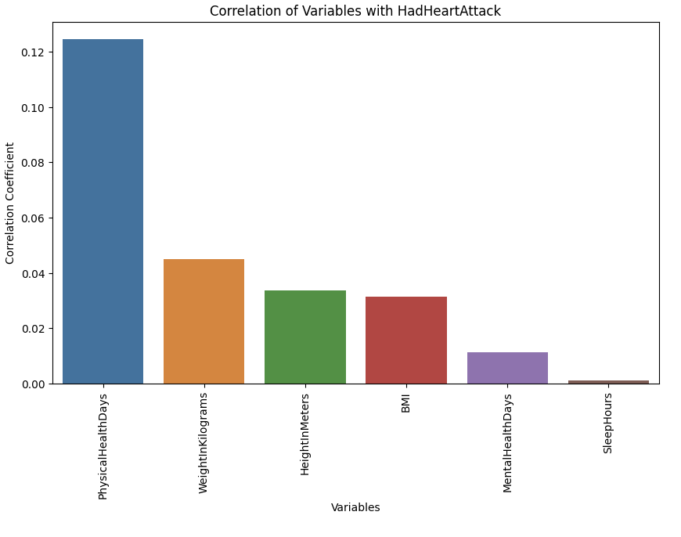
Descriptive Analysis
Variable & Heart Attack Correlation:
Impact of Findings:
Critical need for early detection of heart disease.
Improve prediction accuracy.
Provide insight for healthcare professionals
Notes:
From this graph, it appears that there is a fairly high positive correlation between the number of physical activity days and heart attacks. However, it doesn't necessarily mean that people who spend more days on physical activity are more likely to have a heart attack. On the contrary, because this is based on the survey data, it could be that because they have been diagnosed with a heart attack, they tend to engage in more physical exercise

Slide 5
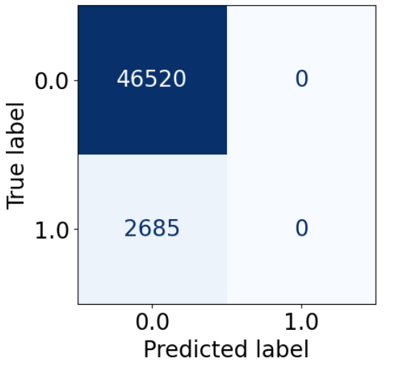
Setting Up Model Evaluation
Custom Cost Matrix
0 | 1
10 | 0
TN
FP
FN
TP
Fit a base model to evaluate future models
Logistic Regression of numeric variables
Utilize Lasso Feature Selection to reduce number of features
Create custom cost matrix that aligns with real world problem
Evaluate models based on Accuracy, Balanced Accuracy, and Cost
Base Model Confusion Matrix

Slide 6
Model Evaluation
Model | Base | KNN | Random Forest | Logistic Regression | Naive Bayes
Parameters | n/a | K_neighbors = 11 | Max_depth = 9, n_estimators = 171 | n/a | Var_smoothing = 0.0001
Accuracy | 0.9443 | 0.9445 | 0.9443 | 0.9482 | 0.7631
Balanced Accuracy | 0.5000 | 0.5121 | 0.5189 | 0.6257 | 0.7578
Cost | 5370 | 5260 | 5153 | 4112 | 3232
Pros | Simple | Easy to fit | High accuracy | Simple, Accurate | Best Cost
Cons | Severely Underfit | Over Predicts FN, expensive to tune | Over Predicts FN | Higher Cost than NB | Overpredicts Positive Results

Slide 7
Challenges Faced
Dataset contained many messy categorical values that needed to be converted into numeric values
We used a pipeline to convert 38 columns into 64 usable features
Data Cleaning
We used kBest and Lasso feature selection to get data to run our models on
Feature Selection
Even with feature selection, models such as SVM & KNN took hours to run
We took a sample of 10% to run initial models to combat this
Long Runtimes
Notes:
Cleaning data
7 float64 and 31 objects were converted to float by constructing below :
Feature Selection
Run time for the models

Slide 8
Conclusion
Feature Selection is important to use in large datasets
Model Evaluation should be directly related to the problem statement
Simple Models can sometimes produce the best results
Naive Bayes emerged as the best model for our project, because of its tendency to over predict positive results
Notes:
What model worked best
How useful model could be in real world
Impact of use
Key Takeaway:
Naive Bayes emerges as the most viable model, offering a good balance between accuracy and interpretability. It stands out for its simplicity and effectiveness in predicting heart disease, marking it as a favorable choice for practical applications in healthcare settings.

Slide 9
Link to Notebook
https://drive.google.com/file/d/1XnjDfbFPOor-2yYptY-JL8GRYMtJAlaG/view?usp=sharing

