Slide 1

Academic Year 2024 - 25 S7 PROJECT WORK I First Review
PROJECT TITLE
"SMART FACTORY AUTOMATION USING PLC-BASED SPEED CONTROL"
BIP PROJECT ID
25S7INT016
CATEGORY
INTERNAL
BATCH MEMBERS
VIGNESHRAM R(7376211MC145)
KAVIN RAJ S (7376211MC119)
THAMARAI KANNAN M K S (7376221MC508)
JUBAIR AHAMED L(7376211MC117)
GUIDE
Mr RAGHUNATH M
Assistant Professor Level II
Department of Mechatronics Engineering

Slide 2
AIM & OBJECTIVES OF THE PROJECT (Problem Statement)
Aim:
The aim of the project is to design and implement a PLC-based bottle handling system. It efficiently handles bottles at the time of capping using pick-and-place mechanism and stacks the bottles with the help of a cartesian manipulator. This helps in overall cost and space of the system. By incorporating two mechanisms together with the combination of HMI, it helps in small-scale industries for high volume production.

Slide 3
AIM & OBJECTIVES OF THE PROJECT (Problem Statement)
Objective:
Several capping techniques, including screw, pick and pace, and lid capping, are used in many different industries. In this case, screw capping includes capping bottles by putting the screw cap on and tightening them using rollers or cappers that have been particularly made. The process for pick-and-place screw capping is the same as before, but it also involves pick-and-place of bottle caps on the bottles. Lid capping is mostly used for pharmaceutical products. An aluminum cap is placed on the bottle, then rollers are used to make creases.
Even though different capping practices are followed, screw capping requires rollers as a support , pick and place type screw capping and lid capping is more expensive and complex to implement in small- scale industries that focuses on large quantity manufacturing and this is a bottleneck for those industries to overcome.
By considering this we came up with an design that combines pneumatic rotary actuator integrated with suction cup for integrating cap positioning and capping workflow. And cartesian type pick and place manipulator is also used for proper material arranging.

Slide 4
LITERATURE SURVEY
Sl.No. | Journal Paper Title with Author | Works carried out ( with details of Methods/ Materials/ Software/ Algorithms / fabrication / techniques/ components used ) | Information gathered relevant to your project
1 | J.P. I. Iloh, Elukpo A.O., Mbachu C.B. and Okwu P.I.,” Computer Based Automation System for Bottle Filling and Capping in Small Scale Bottle Water Processing Industries”-May 2017 | Using Atmega controller with stepper motor for capping. | Screw capping is used for capping process where stepper motor is used for precise control.
2 | Md. Mahbubur Rahman, Emroze Islam , Asef Shahriar,” Economical Automation: Design and Fabrication of Bottle Filling and Capping Systems Using Arduino”- August 2020 | Arduino is used to control the dc motor which is responsible for capping. | Screw capping is used with Arduino and DC motor for capping process which reduces cost.

Slide 5
LITERATURE SURVEY
Sl.No. | References ( Journal Papers Only) | Works carried out ( with details of Methods/ Materials/ Software/ Algorithms / fabrication / techniques/ components used ) | Information gathered relevant to your project
3 | Kalaiselvi Thanupillai, R Praveena, “PLC Based Automatic Bottle Filling and Capping System With User Defined Volume Selection” - August 2012 | PLC is used for the automation and DC motor is incorporated with capping mechanism. | Screw capping is used for capping the products with PLC and DC motor which enhances accuracy and efficiency.
4 | Anzum Al Abir, ” A SIMPLE STUDY ON PLC AND PLC PROGRAM FOR AN AUTOMATED BOTTLE SORTING, FILLING, AND CAPPING PROCESS” - December 2019 | PLC is incorporated to achieve the capping process with DC motor. | Screw capping is commonly preferred for capping with the combination of DC motors and PLC.
5 | Muhammad Hassam Saeed, Joseph Smith ,“Automatic Adjustable Filling and Capping Machine Using Programmable Logic Controller and Human Interface” - December 2020 | PLC with the combination of HMI is used in the process of capping the products with servo motors for precise control. | PLC is used along with HMI for completing the system with screw capping system for the products using servo motors.

Slide 6
SCOPE OF THE PROJECT
Design Scope:
The proposed design can perform two different processes continuously by eliminating time delay between positioning and capping of workpiece.
Mechanism scope :
The design incorporate a pneumatic rotary actuator and a Cartesian cylinder for bottle handelling. it will be equipped with a vacuum suction cup for cap positioning and capping of bottles and to align the cap onto the workpiece in first module. The Cartesian cylinder, operating on a linear axis system, will ensures handelling of product.
System integration :
Intergrating PLC with sensor , acuators to automate the process and incorprating HMI for seamless communication between the user and the system.

Slide 7
SCOPE OF THE PROJECT
Safety considerations:
Safety considerations include employing an emergency stop to keep the system safe from accidents and an MCP to protect it from high voltage.

Slide 8
NEED FOR THE CURRENT STUDY
Several significant aspects contribute to the current requirement for a study on automating cap placement, cap locking, and workpiece storage with a Cartesian actuator controlled by a PLC and HMI.
First, automation can significantly increase efficiency by lowering the time and labor required for manual activities, particularly in industries with high production demands. Second, automated solutions give greater precision and consistency in processes such as cap installation and locking, resulting in superior product quality and fewer errors.
Furthermore, integrating Cartesian actuators with PLC and HMI systems allows for seamless communication and coordination between multiple machines, resulting in smoother operations and simpler monitoring of processes.This is critical for enhancing efficiency and safety since automation reduces the need for human intervention in potentially dangerous jobs.
Scalability is also a significant consideration. As production requirements expand or change, automation systems must adapt to different product sizes and specifications. Finally, with the rapid growth of PLCs, HMIs, and actuator technologies, it is critical to investigate how these advancements might deliver more dependable and cost-effective solutions to industrial processes.

Slide 9
FEASIBILITY ANALYSIS
1. Technical Feasibility
2. Economic Feasibility 3. Operational Feasibility
4. Market Feasibility

Slide 10
FEASIBILITY ANALYSIS Cont….
1. Technical Feasibility:
The technical feasibility of the proposed solution for ( large-scale production in small-scale industries ) will depend on factors. Firstly, the compatibility of the solution with existing machinery and infrastructure within these industries must be assessed. This includes evaluating the compatibility of the solution with different types of capping machines and workpiece handling equipment. Additionally, the scalability of the solution to ensure that can accommodate future growth and increasing production demands. Factors such as the modular design of the solution and its ability to be easily expanded or modified will taken into account .
2. Economic Feasibility:
The economic feasibility of the project will be influenced by the initial investment costs, potential cost savings from increased efficiency, and the expected return on investment. The initial costs will include the development and installation of the solution. Cost savings can be realized through reduced downtime, minimized errors, and improved productivity. Factors such as the cost of labor, energy consumption, and maintenance costs will also need to be considered. By analyzing the potential cost savings and comparing them to the initial investment, a comprehensive assessment of the project's economic viability can be made.

Slide 11
FEASIBILITY ANALYSIS Cont….
3. Operational Feasibility:
The operational feasibility of the project will depend on the potential impact of the solution on existing workflows and processes within small-scale industries. Factors to includes the ease of implementation, the required training for employees, and the potential for disruptions during the transition period.
Market feasibility will depend on the demand for such a solution within the target market and the competitive landscape. Understanding the specific needs and preferences of small-scale industries is crucial in determining the potential market for the solution. Factors such as the size of the target market, the growth potential of the industry, and the competitive landscape will need to be analyzed. Additionally, the pricing strategy for the solution will be a key factor in determining its market viability. By conducting market research and analyzing the competitive landscape, a comprehensive assessment of the market feasibility can be made.
4. Market Feasibility:

Slide 12
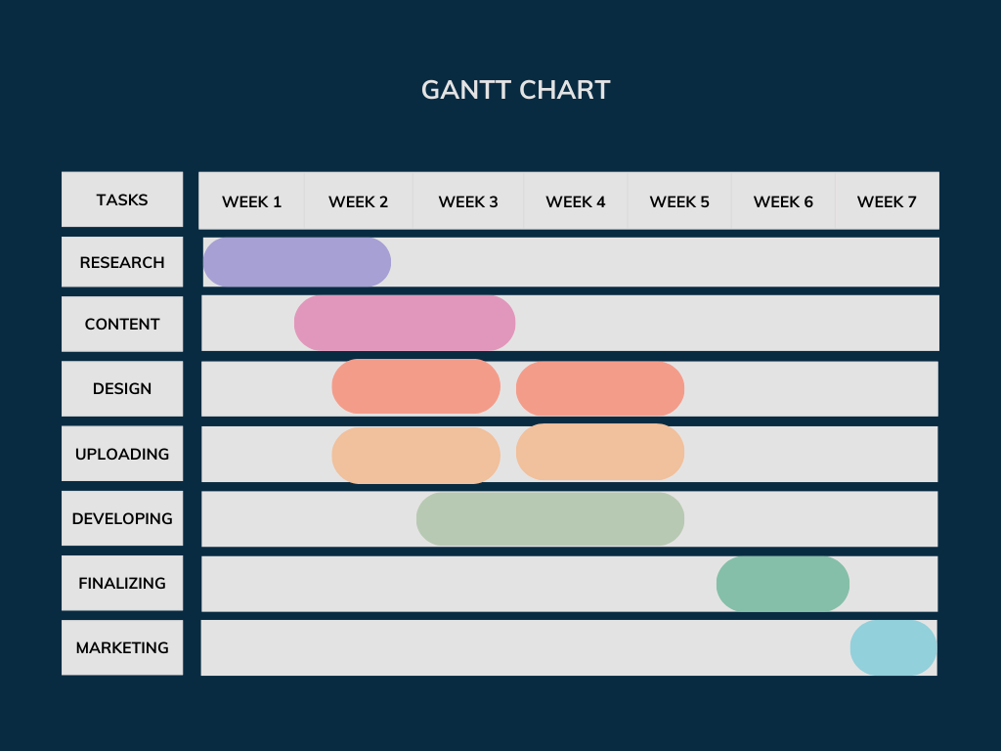
PROPOSED METHODOLOGY ( Gantt Chart)

Slide 13
CHOICE OF COMPONENTS / MODULES / METHODS/TECHNIQUES EQUIPMENT USED FOR PROJECT DEVELOPMENT
PLC (Programmable Logic Controller):
Component: Siemens S7-1500, Allen Bradley, or similar PLC with sufficient I/O ports.
Function: Central control unit to manage the capping, and pick-and-place operations.
Method: Ladder logic or structured text programming for control flow, sensors integration, and system automation.
Sensors:
Proximity Sensors: Detect the presence of Workpiece at different stages (e.g., capping stations).
Function: Provide real-time feedback to the PLC for accurate control.
Method: Use of discrete and analog sensors for detection and measurement the Height of the Workpiece.

Slide 14
CHOICE OF COMPONENTS / MODULES / METHODS/TECHNIQUES EQUIPMENT USED FOR PROJECT DEVELOPMENT
capping system :
Component: Pneumatic Rotary Actuator.
Function: Automatically caps the Workpiece.
Method: The PLC coordinates the timing of the capping process.
Pick and place mechanism :
Component: cartesian pic and place using pneumatic cylinders with a Pneumatic gripper.
Function: Picks up capped Workpiece from the conveyor and places them in designated storage.
Method: PLC-controlled motors to handle Workpiece movement based on predefined paths.

Slide 15
CHOICE OF COMPONENTS / MODULES / METHODS/TECHNIQUES EQUIPMENT USED FOR PROJECT DEVELOPMENT
Conveyor system:
Component: Belt conveyor.
Function: Transport Workpiece through the capping, and storage processes.
Method: Driven by a motor, controlled by the PLC to ensure precise movement and synchronization with other processes.
Actuators :
Types:
Pneumatic Actuators: Used for Placed the capping heads.
Electric Motors: Used to drive conveyors and pick-and-place mechanisms.
Function: Enable the mechanical operations required for capping and movement.
Method: Controlled by PLC through relays or motor drivers.

Slide 16
CHOICE OF COMPONENTS / MODULES / METHODS/TECHNIQUES EQUIPMENT USED FOR PROJECT DEVELOPMENT
Human-Machine Interface (HMI):.
Component: Touchscreen HMI.
Function: Allows operators to monitor and control the entire process, adjust settings, and handle error messages.
Method: PLC-to-HMI communication for real-time system updates.
Power Supply and Relays::
Component: 24V DC power supply, relays, and contactors.
Function: Provide power to the PLC, sensors, and actuators, while relays manage high-power components like motors.
Method: Integration with control systems to ensure reliable power distribution.

Slide 17
CHOICE OF COMPONENTS / MODULES / METHODS/TECHNIQUES EQUIPMENT USED FOR PROJECT DEVELOPMENT
Safety Equipment:
Component: Emergency stop buttons and safety sensors.
Function: Prevent accidents and ensure safe operation during maintenance or in case of system failures.
Method: Hardwired into the PLC to immediately stop operations when triggered.

Slide 18
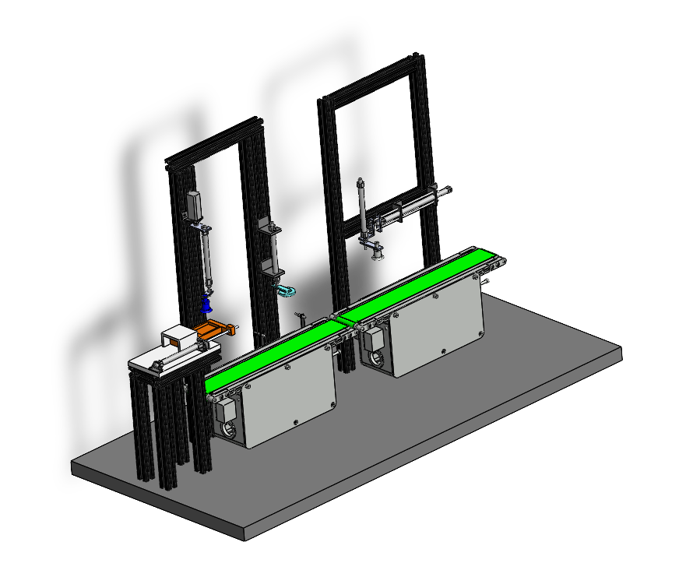
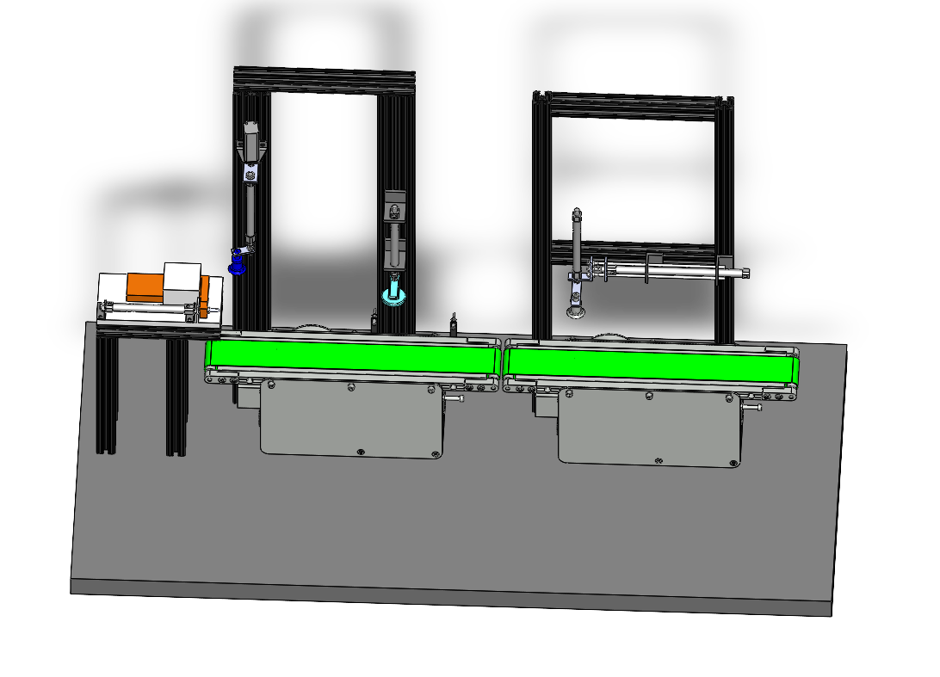
DESIGN(S)

Slide 19
INDIVIDUAL CONTRIBUTIONS TO THE WORK
Batch Member 1 : (7376211MC145 & VIGNESHRAM R )
CAD DESIGNING
COMPONENTS SELECTION
PLC PROGRAMMING
ASSEMBLING

Slide 20
INDIVIDUAL CONTRIBUTIONS TO THE WORK
Batch Member 2 : ( 7376211MC119 & KAVIN RAJ S )
PLC PROGRAMMING
COMPONENT SELECTION
ASSEMBLING
ELECTRICAL WIRING

Slide 21
INDIVIDUAL CONTRIBUTIONS TO THE WORK
Batch Member 3 : (7376221MC508 & THAMARAI KANNAN M K S )
CAD DESIGNING
COMPONENTS SELECTION
PLC PROGRAMMING
ASSEMBLING

Slide 22
INDIVIDUAL CONTRIBUTIONS TO THE WORK
Batch Member 4 : (7376211MC117 & JUBAIR AHAMED L )
COMPONENTS SELECTION
PLC PROGRAMMING
ASSEMBLING
ELECTRICAL WIRING

Slide 23
PENDING WORKS AND PLAN FOR COMPLETION
Capping and Storage Assembly is pending
Write a PLC Programming and interface I/O with Pick and place Robot to Store the Bottle in Storage Area

Slide 24
PLAN FOR PUBLICATIONS
Journal / Conference Identified for Submission
Tentative Dates for Submission / Presentation / Acceptance

Slide 25
Status on Partial Completion and Submission of Project Report
List of Documents to be Submitted
SL.No | List of Documents | Status ( Provide the drive link of prepared document)
1 | Cover Page & Title Page (Both are in same format) | https://drive.google.com/drive/folders/1_BykVXHMcatcO4SHHfWXehlaGpfCkpwp?usp=drive_link
2 | Bonafide Certificate | https://drive.google.com/drive/folders/1_BykVXHMcatcO4SHHfWXehlaGpfCkpwp?usp=drive_link
3 | Declaration | https://drive.google.com/drive/folders/1_BykVXHMcatcO4SHHfWXehlaGpfCkpwp?usp=drive_link
4 | Acknowledgement | https://drive.google.com/drive/folders/1_BykVXHMcatcO4SHHfWXehlaGpfCkpwp?usp=drive_link
5 | Chapter I – Introduction | https://drive.google.com/drive/folders/1_BykVXHMcatcO4SHHfWXehlaGpfCkpwp?usp=drive_link
6 | Chapter 2 – Literature Survey | https://drive.google.com/drive/folders/1_BykVXHMcatcO4SHHfWXehlaGpfCkpwp?usp=drive_link

Slide 26
REFERENCES ( Journal Papers/ Books / Website in IEEE Format )
Journal
[1]. A. Vaskuri, H. Baumgartner, P. Kärhä, G. Andor, and E. Ikonen, "Modeling the spectral shape of InGaAlP-based red light-emitting diodes," Journal of Applied Physics, vol. 118, no. 20, pp. 203103-1–203103-7.
[2]…………………….……….
Books
[1]. A. J. Stewart, A Vulnerable System: The History of Information Security in the Computer Age, Ithaca, NY, USA: Cornell Univ. Press, 2021.
[2]…………………………………..
Patent
[1]. M. A. Genius, “Brain Grow-a-Matic 4 Kids,” US Patent 3 400 126, Mar. 21, 2019.
Website
[1]. D. Holland, "Finding the Building Blocks of Wood." unimelb.edu.au. https://pursuit.unimelb.edu.au/articles/finding-the-building-blocks-of wood?utm_source=linkedin.com&utm_medium=social&utm_content=story.

