Slide 1





FLIGHT RESERVATION SYSTEM
Team Members: Guide: Mrs.R.Umamaheshwari
Robin V
Suman S
Vengadesh R
Aswin B K
Thamaraikannan B

Slide 2
OUTLINE
Abstract
Problem Statement
Aims, Objective
Proposed System/Solution
System Design/Architecture
System Development Approach (Technology Used)
Algorithm
Conclusion
Github link( Source code, Demo video, Report)
Notes:
These are the list of chapters that we are going to cover in these foundation codes. Those are chapter one what are AI and ML? chapter 2 applied Python programming in AI, and chapter 3 is exploratory data analysis for ML.

Slide 3
Abstract
This presentation provides a comprehensive analysis of the flight reservation system, focusing on optimizing the travel experience
This system integrates user friendly interface for passengers to search and book flights
It incorporates real-time data synchronization with airline databases ensuring up-to-date information on flight availability

Slide 4
Problem Statement
Flight reservation systems encounter challenges such as user experience shortcomings, adapting to frequent flight schedule changes, navigating global regulations, ensuring efficient payment processing, optimizing mobile responsiveness, and maintaining competitive pricing are additional hurdles.

Slide 5
Aim
To create a comprehensive flight reservation system using HTML, Java Servlets and MySQL aiming to provide users with a secure, efficient, and user-friendly platform for flight ticket booking.
Objective
Develop a responsive HTML-based frontend to facilitate seamless user interface for ticket booking.
Implement Java Servlets for robust backend logic, ensuring secure user data management and payments.

Slide 6
Proposed Solution
Leveraging a well structured database schema enables user to easily search flights
A secure authentication system safeguards user information
The UI is intuitively designed allowing users to manage profiles, view booking and customize preferences.
The deployment on reliable server ensures optimal performance making our system a an efficient flight ticket booking platform

Slide 7
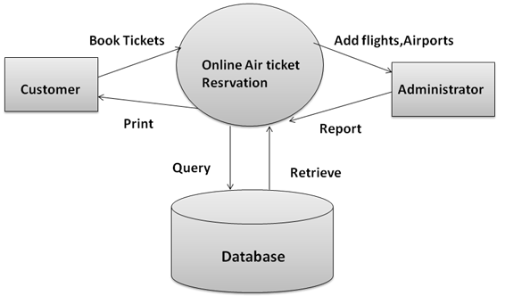
System Architecture

Slide 8
System Deployment Approach
TOOLS AND TECHNOLOGIES:
Frontend: HTML, CSS, JavaScript
Backend: Java Servlets
Front end framework: Bootstrap
Front end library: JQuery
Database: MySQL
Development Environment: Eclipse IDE for Java EE Developers
Deployment Environment: Microsoft Azure cloud

Slide 9
Algorithm
Our project implements various algorithms for different functionalities, but it doesn't specifically refer to a single algorithm by name. Instead, it encompasses a combination of algorithms for tasks such as
1) User authentication
2) Search available flights
3) Filter search results based on user preferences

Slide 10
Conclusion
The project aims to deliver a fully functional and secure flight ticket booking system that enhances user experience, provides real-time flight updates and ensures data integrity. The use of Java Servlets and MySQL database integration will enable a robust and scalable solution for managing transaction operations.

Slide 11
Github Link
Github - https://github.com/thamaraikannanb/Edunet-Flight-reservation-system-

Slide 12
Thank you!
Notes:
thank you very much for joining this PPT, keep learning.
12

