Slide 1
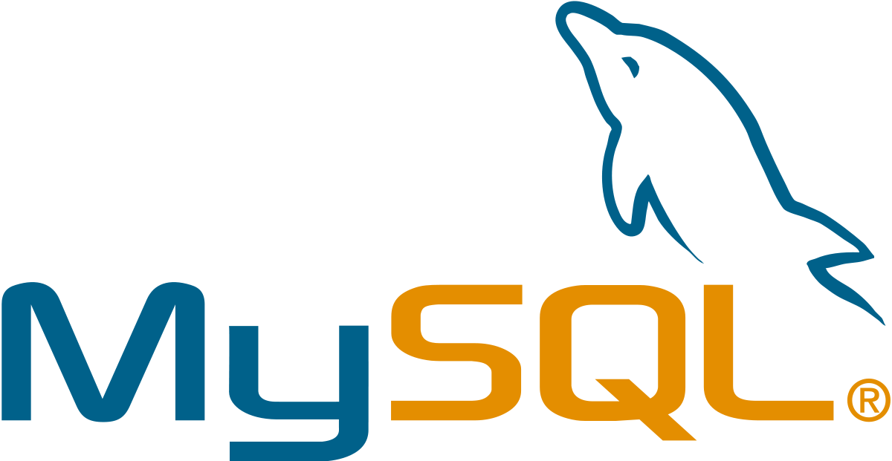
What is MySQL? :
MySQL is a relational database management system (RDBMS) developed by Oracle that is based on structured query language (SQL).
A database is a structured collection of data. It may be anything from a simple shopping list to a picture gallery or a place to hold the vast amounts of information in a corporate network. In particular, a relational database is a digital store collecting data and organizing it according to the relational model. In this model, tables consist of rows and columns, and relationships between data elements all follow a strict logical structure. An RDBMS is simply the set of software tools used to actually implement, manage, and query such a database.

Slide 2
keys to understanding MySQL :
MySQL is widely compatible
MySQL databases are relational
MySQL is easy to use
MySQL is open-source
Because MySQL enjoys the most widespread use in many industries, business users from new webmasters to experienced managers should strive to understand its main characteristics
Though often associated with internet applications or web services, MySQL was designed to be extensively compatible with other technologies and architectures. The RDBMS runs on all major computing platforms, including Unix-based operating systems, such as the myriad Linux distributions or Mac OS, and Windows
Any individual or enterprise may freely use, modify, publish, and expand on Oracle’s open-source MySQL code base. The software is released under the GNU General Public License (GPL).
For MySQL code needing to be integrated or included in a commercial application (or if open-source software is not a priority), enterprises can purchase a commercially licensed version from Oracle.
The primary factor differentiating relational databases from other digital storage lies in how data is organized at a high level. Databases like MySQL contain records in multiple, separate, and highly codified tables, as opposed to a single all-encompassing repository, or collections of semi- or unstructured documents

Slide 3

What’s PostgreSQL :
PostgreSQL is an advanced, enterprise class open source relational database that supports both SQL (relational) and JSON (non-relational) querying. It is a highly stable database management system, backed by more than 20 years of community development which has contributed to its high levels of resilience, integrity, and correctness. PostgreSQL is used as the primary data store or data warehouse for many web, mobile, geospatial, and analytics applications. The latest major version is PostgreSQL 12.
PostgreSQL has a rich history for support of advanced data types, and supports a level of performance optimization that is common across its commercial database counterparts, like Oracle and SQL Server.

Slide 4
Benefits of using PostgreSQL
Rich features and extensions
Reliability and standards compliance
Open source license
PostgreSQL possesses robust feature sets including Multi-Version Concurrency Control (MVCC), point in time recovery, granular access controls, tablespaces, asynchronous replication, nested transactions, online/hot backups, a refined query planner/optimizer, and write ahead logging. It supports international character sets, multi-byte character encodings, Unicode, and it is locale-aware for sorting, case-sensitivity, and formatting.
TPostgreSQL’s write ahead logging makes it a highly fault tolerant database. Its large base of open source contributors lends it a built-in community support network. PostgreSQL is ACID compliant, and has full support for foreign keys, joins, views, triggers, and stored procedures, in many different languages. It includes most SQL:2008 data types, including INTEGER, NUMERIC, BOOLEAN, CHAR, VARCHAR, DATE, INTERVAL, and TIMESTAMP.
PostgreSQL source code is available under an open source license, granting you the freedom to use, modify, and implement it as you see fit, at no charge. PostgreSQL carries no licensing cost, which eliminates the risk for over-deployment.

Slide 5

What’s SQL Server
SQL Server is a relational database management system, or RDBMS, developed and marketed by Microsoft.
Similar to other RDBMS software, SQL Server is built on top of SQL, a standard programming language for interacting with the relational databases. SQL server is tied to Transact-SQL, or T-SQL, the Microsoft’s implementation of SQL that adds a set of proprietary programming constructs.
SQL Server works exclusively on Windows environment for more than 20 years. In 2016, Microsoft made it available on Linux. SQL Server 2017 became generally available in October 2016 that ran on both Windows and Linux.

Slide 6
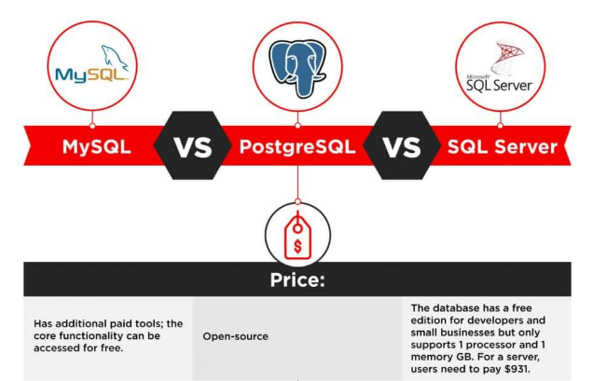

Slide 7
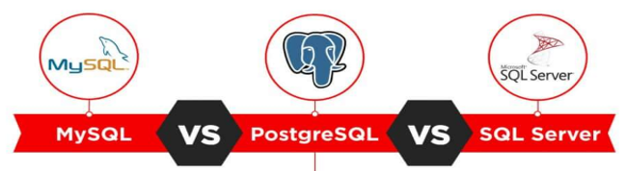
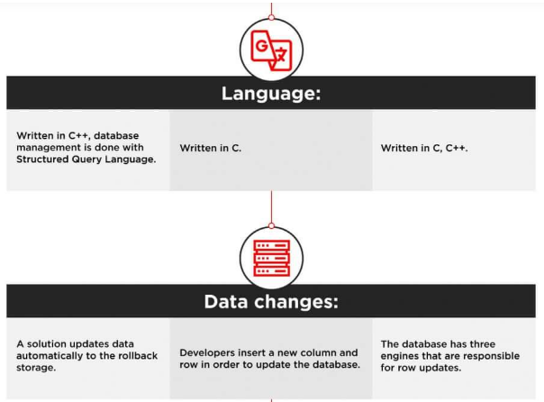

Slide 8
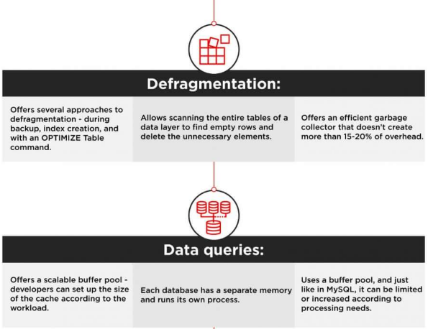

Slide 9
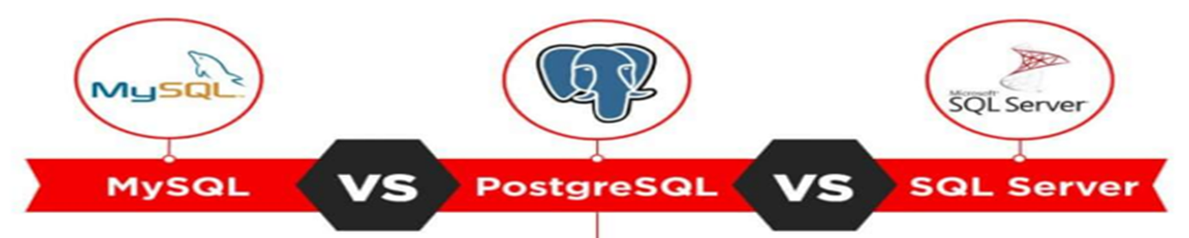
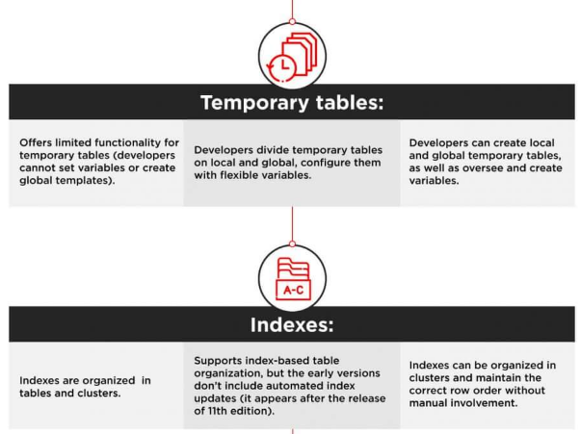

Slide 10
