Slide 1
Credit Scores & Vehicles
Does the make/model of your vehicle give insight to your credit score?
Daniel Fischer, Sonmi Kim, & Trevor Hamilton

Slide 2
Reason for selecting the topic:
Each person within our group has a connection to the selected topic:
Car Enthusiast
Statistical Framework of the project
Intellectually curious about different sources of data and what trends may be inclusive
Deep interest in developing and using machine learning models with different data environments

Slide 3
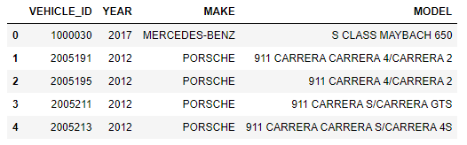
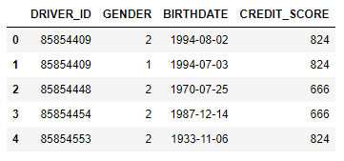
Overview of Data Sources
Vehicle Data:
Driver & Credit Data:

Slide 4
Questions to be answered with the data:
Does the relationship exist?
Is there a relationship to exist between the correlations of car models and owners credit score?
Does the data have a strong enough relationship to be used a potential predictor of credit?
How accurate is the model to predicting credit scores?
What if there isn’t a robust and predictive relationship exists?
Are there any trends to be noted within the data set?
i.e. Clustering of data vs model/avg credit score
Does the machine learning model show any historical trends when looking the data set ?

Slide 5
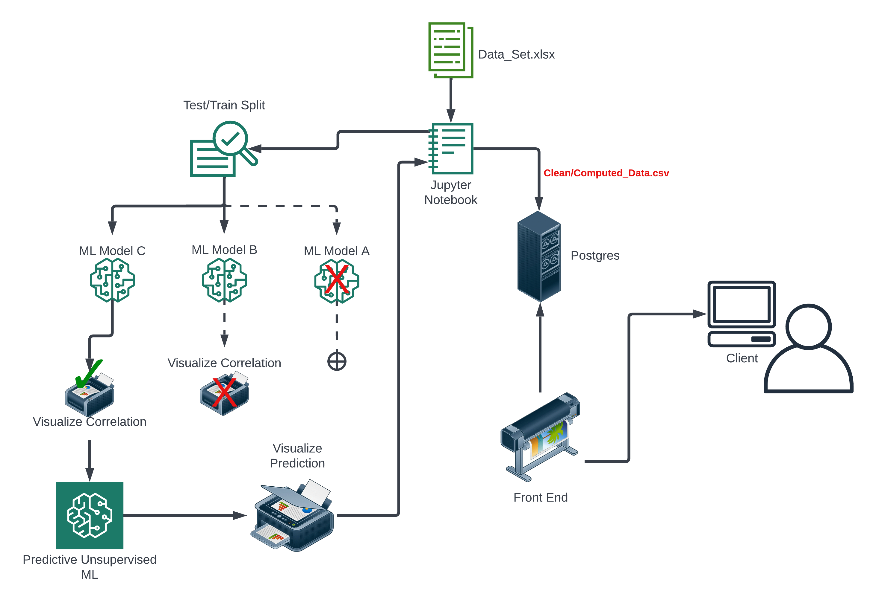
Data Flow Chart

