Slide 1
Recipe preparation agent
CAPSTONE PROJECT
Presented By:
Thamizhvijayan T,
IFET College of Engineering,
Electronics and Communication Engineering.

Slide 2
OUTLINE
Problem Statement
Proposed System/Solution
System Development Approach
Algorithm & Deployment
Result (Output Image)
Conclusion
Future Scope
References

Slide 3
Problem Statement
Recipe Preparation Agent The Challenge - A Recipe Preparation Agent helps users cook meals using only the ingredients they have on hand. By inputting available groceries, users receive tailored recipe suggestions using a RAG-based AI system. The agent retrieves relevant recipes and generates step-by-step instructions adapted to ingredient limitations. It offers substitutions, cooking tips, and dietary adjustments based on user preferences or restrictions. Designed to reduce food waste and save time, it turns pantry items into practical meal solutions. This AI assistant makes everyday cooking smarter, simpler, and more sustainable. Technology - Use of IBM cloud lite services /IBM Granity is mandatory.

Slide 4
Proposed Solution
Data Collection:
Gather a comprehensive dataset of recipes, including ingredients, preparation steps, cuisine types, cooking time, and dietary information.
Utilize real-time data sources, such as seasonal ingredient availability, local store inventories (if integrated), and user preferences or restrictions (e.g., allergies, vegan).
Data Preprocessing:
Clean and preprocess the collected recipe data to handle inconsistencies, duplicates, or missing information.
Apply feature engineering to extract key information such as substitute ingredients, portion sizes, or nutritional values.
Machine Learning Algorithm:
Implement a retriever to search the recipe database for meals that match the user’s available ingredients.
Integrate a generator (using IBM Watson NLP or IBM Granity) to adapt the retrieved recipes by:
Suggesting substitutions for missing ingredients.
Adjusting portion sizes and steps.
Providing cooking tips and dietary modifications.
Deployment:
Develop an intuitive user interface or application that allows users to input available groceries and receive tailored recipes with step-by-step instructions.
Deploy the solution using IBM Cloud Lite services, leveraging IBM Cloud Functions, IBM Cloudant for storage, and IBM Granity for the RAG pipeline.
Evaluation:
Assess the quality and relevance of the recommended recipes using user feedback and metrics like user satisfaction, recipe relevance score, and system response time.
Continuously fine-tune the AI system based on real user interactions to improve recipe suggestions, substitutions, and cooking tips.
Result:
By intelligently combining recipe retrieval and generative AI, the proposed Recipe Preparation Agent helps users make the most of their pantry items, reduces food waste, and transforms everyday cooking into a smarter, simpler, and more sustainable experience

Slide 5
System Approach
The Recipe Preparation Agent will be developed and deployed using robust and scalable technologies to ensure smooth operation and accessibility. The key system requirements are as follows:
System requirements
Hardware Requirements
Processor: Minimum Intel i5 or equivalent (recommended Intel i7/i9 or equivalent for training)
RAM: Minimum 8 GB (recommended 16 GB or more)
Storage: At least 20 GB free disk space for dataset storage, model checkpoints, and logs
Internet connection for cloud deployment and real-time data integration
Software Requirements
Operating System: Windows 10/11, macOS, or any Linux distribution
Python (version 3.8 or higher)
IBM Cloud Lite account with access to:
IBM Watson NLP
IBM Granity (for vector-based retrieval and LLM capabilities)
IBM Cloudant or IBM Db2 Lite for recipe storage
IBM Cloud Functions for serverless API handling
IBM Code Engine or IBM App Runtime for deployment
Web browser for accessing the user interface

Slide 6
Library required to build the model
Core Libraries
pandas — for data cleaning and preprocessing
numpy — for numerical operations
scikit-learn — for any preprocessing utilities and baseline models
NLTK / spaCy — for additional NLP tasks if needed
transformers — for integrating LLM-based generation if combined with open-source models during local development
sentence-transformers — for vector embeddings in the retriever part (if using custom embedding models before sending to IBM Granity)
requests — for making API calls to IBM Watson NLP and IBM Granity services
flask or fastapi — for building a simple backend API if needed
IBM SDKs
ibm-cloud-sdk-core — for authenticating and interacting with IBM Cloud services
ibm-watson — Python SDK for Watson NLP
ibm_db — for connecting to IBM Db2 Lite if used for relational storage
ibm-cos-sdk — for any file or object storage on IBM Cloud Object Storage
Frontend
ReactJS / HTML5/CSS3 — for building the user interface
JavaScript libraries — for API requests and dynamic interaction

Slide 7
Algorithm & Deployment
Algorithm Selection:
The Recipe Preparation Agent uses a Retrieval-Augmented Generation (RAG) approach as its core AI framework.
The retriever component searches a large recipe database for meals that closely match the user’s available ingredients.
The generator component (powered by IBM Watson NLP or IBM Granity) refines these results by rewriting recipes to fit the user’s specific context — for example, adjusting quantities, suggesting substitutions for missing items, or providing dietary adjustments.
The RAG framework is ideal because:
Recipes are highly dependent on matching discrete ingredients — so a semantic search retriever is well-suited for finding the best matches.
Generative AI then customizes the instructions, making the solution flexible, context-aware, and more helpful than a static search alone.

Slide 8
Data Input:
User-input ingredients: The list of available groceries entered by the user.
Recipe dataset: A structured database containing recipe names, ingredients, cooking instructions, portion sizes, cuisine type, cooking time, and nutritional info.
Contextual factors: Optional user preferences, dietary restrictions (e.g., vegan, gluten-free), and real-time constraints like preparation time or serving size.
Optional enrichments: Seasonal ingredient availability or local store inventory data (if integrated).
Training Process:
Retriever: The recipe database is pre-processed and vectorized using embedding models. These embeddings are stored in a vector database (e.g., IBM Granity) to enable fast similarity searches.
Recipes are embedded using transformer-based sentence encoders.
The vector index is continuously updated if new recipes are added.
Generator: The generative model (e.g., Watson NLP or a custom fine-tuned LLM) is trained or configured to rewrite retrieved recipes.
Fine-tuning includes handling instructions for substitutions, portion scaling, and dietary tips.
Training data includes pairs of recipes and their modified versions to teach the model how to adapt instructions.
Optimization: The pipeline may use prompt engineering, parameter tuning, and user feedback to refine outputs for clarity, correctness, and relevance.

Slide 9
Prediction Process:
Retrieval: When a user submits their ingredient list, the retriever performs a semantic similarity search to find recipes with the highest overlap or match.
Generation: The generator then:
Modifies the retrieved recipes to fit only the available ingredients.
Suggests practical substitutions for missing items.
Adjusts portion sizes and cooking times as needed.
Adds relevant cooking tips or dietary notes.
Real-time Output: The final recipe, instructions, and tips are displayed instantly in the user interface. If integrated, the system can adapt recommendations based on real-time factors like new ingredients or changing dietary needs.

Slide 10
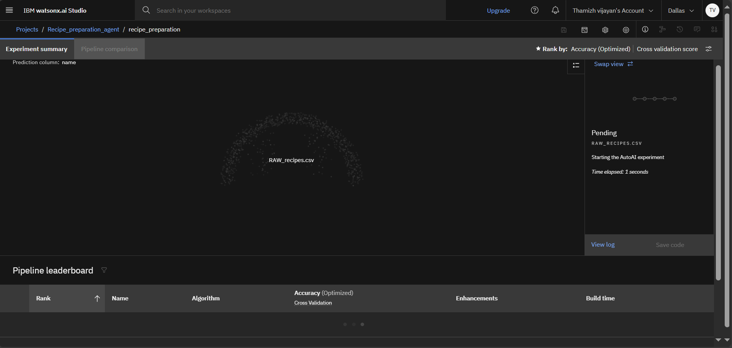
Result

Slide 11
Conclusion
The Recipe Preparation Agent demonstrates how AI can transform everyday cooking by turning available groceries into practical meal solutions. By integrating a Retrieval-Augmented Generation (RAG) approach with IBM Cloud Lite services and IBM Granity, the system intelligently matches user-input ingredients with relevant recipes and generates customized instructions, substitutions, and dietary adjustments. This not only minimizes food waste and saves time but also empowers users to cook creatively and sustainably. Overall, the project highlights the potential of AI-driven solutions in daily life.

Slide 12
Future scope
The Recipe Preparation Agent can be enhanced further to deliver even greater value. Future improvements may include integrating live grocery store APIs to check ingredient availability and suggest nearby shopping options. Personalized nutrition tracking and integration with smart kitchen devices can automate cooking steps or adjust recipes in real time. Expanding the recipe database to include global cuisines and user-submitted recipes will broaden options. Additionally, multilingual support and voice assistants can make the agent more accessible and user-friendly worldwide.

Slide 13
References
Liu, Guoshan, et al. "Retrieval augmented recipe generation." 2025 IEEE/CVF Winter Conference on Applications of Computer Vision (WACV). IEEE, 2025.
Razzaq, Muhammad Saad, et al. "Evorecipes: a generative approach for evolving context-aware recipes." IEEE Access 11 (2023): 74148-74164.
Soekamto, Yosua Setyawan, et al. "Pic2Plate: A Vision-Language and Retrieval-Augmented Framework for Personalized Recipe Recommendations." Sensors 25.2 (2025): 449.
Razzaq, Muhammad Saad, et al. "Evorecipes: a generative approach for evolving context-aware recipes." IEEE Access 11 (2023): 74148-74164.
Rita, Luís, et al. "Optimizing ingredient substitution using Large Language Models to enhance phytochemical content in recipes." Machine Learning and Knowledge Extraction 6.4 (2024): 2738-2752.
Ashraf, Mariyam Mohammed, and M. W. P. Maduranga. "Ingredient-Only Recipe Recommendation via Self-Supervised Contrastive Learning for Sustainable Cooking." Journal of Future Artificial Intelligence and Technologies 2.2 (2025): 215-226.

Slide 14
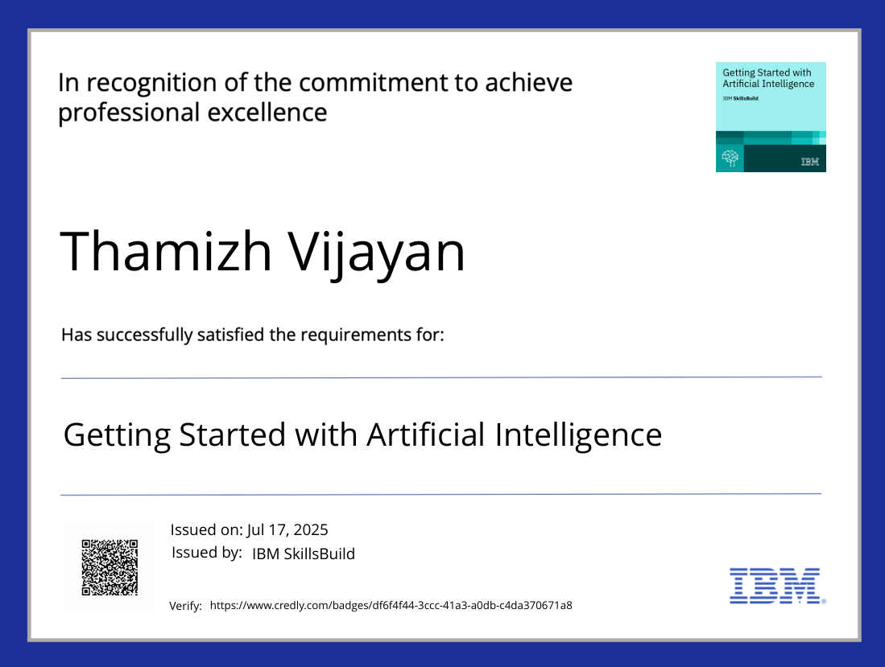
IBM Certifications

Slide 15
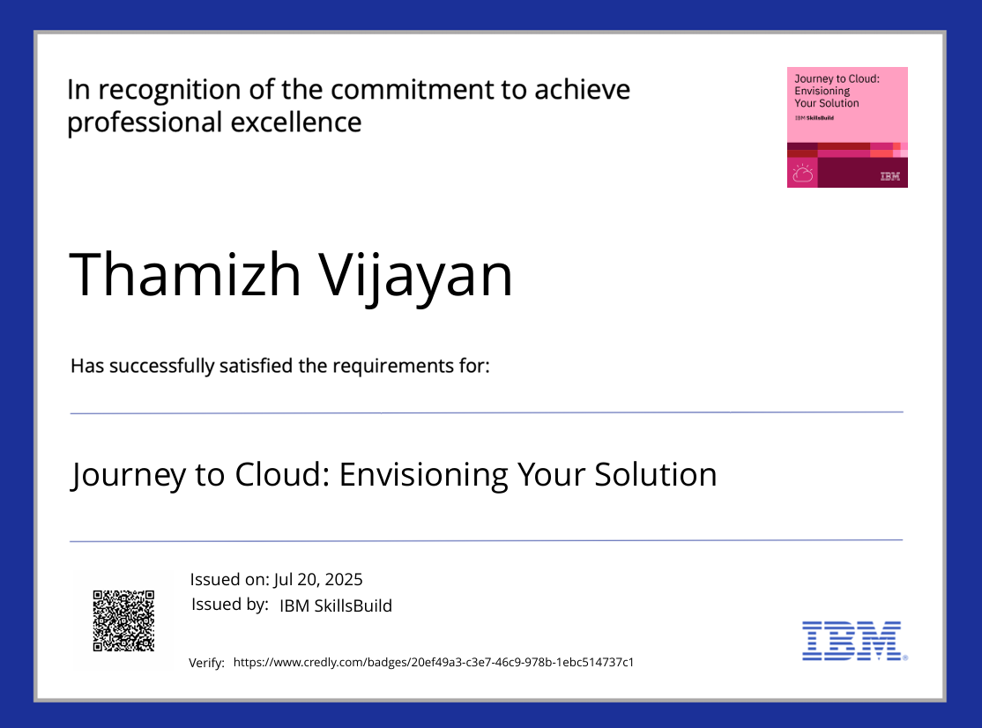
IBM Certifications

Slide 16
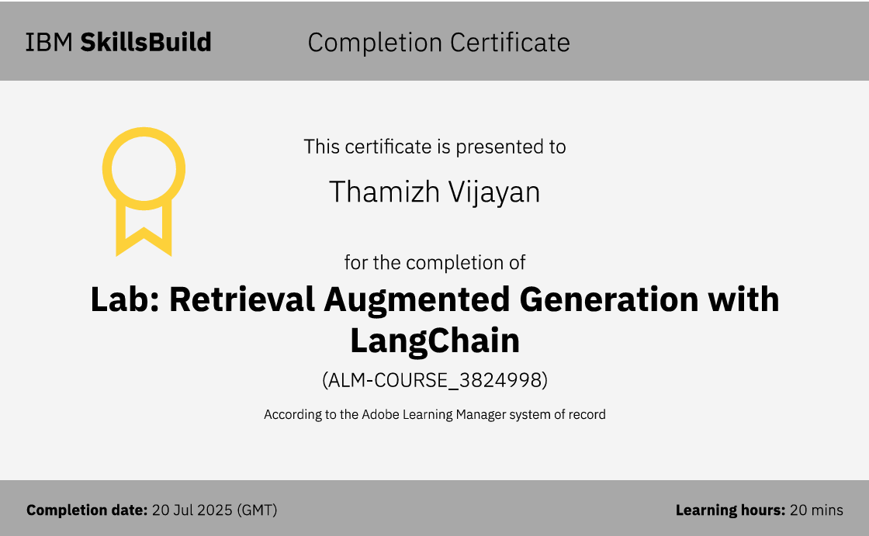
IBM Certifications

Slide 17
THANK YOU

