Slide 1
SMART WATER MANAGEMENT

Slide 2
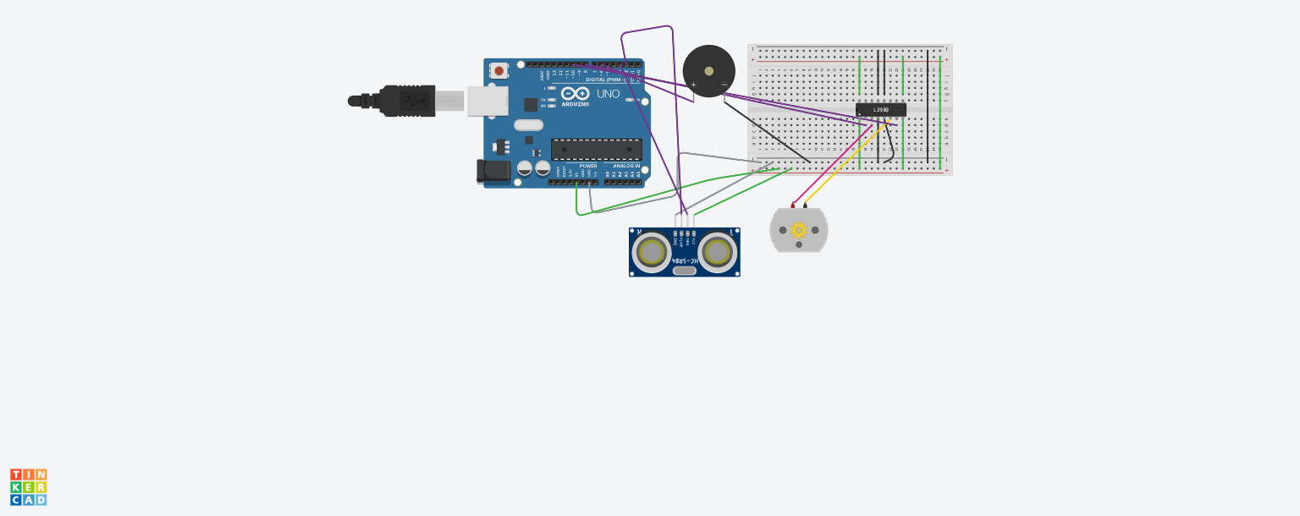
Simulation

Slide 3
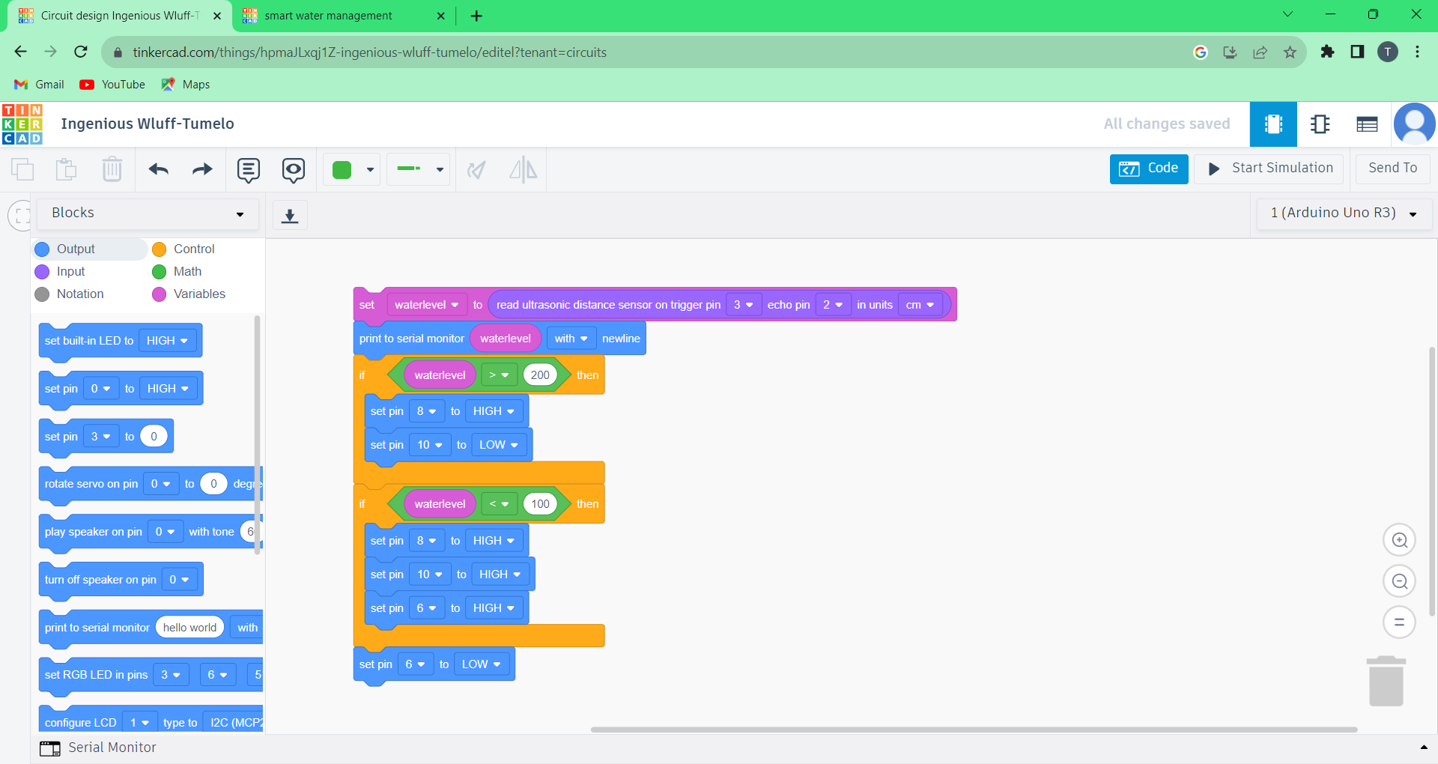
CODING

Slide 4
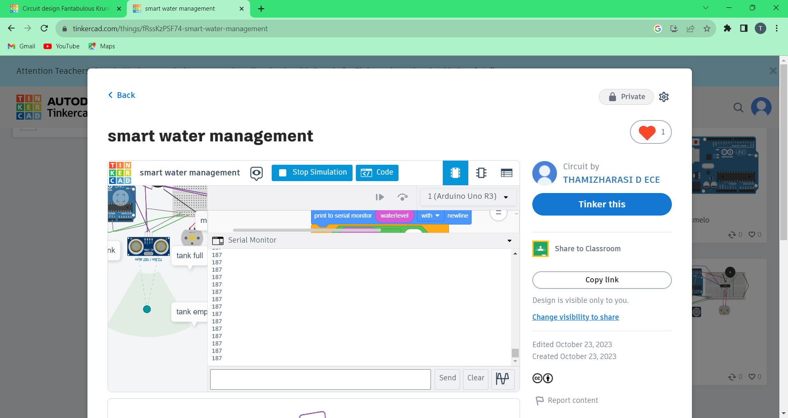
OUTPUT

