Slide 1
Web traffic analysis
Phase 3

Slide 2
Introduction
In the digital age, websites serve as vital hubs of information, interaction, and commerce.
Understanding the behavior of online visitors is not just a strategic advantage but a necessity for businesses and organizations aiming to thrive in the competitive online landscape.
Harnessing the power of data analytics and visualization, especially with advanced tools like IBM Cognos, has become pivotal for interpreting complex datasets and transforming them into actionable insights.
Website traffic analysis using IBM Cognos heralds a new era of data-driven decision-making. IBM Cognos, a robust business intelligence and performance management tool, empowers users to seamlessly integrate, visualize, and analyze data.
In this context, the focus shifts to the intricacies of web user behavior – from page views and click-through rates to user demographics and engagement patterns.

Slide 3
Objective
The objectives of website traffic analysis typically revolve around gaining insights into user behavior, optimizing website performance, and achieving specific business goals.
Here are common objectives for website traffic analysis: Visualize Website Traffic Trends:
Analyze User Engagement
Evaluate Marketing Campaign Performance
Understand User Demographics
optimize Content Strategy

Slide 4
Line chart
# Example: Line chart for website traffic over time plt.figure(figsize=(10, 6)) plt.plot(data[‘date’], data[‘traffic’], marker=‘o’, color=‘b’, label=‘Website Traffic’) plt.xlabel(‘Date’) plt.ylabel(‘Website Traffic’) plt.title(‘Website Traffic Over Time’) plt.legend() plt.xticks(rotation=45) # Rotate x-axis labels for better visibility plt.tight_layout() plt.show()

Slide 5
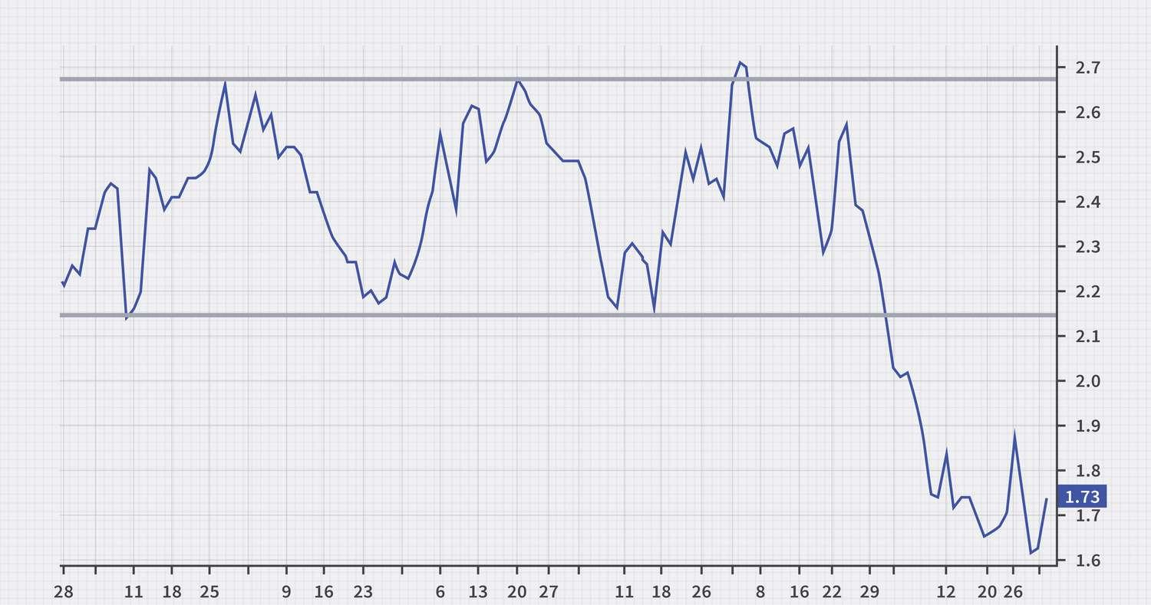
Line Chart

Slide 6
Scatter plot
Import seaborn as sns # Example: Scatter plot for website traffic vs. time spent on site plt.figure(figsize=(8, 6)) sns.scatterplot(x=‘time_spent’, y=‘traffic’, data=data, color=‘green’) plt.xlabel(‘Time Spent on Site (seconds)’) plt.ylabel(‘Website Traffic’) plt.title(‘Website Traffic vs. Time Spent on Site’) plt.show()

Slide 7
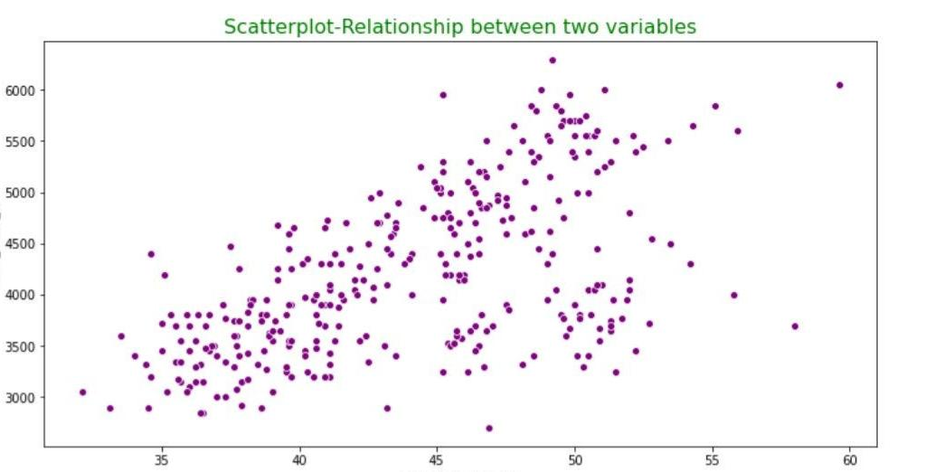
Scatter plot

Slide 8
Bar chart
Import matplotlib.pyplot as plt # Example: Bar chart for website traffic by days of the week plt.figure(figsize=(8, 6)) data.groupby(‘day_of_week’)[‘traffic’].sum().plot(kind=‘bar’) plt.xlabel(‘Day of the Week’) plt.ylabel(‘Website Traffic’) plt.title(‘Website Traffic by Day of the Week’) plt.xticks(rotation=0) # Rotate x-axis labels for better visibility plt.show()

Slide 9
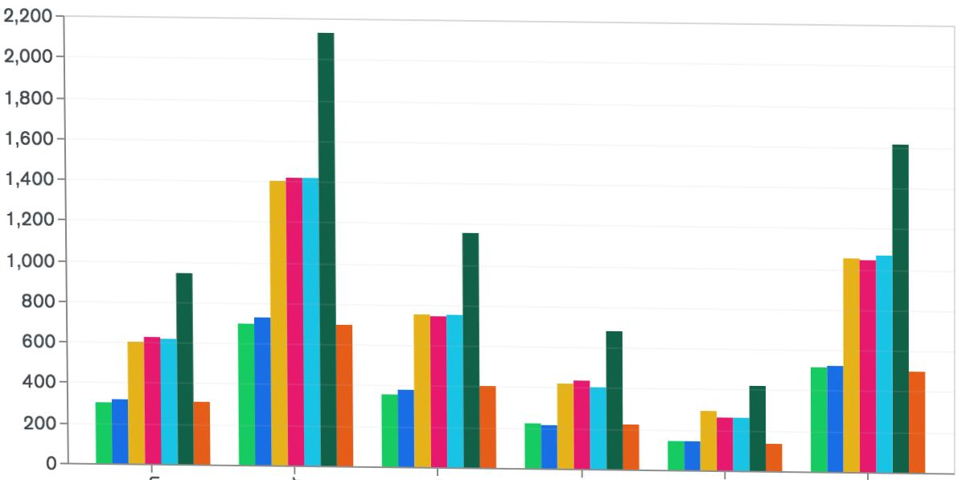
Bar chart

Slide 10
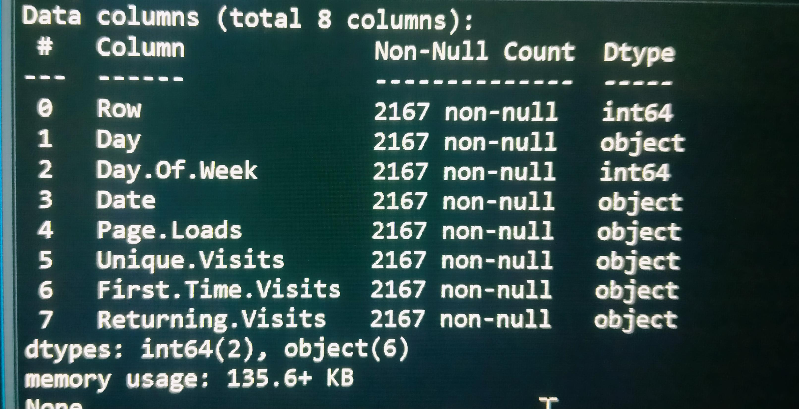
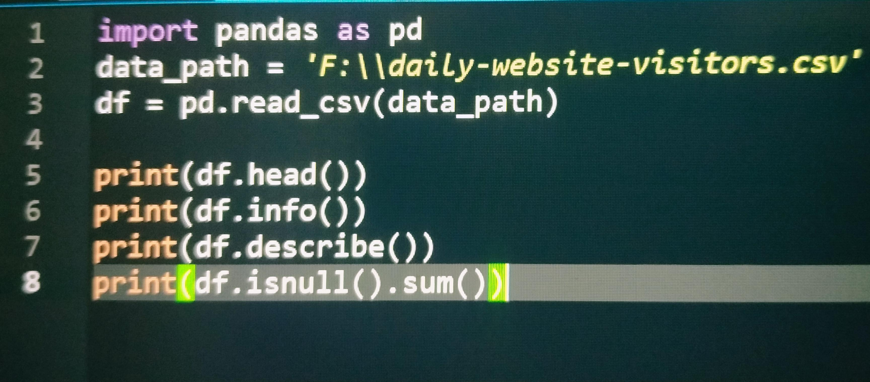
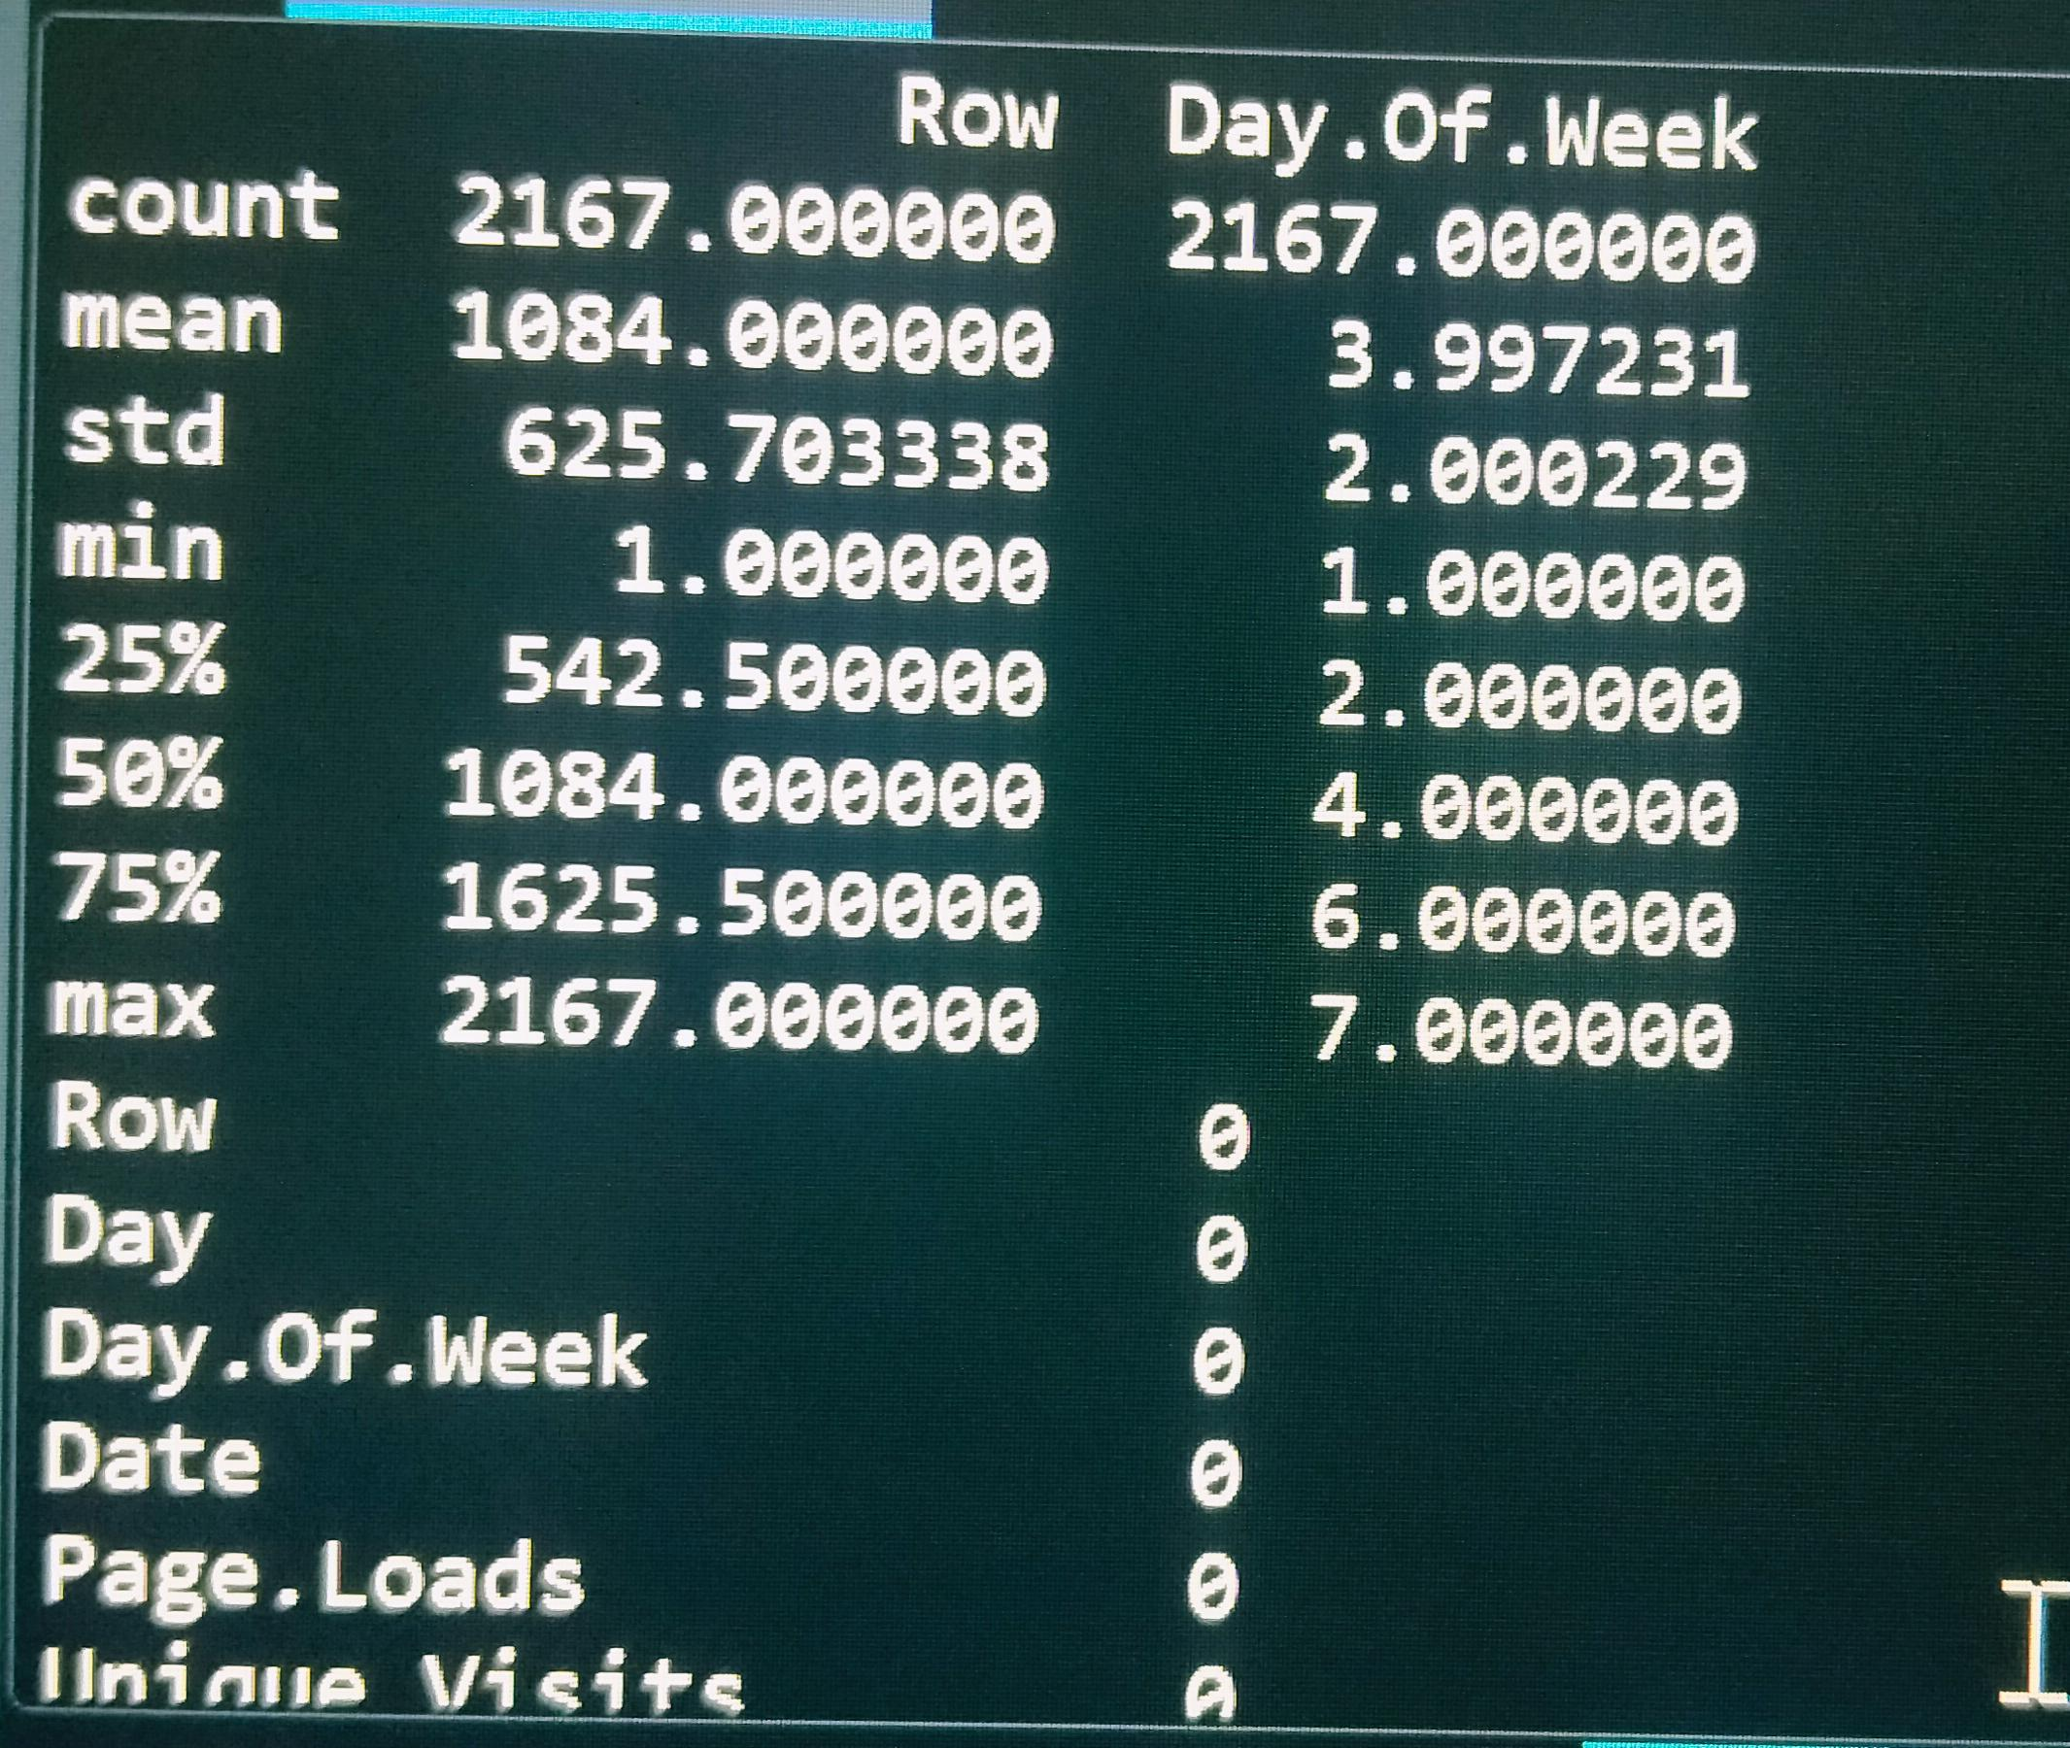
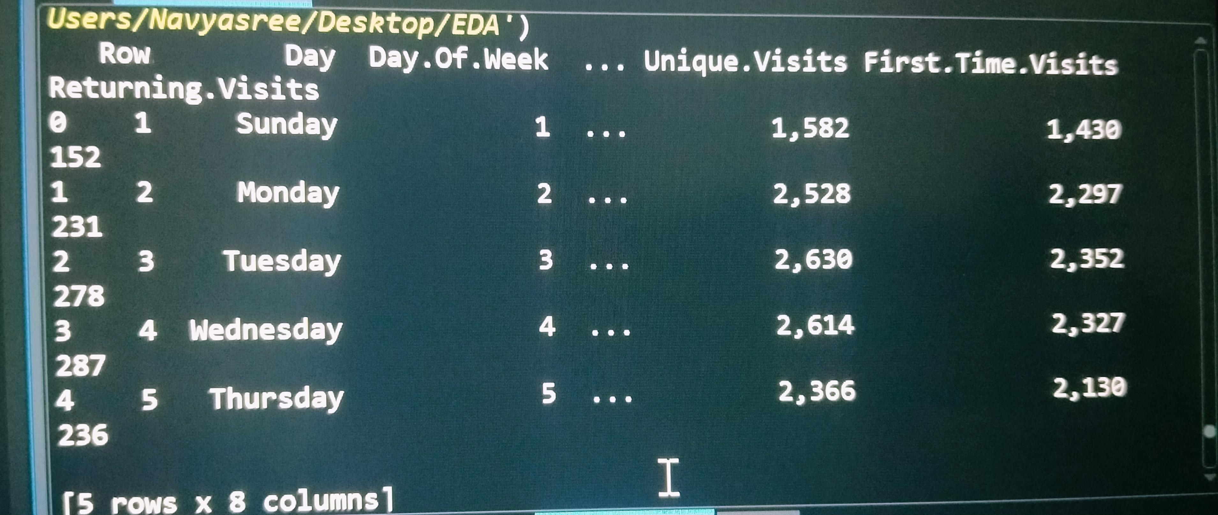
Program

Slide 11
Conclusion
In The realm of digital presence, where data reigns supreme, our journey into building a website traffic analysis using IBM Cognos for visualization has been illuminating.
As we draw the curtain on this exploration, it becomes evident that the convergence of advanced analytics and sophisticated visualization tools has ushered in a new era of understanding, empowering businesses to navigate the complexities of the online landscape with confidence and precision.
Through the lens of IBM Cognos, we have deciphered intricate patterns within website traffic data, unraveling the behaviors and preferences of our online audience.
The dynamic visualizations crafted using IBM Cognos not only transformed raw data into meaningful insights but also provided a roadmap for strategic decisions

