Slide 1

WEB TRAFFIC ANALYSIS
Phase-5

Slide 2
Analysis objective:
The analysis aims to help website owners improve user experience by identifying key performance metrics and insights. Key objectives may include understanding user behavior, site performance, and user satisfaction. This can be achieved by analyzing website traffic, user interactions, and other relevant data.

Slide 3
Data collection process:
Data collection involves gathering various types of data, such as website traffic data (e.g., Google Analytics), user interactions (e.g., clickstream data), and user feedback (e.g., surveys). This data is collected continuously or periodically and stored in a data repository for analysis.

Slide 4
Data visualisation using IBM cognos:
IBM Cognos is a powerful tool for data visualization and reporting. It can be used to create dashboards and reports that present key performance metrics and insights. Some common visualizations in Cognos might include line charts to track website traffic over time, heatmaps to visualize user interactions, and satisfaction scores from user feedback.

Slide 5
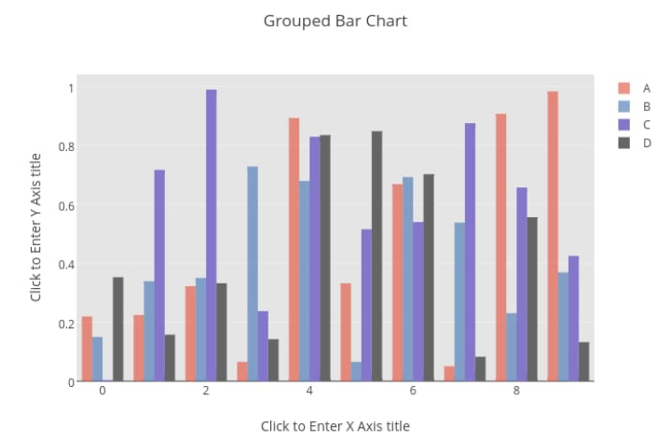
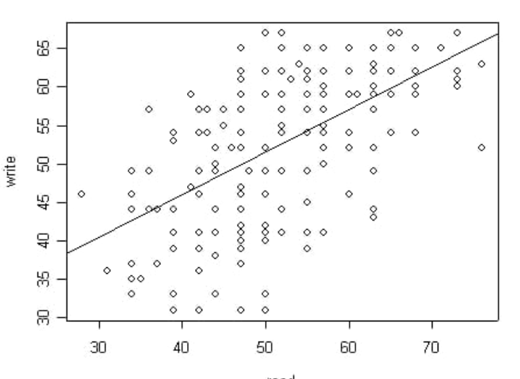
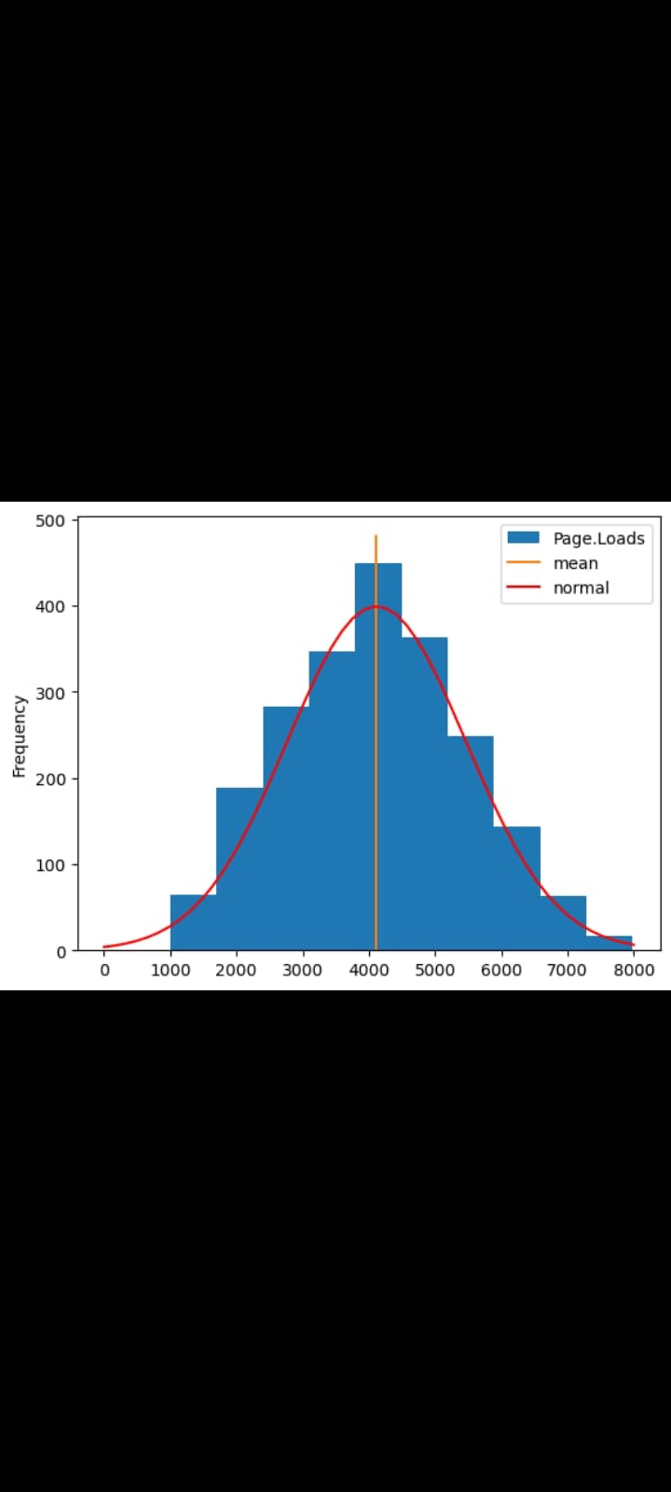
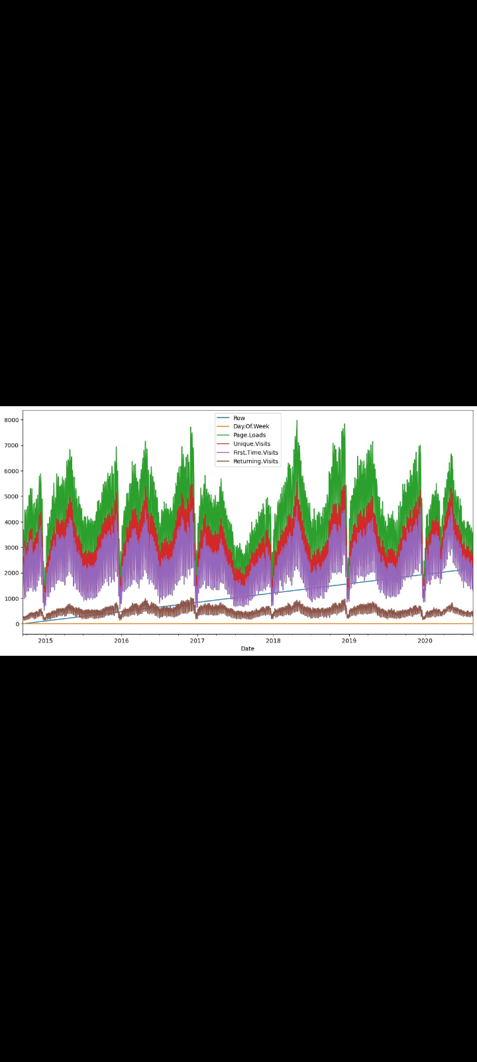

Slide 6
Python code integration:
To enhance the analysis, Python can be integrated for more advanced data processing and machine learning. Python can be used to clean, preprocess, and analyze the data. For example, you can use Python libraries like pandas for data manipulation and scikit-learn for machine learning algorithms to predict user behavior or satisfaction.

Slide 7
IMPROVING USER EXPERIENCE THROUGH INSIGHTS
.

Slide 8
Identifing user behavior pattern:
Analyzing user interactions can help identify common navigation paths, popular content, and areas where users tend to drop off. Website owners can optimize these paths to improve the user journey.

Slide 9
Performance optimisation:
By monitoring website performance metrics such as load times, server response times, and error rates, owners can pinpoint issues that affect user experience and take steps to resolve them.

Slide 10
User feedback analysis:
Gthering user feedback allows website owners to understand user preferences and pain points. This can lead to improvements in website design, content, and overall user satisfaction.

Slide 11
Personalization :
Using machine learning, owners can create personalized content recommendations and experiences for users, enhancing engagement and satisfaction.

Slide 12
Conclusion
The analysis helps website owners make data-driven decisions to enhance user experience by optimizing website performance, user interactions, and content based on actionable insights from the data. This, in turn, can lead to increased user satisfaction, longer visits, and improved conversion rates.

