Slide 1


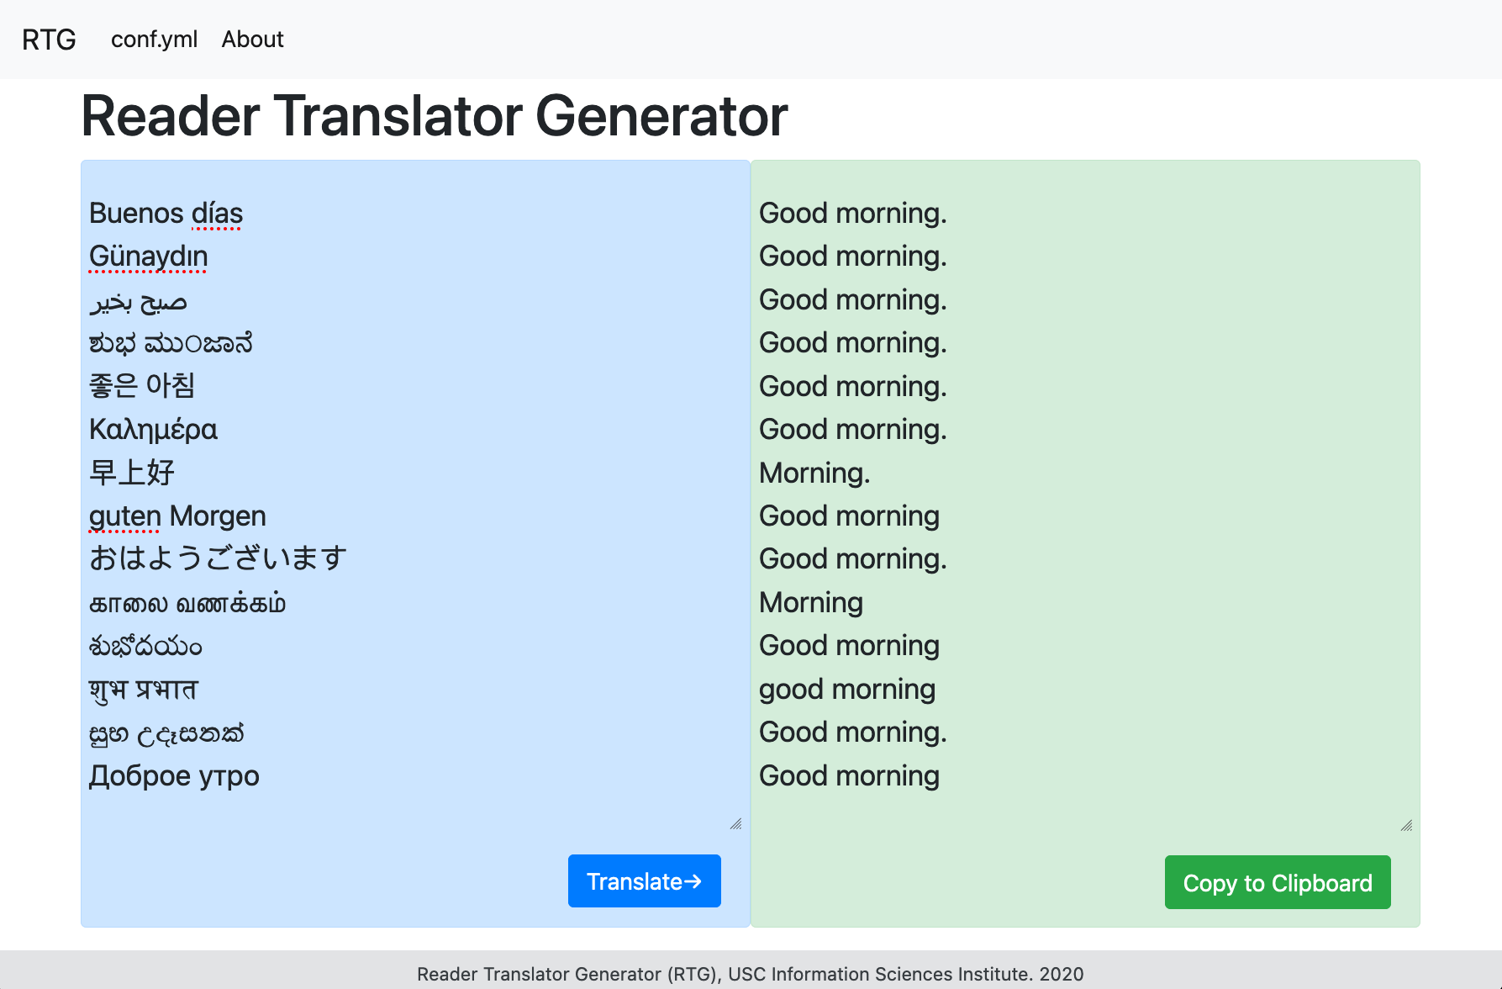
Many-to-English Machine Translation Tools, Data, and Pretrained Models
Information Sciences Institute
Thamme Gowda | Zhao Zhang | Chris Mattmann | Jonathan May
Introducing three tools for machine translation; reproducibility and scalability in focus
MTData: dataset catalogue and downloader
NLCodec: vocabulary manager, dataset storage and retrieval layer
RTG: NMT toolkit, based on PyTorch; from research to production
Massive dataset: 500+ languages, 474 million sentences, 9 billion tokens each side
Massively multilingual NMT model: 500 languages → English translation
Home page: http://rtg.isi.edu/many-eng
MTData
pip install mtdata
Reproducible experiments: clear way of communicating MT dataset
Index of publicly available parallel datasets (120K+ as of June 2021)
Maps language names to ISO-639-3
Unified interface to datasets from heterogeneous sources, and formats
Hides mundane tasks, e.g., locating URLs, downloading, decompression, parsing, and sanity checking
Parses heterogeneous data formats for parallel datasets and produces plain text files after merging
Reduces network transfers by maintaining a local cache, which is shared between experiments
Sanity checks such as segment count matching
Shows BibTeX attributed to datasets
github.com/thammegowda/mtdata
NLCodec pip install nlcodec
Flexible and scalable vocabulary manager and storage layer
Flexible options: word, char, BPE
Uses PySpark backend for scaling
NLDb
Efficient storage layer; adapts integer byte size based on vocabulary size
Memory efficient by adapting datatypes based on vocabulary size.
1-byte unsigned int for vocabulary size < 256 (Latin chars)
2-byte unsigned int for BPE vocabs up to 65,536 types, 4-byte for the rest
Offers a multi-part database with horizontal sharding; supports parallel writes (e.g., Apache Spark) and parallel reads (distributed training).
Batching such as random batches with approx-equal-length sequences
github.com/isi-nlp/nlcodec
RTG pip install rtg
Reader translator generator (RTG) is a NMT toolkit based on Pytorch
Reproducible experiments; all the required parameters of an experiment are included in a single YAML config file; can be shared easily.
Transformers, and RNN with x-attn
Supports distributed training on multi-node multi-GPUs, gradient accumulation, Float16 operations, and integrated Tensorboard
Tied embedding, parent-child transfer, beam decoding with length normalization, early stopping, and checkpoint averaging
Flexible vocabulary options with NLCodec and SentencePiece which can be either shared or separated between source and target languages
CLI, REST API and Web UI
isi-nlp.github.io/rtg
Usage
$ mtdata list –l <l1-l2>
$ mtdata get -l <l1-l2> -tr <train> --merge -tt <test> -o <out> $ nlcodec [learn|encode|decode] –m <model>
$ rtg-pipe <experiment/dir>
$ IMAGE=tgowda/rtg-model:500toEng-v1
$ docker run --gpus '"device=0"' --rm -i -p 6060:6060 $IMAGE $ curl --data “source=<text>” http://localhost:6060/translate

