Slide 1


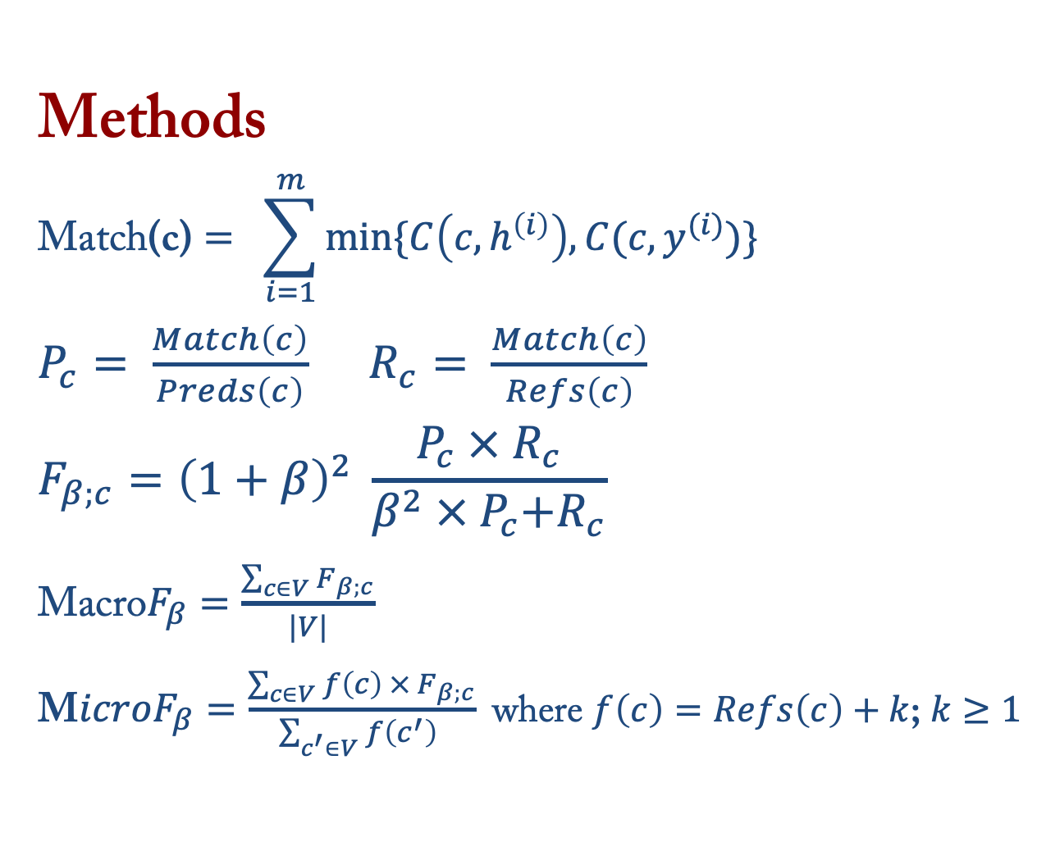
Macro-average: Rare Types Are Important Too
Information Sciences Institute
Thamme Gowda
Weiqiu You
Constantine Lignos
Jonathan May
Introduction:
Natural language types are imbalanced
A few types are frequent ⇒ less information content
Most types are rare ⇒ more information content
Current eval metrics do not address imbalance
MacroF measure is used for classifier evaluation on imbalanced test sets; we apply MacroF for machine translation evaluation
MacroF shows differences in quality of supervised and unsupervised NMT in a way BLEU cannot
Justification
Direct assessment : WebNLG , WMT Metrics Task
Downstream task performance indication
SNMT vs UNMT Quality Diff
Methods
$$\text{Match}\text{(}\text{c}\text{)}= \sum_{i=1}^{m}{min⁡\{C\left(c, h^{\left(i\right)}\right), C(c, y^{(i)})}\}$$
$P_{c}= \frac{Match\left(c\right)}{Preds\left(c\right)}$ $R_{c}= \frac{Match\left(c\right)}{Refs\left(c\right)}$
$$F_{β;c}={\left(1+β\right)}^{2} \frac{P_{c} × R_{c}}{β^{2} ×{ P}_{c}+R_{c}}$$
$\text{Macro}F_{β}=\frac{\sum_{c∈V}{F_{β;c}}}{|V|}$
$\text{M}icroF_{β}=\frac{\sum_{c∈V}{f\left(c\right) × F_{β;c}}}{\sum_{c^{′}∈V}{f\left(c^{′}\right) }}$ where $f\left(c\right)=Refs\left(c\right)+k$; $k≥1$
MacroF1 is a poor indicator of fluency and grammar; but a strong indicator of semantics; These results are based on English only.
Frequent Types: UNMT > SNMT
Rare Types: SNMT > UNMT
MacroF1 has highest number of wins in the recent year when most systems are fluent, and adequacy is the key discriminating factor.
*BLEU is precomputed values in metrics package. MacroF1, MicroF1 share the same tokenizer as BLEU, obtained using SacreBLEU
* Only the top 500 types are shown here
Manual Analysis:
Untranslation and truncation are heavily penalized by MacroF1 than BLEU
Conclusion
MacroF1 is a strong indicator of semantics; competitive on direct assessments and outperforms others on a downstream CLIR task
MacroF1 is easily computable and interpretable, does not appear to have uncontrollable biases resulting from data (unlike model-based metrics)
Macro-averaged evaluation is a useful technique for addressing the importance of long tail of language
CLIR Pipeline
MacroF1 outperforms others while indicating downstream task performance.
Usage
$ pip install git+https://github.com:isi-nlp/sacrebleu.git
$ sacrebleu $REF -m macrof microf < $HYP.detok
$ sacrebleu $REF -m macrof --report report.txt < $HYP.detok

