Slide 1
Macro-Average: Rare Types Are Important Too
Thamme Gowda
Information Sciences Institute
University of Southern California
tg@isi.edu
Weiqiu You
Dept of Computer and Information Science
University of Pennsylvania
weiqiuy@seas.upenn.edu
Constantine Lignos
Michtom School of Computer Science
Brandeis University
lignos@brandeis.edu
Jonathan May
Information Sciences Institute
University of Southern California
jonmay@isi.edu
Presented at NAACL 2021

Slide 2
Zipfian Distribution
Term frequencies from Brown Corpus; ~1M tokens, ~50K types
Imbalanced types
Notes:
Let’s start with something we all know Types in all languages follow Zipfian distribution
Some type are extremely frequent; most types are rare. We have data imbalance

Slide 3
Motivation
Imbalanced types
Machine learning techniques suffer from class imbalance
Favor the frequent types out-of-the-box
Rare types are important [“Last words”, Steedman, 2008]
“Extra care” is needed to favor the rare types
During modeling (recent: Gowda & May, 2020)
During evaluation (this work)
Based on term frequencies from Brown Corpus; ~1M tokens, ~50K types
- log₂ P(x)
P(x)
Notes:
We have imbalanced types
ML techniques we use (say classifiers), they suffer from data imbalance and scarcity
If frequent types are the ones we care, then we are in luck..
But the rare types are important
So, we need extra care while applying ML on this distribution
In our past work, we showed how certain hyper params such as BPE vocabulary influence imbalance, and showed frequency based biases that exist in NMT models
In this work, we focus on evaluation

Slide 4
Overview
Evaluate MT on imbalanced data using MacroF1
Justification for MacroF1:
Direct human assessment
Downstream task: cross-lingual IR
Qualitative differences between Supervised and Unsupervised NMT: Disagreement between BLEU and MacroF1
Notes:
With this background and motivation, here is an overview of whats coming in the next few minutes
First, we describe how to evaluate MT as a multi-class classifier on imbalanced tests.
Then we justify the use of MacroF1 eval metric
AT last, we'd show some interesting patterns between how the quality in Supervised and Unsupervised NMT differ. Notably the way BLEU says they are about same quality, but MacroF1 says "Nooo one is clearly better than other"

Slide 5
Evaluating MT as a Multi-class Classifier on Imbalanced Test Sets

Slide 6
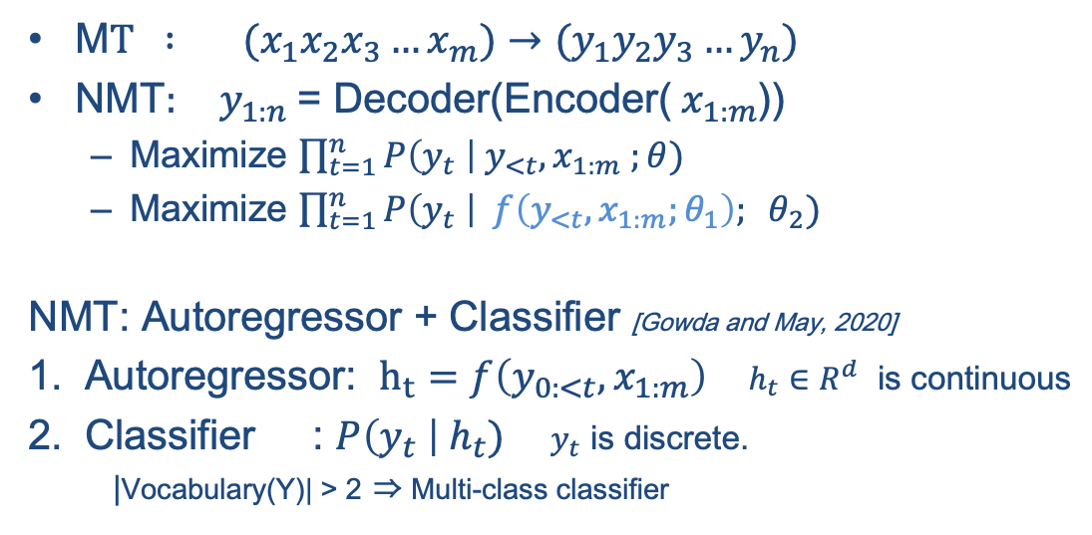
NMT as Classifier
M$T : (x_{1}x_{2}x_{3}…x_{m})→{(y}_{1}y_{2}y_{3}…y_{n})$
$\text{NMT}: y_{1:n}$= Decoder(Encoder(${ x}_{1:m}$))
Maximize $\prod_{t=1}^{n}{P\left(y_{t} \right| y_{<t}, x_{1:m} ;θ)}$
Maximize $\prod_{t=1}^{n}{P\left(y_{t} \right| f\left(y_{<t}, x_{1:m};θ_{1}\right); θ_{2})}$
NMT: Autoregressor + Classifier [Gowda and May, 2020]
Autoregressor: $h_{t}=f\left(y_{0:<t}, x_{1:m}\right)$ $h_{t}∈R^{d}$ is continuous
Classifier : $P\left(y_{t} \right|{ h}_{t})$ $y_{t}$ is discrete. |Vocabulary(Y)| > 2 ⇒ Multi-class classifier
Notes:
Machine Translation, i.e. translation of a sequence of tokens into another
NMT is often seen as Encoder-Decoder networks In our recent work, we proposed to view NMT as Autoregressor and Classifier Classifiers model P(Y | input), it is the last layer in NMT. Our output is a discrete distribution over vocabulary.. All the bottom layers can be abstracted as an autoregressor Autoregressor is internal, we dont evaluate it directly. What we directly evaluate is the last layer, which is a classifier

Slide 7
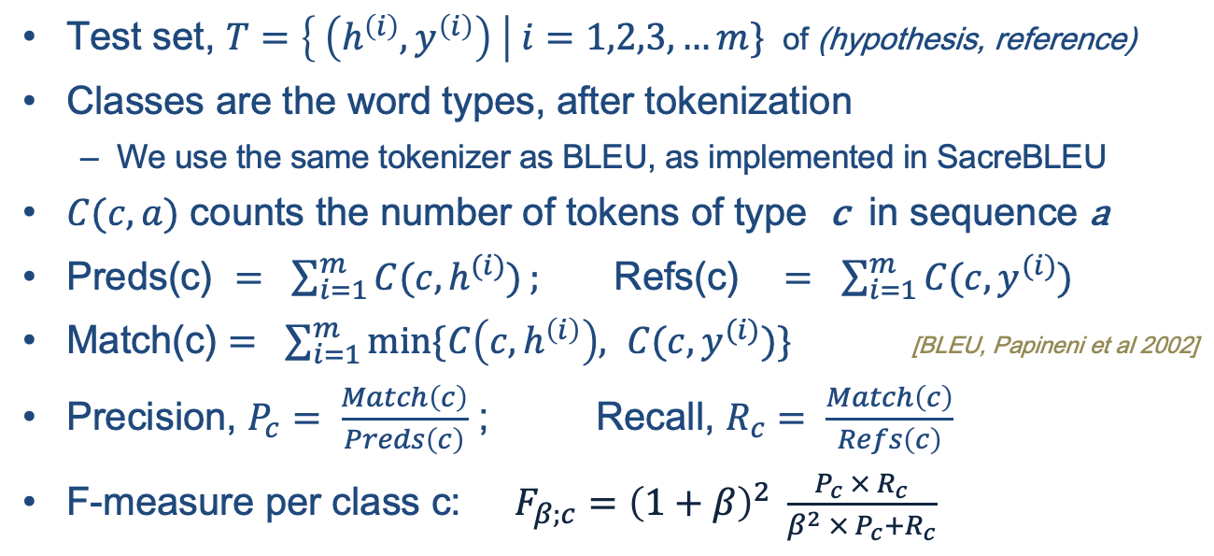
Class Performance
Test set, $T=\left\{ \left(h^{\left(i\right)},y^{\left(i\right)}\right) \right| i=1,2,3, …m\}$ of (hypothesis, reference)
Classes are the word types, after tokenization
We use the same tokenizer as BLEU, as implemented in SacreBLEU
$C(c, a)$ counts the number of tokens of type c in sequence a
$\text{Preds}\text{(}\text{c}\text{) }= \sum_{i=1}^{m}{C(c, h^{(i)})}; \text{Refs}\text{(}\text{c}\text{)} = \sum_{i=1}^{m}{C(c, y^{(i)})}$
$\text{Match}\text{(}\text{c}\text{)}= \sum_{i=1}^{m}{min⁡\{C\left(c, h^{\left(i\right)}\right), C(c, y^{(i)})}\}$ [BLEU, Papineni et al 2002]
Precision, $P_{c}= \frac{Match\left(c\right)}{Preds\left(c\right)}$ ; Recall, $R_{c}= \frac{Match\left(c\right)}{Refs\left(c\right)}$
F-measure per class c: $F_{β;c}={\left(1+β\right)}^{2} \frac{P_{c} × R_{c}}{β^{2} ×{ P}_{c}+R_{c}}$
Notes:
How do we evaluate Classifiers?
We take a test set,
tokenize it -- word types are our classes
Similar to BLEU, we compute match based on predictions, references, and common
Then we compute Precision, the same way as BLEU.. But the difference here is BLEU computes one precision for all unigrams, it doesn't compute precision for each class or type, e.g. it doesnt tell whats the precision for type ‘the’ , but we do... we compute for each type from reference and hypothesis Similarly, we compute recall for each type
And then F-measure for each type
We are all doing this for evaluating classifiers

Slide 8
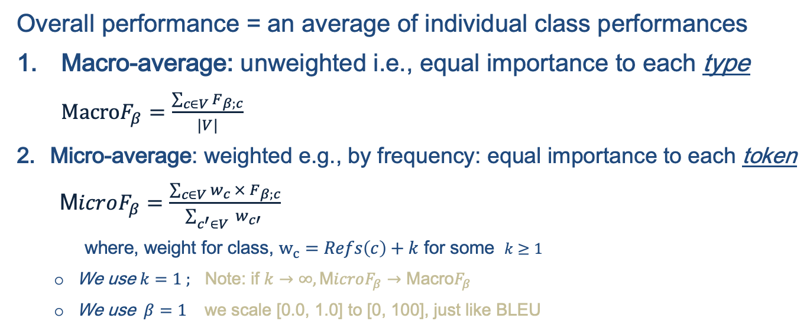
Multiclass Classifier Performance
Overall performance = an average of individual class performances
Macro-average: unweighted i.e., equal importance to each type $\text{Macro}F_{β}=\frac{\sum_{c∈V}{F_{β;c}}}{|V|}$
Micro-average: weighted e.g., by frequency: equal importance to each token $\text{M}icroF_{β}=\frac{\sum_{c∈V}{w_{c} × F_{β;c}}}{\sum_{c^{′}∈V}{ w_{c′} }}$
where, weight for class, $w_{c}=Refs\left(c\right)+k$ for some $k≥1$
We use $k=1 ;$ Note: if $k→∞, \text{M}icroF_{β}→\text{Macro}F_{β}$
We use $β=1$ we scale [0.0, 1.0] to [0, 100], just like BLEU
Notes:
So far, we have F-measure for each type, how do we summarize it to a single number?
We take an average over all types – but how do we average, this is where crucial detail is
We have two options:
First, an unweighted average aka macro average, in this case, we assign equal weight to each type.
Second, we have weighted average aka micro average. In this case, we pick frequencies in the reference side as weight... that's roughly equivalent to treating each token equally.
BLEU, for instance is precision metric -- what kind of precision ? it is Micro-averaged precision

Slide 9
Justification for MacroF1 as an MT evaluation metric
Compare MacroF1 with
BLEU and ChrF1 – popular options
MicroF1 – so we can see the difference micro and macro avg makes
BLEURT – model-based metric based on BERT
* BLEURT has undesirable biases, shown in paper (not talking about here)
Notes:
Will this simple metric work for MT evaluation? We shall do a comparison

Slide 10
MacroF1 vs Others
Frequency Imbalance
Equal weight
WMT 19 DE-EN NewsTest: MacroF1 has equal weight for all types
Micro-averaged metrics overlook improvements from rare types, after rounding to one or two decimals
Notes:
Before we go into details, here is how macro-average is different than the rest. What are we visualizing here ? We replaced types with an OOV type of same number of chars (same chars so length penalty is not in effect), and computed the drop in corpus level score. That’s a proxy for maximum reward a metric offer for correctly learning to translate a type.
Also showing frequencies in the blue line in top. we see --
MicroF1 treats each token equally – so MicroF1 in purple is roughly resembling the shape of frequency
MacroF1 assigns equal weight to each type – so we see a horizontal line in orange.
BLEU and CHRF are more like MicroF than MacroF. They have spikes and surges because of different number n-grams affected by each type. BLEURT scores are not in an interpretable range. So not shown here.
The takeaway is -- the reward from micro-averaged metrics for rare words is in two to three decimal points
Since we generally round the corpus score to just one decimal point, there is a good chance that gain from rare types are easily overlooked

Slide 11
WebNLG Data-to-Text Evaluation
Correlation with Fluency, Grammar, and Semantics on English only
MacroF1 is a poor indicator of Fluency + Grammar, but one of the strong indicators of Semantics

Slide 12
WMT Metrics: Wins per Metric
Wins = Number of times a metric scored highest correlation with human judgements
*BLEU is from the WMT metrics package, precomputed by task organizers
MacroF1 and MicroF1 use the same tokenizer as BLEU, obtained using SacreBLEU
MacroF1 has more wins in the recent year -- when systems are mostly fluent, adequacy is a key discriminator
Notes:
*BLEU is from the metrics package, precomputed by task organizers
BLEU is our own calculations. MacroF1 and MicroF1 share the same tokenizer as BLEU

Slide 13
Downstream CLIR Task (CLSSTS 2020)
IR task with queries and docs in different languages
Translate source docs to target language, and match queries with docs
MT metric having strong correlation with IR metric (e.g. mAP) is more useful
MacroF1 is the strongest indicator of downstream IR task performance
Notes:
About mAP: https://blog.paperspace.com/mean-average-precision/

Slide 14
Qualitative Difference Between Supervised and Unsupervised NMT

Slide 15
SNMT vs UNMT: BLEU and MacroF1
In terms of BLEU, UNMT and SNMT performance is comparable*, but MacroF1 shows significant differences between SNMT ​and UNMT
* SNMT systems were chosen to match BLEU scores with UNMT
Notes:
For one SNMT and one UNMT system that have similar BLEU score, their Macro F1 score differ on 5 out of 6 languages. In all the languages, SNMT systems have better MacroF1 scores than UNMT systems.​
​
Unsupervised neural machine translation systems trained on massive monolingual data without parallel corpora have made significant progress recently. We are then interested in the question that when an unsupervised neural machine translation system (which we refer to as UNMT) and a supervised neural machine translation system (which we refer to as SNMT) have the same BLEU score, are there any qualitative differences that set them apart. Here we select such systems in three language pairs, and to our surprise, MacroF1 alone already shows the differences. Despite having similar BLEU scores, SNMT systems always have better MacroF1 scores than their UNMT counterparts.​

Slide 16
SNMT vs UNMT: DE-EN
Frequent Types: UNMT > SNMT
Rare Types: SNMT > UNMT
* Only the top 500 types are shown here

Slide 17
SNMT and UNMT
E.g.1: MacroF1 is more intolerant to untranslation than BLEU
 | MacroF1 diff: 0.044, favors SNMT; BLEU diff: -0.00087, favors UNMT
Src | "Er ist witzig, er ist sarkastisch, witzig, er liebt es, Leute zu unterhalten, und er ist ein großartiger Kerl, den er im Teamraum haben kann", erklärte er.
Ref | "He's funny, he's sarcastic, witty, likes to poke fun at people, and he's a great guy to have in the team room," he explained.
SNMT | "He is funny, he is sarcastic, funny, he loves to talk people, and he is a great guy he can have in the team room," he explained
UNMT | "He's funny, he's sly, funny, he loves to unterhalten people, and he's a great guy he can have in the team room," he explained.
Problems | SNMT: punctuation, wrong_verb. UNMT: synonym, untranslation
Notes:
MacroF1 is more against untranslation than BLEU
In this example, "unterhalten" means "to chat", which is translated to "to talk" using SNMT, but is not translated but just copied with UNMT. MacroF1 correctly favors SNMT's translation which does not have untranslation, while BLEU favors UNMT's.

Slide 18
SNMT and UNMT
E.g. 2 MacroF1 is more intolerant to truncation than BLEU
 | MacroF1 diff: 0.044, favors SNMT; BLEU diff: -0.00087, favors UNMT
Src | Vor 32 Jahren schloss ich mich als Schüler, wegen der Vernachlässigung der Thatcher-Regierung, Labour an. Diese Vernachlässigung hatte dazu geführt, dass mein Klassenzimmer buchstäblich zusammengebrochen war. Infolgedessen habe ich versucht, mich für bessere öffentliche Dienstleistungen für diejenigen einzusetzen, die sie am meisten brauchen. Egal ob als Gemeinderat oder Minister.
Ref | Ever since I joined Labour 32 years ago as a school pupil, provoked by the Thatcher government‘s neglect that had left my comprehensive school classroom literally falling down, I’ve sought to champion better public services for those who need them most whether as a local councillor or government minister.
SNMT | 32 years ago, I joined Labour as a student because of the neglect of the Thatcher government, which had led to my classroom literally collapsed, and as a result I tried to promote better public services for those who need it most, whether as a local council or ministers.
UNMT | Last 32 years ago, as a student, because of the disdain for the Thatcher-era government, Labour joined Labour.
Problems | SNMT: synonym, word_order UNMT: subject, truncation, word_order
Notes:
MacroF1 is more against truncation than BLEU.
Another problem is trucation. In this other example, there is a large chunk of text, highlighted here, translated in the reference and by SNMT, but UNMT just only translates the first half of the sentence. MacroF1 correctly favors SNMT's translation without truncation, while BLEU favors UNMT's truncated version.

Slide 19
Summary
MT evaluation as multiclass classifier on imbalanced test set
Justified MacroF1 as a legitimate eval metric
Direct assessment: WebNLG, and WMT [2017-19]
Downstream task: Cross lingual information retrieval
SNMT vs UNMT qualitative differences

Slide 20
References
Mark Steedman. 2008. On Becoming a Discipline. Computational Linguistics 34, 1 (2008), 137–144. https://doi.org/10. 1162/coli.2008.34.1.137 arXiv: https://doi.org/10.1162/coli.2008.34.1.137
Gowda, Thamme, and Jonathan May. "Finding the Optimal Vocabulary Size for Neural Machine Translation." Proceedings of the 2020 Conference on Empirical Methods in Natural Language Processing: Findings. 2020.
Rico Sennrich, Barry Haddow, and Alexandra Birch. 2016. Neural Machine Translation of Rare Words with Subword Units. In Proceedings of the 54th Annual Meeting of the Association for Computational Linguistics (Volume 1: Long Papers). Association for Computational Linguistics, Berlin, Germany, 1715–1725. https://doi.org/10.18653/v1/P16-1162
Kishore Papineni, Salim Roukos, Todd Ward, and Wei-Jing Zhu. 2002. BLEU: a Method for Automatic Evaluation of Machine Translation. In Proceedings of the 40th Annual Meeting of the Association for Computational Linguistics. Association for Computational Linguistics, Philadelphia, Pennsylvania, USA, 311–318. https://doi.org/10.3115/1073083. 1073135
Maja Popović. 2015. ChrF: character n-gram F-score for automatic MT evaluation. In Proceedings of the Tenth Workshop on Statistical Machine Translation. Association for Computational Linguistics, Lisbon, Portugal, 392–395. https: //doi.org/10.18653/v1/W15-3049
Thibault Sellam, Dipanjan Das, and Ankur Parikh. 2020. BLEURT: Learning Robust Metrics for Text Generation. In Proceedings of the 58th Annual Meeting of the Association for Computational Linguistics. Association for Computational Linguistics, Online, 7881–7892. https://www.aclweb.org/anthology/2020.acl-main.704
Ilya Zavorin, Aric Bills, Cassian Corey, Michelle Morrison, Audrey Tong, and Richard Tong. 2020. Corpora for Cross-Language Information Retrieval in Six Less-Resourced Languages. In Proceedings of the workshop on Cross-Language Search and Summarization of Text and Speech (CLSSTS2020). European Language Resources Association, Marseille, France, 7–13. https://www.aclweb.org/anthology/2020.clssts-1.2

Slide 21
THANK YOU 🙏🏼
Fork of SacreBLEU: https://github.com/isi-nlp/sacrebleu
Pull request is under review: https://github.com/mjpost/sacrebleu/pull/153

Slide 22
Downstream CLIR Task: Pipeline
IR task with queries, docs in different languages
Build a set of MT models; translate all source docs to the target language ➔ MT metric(s)
For each MT model’s translations, build an IR model, and measure IR metrics
Find the correlation between the set of MT scores and IR scores. MT metric having strongest correlation with IR metric(s) is more useful than others.
Repeat this on many languages: LT-EN, PS-EN, BG-EN from Cross-Language Search and Summarization of Text and Speech (CLSSTS) 2020
Source Docs
Source -> English
Machine Translation
Source -> English Human Translation
Translated Docs (English)
MT Metric
Queries
(English)
IR System
MT score
Query x Doc Rankings by IR
Query x Doc
by Humans
IR Metric
IR score
Correlation
Notes:
Cross-Language Search and Summarization of Text and Speech (CLSSTS) 2020

Slide 23
Usage
Fork of SacreBLEU: https://github.com/isi-nlp/sacrebleu
Pull request is under review: https://github.com/mjpost/sacrebleu/pull/153
Easy to use / familiar interface: sacrebleu $REF -m bleu macrof microf < $HYP
Get a detailed report: precision, recall, and F-measure for each type
sacrebleu $REF -m macrof --report report.txt < $HYP

Slide 24
Justification for MacroF1
Direct assessment: correlation with human judgements
WebNLG data-to-text task
Workshop on Machine Translation (WMT) Metrics 2017-2019
Downstream task: correlation with cross-lingual information retrieval (CLIR) performance
Notes:
Cross-Language Search and Summarization of Text and Speech http://users.umiacs.umd.edu/~oard/clssts/

Slide 25
Zipfian Distribution
Term frequencies from Brown Corpus
Imbalanced types
Discrete distribution
Severely imbalanced
Notes:
Zooming in, 1. We see its a discrete distribution. ML models used for discrete distributions are called classifiers. We will go deeper into this in a while
2. Its severely imbalanced. The log scale on Y axis might make it less severe, if we go to linear scale, then we see severe imbalance. (See the top 50 types shown)

Slide 26
SNMT and UNMT: Favoritism
Manual analysis of top 10 sentences with most magnitude of favoritism in SNMT or UNMT as per MacroF1 and BLEU
MacroF1 is more intolerant to untranslation than BLEU​
MacroF1 is more tolerant to synonyms and word order differences than BLEU​
Notes:
1. MacroF1 is more against untranslation than BLEU​
2. MacroF1 is more tolerant of synonyms and word order than BLEU​
​
If we look at the top 10 sentences that have the more differences in UNMT and SNMT scores according to MacroF1 and BLEU, we can see that MacroF1 takes more points off translations that have untranslations. On the other hand, BLEU punishes more translations that use synonyms or have different word order comparing to the references, which MacroF1 is more tolerant of.​

Slide 27
Source Docs
Source -> English
Machine Translation
Source -> English Human Translation
Translated Docs (English)
MT Metric
Queries
(English)
IR System
MT score
Query x Doc Rankings by IR
Query x Doc
by Humans
IR Metric
IR score
Correlation

Slide 28
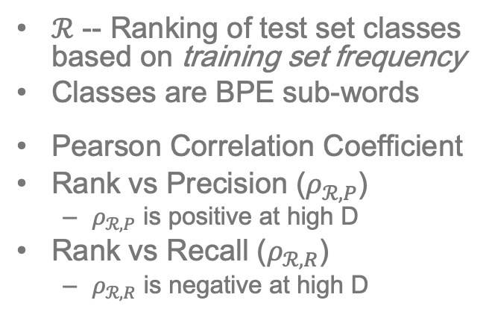
Frequency-based Bias on Class Performance
$ℛ$ -- Ranking of test set classes based on training set frequency
Classes are BPE sub-words
Pearson Correlation Coefficient
Rank vs Precision ($ρ_{ℛ,P}$)
$ρ_{ℛ,P}$ is positive at high D
Rank vs Recall ($ρ_{ℛ,R}$)
$ρ_{ℛ,R}$ is negative at high D

Slide 29
MT Evaluation
Reference: | You must be a doctor.
Hypothesis: | ______ must be a doctor.
 | He | -0.74
 | Joe | -0.98
 | Sue | -1.04
 | She | -1.10
Reference: | It is the greatest country in the world.
Hypothesis: | ______ is the greatest country in the world.
 | France | -0.02
 | America | -0.06
 | Russia | -0.16
 | Canada | -0.31
BLEU
TER
ChrF1
….
METEOR
BEER
YiSi
BLEURT ….
Demo of BLEURT’s internal biases.
Model-free metrics have overlooked the “imbalanced” part. Model-based metrics are expensive, opaque and biased. Q3: Can we evaluate MT as classifier on imbalanced test set?

Slide 30
WMT Metrics

Slide 31
CLIR Task, CLSSTS Datasets, AQWV

Slide 32
CLIR Task: CLSSTS

