Slide 1
Neural Machine Translation with Imbalanced Classes (Ph.D. Qualifier Exam)
Thamme “TG” Gowda
tg@isi.edu / tnarayan@usc.edu

Slide 2
Background: Zipfian Distribution
Term frequencies from Brown Corpus; ~1M tokens, ~50K types
Imbalanced types
Notes:
In NLP, Types in all languages follow Zipfian distribution
Some type are frequent; most types are rare. 1 count. And even zero count

Slide 3
Background: Zipfian Distribution
Term frequencies from Brown Corpus
Imbalanced types
Discrete Variable
Notes:
If we were to apply ML techniques to model a RV, we are going to have discrete random variable

Slide 4
Background: Information Content
Based on term frequencies from Brown Corpus; ~1M tokens, ~50K types
Imbalanced types
Rare types are important [Steedman, 2008]
Machine learning techniques need “extra care”
During modeling
During evaluation
log₂ 1/P(x)
P(x)
Notes:
More ever, our situation is that rare types contain more information than frequent types
Much of probability mass is on the left side. So if you were to count performance in terms of tokens we handled correctly, then you are in luck! We could focus on a few 1000 frequent types and we get a working system, which we evaluated using token based metrics
But… much of information content is on the low frequency side. ML techniques we use today are pretty bad for this kind of setup.

Slide 5
Overview
Cast NMT as a multi-class classifier
Effect of class imbalance on modeling
BPE vocabulary size
Frequency based bias
Effect of class imbalance on evaluation
Evaluation of MT as a multi-class classifier
Justification to support this

Slide 6
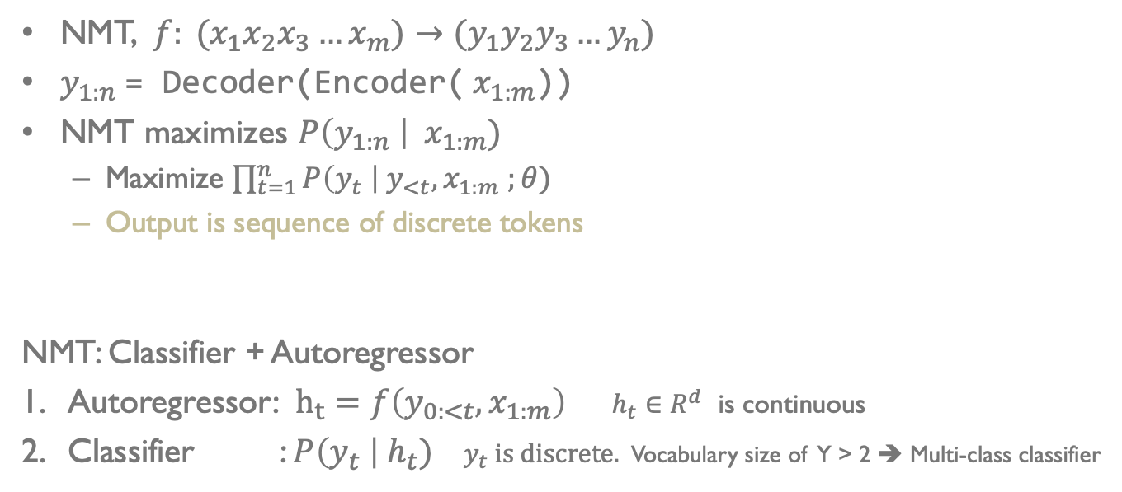
NMT as Classifier
NMT, $f: (x_{1}x_{2}x_{3}…x_{m})→{(y}_{1}y_{2}y_{3}…y_{n})$
$y_{1:n}$= Decoder(Encoder(${ x}_{1:m}$))
NMT maximizes $P\left(y_{1:n} \right| { x}_{1:m})$
Maximize $\prod_{t=1}^{n}{P\left(y_{t} \right| y_{<t}, x_{1:m} ;θ)}$
Output is sequence of discrete tokens
NMT: Classifier + Autoregressor
Autoregressor: $h_{t}=f\left(y_{0:<t}, x_{1:m}\right)$ $h_{t}∈R^{d}$ is continuous
Classifier : $P\left(y_{t} \right|{ h}_{t})$ $y_{t}$ is discrete. Vocabulary size of Y > 2 ➔ Multi-class classifier
Notes:
$y_{o}=[BOS]$; for $t=1, 2… argmax P\left(y_{t}| h_{t}\right)=[EOS]$

Slide 7
Effect of Imbalance on NMT Modeling

Slide 8
Classifiers on Imbalanced Distributions
Frequency based bias degrades performance
Over-classify majority classes, under-classify minority …
Addressing the class imbalance improves performance
Data sampling and augmentation techniques
e.g. Oversampling, Undersampling, Synthetic Minority Oversampling Technique (SMOTE), …
Weighted loss functions, …
In NMT, sampling is hard. But we have BPE for our advantage

Slide 9
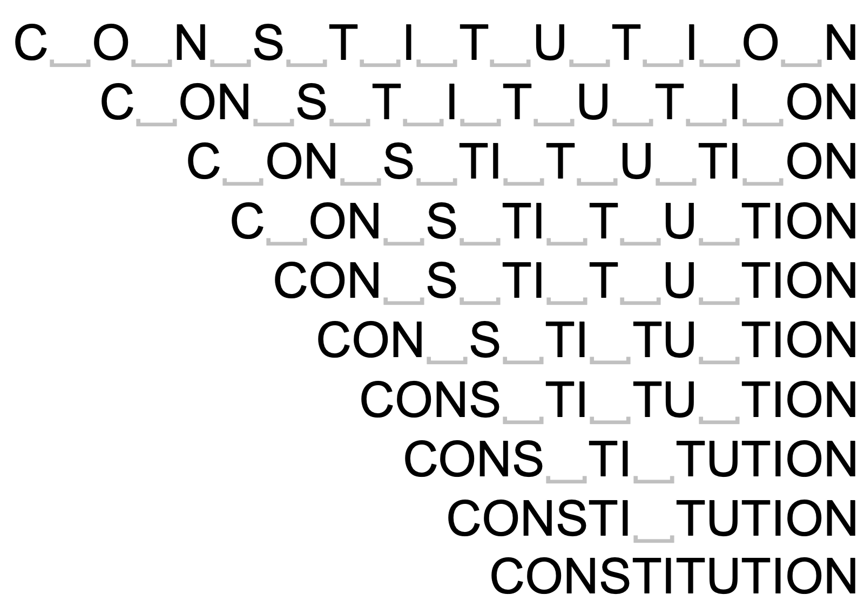
BPE Subwords
Split/merge classes; modifies class distribution
Byte-pair-encoding subwords [Sennrich et al 2016] addresses open-vocabulary generation
Subwords are obtained by merging chars gets better performance than chars and words
Number of merges is a hyper parameter
Why are some vocabulary sizes better than others?

Slide 10
Experiments
Four target languages: DE→EN, EN→DE, EN→HI, and EN→LI
Total of 11 dataset sizes: between 30K and 4.5M sentences
x10 vocabulary sizes: Chars, 500, 1K, 2K, 4K, 8K, 16K, 32K, 48K, and 64K
Transformer with 6 Layers, 512 Dim, 8 Heads, 0.1 Dropout, …
16,000 warmup steps followed by inverted sqrt decay; training stops when the validation loss start to climb up
Beam decoder, length penalty, checkpoint averaging …
Separate vocabs for source and target Decoder’s input and output embeddings are tied

Slide 14
Effect of Imbalance on NMT Modeling
Some BPE vocabulary sizes better than others (Explanation >> )

Slide 15
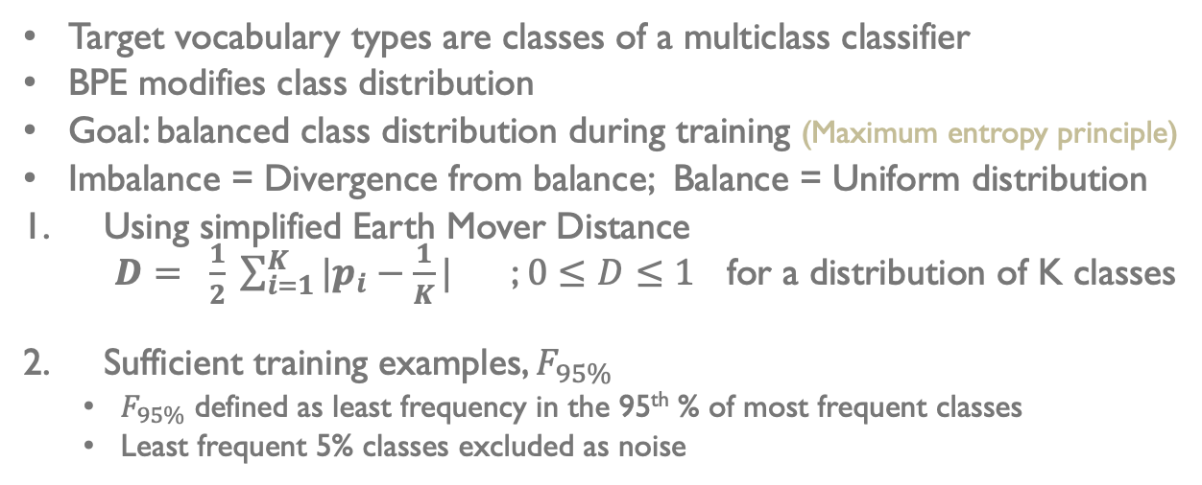
Classifier (C)
Target vocabulary types are classes of a multiclass classifier
BPE modifies class distribution
Goal: balanced class distribution during training (Maximum entropy principle)
Imbalance = Divergence from balance; Balance = Uniform distribution
Using simplified Earth Mover Distance $D= \frac{1}{2} \sum_{i=1}^{K}{|p_{i}−\frac{1}{K}|}$ ; $0≤D≤1$ for a distribution of K classes
Sufficient training examples, $F_{95\%}$
$F_{95\%}$ defined as least frequency in the 95th % of most frequent classes
Least frequent 5% classes excluded as noise

Slide 16
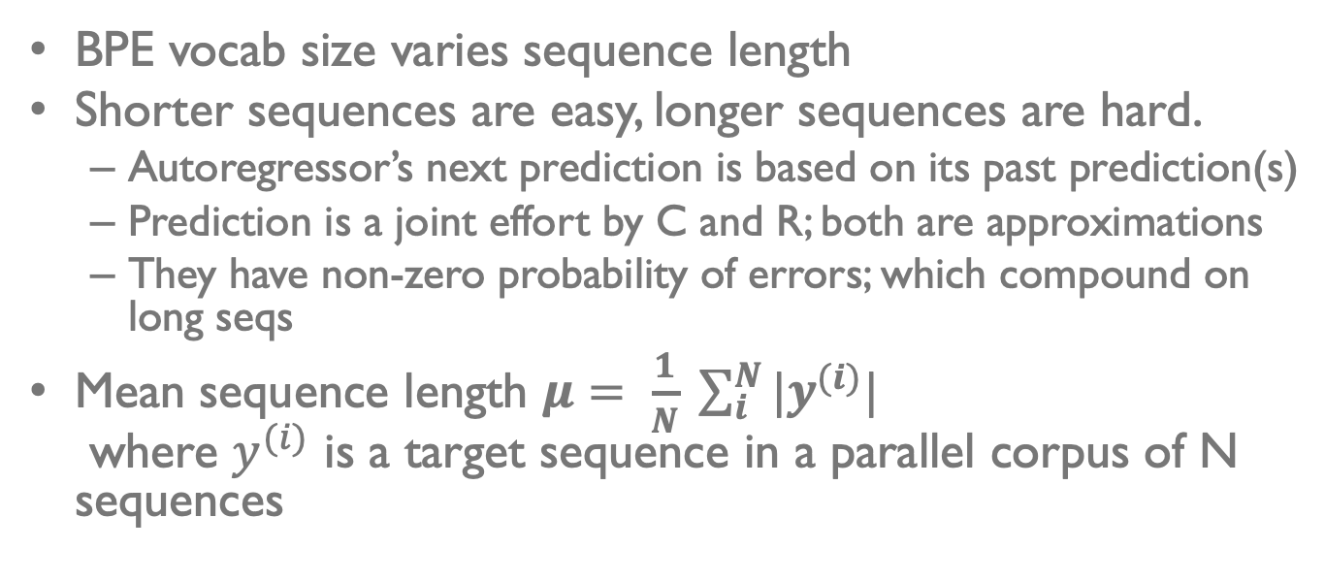
AutoRegressor (R)
BPE vocab size varies sequence length
Shorter sequences are easy, longer sequences are hard.
Autoregressor’s next prediction is based on its past prediction(s)
Prediction is a joint effort by C and R; both are approximations
They have non-zero probability of errors; which compound on long seqs
Mean sequence length $μ= \frac{1}{N} \sum_{i}^{N}{{|y}^{(i)}|}$ where $y^{(i)}$ is a target sequence in a parallel corpus of N sequences

Slide 17
Effect of BPE
As BPE merge operations increase
Sentence length decreases
Class imbalance increases
Need both length and divergence to be small
Best vocab size is the one that reaches a good trade-off

Slide 18
Heuristic
“Use the largest possible BPE vocabulary such that at least 95% of classes have about 100 or more training examples”

Slide 19
Effect of Imbalance on NMT Modeling
Some BPE vocabulary sizes better than others
Frequency-based bias on classes i.e. correlation between class frequency and performance

Slide 20
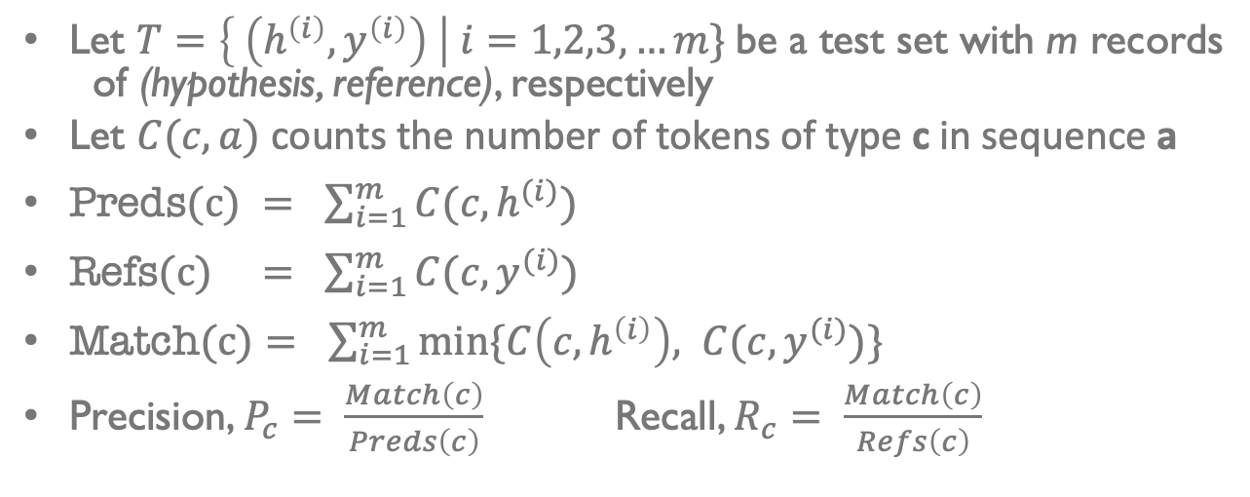
Class Performance
Let $T=\left\{ \left(h^{\left(i\right)},y^{\left(i\right)}\right) \right| i=1,2,3, …m\}$be a test set with m records of (hypothesis, reference), respectively
Let $C(c, a)$ counts the number of tokens of type c in sequence a
$\text{Preds}\text{(}\text{c}\text{) }= \sum_{i=1}^{m}{C(c, h^{(i)})}$
$\text{Refs}\text{(}\text{c}\text{)} = \sum_{i=1}^{m}{C(c, y^{(i)})}$
$\text{Match}\text{(}\text{c}\text{)}= \sum_{i=1}^{m}{min⁡\{C\left(c, h^{\left(i\right)}\right), C(c, y^{(i)})}\}$
Precision, $P_{c}= \frac{Match\left(c\right)}{Preds\left(c\right)}$ Recall, $R_{c}= \frac{Match\left(c\right)}{Refs\left(c\right)}$

Slide 21
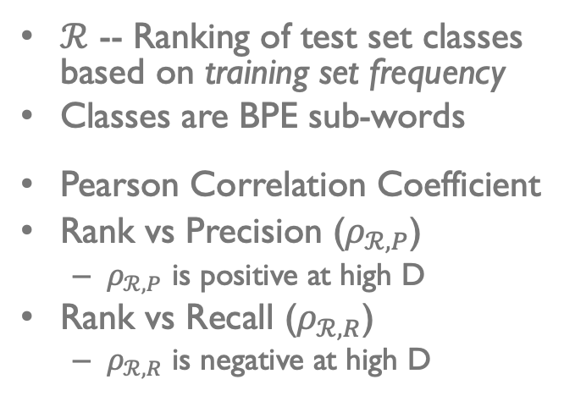
Frequency-based Bias on Class Performance
$ℛ$ -- Ranking of test set classes based on training set frequency
Classes are BPE sub-words
Pearson Correlation Coefficient
Rank vs Precision ($ρ_{ℛ,P}$)
$ρ_{ℛ,P}$ is positive at high D
Rank vs Recall ($ρ_{ℛ,R}$)
$ρ_{ℛ,R}$ is negative at high D

Slide 22
Evaluating MT as a Multi-class Classifier on Imbalanced Test Sets

Slide 23
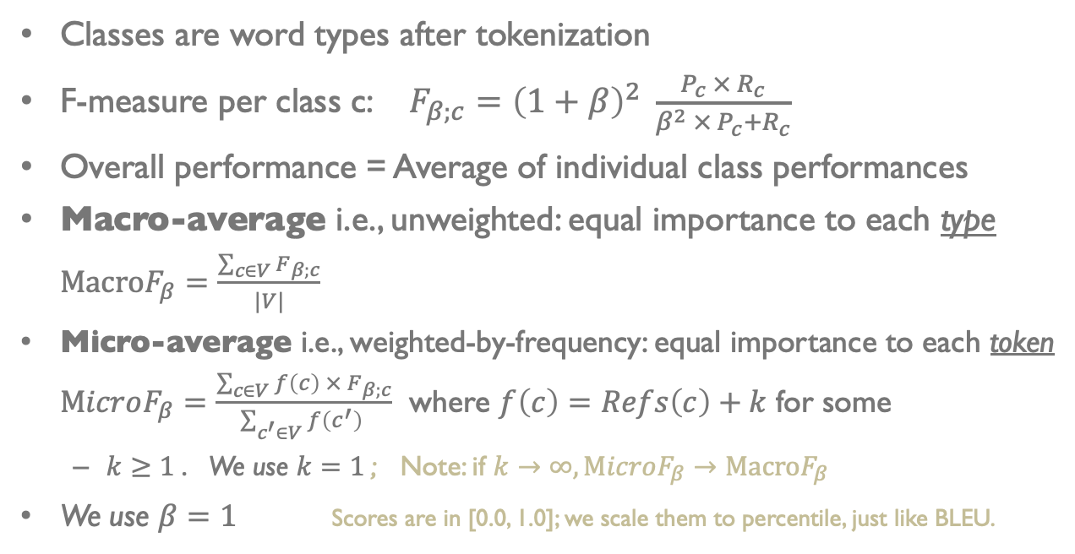
Evaluating MT as a Multiclass Classifier
Classes are word types after tokenization
F-measure per class c: $F_{β;c}={\left(1+β\right)}^{2} \frac{P_{c} × R_{c}}{β^{2} ×{ P}_{c}+R_{c}}$
Overall performance = Average of individual class performances
Macro-average i.e., unweighted: equal importance to each type $\text{Macro}F_{β}=\frac{\sum_{c∈V}{F_{β;c}}}{|V|}$
Micro-average i.e., weighted-by-frequency: equal importance to each token $\text{M}icroF_{β}=\frac{\sum_{c∈V}{f\left(c\right) × F_{β;c}}}{\sum_{c^{′}∈V}{f\left(c^{′}\right) }}$ where $f\left(c\right)=Refs\left(c\right)+k$ for some
$k≥1$. We use $k=1$; Note: if $k→∞, \text{M}icroF_{β}→\text{Macro}F_{β}$
We use $β=1$ Scores are in [0.0, 1.0]; we scale them to percentile, just like BLEU.

Slide 24
Justification for MacroF1
Macro-F1 is commonly used for evaluating classifiers on imbalanced test sets
Compare MacroF1 with MicroF1, BLEU, ChrF1, and BLEURT
MicroF1, BLEU, and ChrF1 are micro-averaged metrics BLEURT is BERT model finetuned to predict human judgement score
WebNLG data-to-text Task: Correlation with Fluency, Grammar, and Semantics; on English only
WMT Metrics Task 2017-2019 Correlation with direct human assessments on tens of languages
Workshop on CLSSTS 2020 Correlation with downstream CLIR task performance on LT-EN, PS-EN, BG-EN
Notes:
Cross-Language Search and Summarization of Text and Speech http://users.umiacs.umd.edu/~oard/clssts/

Slide 25
WebNLG Data-to-Text Evaluation

Slide 26
WMT Metrics: Wins per Metric
Wins = Number of times metric scored highest correlation with human judgements
*BLEU is from the metrics package, precomputed by task organizers
BLEU is our own calculations. MacroF1 and MicroF1 share the same tokenizer as BLEU
Notes:
*BLEU is from the metrics package, precomputed by task organizers
BLEU is our own calculations. MacroF1 and MicroF1 share the same tokenizer as BLEU

Slide 27
CLIR Task: Pipeline
IR task with queries and docs in different languages
Build a set of MT models; translate all source documents to the target language, compute MT metric(s)
For each MT model’s translations, build an IR model, and measure IR metrics
Find the correlation between the set of MT scores and IR scores. The MT metric having stronger correlation with IR metric(s) is more useful than others.
Repeat this on many languages CLSSTS 2020 datasets: LT-EN, PS-EN, BG-EN
Source Docs
Source -> English
Machine Translation
Source -> English Human Translation
Translated Docs (English)
MT Metric
Queries
(English)
IR System
MT score
Query x Doc Rankings by IR
Query x Doc
by Humans
IR Metric
IR score
Correlation

Slide 28
CLIR Task, CLSSTS Datasets, mAP
Notes:
About mAP: https://blog.paperspace.com/mean-average-precision/

Slide 29
Summary
Casting NMT as multi-class classifier
Effect of class imbalance on modeling: BPE vocab size, bias
Evaluation of NMT as multi-classifier considering class imbalance

Slide 30
References
Mark Steedman. 2008. On Becoming a Discipline. Computational Linguistics 34, 1 (2008), 137–144. https://doi.org/10. 1162/coli.2008.34.1.137 arXiv: https://doi.org/10.1162/coli.2008.34.1.137
Rico Sennrich, Barry Haddow, and Alexandra Birch. 2016. Neural Machine Translation of Rare Words with Subword Units. In Proceedings of the 54th Annual Meeting of the Association for Computational Linguistics (Volume 1: Long Papers). Association for Computational Linguistics, Berlin, Germany, 1715–1725. https://doi.org/10.18653/v1/P16-1162
Kishore Papineni, Salim Roukos, Todd Ward, and Wei-Jing Zhu. 2002. BLEU: a Method for Automatic Evaluation of Machine Translation. In Proceedings of the 40th Annual Meeting of the Association for Computational Linguistics. Association for Computational Linguistics, Philadelphia, Pennsylvania, USA, 311–318. https://doi.org/10.3115/1073083. 1073135
Maja Popović. 2015. ChrF: character n-gram F-score for automatic MT evaluation. In Proceedings of the Tenth Workshop on Statistical Machine Translation. Association for Computational Linguistics, Lisbon, Portugal, 392–395. https: //doi.org/10.18653/v1/W15-3049
Thibault Sellam, Dipanjan Das, and Ankur Parikh. 2020. BLEURT: Learning Robust Metrics for Text Generation. In Proceedings of the 58th Annual Meeting of the Association for Computational Linguistics. Association for Computational Linguistics, Online, 7881–7892. https://www.aclweb.org/anthology/2020.acl-main.704
Ilya Zavorin, Aric Bills, Cassian Corey, Michelle Morrison, Audrey Tong, and Richard Tong. 2020. Corpora for Cross-Language Information Retrieval in Six Less-Resourced Languages. In Proceedings of the workshop on Cross-Language Search and Summarization of Text and Speech (CLSSTS2020). European Language Resources Association, Marseille, France, 7–13. https://www.aclweb.org/anthology/2020.clssts-1.2

Slide 31
THANK YOU 🙏🏼

Slide 32
ML Problem Types
ML problem types based on the nature of output RV
Regression: continuous variable e.g., quantities: price
Classification: discrete variable e.g., labels: cat/dog
Autoregression: Output variable depends on its own past predictions

Slide 33
Datasets
Languages | Sentences | EN, XX Toks | Train Set | Validation Set | Test Set
DE-EN EN-DE | 30K | 0.8M, 0.8M | Europarl10 + WMT13CCrawl + NewsComm14 | NewsTest18 | NewsTest19
 | 0.5M | 12.9M, 12.2M
 | 1M | 25.7M, 24.3M
 | 4.5M | 116M, 109.8M
EN-HI | 0.5M | 8M, 8.6M | IITB Train | IITB Dev | IITBTest
 | 1.3M | 21M, 22.5M
EN-LT | 0.6M | 17M, 13.4M | Europarl10 | NewsDev19 | NewsDev19
4 target languages; a total of 11 data sets x 10 vocabulary sizes

Slide 34
MT Evaluation
Reference: | You must be a doctor.
Hypothesis: | ______ must be a doctor.
 | He | -0.74
 | Joe | -0.98
 | Sue | -1.04
 | She | -1.10
Reference: | It is the greatest country in the world.
Hypothesis: | ______ is the greatest country in the world.
 | France | -0.02
 | America | -0.06
 | Russia | -0.16
 | Canada | -0.31
BLEU
TER
ChrF1
….
METEOR
BEER
YiSi
BLEURT ….
Demo of BLEURT’s internal biases.
Model-free metrics have overlooked the “imbalanced” part. Model-based metrics are expensive, opaque and biased. Q3: Can we evaluate MT as classifier on imbalanced test set?

Slide 35
WMT Metrics

Slide 36
CLIR Task: Pipeline
IR task with queries and docs in different languages
Build a set of MT models; compute MT metrics
For each MT model, translate all source documents to the target language, build an IR model, and measure IR metrics
Find the correlation between the set of MT scores and IR scores. The MT metric having stronger correlation with IR metric(s) is more useful than others.
Repeat this on many languages. We use datasets for LT-EN, PS-EN, BG-EN

Slide 37
CLIR Task, CLSSTS Datasets, AQWV

Slide 38
Heuristic: the largest possible BPE vocabulary such that at least 95% of classes have 100 or more examples in training.

Slide 39
Ignore this chart; BLEU scores are too low

Slide 41
CLIR Task: CLSSTS

