Slide 1
Neural Machine Translation with Imbalanced Classes (Ph.D. Qualifier Exam)
Thamme “TG” Gowda
tg@isi.edu / tnarayan@usc.edu

Slide 2
Background
Term frequencies from Brown Corpus; ~1M tokens, ~50K types
Zipfian distribution
Imbalanced types

Slide 3
Background
Term frequencies from Brown Corpus
Zipfian distribution
Imbalanced types
Discrete RV

Slide 4
Information Content
Term frequencies are from Brown Corpus; ~1M tokens, ~50K types
We have imbalanced types
Rare types are important [Steedman, 2008]
Machine learning techniques need “extra care”
During modeling
During evaluation
log₂ 1/P(x)
P(x)
Notes:
Much of probability mass is on the left side. So if you were to count performance in terms of tokens we handled correctly, then you are in luck! We could focus on a few 1000 frequent types and we get a working system, which we evaluated using token based metrics
But… much of information content is on the low frequency side. ML techniques we use today are pretty bad for this kind of setup.

Slide 5
Overview
Cast NMT is a multi-class classifier
Effect of class imbalance on modeling
Number of BPE merges i.e., vocabulary size
Frequency based bias
Evaluation of MT as a multi-class classifier (with consideration of test set imbalance) and justification to support this

Slide 6
Cast NMT as Classifier
ML problem types based on the nature of output RV
Regression: continuous variable e.g., quantities: price
Classification: discrete variable e.g., labels: cat/dog
Autoregression: Output variable depends on its own past predictions

Slide 7
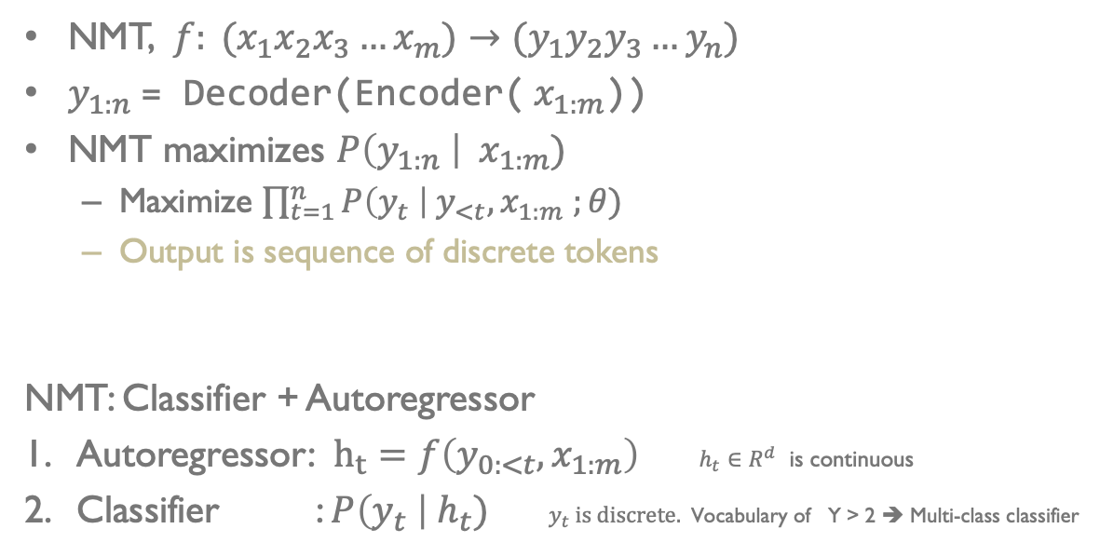
NMT as Classifier
NMT, $f: (x_{1}x_{2}x_{3}…x_{m})→{(y}_{1}y_{2}y_{3}…y_{n})$
$y_{1:n}$= Decoder(Encoder(${ x}_{1:m}$))
NMT maximizes $P\left(y_{1:n} \right| { x}_{1:m})$
Maximize $\prod_{t=1}^{n}{P\left(y_{t} \right| y_{<t}, x_{1:m} ;θ)}$
Output is sequence of discrete tokens
NMT: Classifier + Autoregressor
Autoregressor: $h_{t}=f\left(y_{0:<t}, x_{1:m}\right)$ $h_{t}∈R^{d}$ is continuous
Classifier : $P\left(y_{t} \right|{ h}_{t})$ $y_{t}$ is discrete. Vocabulary of Y > 2 ➔ Multi-class classifier
Notes:
$y_{o}=[BOS]$; for $t=1, 2… argmax P\left(y_{t}| h_{t}\right)=[EOS]$

Slide 8
Implication of Imbalance

Slide 9
Classifiers on Imbalanced Distributions
Frequency based bias degrades performance
Over-classify majority , under-classify minority, …
Modeling requires addressing class imbalance
Data sampling and augmentation techniques
e.g. Up-sampling, Down-sampling, Synthetic Minority Oversampling Technique (SMOTE), …
Weighted loss functions, …
In NMT sampling is hard. But we have BPE for our advantage!

Slide 10
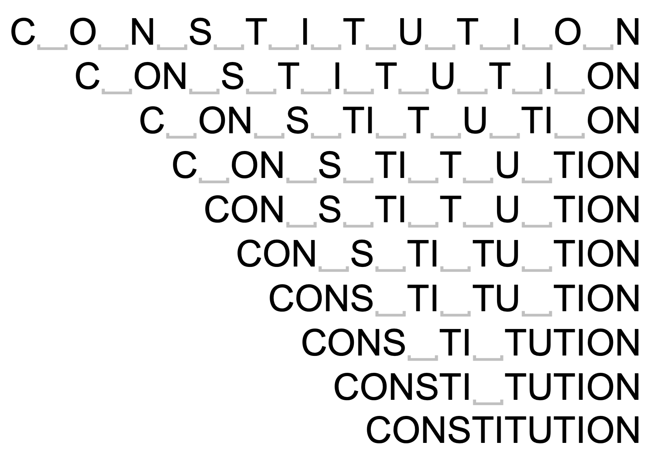
BPE Subwords
Byte-pair-encoding subwords [Sennrich et al 2016] addresses open-vocabulary generation
Using only a fixed set of chars and subwords obtained by merging
Subwords are better than chars and words
Number of merges is a hyper parameter
Why some vocabulary sizes are better than others?

Slide 11
Models
Ten Vocabulary Sizes: Chars, 500, 1K, 2K, 4K, 8K, 16K, 32K, 48K, and 64K
Transformer with 6 Layers, 512 Dim, 8 Heads, 0.1 Dropout, …
16,000 warmup steps followed by inverted sqrt decay; training stops when the validation loss start to climb up
Beam decoder, length penalty, checkpoint averaging …
Separate vocabs for source and target. Decoder’s input and output embeddings are tied

Slide 12
Datasets
Languages | Sentences | EN, XX Toks | Train Set | Validation Set | Test Set
DE-EN EN-DE | 30K | 0.8M, 0.8M | Europarl10 + WMT13CCrawl + NewsComm14 | NewsTest18 | NewsTest19
 | 0.5M | 12.9M, 12.2M
 | 1M | 25.7M, 24.3M
 | 4.5M | 116M, 109.8M
EN-HI | 0.5M | 8M, 8.6M | IITB Train | IITB Dev | IITBTest
 | 1.3M | 21M, 22.5M
EN-LT | 0.6M | 17M, 13.4M | Europarl10 | NewsDev19 | NewsDev19
4 target languages; a total of 11 data sets x 10 vocabulary sizes

Slide 16
Q1: Why are some vocabulary sizes better than others ?

Slide 17
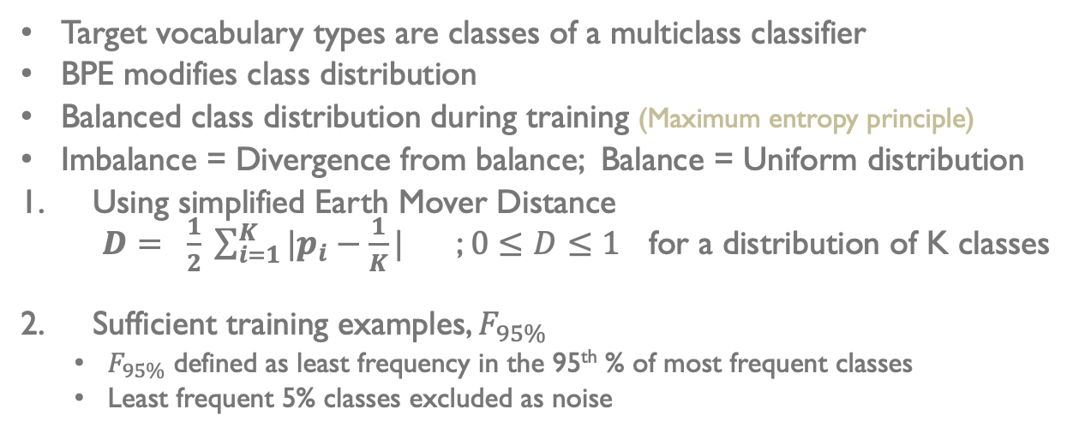
Classifier (C)
Target vocabulary types are classes of a multiclass classifier
BPE modifies class distribution
Balanced class distribution during training (Maximum entropy principle)
Imbalance = Divergence from balance; Balance = Uniform distribution
Using simplified Earth Mover Distance $D= \frac{1}{2} \sum_{i=1}^{K}{|p_{i}−\frac{1}{K}|}$ ; $0≤D≤1$ for a distribution of K classes
Sufficient training examples, $F_{95\%}$
$F_{95\%}$ defined as least frequency in the 95th % of most frequent classes
Least frequent 5% classes excluded as noise

Slide 18
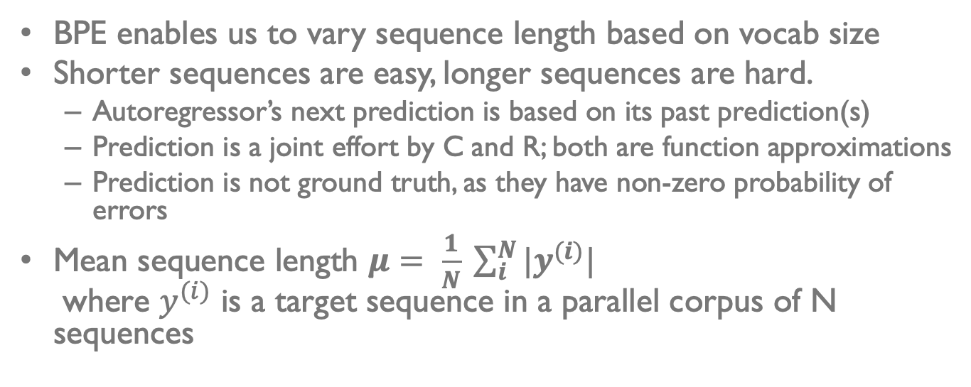
AutoRegressor (R)
BPE enables us to vary sequence length based on vocab size
Shorter sequences are easy, longer sequences are hard.
Autoregressor’s next prediction is based on its past prediction(s)
Prediction is a joint effort by C and R; both are function approximations
Prediction is not ground truth, as they have non-zero probability of errors
Mean sequence length $μ= \frac{1}{N} \sum_{i}^{N}{{|y}^{(i)}|}$ where $y^{(i)}$ is a target sequence in a parallel corpus of N sequences

Slide 19
Effect of BPE
As BPE merge operations increase
Sentence length decreases
Class imbalance increases
Need both length and divergence to be small
Best vocab size is the one that reaches a good trade-off

Slide 20
Heuristic
“Use the largest possible BPE vocabulary such that at least 95% of classes have about 100 or more training examples”

Slide 21
Does frequency-based bias on classes exist in NMT ➔ Is there a correlation between class frequency and performance ?

Slide 22
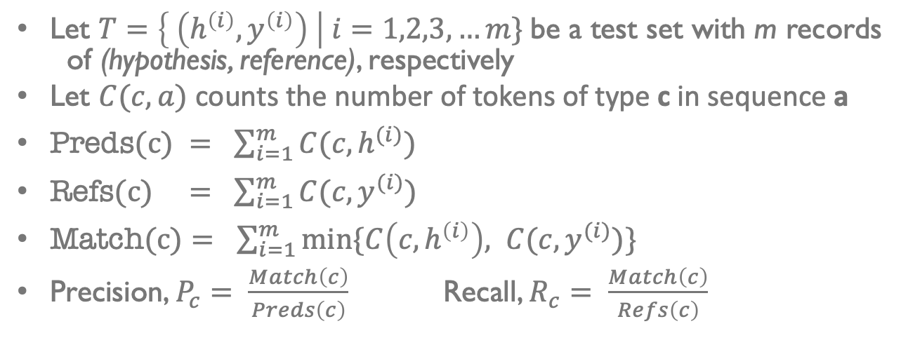
Class Performance
Let $T=\left\{ \left(h^{\left(i\right)},y^{\left(i\right)}\right) \right| i=1,2,3, …m\}$be a test set with m records of (hypothesis, reference), respectively
Let $C(c, a)$ counts the number of tokens of type c in sequence a
$\text{Preds}\text{(}\text{c}\text{) }= \sum_{i=1}^{m}{C(c, h^{(i)})}$
$\text{Refs}\text{(}\text{c}\text{)} = \sum_{i=1}^{m}{C(c, y^{(i)})}$
$\text{Match}\text{(}\text{c}\text{)}= \sum_{i=1}^{m}{min⁡\{C\left(c, h^{\left(i\right)}\right), C(c, y^{(i)})}\}$
Precision, $P_{c}= \frac{Match\left(c\right)}{Preds\left(c\right)}$ Recall, $R_{c}= \frac{Match\left(c\right)}{Refs\left(c\right)}$

Slide 23
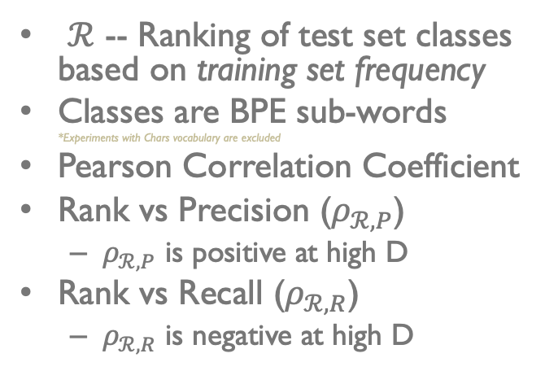
Frequency-based Bias on Class Performance
$ℛ$ -- Ranking of test set classes based on training set frequency
Classes are BPE sub-words *Experiments with Chars vocabulary are excluded
Pearson Correlation Coefficient
Rank vs Precision ($ρ_{ℛ,P}$)
$ρ_{ℛ,P}$ is positive at high D
Rank vs Recall ($ρ_{ℛ,R}$)
$ρ_{ℛ,R}$ is negative at high D

Slide 24
Evaluating MT as a Multi-class Classifier on Imbalanced Test Sets

Slide 25
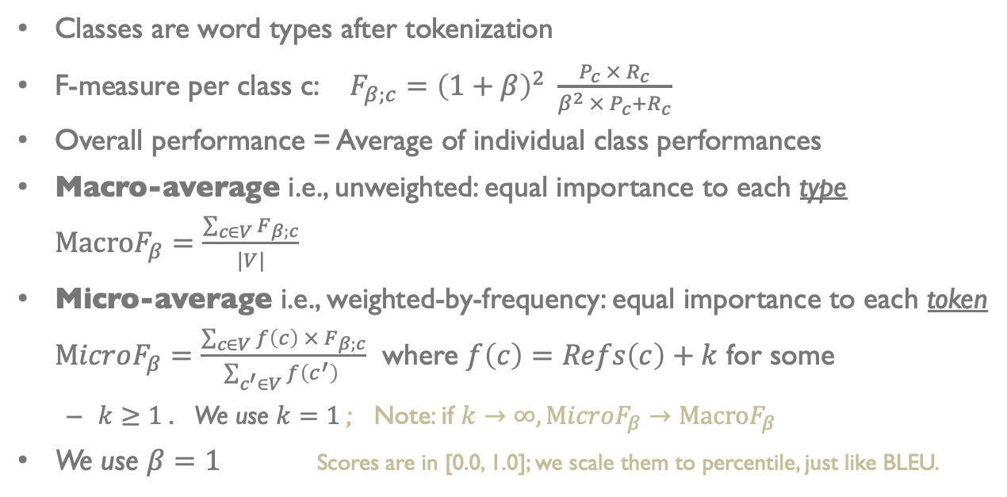
Evaluating MT as a Multiclass Classifier
Classes are word types after tokenization
F-measure per class c: $F_{β;c}={\left(1+β\right)}^{2} \frac{P_{c} × R_{c}}{β^{2} ×{ P}_{c}+R_{c}}$
Overall performance = Average of individual class performances
Macro-average i.e., unweighted: equal importance to each type $\text{Macro}F_{β}=\frac{\sum_{c∈V}{F_{β;c}}}{|V|}$
Micro-average i.e., weighted-by-frequency: equal importance to each token $\text{M}icroF_{β}=\frac{\sum_{c∈V}{f\left(c\right) × F_{β;c}}}{\sum_{c^{′}∈V}{f\left(c^{′}\right) }}$ where $f\left(c\right)=Refs\left(c\right)+k$ for some
$k≥1$. We use $k=1$; Note: if $k→∞, \text{M}icroF_{β}→\text{Macro}F_{β}$
We use $β=1$ Scores are in [0.0, 1.0]; we scale them to percentile, just like BLEU.

Slide 26
Justification for MacroF1
➔ Comparing MacroF1 and MicroF1 with BLEU, ChrF1 and BLEURT
WebNLG data-to-text Task: Correlation with Fluency, Grammar, and Semantics; on English only
WMT Metrics Task 2017-2019 Correlation with direct human assessments on tens of languages
Workshop on CLSSTS 2020 Correlation with downstream CLIR task performance on LT-EN, PS-EN, BG-EN

Slide 27
WebNLG Data-to-Text Evaluation

Slide 28
WMT Metrics

Slide 29
WMT Metrics: Wins per Metric

Slide 30
CLIR Task: Pipeline
IR task with queries and docs in different languages
Build a set of MT models; compute MT metrics
For each MT model, translate all source documents to the target language, build an IR model, and measure IR metrics
Find the correlation between the set of MT scores and IR scores. The MT metric having stronger correlation with IR metric(s) is more useful than others.
Repeat this on many languages. We use CLSSTS datasets: LT-EN, PS-EN, BG-EN

Slide 31
CLIR Task, CLSSTS Datasets, AQWV

Slide 32
CLIR Task, CLSSTS Datasets, MAP

Slide 33
Summary
Q1: Why are some vocabulary sizes better than others
Autoregressor works best on short sequences
Classifier works best on balanced classes with sufficient Frequency@95%
Use the largest possible BPE vocabulary such that at least 95% of classes have 100 or more examples in training
Q2: Does frequency-based bias on classes exist in NMT?
Yes; we need to investigate further and resolve it
Q3: Evaluating MT as a multiclass classifier
MacroF1, used for classifiers on imbalanced tests, is useful for MT eval
Justification from WebNLG, WMT Metrics, CLSSTS

Slide 34
Mark Steedman. 2008. On Becoming a Discipline. Computational Linguistics 34, 1 (2008), 137–144. https://doi.org/10. 1162/coli.2008.34.1.137 arXiv:https://doi.org/10.1162/coli.2008.34.1.137

Slide 35
THANK YOU 🙏🏼

Slide 36
MT Evaluation
Reference: | You must be a doctor.
Hypothesis: | ______ must be a doctor.
 | He | -0.74
 | Joe | -0.98
 | Sue | -1.04
 | She | -1.10
Reference: | It is the greatest country in the world.
Hypothesis: | ______ is the greatest country in the world.
 | France | -0.02
 | America | -0.06
 | Russia | -0.16
 | Canada | -0.31
BLEU
TER
ChrF1
….
METEOR
BEER
YiSi
BLEURT ….
Demo of BLEURT’s internal biases.
Model-free metrics have overlooked the “imbalanced” part. Model-based metrics are expensive, opaque and biased. Q3: Can we evaluate MT as classifier on imbalanced test set?

Slide 37
Heuristic: the largest possible BPE vocabulary such that at least 95% of classes have 100 or more examples in training.

Slide 38
Ignore this chart; BLEU scores are too low

Slide 40
CLIR Task: CLSSTS

