Slide 1

UNIVERSITY BUS TRACKING SYSTEM
Real-Time GPS Tracking and Arrival Prediction for Campus Transport
MINI PROJECT PHASE-2 REVIEW · CAF7104
PRESENTED BY
Name: Thameem
RRN No: [250282601112]
Class: MCA
Guide: [Dr.Javabur Sathick]
PHASE-2 STATUS
MODULE 1: Live location pipeline — completed
TESTS: 29 of 29 automated tests passing
DATA: 28 routes · 395 boarding points loaded
LATENCY: 19.5 ms median, driver to map
Notes:
About 15 s. Introduce the project and say that this review covers the 12 Phase-2 rubric items, then a live demo of Module 1, the real-time location pipeline.

Slide 2
PHASE-2 REVIEW — RUBRIC COVERAGE
01
Existing System
Slide 3
02
Existing System Limitations
Slide 4
03
Literature Survey
Slide 5 – 6
04
Literature Comparison
Slide 7 – 8
05
Research / Project Gap
Slide 9
06
Proposed Solution
Slide 10
07
Project Objectives
Slide 11
08
Project Scope
Slide 12
09
Technology Identification
Slide 13
10
Data / Dataset Identification
Slide 14
11
System Design
Slide 15 – 18
12
Initial Implementation — Module 1
Slide 19 – 22 + demo
Highlighted item is mandatory: Module 1 is implemented, tested and demonstrated live.
Notes:
About 10 s. Point out that every rubric item has a slide, and that item 12 is implemented and will be demonstrated.

Slide 3
EXISTING SYSTEMS
Four systems studied: what students use today, and three tracking products
BSACIST Transport Circular
IN USE AT BSACIST TODAY
Route list for 2026-27: 28 routes, 395 boarding points
One fixed pick-up time per stop
Driver's mobile number printed for enquiries
Single evening departure at 4.30 PM
MTC “Chennai Bus” App
CITY TRANSIT · CHENNAI · 2022
Launched by Tamil Nadu Transport Dept. for MTC buses
GPS on MTC buses gives live location and ETA
Nearby stops, trip planner, favourites
SOS button to the MTC control centre
Chalo
COMMERCIAL · 20+ INDIAN CITIES
GPS devices installed in operators' city buses
Live bus location and live arrival time
Crowd indicator, mobile tickets and passes
Available only where the operator has partnered
TransLoc
CAMPUS SHUTTLES · USA
Platform sold to universities and transit agencies
Real-time shuttle tracking with arrival estimates
Rider app, SMS arrival times, lobby display screens
Also offers on-demand “Safe Ride” booking
Common pattern: a GPS source on the bus, a server, and a map or ETA for riders — none of them covers the BSACIST fleet.
Notes:
About 30 s. Explain, do not read. BSACIST today: students rely on the printed circular and call the driver. Chennai Bus (MTC) and Chalo track city buses in Chennai. TransLoc is the campus-shuttle product used by US universities. If asked to demonstrate: open the Chennai Bus or Chalo app on a phone and show a live bus.

Slide 4
LIMITATIONS OF EXISTING SYSTEMS
System | Limitation | Type | Why it is technically valid
BSACIST circular | No live position; times are fixed whatever the traffic | Manual · Accuracy | Students phone a driver who is driving — unsafe, and one driver cannot answer 40–55 riders. A delay is invisible until the bus arrives.
MTC Chennai Bus | Tracks only MTC's own city fleet | Coverage | University buses are privately operated, so they are not in MTC's GPS feed; the app has no university stops or timetable.
Chalo | Needs an operator partnership and installed GPS devices | Cost · Access | Built for city bus operators; a 28-bus private fleet cannot add its own buses, and the ETA method is proprietary.
TransLoc | Paid platform designed for US campuses | Cost | Institutional licensing; data stays with the vendor; no stops, language or timetable for an Indian campus.
Research prototypes (IoT / Firebase) | Hardware in every bus; clients write straight to the database | Accuracy · Features | No server-side check of GPS fixes, so a stale or wrong point is drawn as current; no stored history to measure ETA.
Categories used by the rubric: cost, accuracy, manual work, coverage and missing features.
Notes:
About 30 s. Stress the technical reasons: coverage (private buses are not in MTC data), cost (hardware and licences), and data trust (client writes straight to Firebase, no validation, stale points look live).

Slide 5
LITERATURE SURVEY
Part A — Tracking systems · 10 papers studied: abstract, methodology and results
# | Paper title | Authors | Year · Venue | Relevance to this project
1 | Where Is My Bus? Impact of mobile real-time information on the perceived and actual wait time of transit riders | K. E. Watkins, B. Ferris, A. Borning, G. S. Rutherford, D. Layton | 2011 · Transportation Research Part A | Foundational evidence that real-time information cuts actual waiting time
2 | College Bus Tracking and Notification System | K. Premkumar, K. Pavithra, J. Presiela, D. Priyadarshini, P. Priyanga | 2020 · IEEE ICSCAN | Same user group: college buses, Android app, Google Maps
3 | IoT Bus Tracking System Localization via GPS-RFID | M. Kassim, A. S. Salleh, S. Shahbudin, M. Yusoff, N. A. Kamaluddin | 2022 · IEEE ICPEA | Hardware tracker; checks route deviation and unwanted stops
4 | FIEE Smart Campus IoT Real-Time Bus Tracking System and Web App Using LoRaWAN | M. Arevalo Villanueva, A. Aspilcueta Narvaez, G. A. Arias Obregon, S. L. Cabrera Ronceros, F. Bendezu Isidro | 2022 · IEEE ISC2 | University bus on a web map — alternative radio link to GPRS
5 | Smart Campus Bus Tracking Alert System Using Real-Time GPS | M. Sobhana, T. Revanth Chowdary, M. G. S. S. Venkatesh, K. Sri Devendra | 2023 · IEEE ICACCS | Stop-crossed alerts → basis for our notification module
Notes:
About 20 s. Five tracking papers from 2011 to 2023. Watkins et al. is the foundational study: real-time information users waited almost 2 minutes less. The others are college or campus tracking systems built with Android, RFID, LoRaWAN and Firebase.

Slide 6
LITERATURE SURVEY
Part B — Arrival-time prediction · 10 papers studied: abstract, methodology and results
# | Paper title | Authors | Year · Venue | Relevance to this project
6 | GPS-based Arrival Time Prediction for Bus Schedules: Enhancing Commuter Experience | N. Shanthi, R. C. Suganthe, V. Manimaran, P. Manoj Kumar, A. Kavin Bharathi, E. Mythili | 2023 · IEEE ICoAC | LSTM ETA using distance, dwell time, traffic density and junctions
7 | Real-Time Bus Arrival Prediction: A Deep Learning Approach for Enhanced Urban Mobility | N. Rashvand, S. S. Hosseini, M. Azarbayjani, H. Tabkhi | 2023 · arXiv 2303.15495 | Sets an ETA error benchmark (under 40 s) on large data
8 | Real-Time Bus Departure Prediction Using Neural Networks for Smart IoT Public Bus Transit | N. Rashvand, S. S. Hosseini, M. Azarbayjani, H. Tabkhi | 2024 · IoT (MDPI) 5(4) | IoT framing; deviation from timetable as the target
9 | ArrivalNet: Predicting City-wide Bus/Tram Arrival Time with Two-dimensional Temporal Variation Modeling | Z. Li, P. Wolf, M. Wang | 2024 · arXiv 2410.14742 | Reports MAE and RMSE — the metrics we adopt
10 | Real-time Bus Travel Time Prediction and Reliability Quantification: A Hybrid Markov Model | Y. Sun, J. Spall, W. Wong, X. Zhao | 2025 · arXiv 2503.05907 | Segment-by-segment travel time with uncertainty bounds
Notes:
About 20 s. Five arrival-prediction papers from 2023 to 2025: LSTM, fully connected neural networks, a CNN-based model and a hybrid Markov model. All are verifiable: IEEE DOIs and arXiv IDs are on the references slide.

Slide 7
LITERATURE COMPARISON
Paper | Method | Technology | Dataset | Findings
[1] Watkins 2011 | Rider survey with observed wait times | OneBusAway: web, SMS, phone, smartphone | King County Metro (Seattle) riders | Real-time users waited almost 2 min less than timetable users
[2] Premkumar 2020 | Bus GPS position shared to students' app | Android, GPS, Google Maps API | College-bus prototype; no dataset reported | Live bus on the map; alarm to driver when a student is near the stop
[3] Kassim 2022 | GPS location + RFID bus identification | 2 × ESP8266, GPS Neo-6M, RFID MFRC522, IR sensors, Blynk | Prototype tested at 3 locations, buses A–C | Buses tracked; passenger counter recorded 0–5 people on board
[4] Arevalo V. 2022 | LoRaWAN link instead of GPRS/GSM | Arduino UNO, RAK811, Neo-6M, Vue.js, Firebase | University campus prototype | Bus shown live on a web app over LoRaWAN
[5] Sobhana 2023 | Real-time location sync with stop alerts | Java app, GPS, Firebase | School-bus prototype | Parents alerted when the previous stop is crossed
TAKEAWAY Tracking papers stop at showing the bus: data is written straight to the cloud and never checked.
Notes:
About 20 s. Compare by method, technology, dataset and findings. Note that the tracking prototypes report no accuracy numbers and use hardware or Firebase.

Slide 8
LITERATURE COMPARISON
Paper | Method | Technology | Dataset | Findings
[6] Shanthi 2023 | LSTM neural network | IoT GPS feed + LSTM | Trajectory data with distance, dwell, traffic, junctions | Stop-level ETA that accounts for dwell time and junctions
[7] Rashvand 2023 | Fully connected neural network | Deep learning (FCNN) | New York buses: 200+ lines, 2 M data points | Arrival error under 40 s; inference < 0.006 ms per point
[8] Rashvand 2024 | FCNN on historical departures + feature engineering | Neural network | Boston: 151 routes | Deviation predicted within 80 s (baseline deviation ≈ 4 min)
[9] Li 2024 | 2-D temporal variation modelling | CNN (computer-vision backbones) | Dresden: 125 days of bus/tram data | MAE lower by ≥ 14.7 %, RMSE by ≥ 6.1 % vs. baselines
[10] Sun 2025 | Hybrid Markov model, MLE, Fisher information | Statistical model on GTFS | Gainesville, FL: GTFS static + realtime, 2023 | Beat historical-mean and AI baselines with narrower 95 % bounds
TAKEAWAY ETA papers need clean, timestamped history (millions of points). Module 1 collects exactly that.
Notes:
About 20 s. The ETA papers report numbers (40 s, 80 s, MAE improvements) but depend on large clean datasets. That is why Module 1 focuses on clean validated history first.

Slide 9
RESEARCH / PROJECT GAP
GAP
EXISTING SOLUTIONS
THIS PROJECT ADDS
DATA TRUST
Device writes straight to Firebase or a cloud DB; nothing checks the fix
Server is the only writer: 11 validation rules; every rejection logged with its reason
STALENESS
The last known point is drawn as if it were live
Explicit Live ≤ 30 s / Delayed ≤ 2 min / Offline with last-seen place
COST
A GPS, LoRa or RFID unit must be fitted and maintained in every bus
The driver's phone is the tracker — no hardware to buy
ETA EVIDENCE
ETA models need big city datasets; campus systems show no measured ETA
Clean trip history from day one; ETA evaluated by MAE per route
What is missing? A low-cost campus tracker whose positions can be trusted: validated, honest about freshness, and measured.
Notes:
About 30 s. Answer "what is missing?" in one line: a trusted, low-cost campus tracker. Four gaps: data trust, staleness, hardware cost, and no measured ETA.

Slide 10
PROPOSED SOLUTION
MAIN IDEA
One validated location pipeline for the BSACIST fleet.
The driver's phone reports the position. The server checks it, stores it and pushes it. Every student sees their bus with an honest freshness label, and later an ETA measured against real arrivals.
01
Driver app
Start trip; GPS every 5–15 s; offline buffer
✓ Module 1
02
Validate & store
11 rules; full history + latest per bus
✓ Module 1
03
Live map
Socket.IO push, freshness, nearest stop
✓ Module 1
04
ETA
Arrival at my stop, reported with MAE
Phase 3
05
Alerts
“Bus 10 min from your stop”, delay notices
Phase 3
06
Admin & reports
Routes, stops, drivers, trip history export
Phase 3
EXPECTED OUTCOME Students stop guessing and calling drivers; the transport office sees every bus at once; the university gets stored trip data to analyse delays.
Notes:
About 30 s. Explain without reading: main idea, six functions (first three done in Module 1), expected outcome.

Slide 11
PROJECT OBJECTIVES
1
DEVELOP a driver client that sends a GPS fix every 5–15 s and buffers up to 200 fixes when offline.
≥ 95 % of fixes delivered in the pilot
2
VALIDATE every fix on the server before it is stored, using 11 defined rules.
100 % of invalid test fixes rejected — met: 46 / 46
3
BROADCAST accepted positions to students in real time over WebSocket.
< 1 s fix-to-map — measured 19.5 ms median
4
DISPLAY every bus with a freshness state and its last-seen place.
Live ≤ 30 s · Delayed ≤ 2 min · Offline — met
5
PREDICT arrival time at a chosen stop from stored trip history.
MAE ≤ 3 min per route on pilot data
6
MANAGE routes, stops, buses, drivers and trips, with exportable reports.
All 28 routes and 395 stops editable
Green = already measured in Module 1
Notes:
About 25 s. Six objectives, each starting with an action verb, each with a measurable target. Three targets are already met and measured by Module 1.

Slide 12
PROJECT SCOPE
IN SCOPE
Driver web app using the phone's GPS (Android wrapper later)
Server validation, trips and full location history
Student live map for 28 routes and 395 boarding points
Freshness states, nearest stop and stop timeline
ETA at a selected stop, evaluated with MAE
Stop-approach and delay notifications (web push)
Admin: routes, stops, buses, drivers and trips
Trip reports (CSV) and a pilot on one route
OUT OF SCOPE
Ticketing, fees and payments — handled by the university office
Dedicated GPS / IoT hardware — the phone is the tracker
Seat-level occupancy sensors — needs hardware
Route optimisation and re-planning — separate research problem
Native iOS app — web app works on iPhone
MTC / city bus integration — different operator
SMS gateway for parents — needs a paid telecom API
Realistic for an MCA mini project: one developer, a web stack, no hardware purchase, pilot on a single route (118 Velachery).
Notes:
About 20 s. In-scope is software only, on the phone the driver already has. Hardware, payments and city buses are out of scope.

Slide 13
INITIAL TECHNOLOGY IDENTIFICATION
Layer | Technology | Why it is suitable | Status
Frontend | React 19 + Vite | Component UI; one codebase for student and driver screens; fast builds | Used in Module 1
Maps | Leaflet + OpenStreetMap | Free map tiles with no API key or billing; markers and route lines | Used in Module 1
Backend | Node.js 24 + Express 5 | Non-blocking I/O suits many small GPS requests; same language as the UI | Used in Module 1
Realtime | Socket.IO 4 | WebSocket with automatic reconnect and one room per route | Used in Module 1
Database | PostgreSQL (PGlite locally, Supabase hosted) | Transactions, partial unique indexes, upserts; PostGIS for spatial queries | Used · PostGIS in M2
Security | JWT + bcrypt | Stateless role-based tokens; passwords stored only as hashes | Used in Module 1
GPS source | Browser Geolocation API → Android app | High-accuracy location from the driver's phone; no hardware | Web in M1 · Android M6
AI / ML (ETA) | Python, pandas, scikit-learn (Gradient Boosting) | Learns segment time by time band; compared with a historical-mean baseline by MAE | Module 2
Notifications | Web Push API (service worker) | Free push notifications to phone browsers | Module 3
Test & hosting | node:test · Render + Supabase | Automated tests; free-tier https hosting (phone GPS requires https) | Tests in M1
Notes:
About 20 s. Same stack as the approved proposal. Note that the prototype runs real PostgreSQL inside Node (PGlite), and switches to Supabase by setting DATABASE_URL. ML tools come in Module 2.

Slide 14
DATA / DATASET IDENTIFICATION
1 BSACIST BUS ROUTE 2026-27
Primary reference data
Source: Estate Office – Transport Dept. circular for the academic year 2026-2027
Size: 28 routes · 28 buses · 395 boarding points
Attributes: route code, name, start, end, departure; per stop: order, name, scheduled time, offset, fee; bus type, seats, AC
Coordinates: 285 stops geocoded to locality centroids; 110 interpolated between neighbours (shown “approx.”)
2 LIVE GPS STREAM
Collected by this system
Method: Driver phone, Geolocation API, one fix every 5–15 s
Attributes: lat, lng, speed, heading, accuracy, recorded_at, received_at, trip, bus
Size: 28 buses × ~96 min each way × 2 × 1 fix / 5 s ≈ 65,000 fixes / day ≈ 1.4 M / month
Quality: Rejected fixes stored with their reason
3 ETA TRAINING SET
Derived from stream 2 · Module 2
Events: Stop arrival = bus within 50 m of a stop
Features: segment, time of day, weekday, previous-segment delay, speed
Label: actual arrival time at each stop
Evaluation: train on earlier weeks, test on later weeks; MAE per route and time band
Pilot: route 118 Velachery (14 stops) — replace approximate stop coordinates with positions measured from real bus stops.
Notes:
About 25 s. Dataset 1 is real: the official 2026-27 route circular. Be honest that stop coordinates are locality-level, not surveyed. Dataset 2 is what Module 1 now collects. Dataset 3 is derived from it for ETA, measured by MAE.

Slide 15
SYSTEM DESIGN — ARCHITECTURE
CLIENTS
React + Leaflet
Driver App
phone GPS, trip control
Student Live Map
freshness, nearest stop
Admin Dashboard
fleet, routes, reports
HTTPS REST + JWT
WebSocket (Socket.IO)
SERVER
Node.js + Express
Auth
JWT · roles
Trip service
one active trip / bus
Ingest + Validation
11 rules
Live cache + Freshness
ticker every 5 s
Socket.IO gateway
room per route
ETA · Notifier
Modules 2–3
SQL · transactions
DATA
PostgreSQL
Timetable
routes · stops · buses
users
bcrypt hashes
trips
location_pings
full history
bus_latest
live view
rejected_pings
with reason
■ Built in Module 1 □ Later modules Rule: the server is the only writer; only the newest valid fix per bus is pushed.
Notes:
About 20 s. Three layers. Navy boxes exist now; dashed boxes are later modules. The key design rule: only the server writes positions.

Slide 16
SYSTEM DESIGN — MODULES
Module | Main functions | Users | Status / plan
M1 Live Location Pipeline | Driver login, trips, GPS ingest, 11-rule validation, history + latest, Socket.IO push, live map, freshness | Driver, Student | Completed — Phase 2
M2 ETA Prediction | Stop-arrival detection, segment travel times, historical-mean baseline vs. Gradient Boosting, MAE report | Student | Phase 3 · weeks 1–3
M3 Notifications | “Bus is 10 min from your stop”, delay and breakdown notices (web push) | Student | Phase 3 · week 4
M4 Admin Dashboard | Manage routes, stops, buses and drivers; live fleet view; alerts | Transport office | Phase 3 · weeks 4–5
M5 Reports & History | Trip replay, delay per stop and route, CSV export, GPS-quality report | Transport office | Phase 3 · week 6
M6 Android App + Pilot | Background GPS; measure update delay, accuracy, battery and data on route 118 | Driver | Phase 3 · weeks 7–8
Notes:
About 15 s. Six modules. Module 1 is done; the others follow over eight weeks in Phase 3.

Slide 17
SYSTEM DESIGN — DATABASE (PostgreSQL)
routes
stops
buses
users
PK id
code (unique)
name
start_point, end_point
departure_time
duration_minutes
PK id
FK route_id
seq (unique per route)
name
lat, lng
scheduled_time
geo_source
PK id
fleet_code (unique)
FK route_id
bus_type, capacity
is_ac
PK id
username (unique)
password_hash
role: admin/driver/student
FK bus_id (drivers)
1 : N
1 : 1
1 : N trips
1 : 1 bus_latest
trips
location_pings
bus_latest
rejected_pings
PK id
FK bus_id, route_id
FK driver_id
status: active/completed
started_at, ended_at
unique active trip per bus
PK id
FK trip_id, bus_id
lat, lng
speed, heading, accuracy
recorded_at (device)
received_at (server)
PK FK bus_id
FK trip_id
lat, lng, speed, heading
recorded_at
one row per bus
PK id
FK bus_id, trip_id
reason
payload (JSONB)
received_at
1 : N
Also: routes 1:N buses · buses 1:N trips · users(driver) 1:N trips · trips 1:N rejected_pings. Red tables are written on every GPS fix, inside one transaction.
Notes:
About 20 s. Eight tables. Point to the two red ones: location_pings is the full history, bus_latest holds one row per bus for the live map. The partial unique index on trips guarantees one active trip per bus.

Slide 18
SYSTEM DESIGN — WORKFLOW OF ONE GPS FIX
Driver App
Express API
Validation
PostgreSQL
Socket.IO
Student Map
1 POST /api/driver/locations + JWT
2 validateFix(fix, previous)
3 ok | reason (e.g. IMPOSSIBLE_JUMP)
4 INSERT location_pings + UPSERT bus_latest
5 emit bus:location → route room
6 push newest position
7 202 accepted | 422 + reasons
No network → fixes buffered, sent as one batch
rejected → INSERT rejected_pings (not broadcast)
every 1 s: Live → Delayed → Offline
Notes:
About 25 s. Walk one fix left to right: POST with token, validation, one transaction writing history and latest, broadcast only to that route room, and the reply to the driver. Rejected fixes go to rejected_pings and are never broadcast.

Slide 19
INITIAL IMPLEMENTATION — MODULE 1 STATUS
COMPLETED — MODULE 1: LIVE LOCATION PIPELINE
✓ Driver login with JWT; role checked on every driver call
✓ Trip start / end; one active trip per bus (database constraint)
✓ GPS from the phone or route simulation, every 5 / 10 / 15 s
✓ Offline buffer (up to 200 fixes) uploaded as one batch
✓ 11-rule server validation + re-anchoring after GPS glitches
✓ PostgreSQL history (location_pings) + live table (bus_latest)
✓ Socket.IO push with one room per route
✓ Live map: gliding markers, Live / Delayed / Offline, nearest stop
✓ Real BSACIST data seeded: 28 routes, 395 boarding points
✓ 29 automated tests · bus simulator · latency script
29 / 29
automated tests passing
46 / 46
injected bad fixes rejected
with the correct reason
19.5 ms
median driver → map
(p95 43 ms, localhost)
2,342
lines of code
server 928 · client 911 · tests 503
Notes:
About 20 s. Everything in the list is implemented. The numbers on the right are measured, not estimated: npm test, the simulator with --faults, and npm run measure.

Slide 20
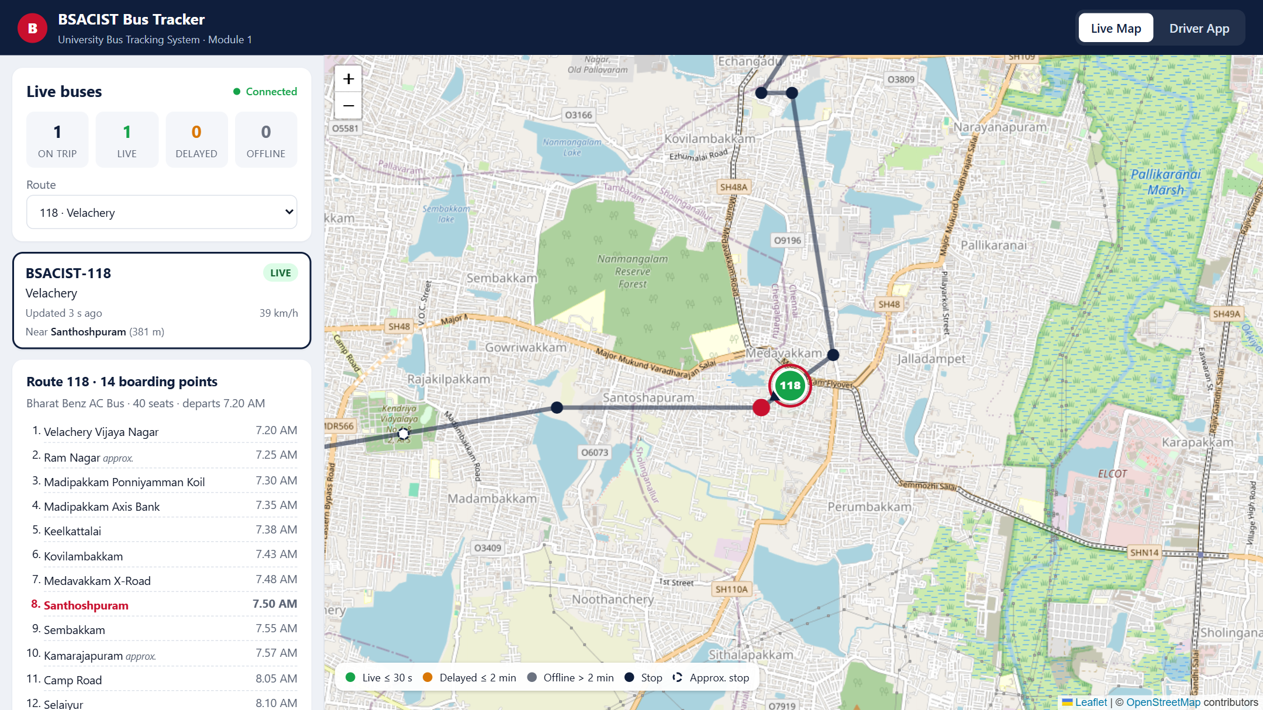
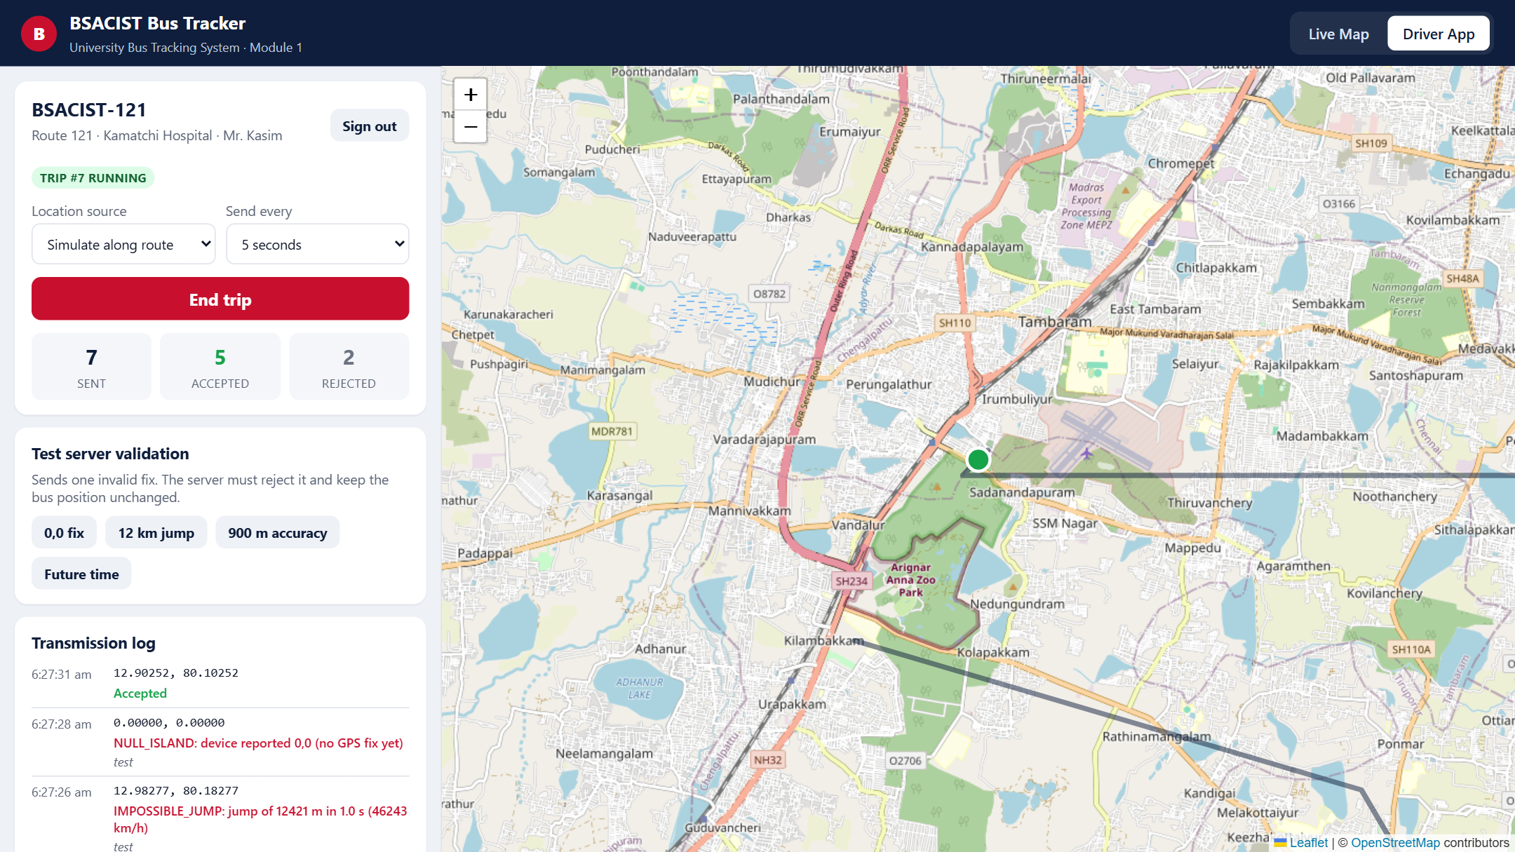
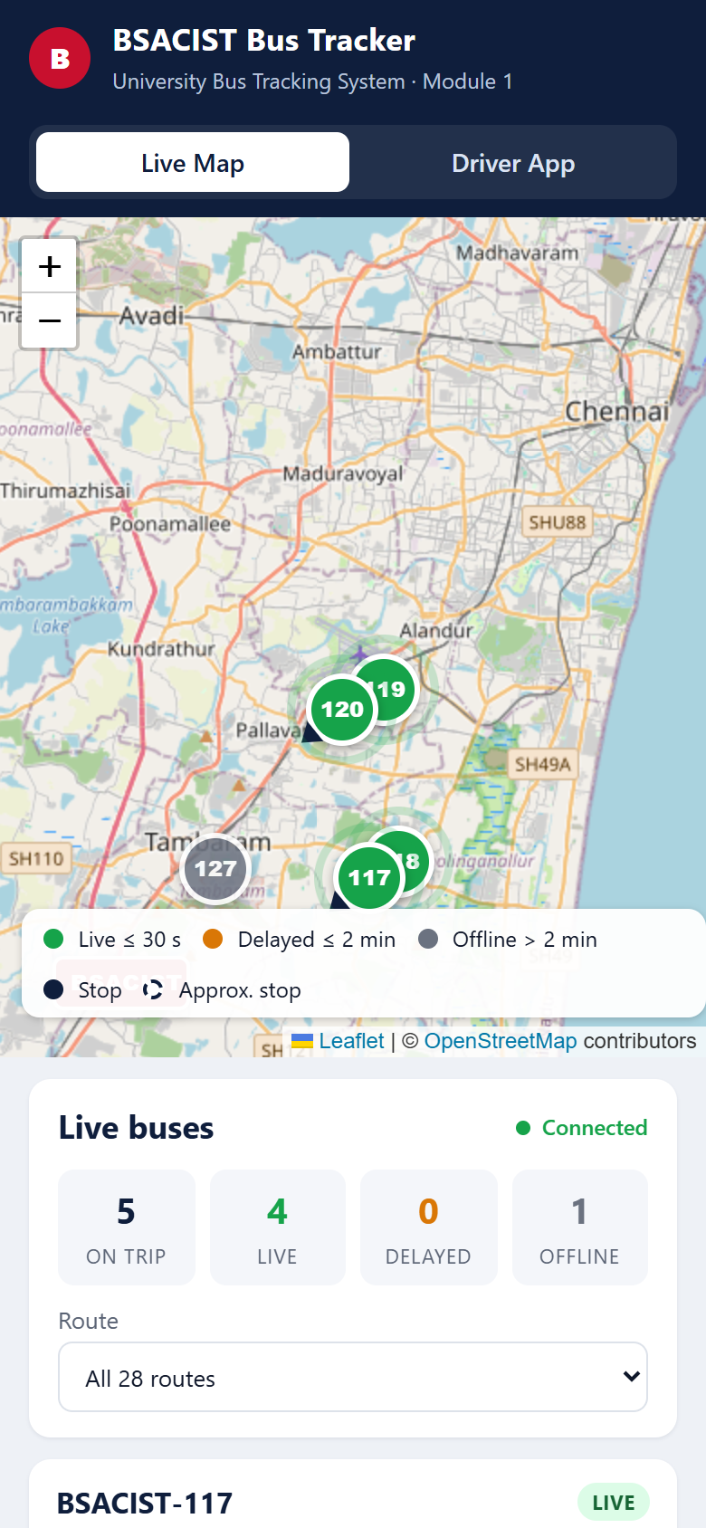
MODULE 1 — SCREENS
Student live map
Route 118 selected: stops, timeline, nearest stop highlighted
Driver app
Trip running; test fixes rejected with their reasons
Phone width
LIVE DEMO Driver signs in ➜ Start trip ➜ bus appears on the student map ➜ send a bad fix ➜ rejected, bus unchanged ➜ a bus goes silent ➜ Delayed after 30 s, Offline after 2 min
Notes:
About 15 s, then switch to the live demo. Demo script is in docs/DEMO_SCRIPT.md.

Slide 21
MODULE 1 — SOURCE CODE EXPLAINED
// server/validation.js (simplified excerpt)
export function validateFix(fix, previous, limits, area, now) {
if (!isFiniteNumber(lat) || Math.abs(lat) > 90 ...)
return fail(REJECT.INVALID_COORDINATES);
if (lat ≈ 0 && lng ≈ 0) return fail(REJECT.NULL_ISLAND);
if (outside(area)) return fail(REJECT.OUTSIDE_SERVICE_AREA);
if (accuracyM > 100) return fail(REJECT.LOW_ACCURACY);
// ... speed, heading, future / stale timestamp
if (previous) {
if (dtS <= 0) return fail(REJECT.OUT_OF_ORDER);
const kmh = haversine(previous, fix) / dtS * 3.6;
if (metres > 50 && kmh > 150) return fail(REJECT.IMPOSSIBLE_JUMP);
}
return { ok: true, fix };
}
auth.js
bcrypt check, JWT with role and bus. The bus id comes from the token — a driver can only move their own bus.
validation.js
Pure function, 11 rules, unit-tested. Jitter under 50 m is never called a jump.
tracking.js
Per-bus queue, batch sorted oldest first, one transaction per fix, re-anchor after 3 consistent jumps.
// server/tracking.js ingestNow()
for (const fix of oldestFirst(batch)) {
const verdict = validateFix(fix, previous, ...);
if (!verdict.ok) { INSERT rejected_pings; continue; }
await db.transaction(tx => {
INSERT location_pings ...;
UPSERT bus_latest ... ON CONFLICT (bus_id) DO UPDATE;
});
previous = verdict.fix;
}
emit('route:' + code, 'bus:location', newest);
app.js
REST routes; 202 / 422 per batch; Socket.IO rooms so a student only receives their route.
LiveMap.jsx
Snapshot + events; freshness recomputed each second; markers glide between fixes.
Notes:
About 30 s here, more if asked. Full walkthrough with line numbers is in docs/CODE_WALKTHROUGH.md. Open server/validation.js and server/tracking.js in VS Code if the panel asks to see the real code.

Slide 22
MODULE 1 — TESTING AND MEASURED RESULTS
Test suite | What is checked | Cases | Result
Validation rules | each rejection rule, clock skew, jitter, out-of-order, jump | 18 | Pass
Freshness | boundaries 30 s / 31 s / 120 s / 121 s | 1 | Pass
Geometry | haversine distance, path walking | 2 | Pass
API end-to-end | real PostgreSQL: seed, login, 401 / 403 / 409, store + push, batch order, re-anchor, trip end | 8 | Pass
Total | npm test | 29 | 29 / 29
MEASURED ON THE RUNNING SYSTEM
Driver POST → student map
median 19.5 ms · p95 43.1 ms · max 73.5 ms (100 fixes)
HTTP response to the driver
median 20.9 ms · p95 46.8 ms
Invalid fixes injected (4 kinds)
46 / 46 rejected with the correct reason
Freshness
silent bus: Delayed after 30 s, Offline after 2 min, last-seen stop shown
Honest limits: latency is measured on localhost with 4 simulated buses, so it excludes the mobile network. The route-118 pilot will measure real network delay, GPS accuracy, battery and data use.
Notes:
About 20 s. Tests and measurements are reproducible: npm test, npm run simulate -- --faults, npm run measure. Be clear the latency is localhost.

Slide 23
STATUS AND NEXT STEPS (PHASE 3)
Weeks 1–3
Week 4
Weeks 4–5
Week 6
Weeks 7–8
M2 ETA
Stop-arrival detection; baseline vs. Gradient Boosting; MAE per route
M3 Alerts
Web push: bus 10 min away, delay and breakdown notices
M4 Admin
CRUD for routes, stops, buses, drivers; live fleet view
M5 Reports
Trip replay, delay per stop, CSV export
M6 Android + pilot
Background GPS; pilot on route 118; final report
DONE IN PHASE 2
All 12 rubric items prepared; Module 1 implemented, tested and demonstrable.
RISKS AND MITIGATION
Phone battery / background GPS → Android foreground service. Weak network → offline buffer (built).
Notes:
About 15 s. Eight-week plan for the remaining modules, ending with a pilot on route 118.

Slide 24
REFERENCES
[1] K. E. Watkins, B. Ferris, A. Borning, G. S. Rutherford, D. Layton, “Where Is My Bus? Impact of mobile real-time information on the perceived and actual wait time of transit riders,” Transportation Research Part A, 2011. doi:10.1016/j.tra.2011.06.010
[2] K. Premkumar et al., “College Bus Tracking and Notification System,” IEEE ICSCAN, 2020. doi:10.1109/ICSCAN49426.2020.9262303
[3] M. Kassim et al., “IoT Bus Tracking System Localization via GPS-RFID,” IEEE ICPEA, 2022. doi:10.1109/ICPEA53519.2022.9744710
[4] M. Arevalo Villanueva et al., “FIEE Smart Campus IoT real-time bus tracking system and web app using LoRaWAN,” IEEE ISC2, 2022. doi:10.1109/ISC255366.2022.9922172
[5] M. Sobhana et al., “Smart Campus Bus Tracking Alert System Using Real-Time GPS,” IEEE ICACCS, 2023. doi:10.1109/ICACCS57279.2023.10112757
[6] N. Shanthi et al., “GPS-based Arrival Time Prediction for Bus Schedules: Enhancing Commuter Experience,” IEEE ICoAC, 2023. doi:10.1109/ICoAC59537.2023.10249289
[7] N. Rashvand, S. S. Hosseini, M. Azarbayjani, H. Tabkhi, “Real-Time Bus Arrival Prediction: A Deep Learning Approach for Enhanced Urban Mobility,” arXiv:2303.15495, 2023.
[8] N. Rashvand, S. S. Hosseini, M. Azarbayjani, H. Tabkhi, “Real-Time Bus Departure Prediction Using Neural Networks for Smart IoT Public Bus Transit,” IoT, 5(4), 650–665, 2024. doi:10.3390/iot5040029
[9] Z. Li, P. Wolf, M. Wang, “ArrivalNet: Predicting City-wide Bus/Tram Arrival Time with Two-dimensional Temporal Variation Modeling,” arXiv:2410.14742, 2024.
[10] Y. Sun, J. Spall, W. Wong, X. Zhao, “Real-time Bus Travel Time Prediction and Reliability Quantification: A Hybrid Markov Model,” arXiv:2503.05907, 2025.
SYSTEMS AND DATA
[11] MTC “Chennai Bus” app launch — DT Next, 5 May 2022; mtcbus.tn.gov.in
[12] Chalo — chalo.com (live bus tracking, 20+ Indian cities)
[13] TransLoc — transloc.com/universities
[14] BSACIST Estate Office – Transport Department, Bus Route for the Academic Year 2026-2027
[15] GTFS Realtime reference — gtfs.org
Notes:
Show only if asked. Every paper is verifiable by DOI or arXiv ID.

Slide 25
THANK YOU
Live demo: Module 1 — Real-Time Location Pipeline
1
Driver App: sign in as the driver of route 118 and start the trip
2
Student Live Map: the bus appears and glides along its real route
3
Send a 0,0 fix and a 12 km jump: both rejected, bus position unchanged
4
Stop a bus: Live ➜ Delayed after 30 s ➜ Offline after 2 min with last-seen stop
Questions?
Notes:
Switch to the browser for the demo. Keep the simulator running in the background so other buses are already moving.

