Slide 1
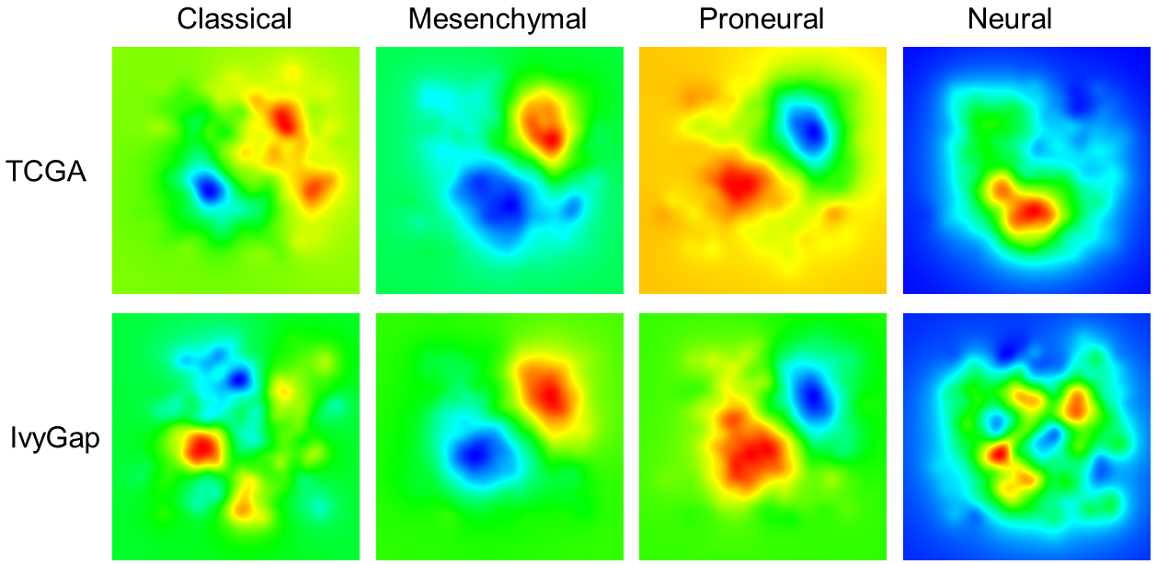
GBM Subtype Transcriptome Profiles A GeneTerrain Representation Example Result

Slide 2
Querying overexpressed genes and pathways using GeneTerrain peak analysis and GSEA (http://discovery.informatics.uab.edu/PAGER/)
PAG name | FDR
Housekeeping genes identified as expressed across 19 normal tissues. | 5.50E-31
GO:0045321 biological process leukocyte activation | 1.16E-25
GO:0002274 biological process myeloid leukocyte activation | 6.21E-26
GO:0002376 biological process immune system process | 1.45E-23
antigen processing and presentation | 2.03E-08
Mesenchymal Stem Cells Boeuf08 23genes | 6.95E-10
HLA-DPA1, VIM, GNG5, S100A6, COL1A2, TGFBI, SPP1, PFN1, CKB, CSTB, CDK4, CTSB, TIMP1, HLA-A, HLA-E, SDCBP, PTGDS, A2M, FABP5, CD81, B2M, AGT, C3, HMGB1, ANXA2, ANXA5, TNC, LTF, ANXA1, FTL, CD74, SPARC, CHI3L1, FABP7, PRDX6, RHOB, SLC1A3, CLU, HLA-DRA, S100B, ALDOA, S100A10, CST3, MYL6, …
Mesenchymal
PAG name | FDR
Housekeeping genes identified as expressed across 19 normal tissues. | 1.14E-148
L13a mediated translational silencing of Ceruloplasmin expression | 1.65E-137
GO:0045047 biological process protein targeting to ER | 1.02E-136
Genes up regulated in comparison of naive CD4, CD8 T cells versus unstimulated dendritic cells (DC). | 4.97E-46
StemCell Nilsson07 3153genes | 4.29E-34
RPS19, RPS3, HINT1, RPL37, EEF2, COX6A1, COX7A2, RPS3A, DDX5, ATP5H, ATP5B, ATP5E, PFDN5, RPS13, RPS11, RPS10, RPS17, RPS16, RPS15, RPS14, PARK7, SNRPD2, PSMD14, PPA1, RPL7A, SRP9, MRPL3, POLR2G, RPL39, RPL36, RPL34, RPL35, RPL30, YBX1, TBCA, ERH, UBA52, HNRNPA1, HSPD1, …
Proneural

