Slide 1
Group Sorter

Slide 2
Disclaimer
Clean the data
Standardize inputs like other, others, other(s) to just other, the program is unable to distinguish between the 3 elements
The .exe only work on Windows
The script is available for Mac users with Python pre-installed
However, only .exe is available for users without Python pre-installed
There are a lot of unhandled exceptions
The program will not work if an error occurs
Error will be reflected in the terminal
Just restart the program and avoid the errors

Slide 3

Running the Executable
Go to diversity_v3 > dist > interface.exe
Double click on the .exe file

Slide 4


Terminal
Terminal appears when you run the .exe file
Wait for around 15 seconds for the algorithm to load
You will see a small window appear with a button that allows you to import a file

Slide 5
Import Button
Allows .csv, .xls and .xlsx files
For Excel files, the algorithm only reads the first sheet
The algorithm will read the first row as the column titles
You may test it with the ‘Sample Import File.xlsx’

Slide 6
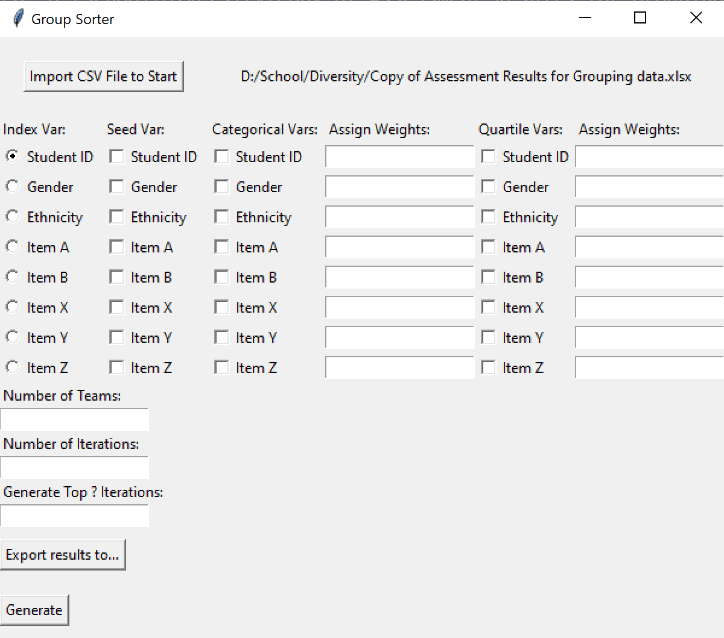
Interface
Seed Variable Column
Categorical Variable Column
Import Button
Index Variable Column
Quartile Variable Column
Number of Teams, Iterations & Top Results
Export
Generate

Slide 7
Index Variable Column
Required item
Choose a column that will uniquely represent each person
Unique assigned ID
Matriculation number
Etc
Select only one option

Slide 8
Seed Variable Column
Optional item
To seed, select only one continuous variable
Everyone will be sorted in descending order by the selected variable
The first x number of people will be seeded into x number of groups
Without seed, do not select any (uncheck all)
The first x number of people will be randomly selected for each iteration

Slide 9
Categorical Variable Columns
Select discrete variables only
Gender
Ethnicity
Race
Nationality
Etc
The corresponding textbox to the right of the checkbox is the weights assigned to the variable
Only read integers
If option is chosen but no number is assigned, default = 1

Slide 10
Quartile Variable Columns
Select continuous variables only
Extraversion
IQ
CAP
Etc
Continuous variables will be converted to quartiles
i.e. top 25% of people for a selected column will be 1, next 25% 2…
Each person is evaluated based on quartile, not the original continuous variable
The corresponding textbox to the right of the checkbox is the weights assigned to the variable
Only read integers
If option is chosen but no number is assigned, default = 1

Slide 11
Number of Teams, Iterations & Top Results
Enter the number of groups you wish to have (required)
Enter the number of iterations (required)
Each iteration is a possible permutation of everyone in x number of groups
There may not be a ‘perfect’ group
Recommended >50 iterations for a variety of permutations to choose from
Enter Top ? Of Iterations (required)
Algorithm will rank order all iterations by mean and variance
Then, it will select the top ? Iterations with the lowest mean and variance score
Top ? Of iterations must be lower than number of iterations

Slide 12
Export Button
Click on the button to choose the directory to save the output file
Enter the name of the file you wish to save as
The algorithm will append the rank to each file
If the output file name is ‘result’, and you have entered top 5 iterations, the algorithm will generate ‘result1’, ‘result2’, ‘result3’, ‘result4’, & ‘result5’
‘result1’ should have the lowest mean and variance

Slide 13
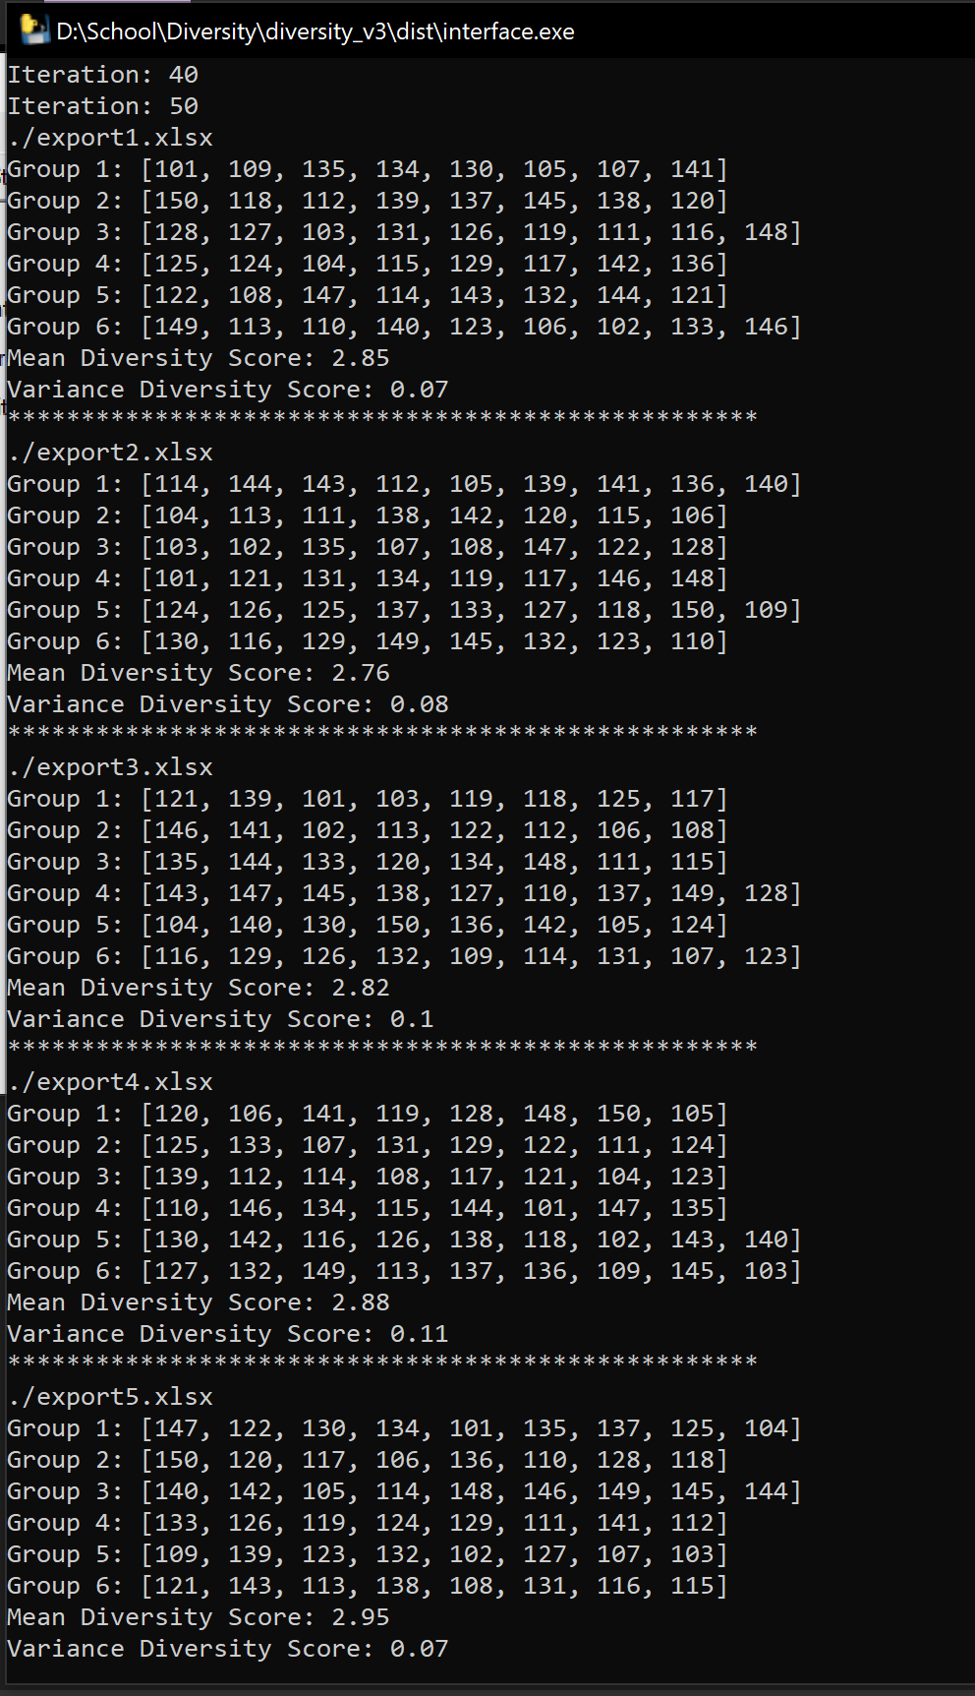
Terminal
Appears when you run the .exe file
Shows the number of iterations completed
After it has evaluated the each iteration, it prints out the top groups with 1 being the best iteration
It also displays the file the result was export to, the mean and variance diversity scores

Slide 14
Algorithm
Algorithm starts by obtaining the ideal percentage of each unique element in a column
For example, ideally in a perfectly diverse group, assuming we have 2 gender
Male = 0.5 and female = 0.5 (ideal state)
If a group has 2 male and 2 female, the algorithm awards
Male = 0.5 and female = 0.5 (current state)
It then subtracts the ideal state with the current state and that’s the absolute value
Male: |0.5–0.5| = 0 and Female: |0.5–0.5| = 0
Total score for this column = 0 + 0 = 0
The result is then added with other columns to get the total diversity score
The lower the score, the better the diversity

Slide 15
Algorithm
Now, if we have 3 males and 1 female, the algorithm awards
Male = 0.75 and female = 0.25
Subtract ideal by current state
Male = |0.5 – 0.75| = 0.25 and female = |0.5 – 0.25 | = 0.25
Total score for this column = 0.25 + 0.25 = 0.5
Now if we have 3 Chinese, 1 Indian and 1 Malay, the algorithm awards
Chinese = 0.6, Indian = 0.2 and Malay = 0.2, while ideal = 0.33
Chinese = |0.33-0.6| = 0.27, Indian = |0.33-0.2| = 0.13, Malay = |0.33-0.2| = 0.13
Total score for this column = 0.27 + 0.13 + 0.13 = 0.53
There may be more Chinese than other races (in the case of SG) but the score is meant to be taken relative to other iterations

Slide 16
Algorithm
Quartiles variables ideally should have a proportion of 0.25
As such the ideal state would be to have equal number of a quartile in a group
If there are 8 people in a group, 2 will be from Q1, 2 from Q2, 2 from Q3 and 2 from Q4

Slide 17
Weights
Using the example previously, the weights assigned are multiplied to the column score
The higher the weight the more influence it has over the total score
If gender weightage is 2 and race is 1 (assuming just 2 columns)
Diversity score = 2(0.5) + 1(0.53) = 1.53
The absolute diversity score does not hold meaning, it has to be evaluated alongside other diversity score and its performance is relative

Slide 18
Iterations
1 iteration
One iteration generates one possible permutation
Apart from seeding, the algorithm randomly selects people from the pool and allocate them base on the improvement of diversity they bring to the group
It is possible 2 iterations has exactly the same permutation, though very unlikely
Each group in the iteration is awarded a score
The mean diversity score of the iteration is the mean score of all the groups, while variance is the variance of all groups
We are looking for the lowest mean (greatest diversity) and lowest variance (equally balanced)

Slide 19
Contact
Feel free to reach out to me
Wai Kin
thamwaikin@u.nus.edu

