Slide 1

Analysis and Prediction of Wine Quality
TEACHER INSTRUCTIONS: QUÁCH ĐÌNH HOÀNG
SUBJECTS: PROGRAMMING R FOR ANALYSIS

Slide 2
Team member
STT ID Full name
30 19133032 Nguyễn Thị Mỹ Linh
42 19133046 Lê Thị Thanh Phương
43 19133003 Nguyễn Duy Phước
49 19133051 Võ Thị Ngọc Thắm

Slide 3
Introduction to data sets
Link dataset : https://www.kaggle.com/rajyellow46/wine-quality
The two datasets are related to red and white variants of the Portuguese "Vinho Verde" wine. The reference [Cortez et al., 2009]. Due to privacy and logistic issues, only physicochemical (inputs) and sensory (the output) variables are available (e.g. there is no data about grape types, wine brand, wine selling price, etc.)

Slide 4
Introduction to data sets
Dataset have 13 col and 6497 row
1 "type" 7 "free.sulfur.dioxide" 13 "quality"
2 "fixed.acidity" 8 "total.sulfur.dioxide"
3 "volatile.acidity" 9 "density"
4 "citric.acid" 10 "pH"
5 "residual.sugar" 11 "sulphates"
6 "chlorides" 12 "alcohol"

Slide 5
Test data
Checking the data shows that there are 38 null values

Slide 6
ANALYSIS GOAL
Factor linkage analysis into quality wine
Use the model(k-Nearest Neighbors, Linear Regression, Decsion Tree) to predict wine quality

Slide 7
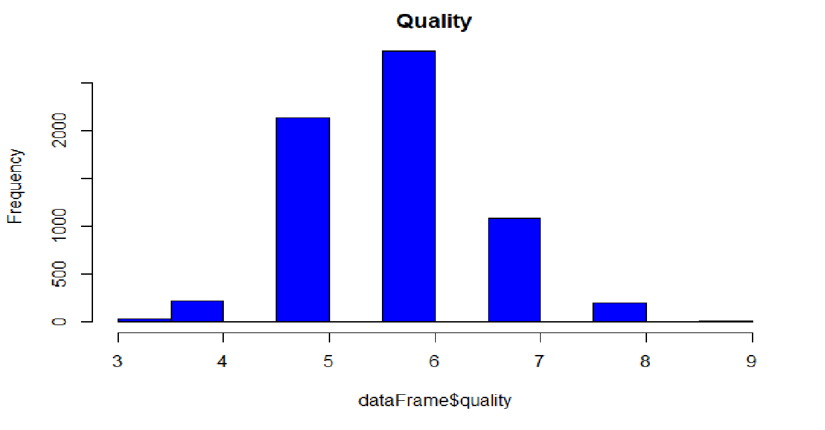
Factor linkage analysis into quality wine
Wine quality appear to follow a fairly normal bell shaped distribution
This implies most wines are of average quality and few are good or bad

Slide 8
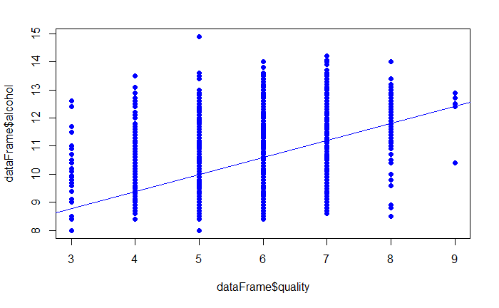
Factor linkage analysis into quality wine
->covariate relationship

Slide 9
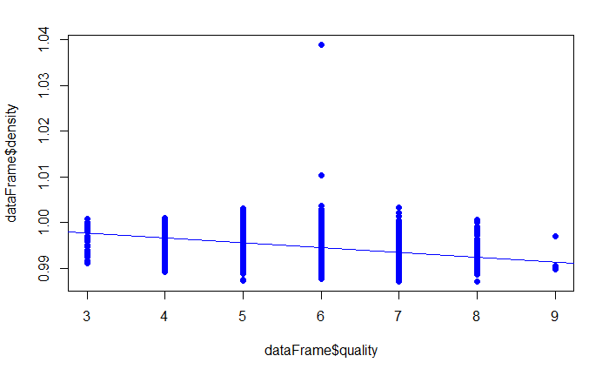
Factor linkage analysis into quality wine
-> inverse relationship

Slide 10
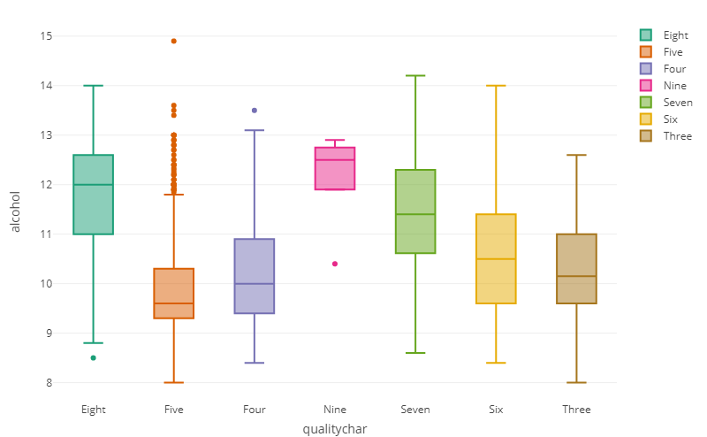
Factor linkage analysis into quality wine

Slide 11
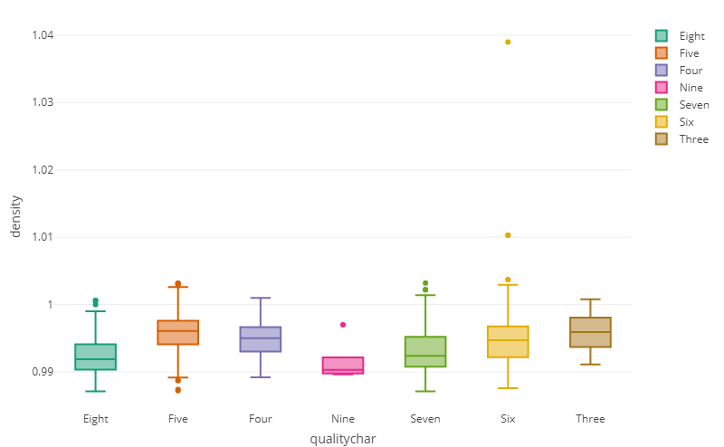
Factor linkage analysis into quality wine

Slide 12
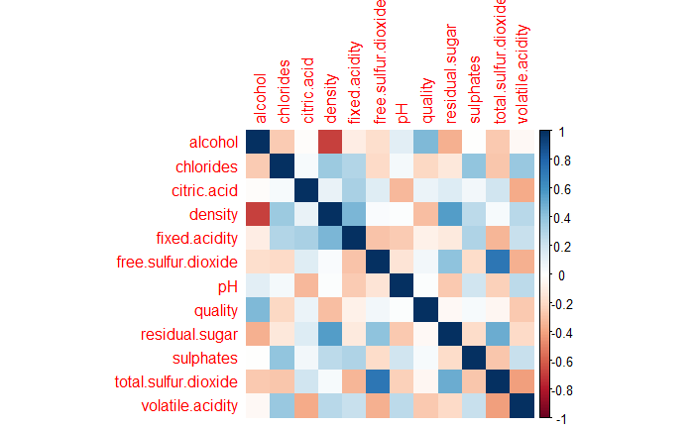
Factor linkage analysis into quality wine

Slide 13
Factor linkage analysis into quality wine
Summary:
Most wines are of average quality and few are good or bad
Variable alcohol, density has a high influence on variable quality
alcohol have a proportional relationship with quality
density have a inverse relationship with quality

Slide 14
k-Nearest Neighbors

Slide 15
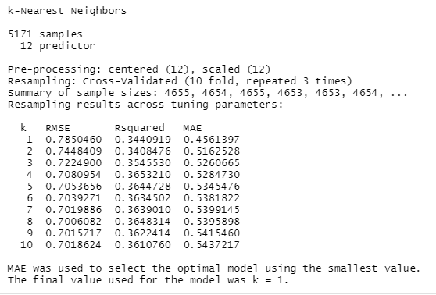
Modeling Regression on Train set

Slide 16
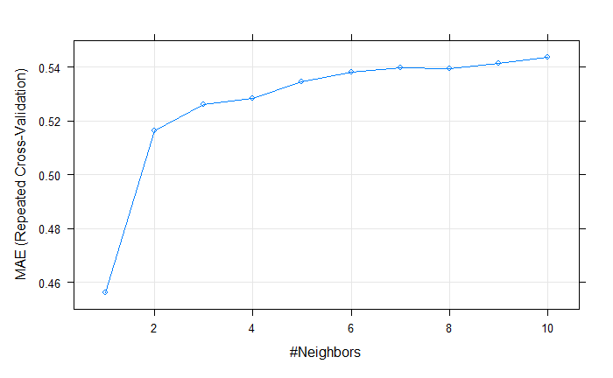
Visualization
K = 1
minimum MAE value
0.4561397

Slide 17
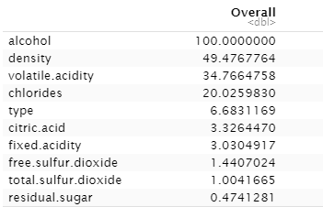
Model Evaluation
Loess r-squared variable importance

Slide 18


Model Evaluation
Summary of Actual:
Summary of Predicted:
Comment: From the summaries above, it is obvious that the model does really bad at estimating the bad and the really good wine.

Slide 19
Model Evaluation
MAE:
[1] 0.4427245
Comment: An MAE of 0,44 is acceptable given MAE is from a scale of 0 to 10

Slide 20
Linear Regression

Slide 21
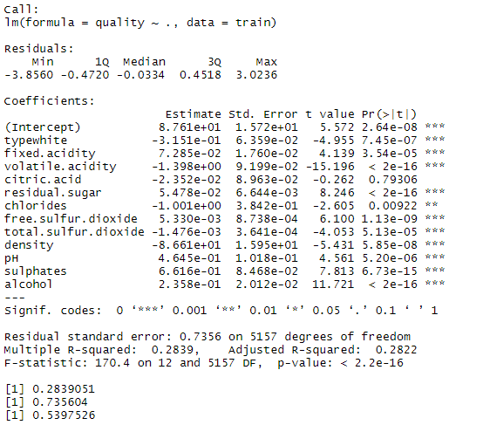
Model on training data
R-squared = 0.28
MSE = 0.53

Slide 22
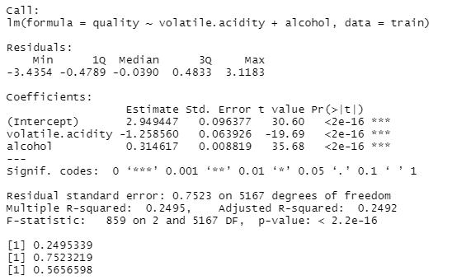
R-squared = 0.25
MSE = 0.56
quality ≈ 2.9 - 1.26 volatile.acidity + 0.31 alcohol
The alcohol coefficient suggests that for every 1 increase in alcohol, holding all other predictors constant, we can expect an increase of 0.3 quality units, on average
The volatile.acidity coefficient suggests that for every 1 decrease in volatile.acidityl , holding all other predictors constant, we can expect an increase of 1.26 quality units, on average

Slide 23
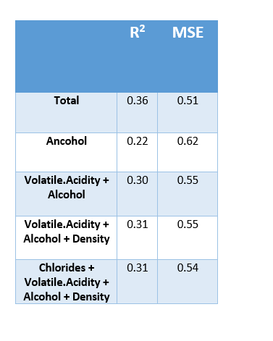
Model on Test data
Results on the test set are not significantly different from on the train set
1. Is there a relationship between quality and predictors ?
Indicating clear evidence of a relationship between predictors and quality
2. Is the relationship linear?
Not good

Slide 24
Decsion Tree
Notes:
Cây quyết định (Decision Tree) là một cây phân cấp có cấu trúc được dùng để phân lớp các đối tượng dựa vào dãy các luật.

Slide 25
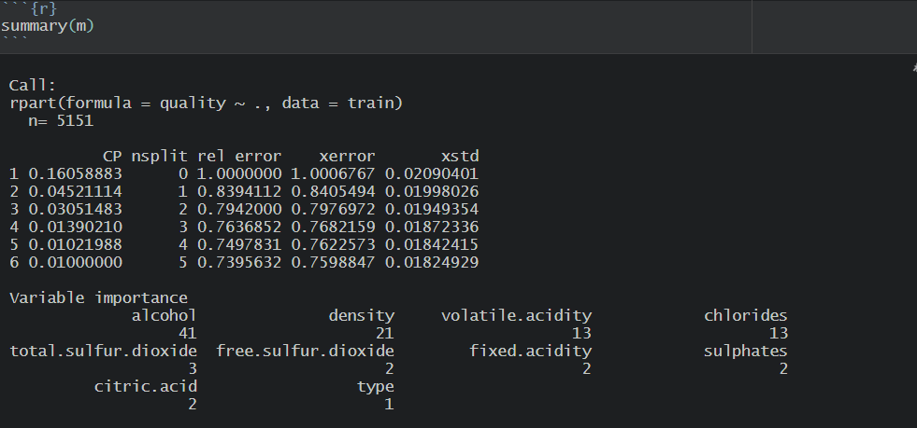
Model Training (Regression Tree)

Slide 26
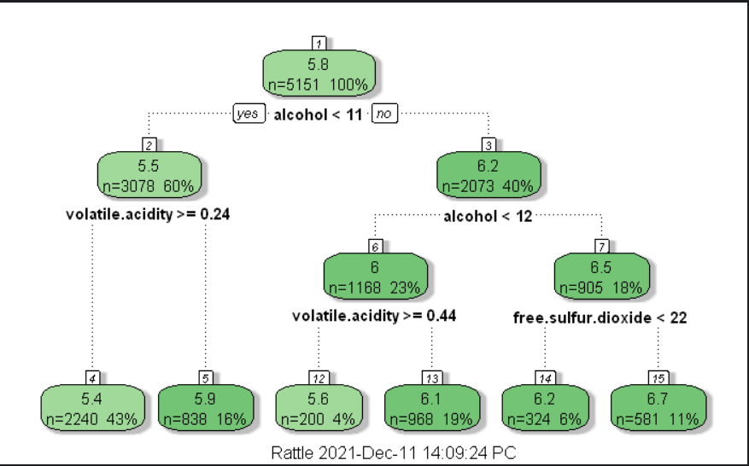
Visualizing Decision Trees

Slide 27
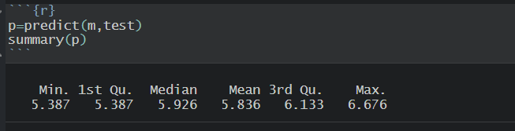
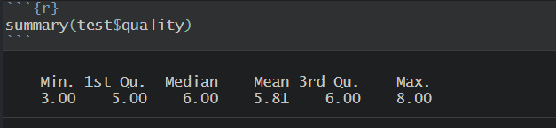
Model Evaluation
Summary of Predicted :
Comment : From the summaries above, it is obvious that the model does really bad at estimating the bad and the really good wine.
Summary of Actual:

Slide 28
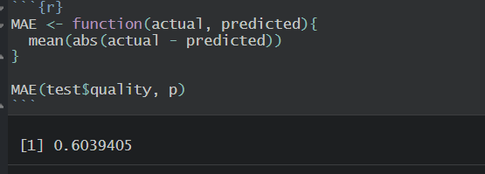
Model Evaluation
Mean Absolute Error (MAE):
Comment: An MAE of 0.6 is acceptable given MAE is from a scale of 0 to 10 .

Slide 29
Summary :
According to 3 models KNN is the best model in predicting wine quality
The important variables in the model : Alcohol, density, volatility.acidity, chloride.

