Slide 1
Dota2 matches
dataset

Slide 2
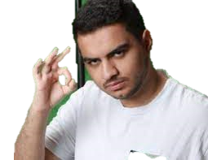
What’s Dota2
The best MOBA game in the world
To win the match
Farm
Fight
Attack the tower
To lose the match
Farm all game ☺

Slide 3
What’s inside the dataset
50,000 Matches
Player stat in any matches
Score and income every 60 seconds
537,768 team fights
End match data
Time dependency

Slide 4
Data at the end of the match
each player scores in the match
Hero
Gold spent
GPM and XPM
Score
Stun duration

Slide 5
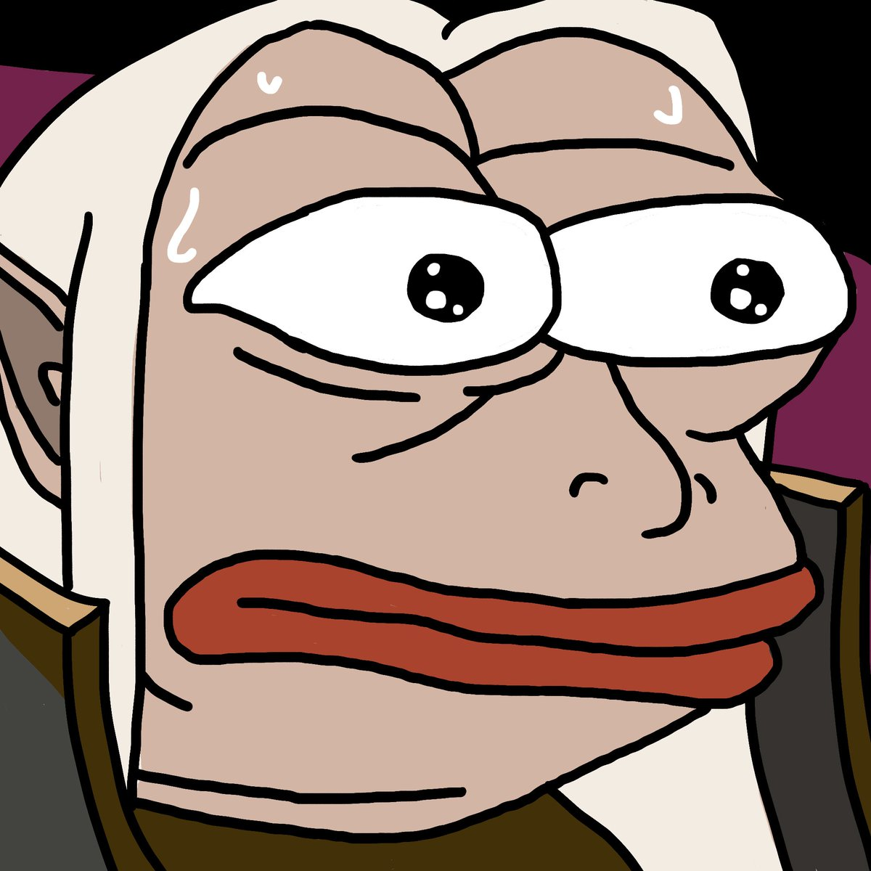

Hero Cluster
Cluster 0
Shadow Fiend
Windranger
Alchemist
Juggernaut
Invoker
Cluster 1
Windranger
Earthshaker
Slardar
Dazzle
Rubick

Slide 6
Data at the end of the match
Match data
Each player scores in the match
Match id | duration | Tower_Barracks status | First blood time | winner
0
1
Match id | Player slot | Hero id | statistic | score
0 | 1
0 | 2
[500000, 17]
[50000, 8]
Sum value for team features
Match id | duration | Tower_barrack status | First blood time | Radiant score | dire score | Radiant stat | Dire stat | winner
0
1
[50000, 36]

Slide 7
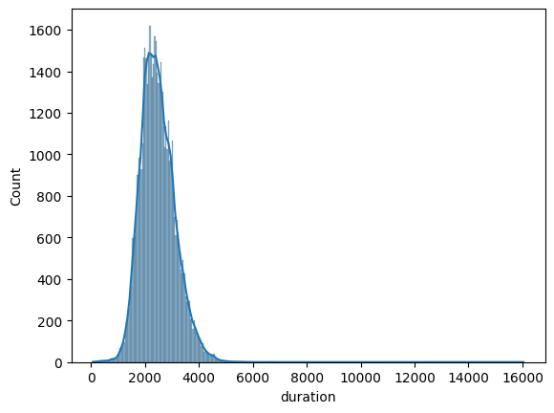
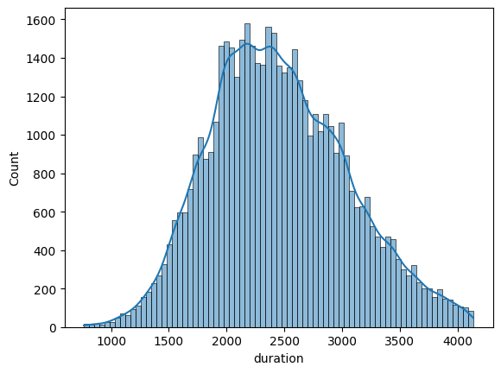
Duration of gameplay
Remove outliers

Slide 8
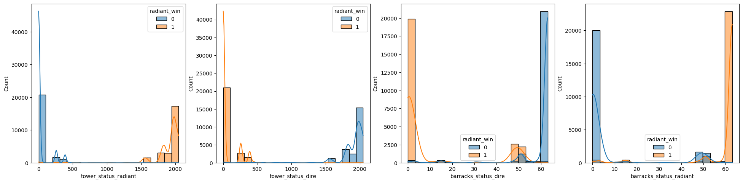
Tower and barracks status
Remove 4 features because
Bias feature, the winner measured at the last tower

Slide 9
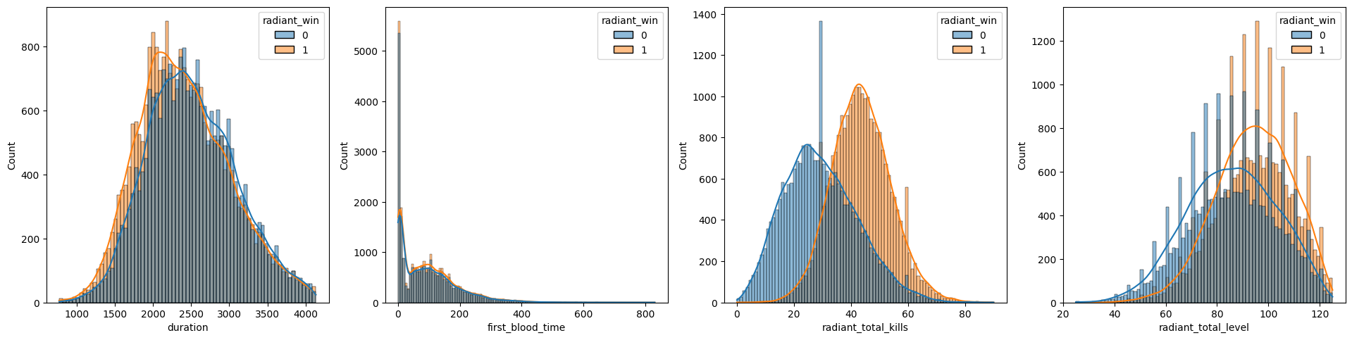
What’s we get?
Most games end at 2476 seconds
The average level of the whole team is 18
The killing score of winner team is 44.7 and 29.37 for the loser team
36.7% of first blood time is in range 0 - 41.55 seconds

Slide 10
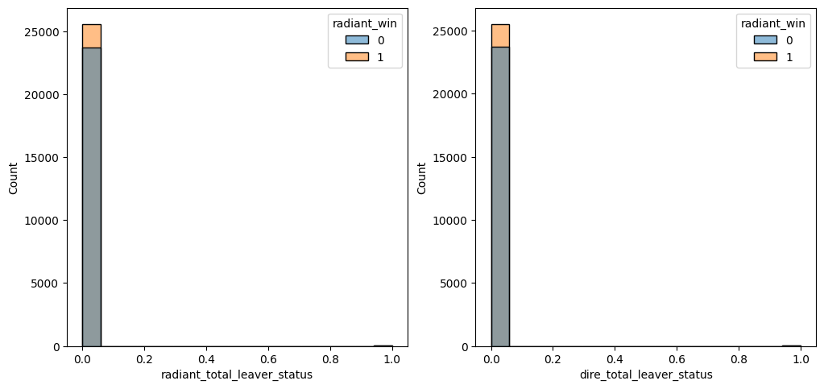
Leaver status
The data of abandoned matches is too less

Slide 11
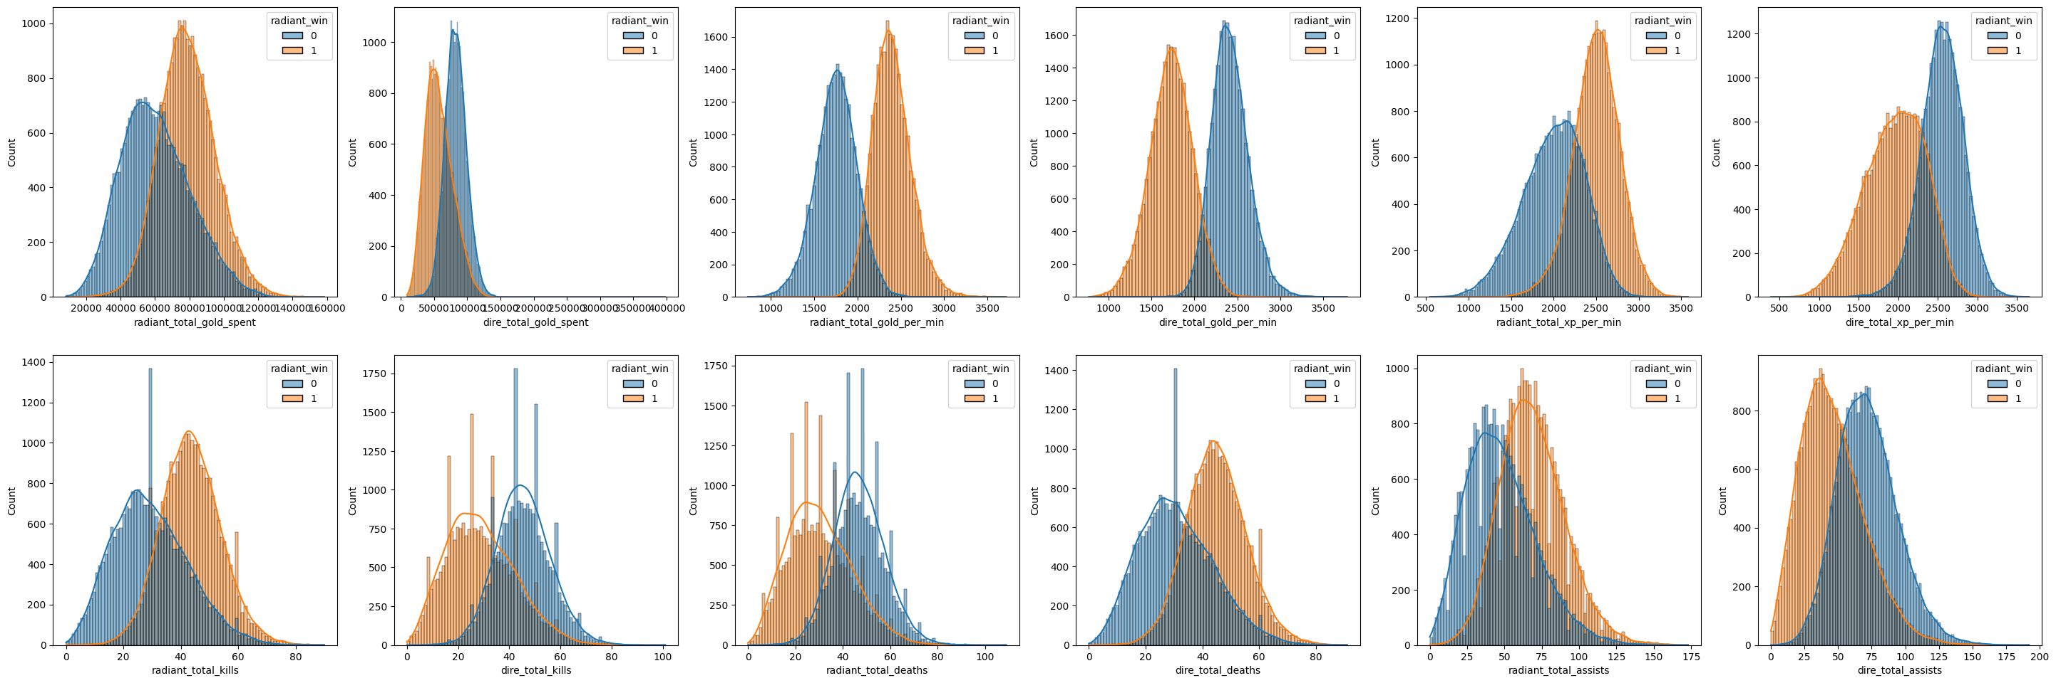
Good feature for predict winner team
Incomes and expenses
Team score

Slide 12
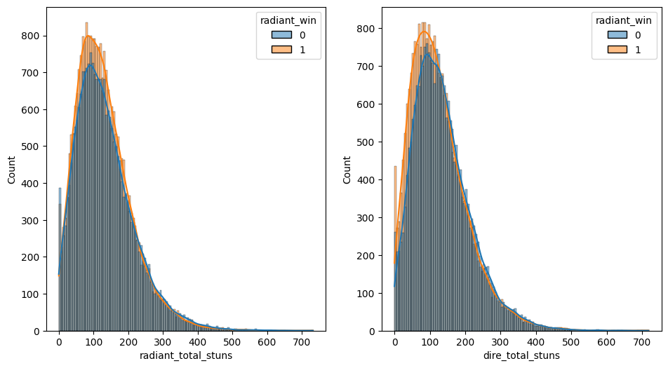
Stuns duration
Stuns duration do not impact wins and losses
What does it indicate?

Slide 13
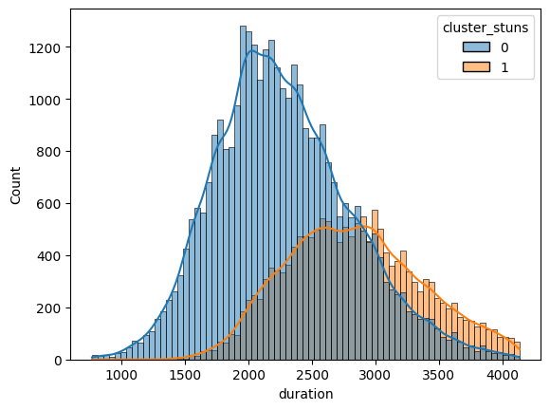
Cluster stuns duration
The clusters with high stuns duration will slightly increase gameplay time

Slide 14
Team fight during a matches
The data include
Team fight timestamp
Delta gold and XP for each player after the team fights
Each Player stat every 60 seconds in the match
Objective: predict the benefit team
Assumption: the team with more gold and XP before the team fight will get benefits after the team fight
Compare each team and
define this feature as the target

Slide 15
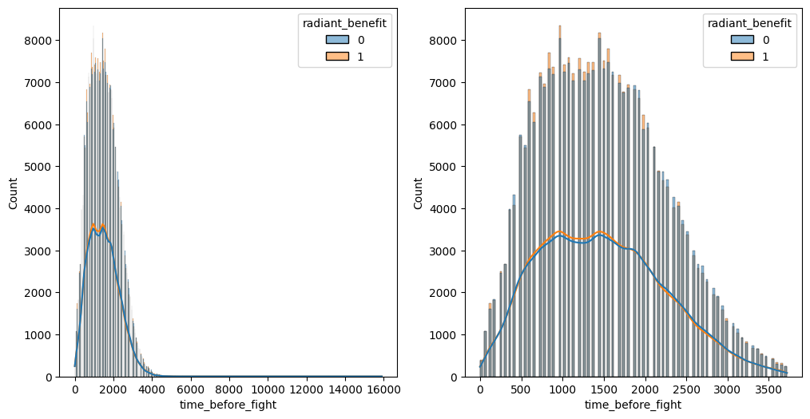
Time before team fight
Remove outliers

Slide 16
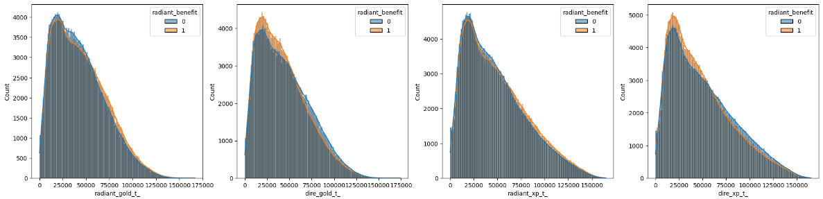
Gold and XP before team fight
The gold and XP each team before the team fight doesn't affect to the benefit of that team fight

Slide 17
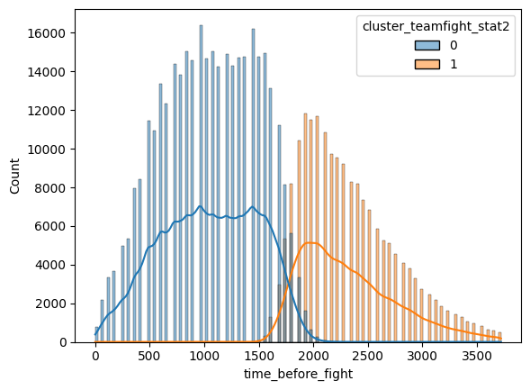
What does it indicate?
Ans Time before the team fight

Slide 18
Summarize

Slide 19

THANK YOU

