Slide 1
React-query
Siam smile broker
Workshop by p. Thanapoom

Slide 2
1.Introduction react-query
https://react-query.tanstack.com/

Slide 3
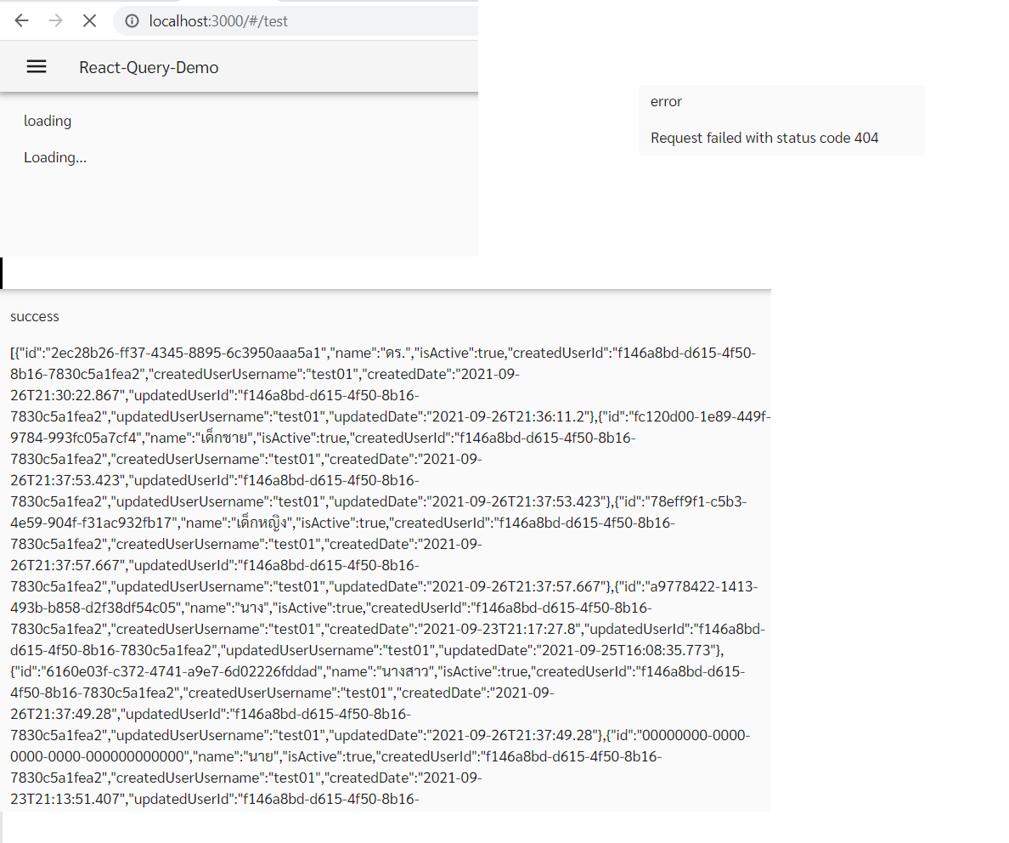
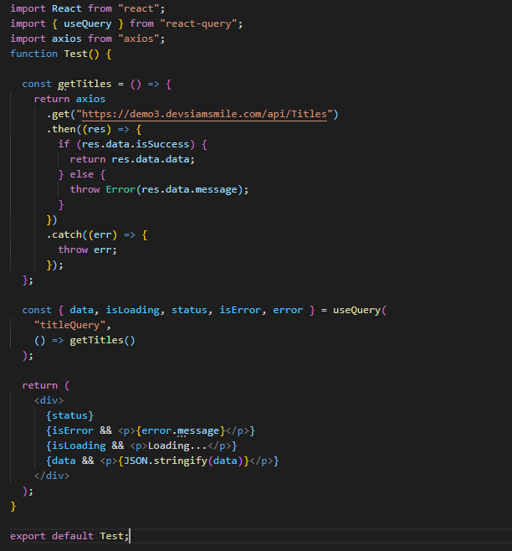
2.Basic query

Slide 4
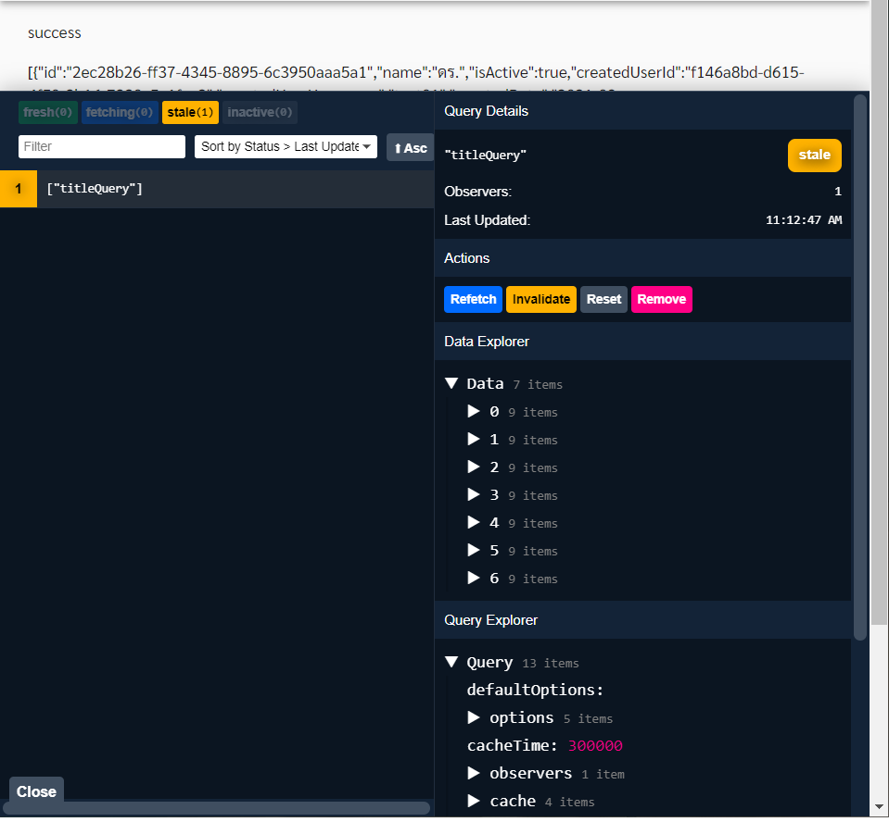
3.Dev tools

Slide 5
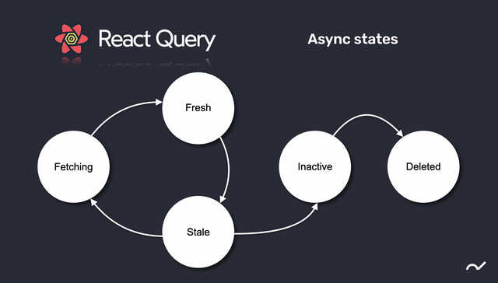
React query state

Slide 6
4.Important default
https://react-query.tanstack.com/guides/important-defaults
Stale queries are refetched automatically in the background when:
New instances of the query mount
The window is refocused
The network is reconnected.
The query is optionally configured with a refetch interval.
By default, "inactive" queries are garbage collected after 5 minutes.
Queries that fail are silently retried 3 times, with exponential backoff delay before capturing and displaying an error to the UI.
To configure default =>
https://react-query.tanstack.com/reference/QueryClient#queryclientgetdefaultoptions

Slide 7
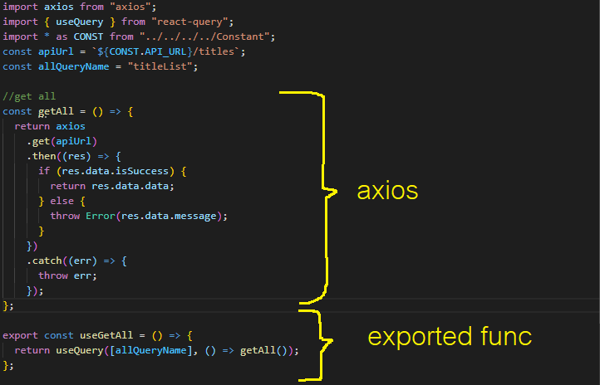
5.Reuse-api

Slide 8
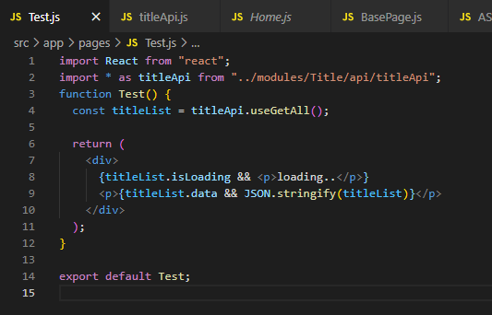
5.Reuse-api #2

Slide 9
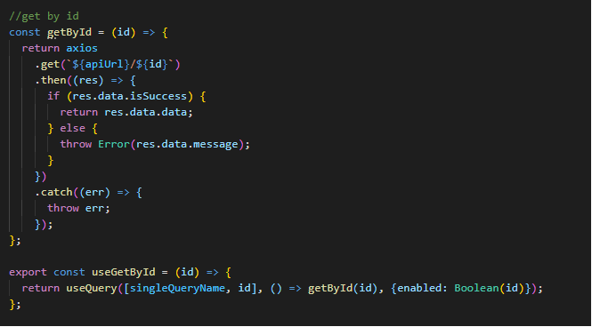
6.Passing parameters to react-query
https://react-query.tanstack.com/guides/query-keys#if-your-query-function-depends-on-a-variable-include-it-in-your-query-key
params
Make query enabled only when parameter passed to it

Slide 10
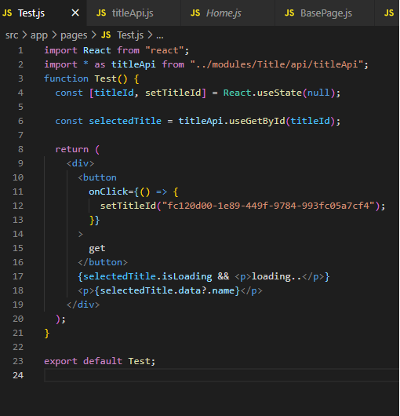
Passing params #2

Slide 11
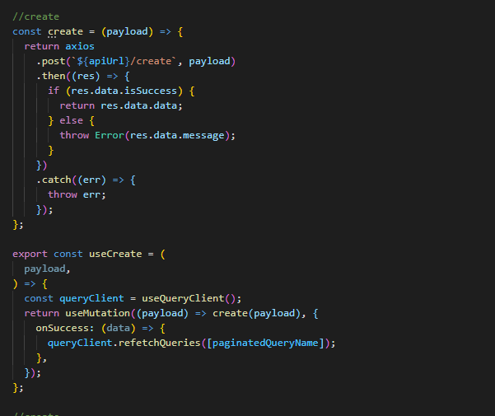
7. Post (mutate)
Trigger to update another queries
By query name

Slide 12
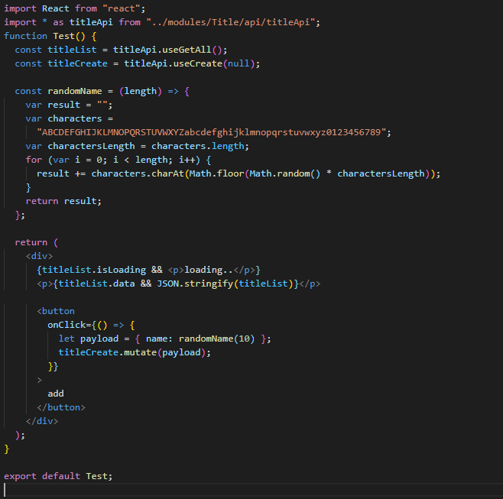
Post (mutate) #2

Slide 13
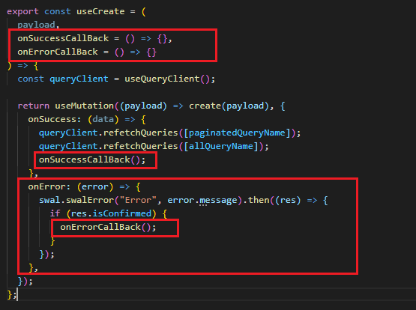
8.Call back

Slide 14
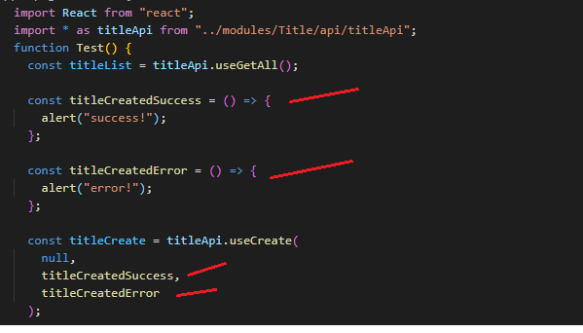
Call back #2

Slide 15
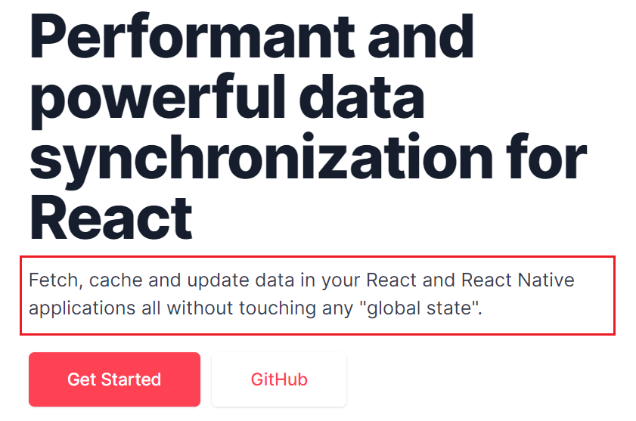
9. react-query & redux
https://react-query.tanstack.com/guides/does-this-replace-client-state
React-query
SERVER State
redux
global State
Persist states
Layout
Global states
Component states

