Slide 1
MTG Satellites, Instruments and Data, a limited overview
NOA/ReACT Athanasios Natsis

Slide 2
Definitions
MTG: Meteosat Third Generation system of geostationary satellites operated by EUMETSAT.
EUMETSAT: Europe’s meteorological satellite agency, an intergovernmental organization.
goal: Produce satellite data on weather, climate, and the environment. Provide near-real time data for members, partners, and other data users.
fields: Nowcasting, Numerical Weather Prediction models, Climate records, Other products and services (firefighting, air quality forecasts, air traffic control, search and rescue missions, disaster risk reduction, agricultural productivity, marine and coastal management……)

Slide 3
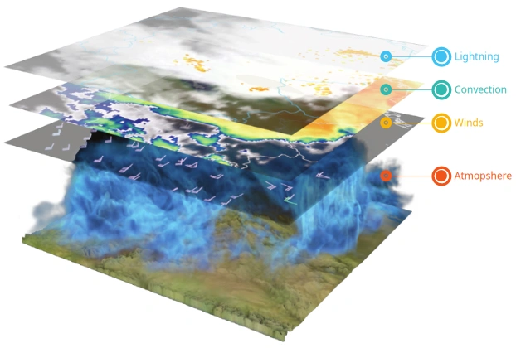
Data scope
NRT 4d weather cube

Slide 4
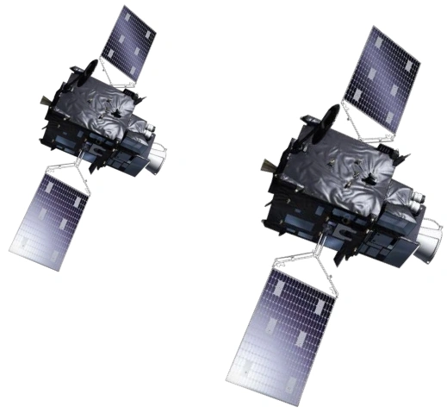
MTG-I Imaging mission
FCI - Full disc scanning service
/10 minutes, 16 spectral bands
FCI - Rapid scanning service
Europe /2.5 minutes, 16 spectral bands
LI - Lightning Imager
Full disc, continuous
MTG-I
https://www.eumetsat.int/meteosat-third-generation
https://user.eumetsat.int/resources/user-guides/mtg-in-operations

Slide 5
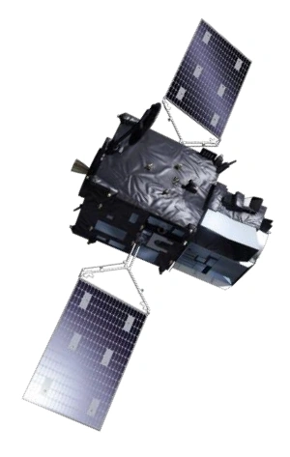
MTG-S Sounding mission
Infrared Sounder (IRS)
1/4 of Full disk /15 minutes
Ultraviolet Visible Near-infrared (UVN) Sounder
Copernicus Sentinel-4
Smaller disc than FCI, /60min
MTG-S
https://www.eumetsat.int/meteosat-third-generation
https://user.eumetsat.int/resources/user-guides/mtg-in-operations

Slide 6
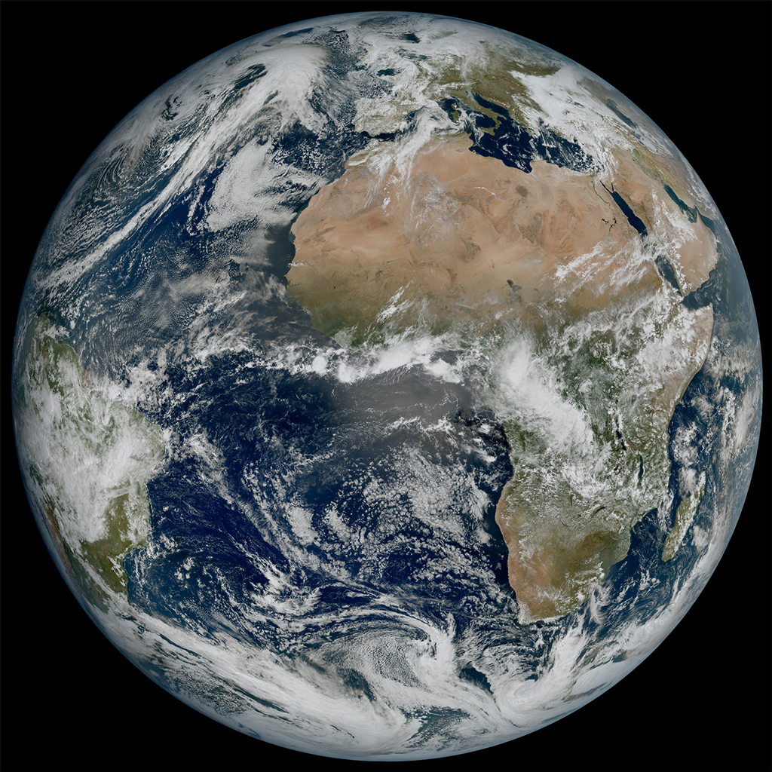

Slide 7
 | Channel | λc | Δλ | SSD
1 | VIS 0.4 | 0.444 µm | 0.060 µm | 1.0 km
2 | VIS 0.5 | 0.510 µm | 0.040 µm | 1.0 km
3 | VIS 0.6 | 0.640 µm | 0.050 µm | 1.0 km 0.5 km (HR)
4 | VIS 0.8 | 0.865 µm | 0.050 µm | 1.0 km
5 | VIS 0.9 | 0.914 µm | 0.020 µm | 1.0 km
6 | NIR 1.3 | 1.380 µm | 0.030 µm | 1.0 km
7 | NIR 1.6 | 1.610 µm | 0.050 µm | 1.0 km
8 | NIR 2.2 | 2.250 µm | 0.050 µm | 1.0 km 0.5 km (HR)
9 | IR 3.8 | 3.800 µm | 0.400 µm | 2.0 km 1.0 km (HR)
10 | WV 6.3 | 6.300 µm | 1.000 µm | 2.0 km
11 | WV 7.3 | 7.350 µm | 0.500 µm | 2.0 km
12 | IR 8.7 | 8.700 µm | 0.400 µm | 2.0 km
13 | IR 9.7 | 9.660 µm | 0.300 µm | 2.0 km
14 | IR 10.5 | 10.500 µm | 0.700 µm | 2.0 km 1.0 km (HR)
15 | IR 12.3 | 12.300 µm | 0.500 µm | 2.0 km
16 | IR 13.3 | 13.300 µm | 0.600 µm | 2.0 km
Flexible Combined Imager FCI
Full Earth disk every 10 minutes
λc: Central wavelength [μm]
Δλ: Spectral width
SSD: Spatial Sampling Distance
Channels: VIS (Visible), NIR (Near IR), IR (Infrared), WV (Water Vapour)
https://user.eumetsat.int/resources/user-guides/mtg-fci-level-1c-data-guide

Slide 8
EUMETSAT MTG available products (2026-02-01)
Accumulated precipitation at ground by blended MW+IR and FCI
Active Fire Monitoring (CAP, netCDF)
All Sky Radiance (BUFR, netCDF)
Atmospheric Motion Vectors (BUFR, netCDF)
Clear Sky Reflectance Map
Cloud Mask (GRIB2, netCDF)
Cloud Top Temperature and Height
Cloud Type
FCI Level 1c High Resolution Image Data
FCI Level 1c Normal Resolution Image Data
FCI Level 3 Sea Surface Temperature
FCI Snow detection (snow mask) by VIS/NIR radiometry
Global Instability Indices
LI Accumulated Flash Area
LI Accumulated Flash Radiance
LI Accumulated Flashes
LI Lightning Events Filtered
LI Lightning Flashes
LI Lightning Groups
Land Surface Temperature
Optimal Cloud Analysis
Outgoing LW radiation at TOA
Precipitation rate at ground by blended FCI IR / LEO MW precipitation
https://data.eumetsat.int/extended?query=mtg

Slide 9
FCI composites (MTG-I)
Predefined composites of wavelengths…
from satpy import Scene
scn = Scene(filenames = files, reader = 'fci_l1c_nc')
print(scn.available_composite_names())
24h_microphysics, airmass, ash, cimss_cloud_type, cimss_cloud_type_raw, cloud_phase, cloud_phase_distinction, cloud_phase_distinction_raw, cloud_phase_raw, cloud_phase_with_night_ir105, cloud_type, cloud_type_with_night_ir105, cloudtop, colorized_ir_clouds, convection, day_essl_colorized_low_level_moisture, day_essl_low_level_moisture, day_microphysics, day_severe_storms, day_severe_storms_tropical, dust, essl_colorized_low_level_moisture, essl_low_level_moisture, fci_fire_channels_sum, fire_temperature, fire_temperature_38refl, fire_temperature_rad, flames_masked, fog, geo_color, geo_color_background_with_low_clouds, geo_color_high_clouds, geo_color_low_clouds, geo_color_night, green_snow, hrv_clouds, ir108_3d, ir_cloud_day, ir_sandwich, ir_sandwich_with_night_colorized_ir_clouds, natural_color, natural_color_raw, ndvi_hybrid_green, ndvi_hybrid_green_fully_sunzencorrected, ndvi_hybrid_green_raw, night_fog, night_ir105, night_ir_alpha, night_ir_with_background, night_ir_with_background_hires, night_microphysics, night_microphysics_tropical, overshooting_tops, rocket_plume_day, rocket_plume_night, simple_fci_fire_mask, snow, true_color, true_color_flames_with_night_ir105, true_color_fully_sunzencorrected, true_color_raw, true_color_raw_with_corrected_green, true_color_reproduction, true_color_reproduction_corr, true_color_reproduction_uncorr, true_color_with_night_ir, true_color_with_night_ir105, true_color_with_night_ir_hires, volcanic_emissions

Slide 10
LI Lightning Imager MTG-I
Events (LEF - Lightning Events Filtered): The finest scale of data. An event is a single triggered pixel where a sudden increase in energy is detected within a 1 ms frame.
Groups (LGR - Lightning Groups): Aggregated adjacent events occurring within the same 1 ms acquisition frame. Group locations are calculated as the radiance-weighted centroid of the events within them.
Flashes (LFL - Lightning Flashes): A collection of groups that are correlated in space (within 16.5 km) and time (within 330 ms)
https://user.eumetsat.int/resources/user-guides/using-mtg-lightning-imager-li-to-track-convective-storms

Slide 11
Variable | Description
group_time | UTC time of the group
latitude | Avg latitude of the events in the group weighted by the event radiance
longitude | Avg longitude of the events in the group weighted by the event radiance
radiance | Total radiance of the group (Optical Characteristics of OTD Flashes and the Implications…)
number_of_events | Number of events in the group
flash_id | ID of the flash that allows one to relate the groups in the LI-2-LGR-x-FD-x to the LI-2-LFL-x-FD-x
group_filter_qa | Quality of the group computed at the group-rejection step (Rejection of groups prior to the comp…)
LI Lightning Imager
MTG-I
Lightning Imager Groups
Key variables in LI-2-LGR-x-FD-x.
https://user.eumetsat.int/resources/user-guides/mtg-li-level-2-data-guide

Slide 12
Variable | Description
flash_time | UTC time of the first group in the flash
flash_duration | Duration of the flash, ie, time difference between the first a the last group of the flash
latitude | Average latitude of the events in the flash weighted by the event radiance
longitude | Average longitude of the events in the flash weighted by the event radiance
radiance | Total radiance of the flash (Optical Characteristics of OTD Flashes and the Implications…)
number_of_events | Number of events in the flash
number_of_groups | Number of groups in the flash
flash_footprint | Size of the flash footprint in number of pixels
flash_id | ID of the flash
flash_filter_confidence | Quality of the filter computed at the group-rejection step (Rejection of flashes)
LI Lightning Imager
MTG-I
Lightning Imager Flashes
Key variables in LI-2-LFL-x-FD-x.
https://user.eumetsat.int/resources/user-guides/mtg-li-level-2-data-guide

Slide 13
InfraRed Sounder IRS (MTG-S)
Hyperspectral infrared sounder
Goal:
Derive the evolution of vertically resolved water vapour structures
Extract 3D wind fields with a vertical resolution ~ 2 km
Track the 3D structures
atmospheric water vapour and temperature
carbon monoxide and pollution
atmospheric dynamic variables
Spatial: 4km at nadir (1.025° x 1.025°)
Temporal: 15 – 30 min local zones, 60 min full disk
Notes:
spatial on the Earth surface is 4km at nadir, increasing up to 10km, and above
160 x 160 interferograms and four broad-band high-resolution images for each spectral band
No concurrent ‘full disc scan’
160 x 160 x (877;1076)

Slide 14
InfraRed Sounder IRS (MTG-S) Instrument
Band | Wavenumber Range | Channels | Main Targets
Long Wave IR (LWIR) | 679.5 – 1210.0 cm⁻¹ | 887 | H2O, CO2, O3, Surface, Clouds, Aerosols
Mid Wave IR (MWIR) | 1600.0 – 2250.4 cm⁻¹ | 1076 | H2O, CO, N20, NO
Vertical resolution TBD … (~ 2km)
https://user.eumetsat.int/resources/user-guides/mtg-irs-level-1-data-guide

Slide 15
InfraRed Sounder IRS (MTG-S)
L2 data
Temperature, humidity and ozone profiles
Earth Surface parameters
Instability indices and total vertical column
Cloud products
Contextual parameters
Test/Simulated data available here
https://user.eumetsat.int/resources/user-guides/mtg-irs-level-1-data-guide

Slide 16
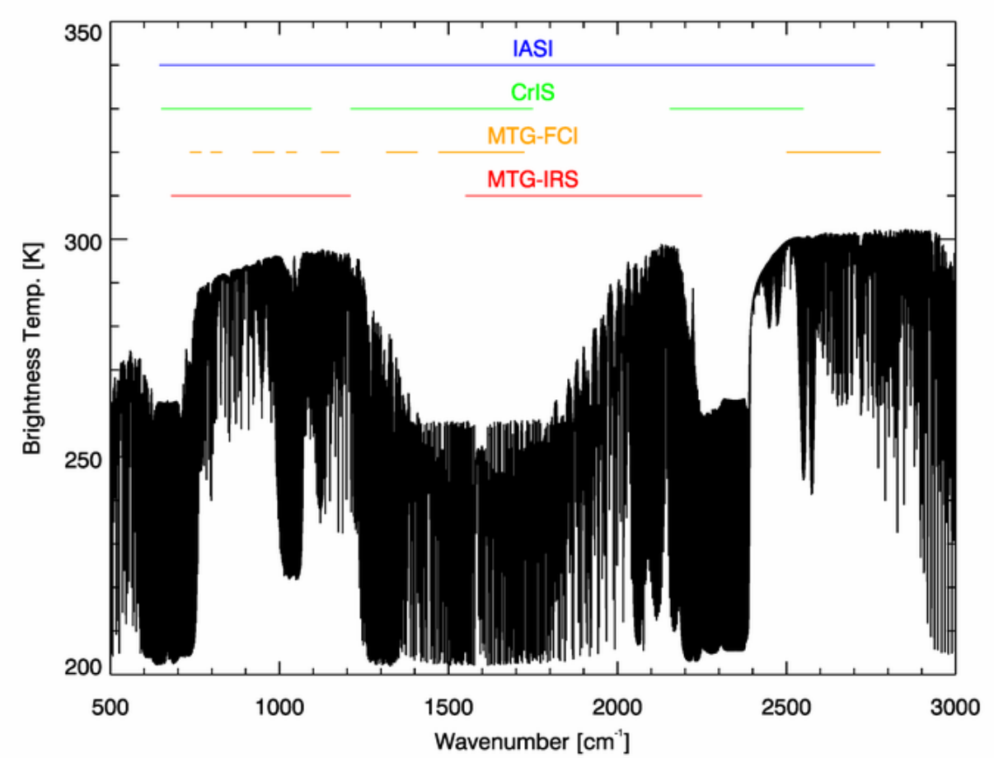
Spectral coverage
Infrared Atmospheric Sounding Interferometer (LEO)
Cross-track Infrared Sounder (LEO)
MTG InfraRed Sounder (GEO)
MTG Flexible Combined Imager (GEO)
user.eumetsat.int/resources/user-guides/mtg-irs-level-1-data-guide

Slide 17
Sentinel-4/Ultraviolet, Visible and Near-infrared Spectrometer (S4 / UVN) (MTG-S)
objective: Observe the diurnal cycle of the tropospheric composition, trace gases, aerosol and cloud properties
O3 (Ozone), NO2 (Nitrogen dioxide), SO2 (Sulfur dioxide), HCHO (Formaldehyde), CHOCHO (glyoxal)
Instrument type | Passive imaging spectrometer
Spectrometric bands | 3, Ultraviolet (305-400 nm), Visible (400-500 nm) and Near Infrared (750-775 nm) ¹
Spectrometric channels | 2, (UV-VIS channel; NIR channel)
Field Of View | E-W: 30°W-46.5°E @ 40°N, N-S: 30°N-65°N
Spatial resolution | 8 x 8 km²
Spectral resolution | 0.5 nm for the UV-VIS channel; 0.12 nm for the NIR channel
Radiometric accuracy (absolute) | 3% (2% goal) of the measured sun irradiance, earth radiance and spectral reflectance
Revisit time | ~ 60 min

Slide 18
Sentinel-4/Ultraviolet, Visible and Near-infrared Spectrometer (S4 / UVN) (MTG-S)
L1 data
Level-1B product | Parameter(s) | Distributed
Earth Radiance | Spectrally and radiometrically calibrated and geo-located Earth radiance | To all users
Solar Irradiance | Spectrally and radiometrically calibrated Solar irradiance | To all users
DPPF | Data Processing Parameters | To Expert Users
Calibration | Calibration data. | To Expert Users
Star | Star calibration data | To Expert Users
Diagnostic | Instrument diagnostic data | To Expert Users

Slide 19
Sentinel-4/Ultraviolet, Visible and Near-infrared Spectrometer (S4 / UVN) (MTG-S)
L2 data
Level-2 products | Parameter(s)
O3 | Ozone (O3) total column, tropospheric sub-column,
NO2 | Nitrogen dioxide (NO2) total column, tropospheric sub-column
SO2 | Sulfur dioxide (SO2) total column
HCHO | Formaldehyde (HCHO) total column
CHOCHO | Glyoxal (CHOCHO) total column
Cloud | Cloud optical thickness, cloud fraction, cloud altitude
Aerosol | Aerosol column optical thickness, type, layer height, absorbing index
Surface | Surface and aerosol characteristics
https://sentinels.copernicus.eu/missions/sentinel-4

Slide 20
Main data resources
EUMETSAT data store / EUMETSAT data catalogue
EUMETSAT ‘data archive’
Satellite Application Facilities SAF
AC SAF, Atmospheric Composition Monitoring, ozone, trace gases, aerosols and ultraviolet data
H SAF, Operational Hydrology and Water Management, data for operational hydrological
LSA SAF, Land Surface Analysis, land, land-atmosphere interactions and biosphere
NWC SAF, Nowcasting and Very Short Range Forecasting, forecast for the next few hours
NWP SAF, Numerical Weather Prediction, interface between satellite data and European activities in NWP
OSI SAF, Ocean and Sea Ice, ocean-atmosphere interface
ROM SAF, Radio Occultation Meteorology, high-quality GNSS Radio Occultation (RO) data for NWP and climate application areas
Notes:
SAFs in general have data and Software

Slide 21
Main reference resources
EUMETView, interactive map and product explorer
EUMETSAT User Portal, guides and products references
Training
Software
Guides
……

Slide 22
SAF example
Land Surface Analysis LSA SAF, available products:
Land Surface Albedo (MTDAL)
Fire Radiative Power (MTFRP)
Land Surface Temperature (MTLST)
https://datalsasaf.lsasvcs.ipma.pt/PRODUCTS/MTG/

Slide 23
SAF example
Atmospheric Composition Monitoring AC SAF, available products
NRT products
Total ozone column
Total and tropospheric NO2 columns
Total SO2 column
Total HCHO column
High-resolution ozone profile
Absorbing aerosol height
Absorbing aerosol index from PMDs
Global 1-day UV index forecast
Global tropospheric ozone column
IASI CO
IASI SO2
IASI HNO3
IASI total O3 and O3 profiles
Offline products
Total ozone column
Total and tropospheric NO2 columns
Total SO2 column
Total BrO column
Total HCHO column
Total H2O column
High-resolution ozone profile
Absorbing aerosol height
Absorbing aerosol index from PMDs
Surface UV
Tropical tropospheric ozone column
Global tropospheric ozone column
GOME-2 level 3 daily trace gas columns
GOME-2 level 3 monthly trace gas columns
Data records
Total ozone column
Total and tropospheric NO2 columns
Total SO2 column
Total BrO column
Total HCHO column
Total H2O column
OCIO column
Total CHOCHO column
NO2 and H2O climate data records
Tropospheric BrO column
High-resolution ozone profile
Absorbing aerosol height
Absorbing aerosol index from PMDs
Lambertian-equivalent reflectivity
Surface UV
IASI L2 O3
IASI L2 CO
IASI L2 SO2
Demonstrational products
Daily IASI NH3 product
Daily IASI dust product
European UV product/data record
acsaf.org

Slide 24
Other Links
MTG in operations Current status and operational information
MTG test data If you want to test possible applications

Slide 25
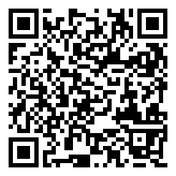
This was an overview of the MTG satellites and data
ευχαριστώ! Thanks!
contact: anatsis@noa.gr
presentation: github.com/thanasisn/presentations

