Slide 1
Investigation of direct and global downward sort-wave radiation over Thessaloniki
Includes newest trends! Athanasios Natsis

Slide 2
What we measure

Slide 3
How we measure

Slide 4
How we prosses

Slide 5
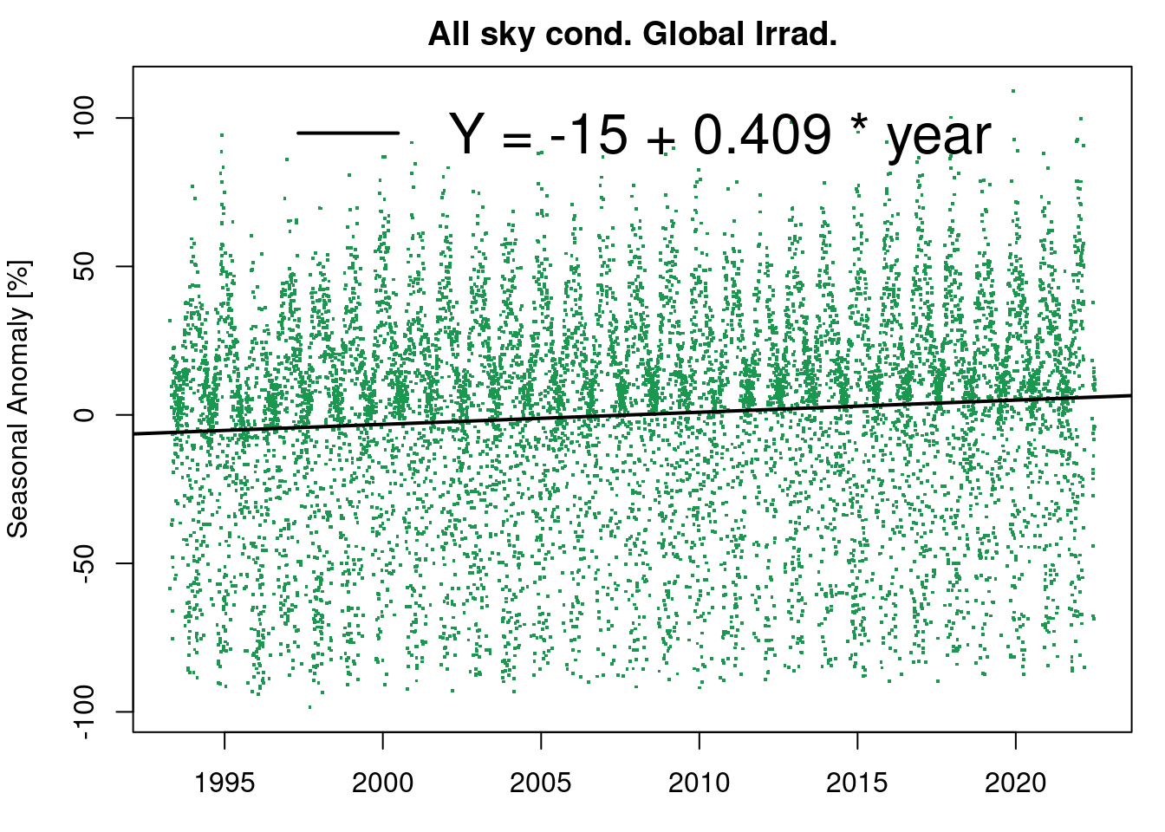
Rusults

Slide 6
3

Slide 7
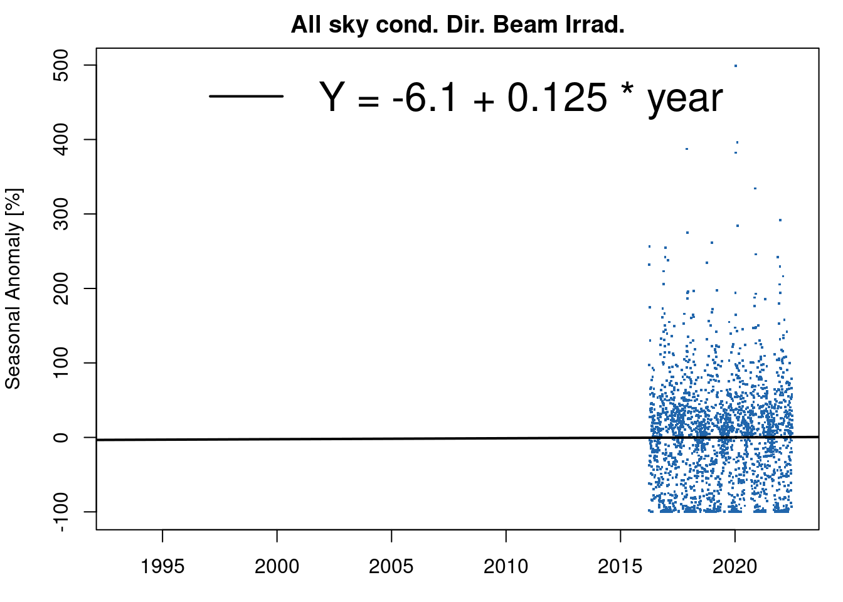
d

Slide 8
d

Slide 9
d

Slide 10
d

Slide 11
ddd
table of pers

Slide 12
4

Slide 13
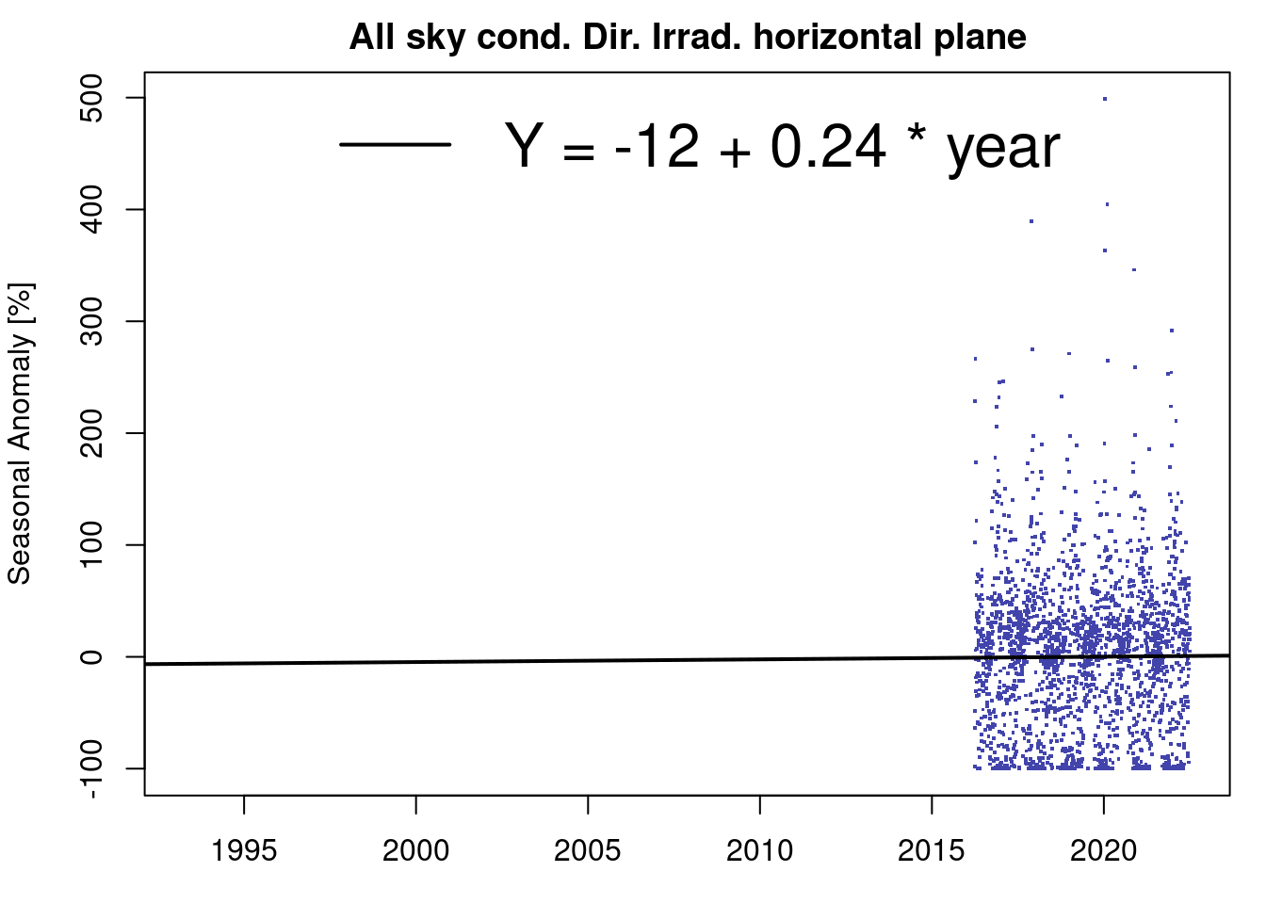
5

Slide 14
dddd

Slide 15
END
Quarto enables you to weave together content and executable code into a finished presentation. To learn more about Quarto presentations see https://quarto.org/docs/presentations/.

Slide 16
Bullets
When you click the Render button a document will be generated that includes:
Content authored with markdown
Output from executable code

Slide 17
Code
When you click the Render button a presentation will be generated that includes both content and the output of embedded code. You can embed code like this:
[1] 2
Eat spaghetti
Drink wine
dd

Slide 18
Slide with a pause
content before the pause
. . .
content after the pause

Slide 19
colunmbs
Left column
Right column

Slide 20
Slide with speaker notes
Slide content
Notes:
Speaker notes go here. nodfs dfs fs fdsfsdfsf dsfdsfdsfdsfa dsfsaf

Slide 21
Slide Title
Slide content
Some additional commentary of more peripheral interest.

Slide 22
Slide Title
Green ¹
Brown
Purple
Some additional commentary of more peripheral interest.

Slide 23
Notes
1. A footnote

