Slide 1
FINAL PROJECT
THANATE BANCHONHATTAKIJ
CSC8008: DATA EXPLORATION, ANALYTICS, AND VISUALIZATION

Slide 2
DATA VISUALIZATIONS
U.S. HOSPITAL CONSULTANT
CDC WONDER DATASETS

Slide 3
DATASET
AGE
VACCINE TYPE & CODE
The groups of people’s age contains < 6 months, 6-11 months, 1-2 years, 3-5 years, 6-17 years, 18-29 years, 30-39 years, 40-49 years, 50-59 years, 60-64 years, 65+ years, and unknown
The name of vaccine and vaccine code based on diseases.
GENDER
EVENTS REPORTED
The groups of people divided by genders consists of male, female, and unknown
The number of reported events from U.S. hospitals.

Slide 4

DATA VISUALIZATION TOOL
DATABASE FROM CDC WONDER
Age, Vaccine type, Gender, and Events Reported
THE PURPOSE AND
TARGET AUDIENCES
The purpose of this presentation is to help hospital develop a vaccine policy for hospital management, healthcare workers, the lay public, and other hospital analysts.
Data Visualization
TABLEAU PUBLIC
Free version of Tableau for analysis to create visualizations

Slide 5
OUTLINE
01
HOSPITAL MANAGEMENT
Overall of the hospital information
02
THE LAY PUBLIC
Common information for people
03
HEALTHCARE WORKERS
Technical information for work
04
OTHER HOSPITAL ANALYSTS
Analytical information

Slide 6
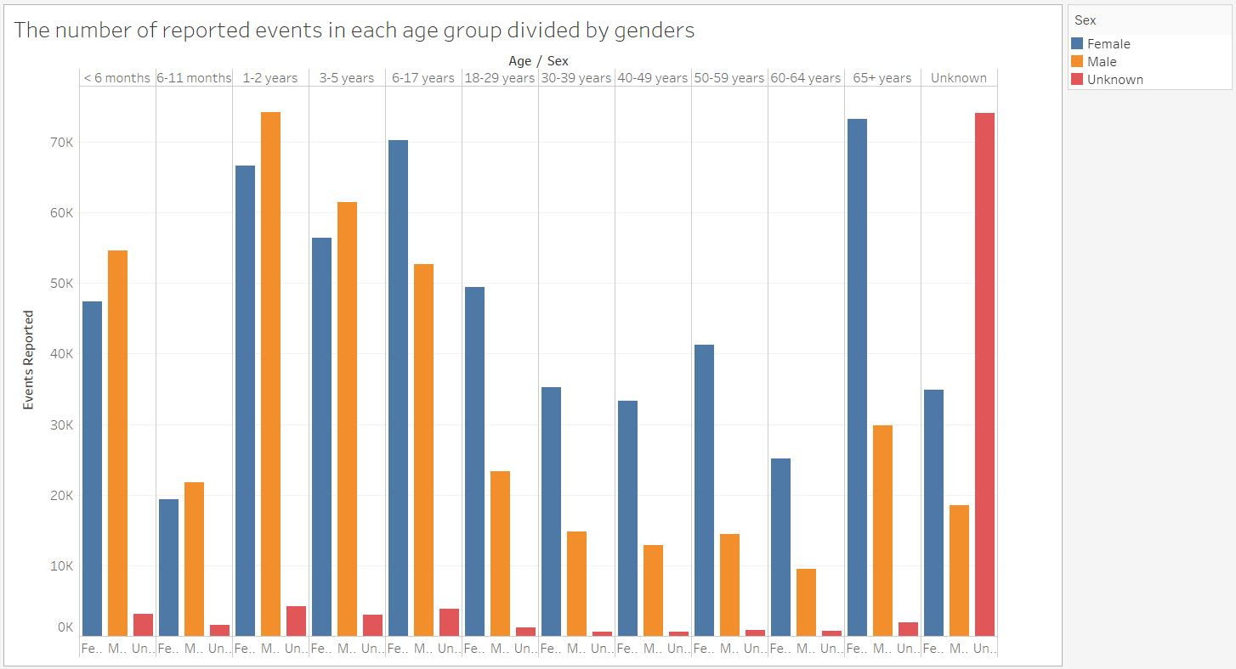
HOSPITAL MANAGEMENT
Overall events reported
Most cases: 1 – 2 years
145,005 cases (13.99% of Total)
Least cases: 60 – 64 years
35,317 cases (3.41 % of Total)

Slide 7
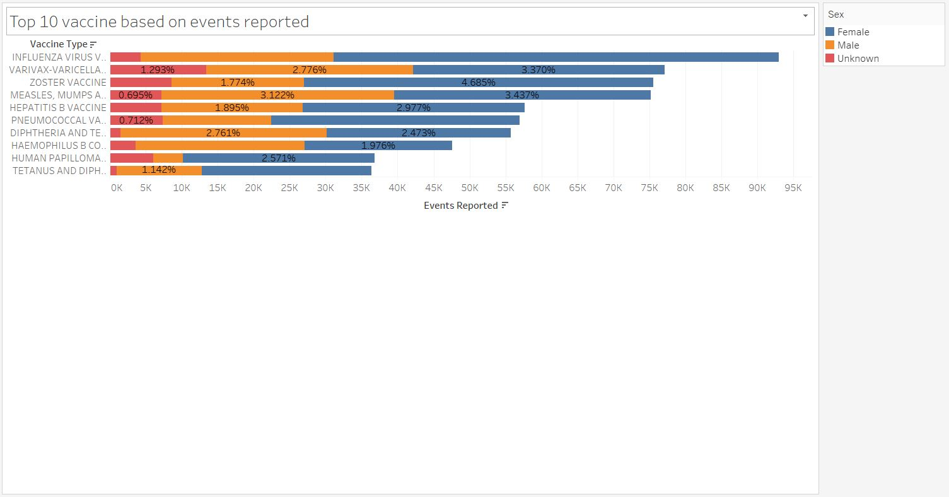
HOSPITAL MANAGEMENT
Top 10 vaccines
Top vaccine: INFLUENZA VIRUS VACCINE, TRIVALENT (INJECTED)
92,975 cases (8.96 % of Total)
Female: 66.53%
61,853 cases
Male: 28.85%
26,823 cases
Unknown: 4.62%
4,299 cases

Slide 8
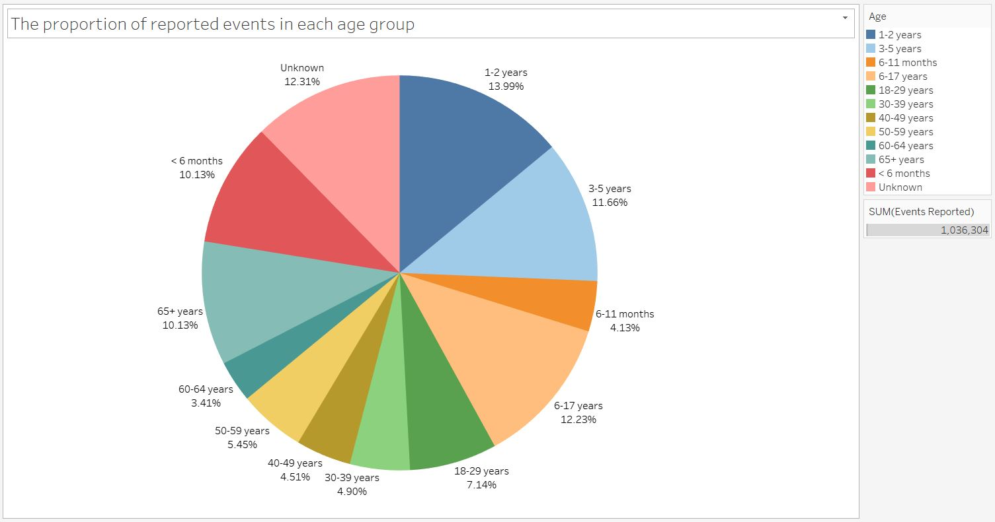
HOSPITAL MANAGEMENT
Proportion of patients’ cases
Most cases: 1 – 2 years
145,005 cases (13.99% of Total)
Least cases: 60 – 64 years
35,317 cases (3.41 % of Total)

Slide 9
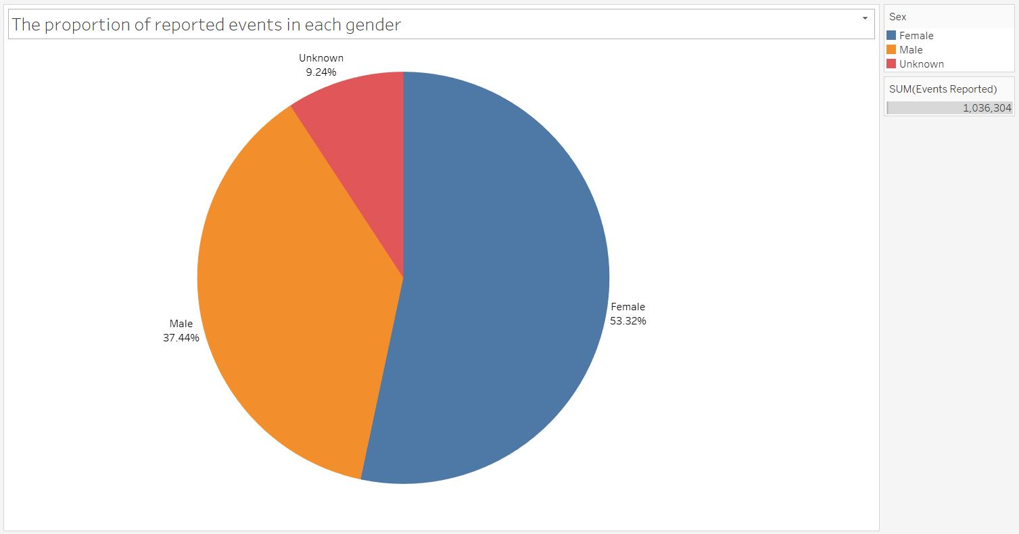
HOSPITAL MANAGEMENT
Proportion of patients’ gender
Female: 53.32%
552,583 cases
Male: 37.44%
387,961 cases
Unknown: 9.24%
95,760 cases

Slide 10
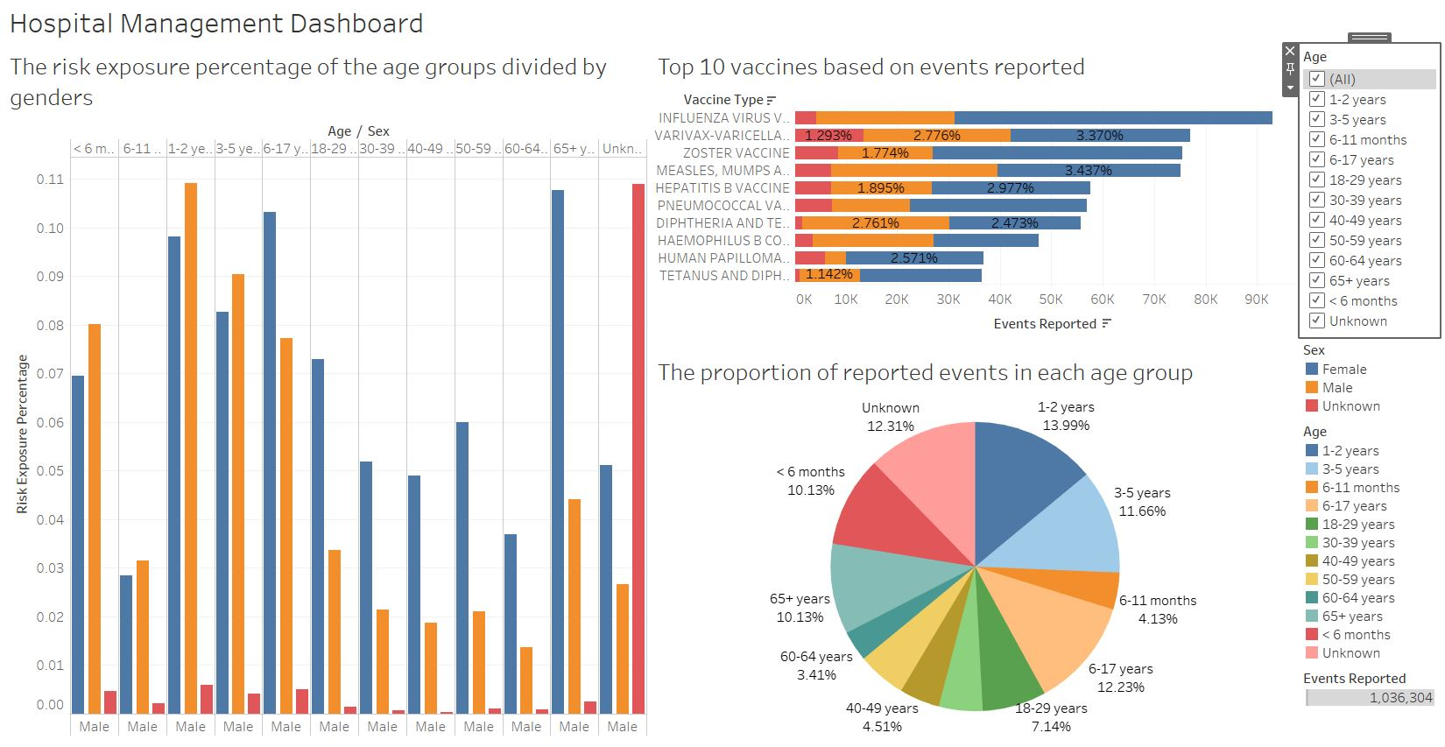
URL: https://public.tableau.com/profile/thanate.banchonhattakij#!/vizhome/HospitalManagement/HospitalManagementDashboard?publish=yes

Slide 11
OUTLINE
01
HOSPITAL MANAGEMENT
Overall of the hospital information
02
THE LAY PUBLIC
Common information for people
03
HEALTHCARE WORKERS
Technical information for work
04
OTHER HOSPITAL ANALYSTS
Analytical information

Slide 12
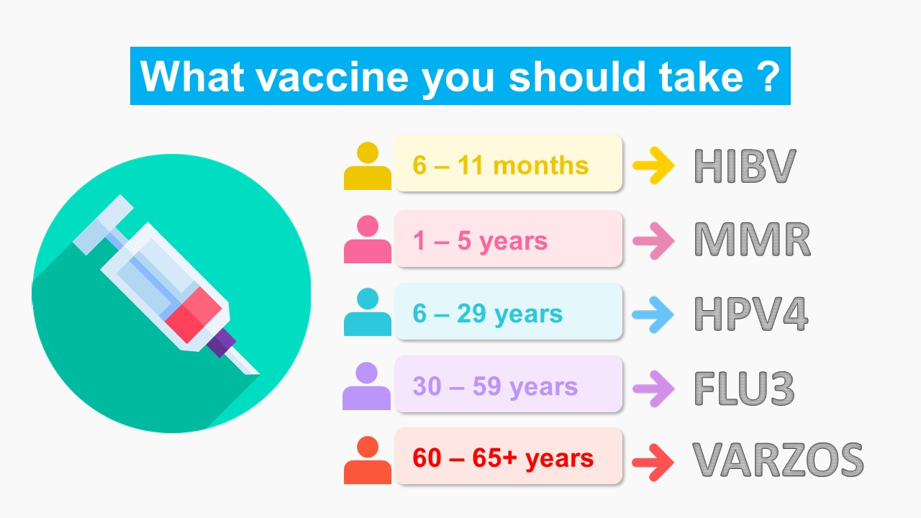
THE LAY PUBLIC
Create an infographic to present them
what vaccine they should take?
in each age group of people

Slide 13
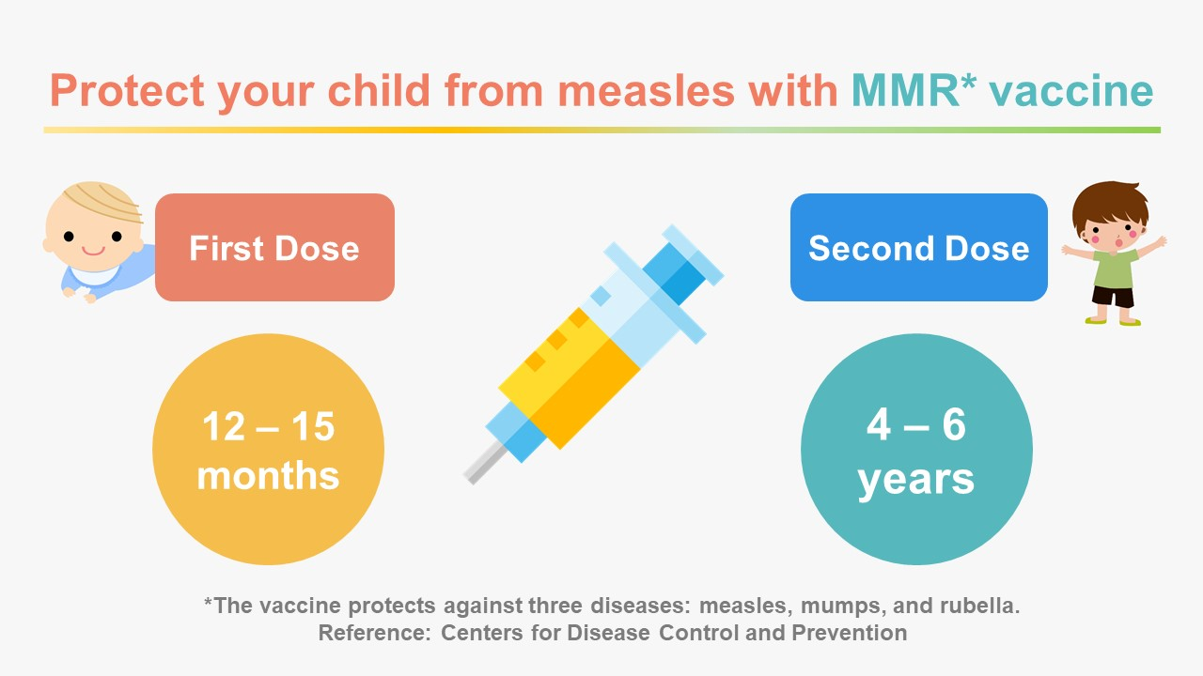
THE LAY PUBLIC
Create an infographic to tell parents the MMR vaccine that prevents their children from measles

Slide 14
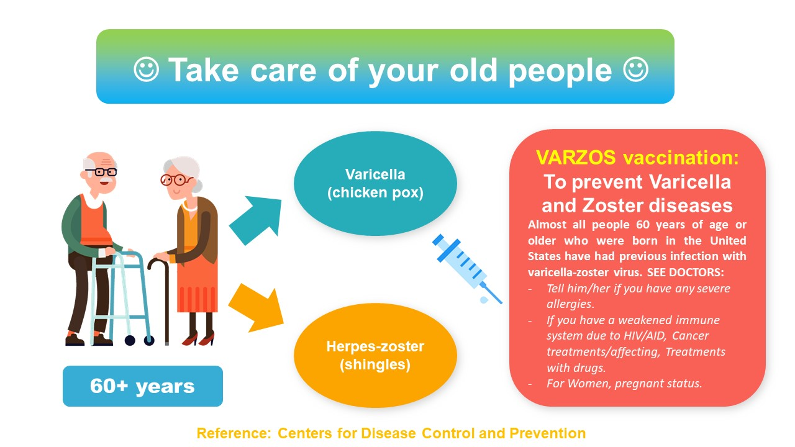
THE LAY PUBLIC
Create an infographic to awake old people which vaccine they should take when they are 60+ years

Slide 15
OUTLINE
01
HOSPITAL MANAGEMENT
Overall of the hospital information
02
THE LAY PUBLIC
Common information for people
03
HEALTHCARE WORKERS
Technical information for work
04
OTHER HOSPITAL ANALYSTS
Analytical information

Slide 16
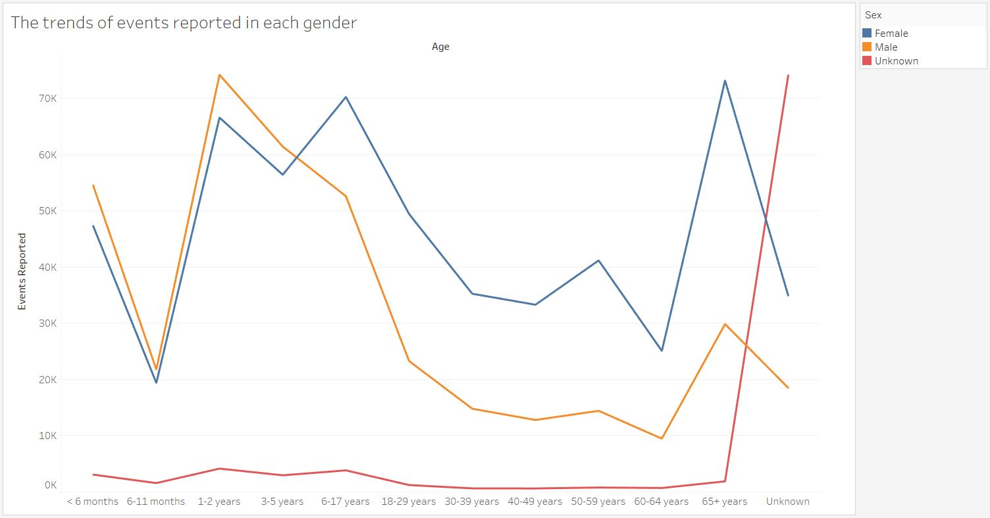
HEALTHCARE WORKERS
Trends of events in people
Peak of female: 65+ years
73,214 cases
Peak of male: 1 – 2 years
74,228 cases
Peak of unknown: Unknown*
*Unknown information

Slide 17
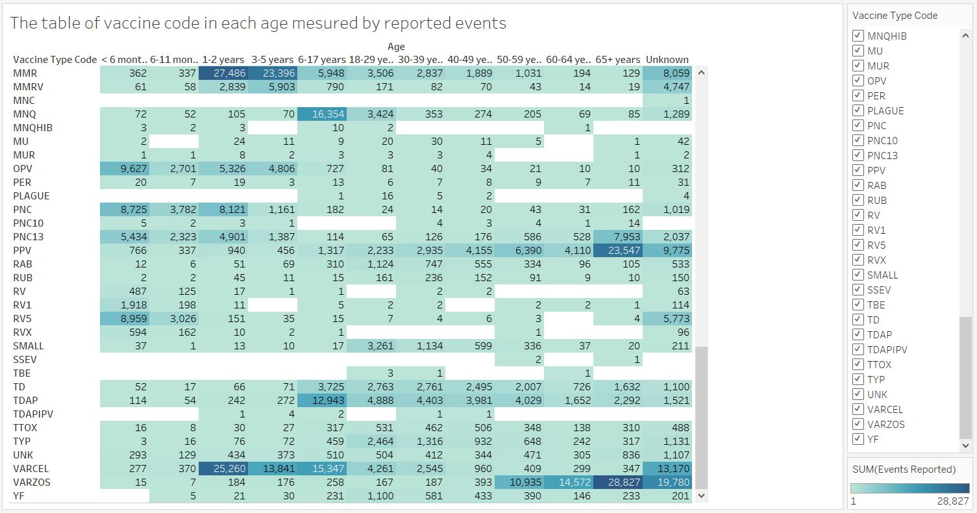
HEALTHCARE WORKERS
Table of vaccine code
in each age group
Show:

Slide 18
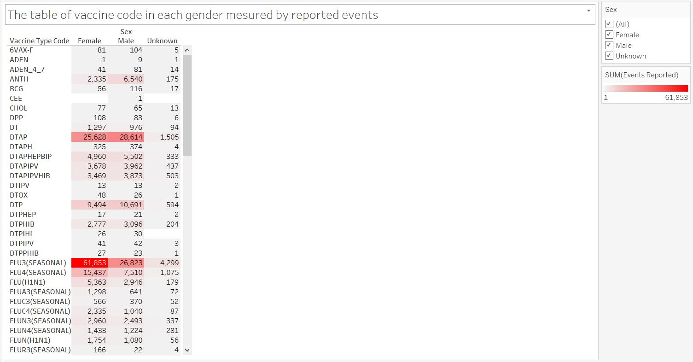
HEALTHCARE WORKERS
Table of vaccine code
In each gender
Show:

Slide 19
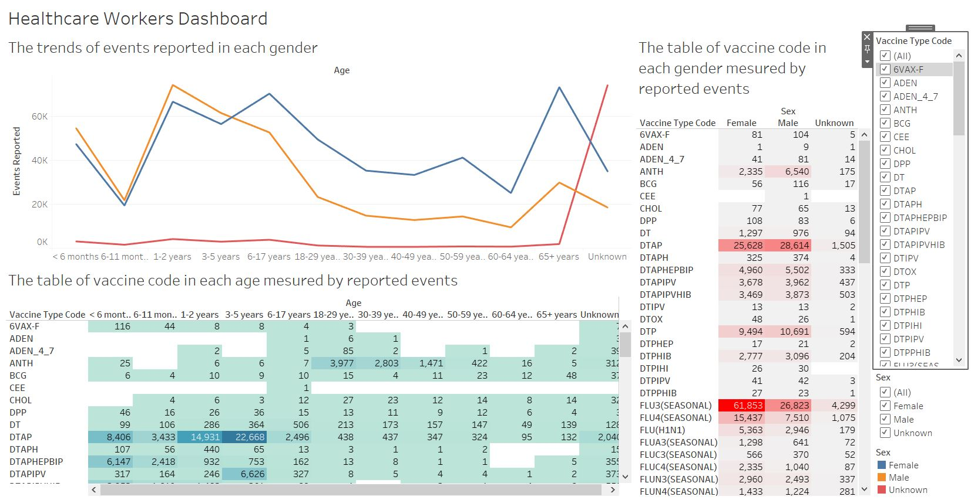
URL: https://public.tableau.com/profile/thanate.banchonhattakij#!/vizhome/HealthcareWorkers/HealthcareWorkersDashboard?publish=yes

Slide 20
OUTLINE
01
HOSPITAL MANAGEMENT
Overall of the hospital information
02
THE LAY PUBLIC
Common information for people
03
HEALTHCARE WORKERS
Technical information for work
04
OTHER HOSPITAL ANALYSTS
Analytical information

Slide 21
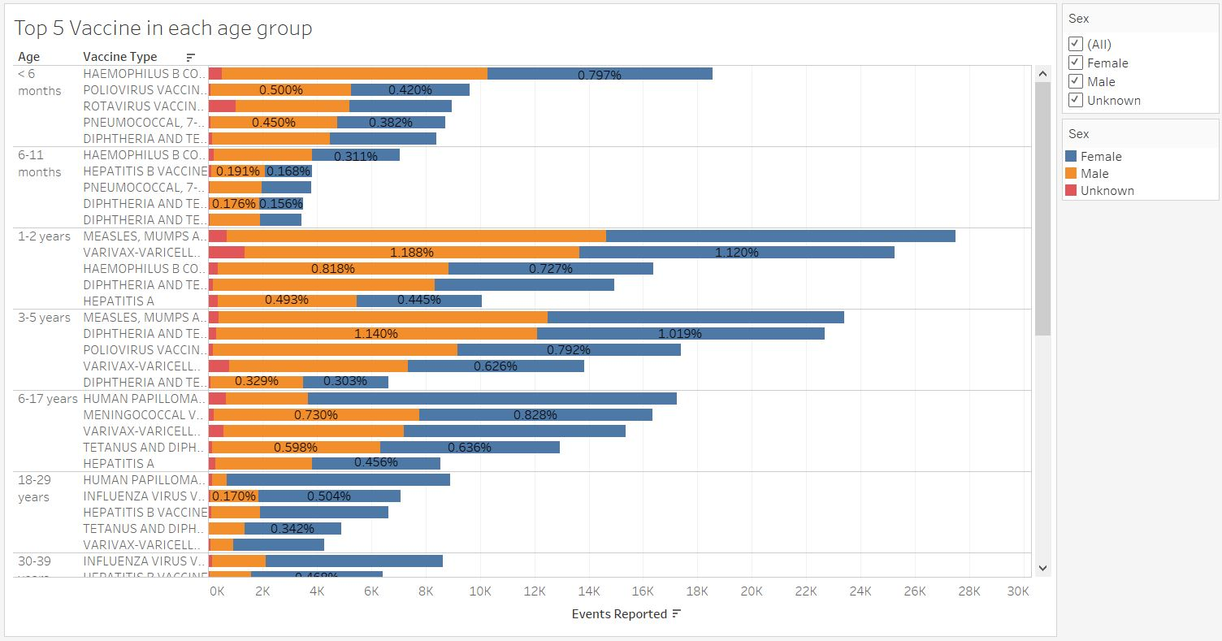
OTHER HOSPITAL ANALYSTS
Top 5 vaccine
in each age group
Show:

Slide 22
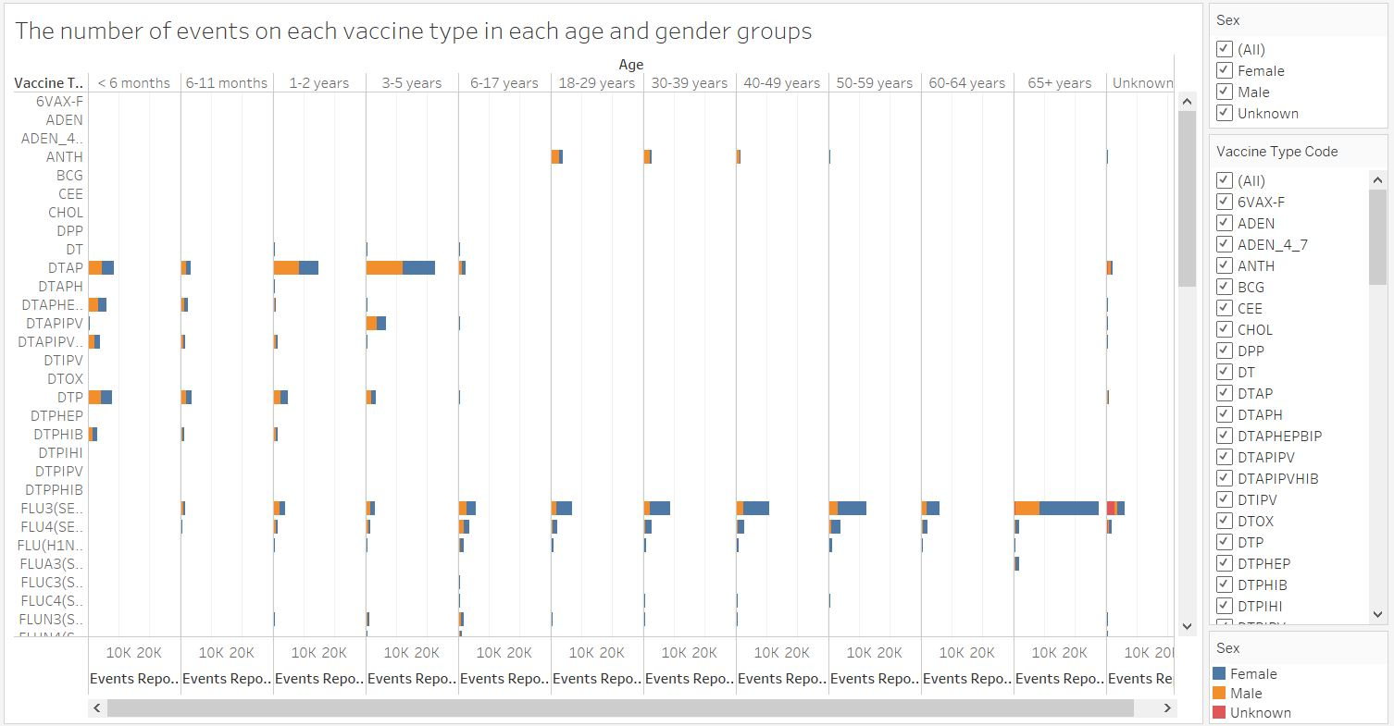
OTHER HOSPITAL ANALYSTS
Overall vaccine type
in each age and
gender groups
Show:

Slide 23
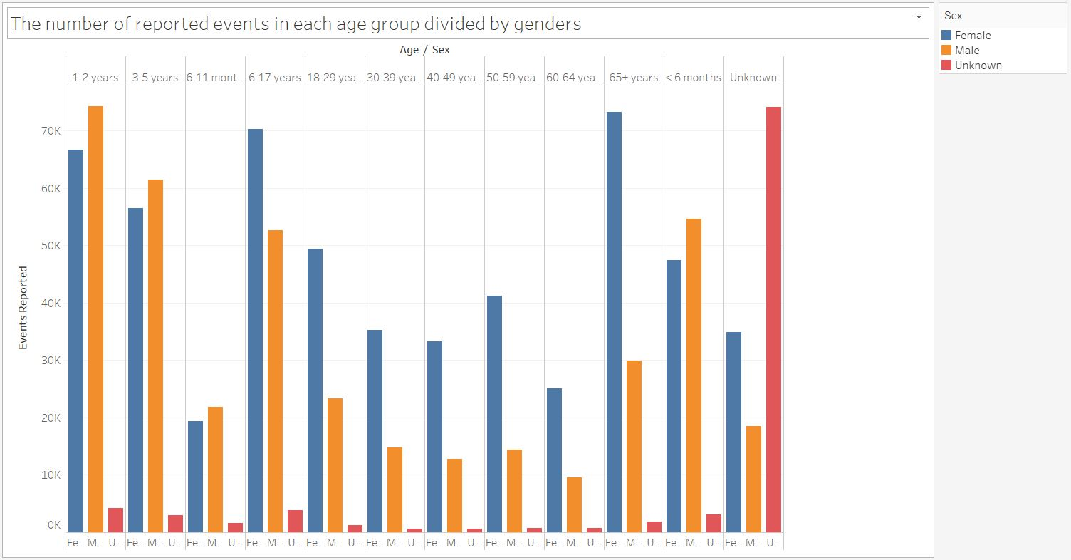
OTHER HOSPITAL ANALYSTS
Overall events reported
Most cases: 1 – 2 years
145,005 cases (13.99% of Total)
Least cases: 60 – 64 years
35,317 cases (3.41 % of Total)

Slide 24
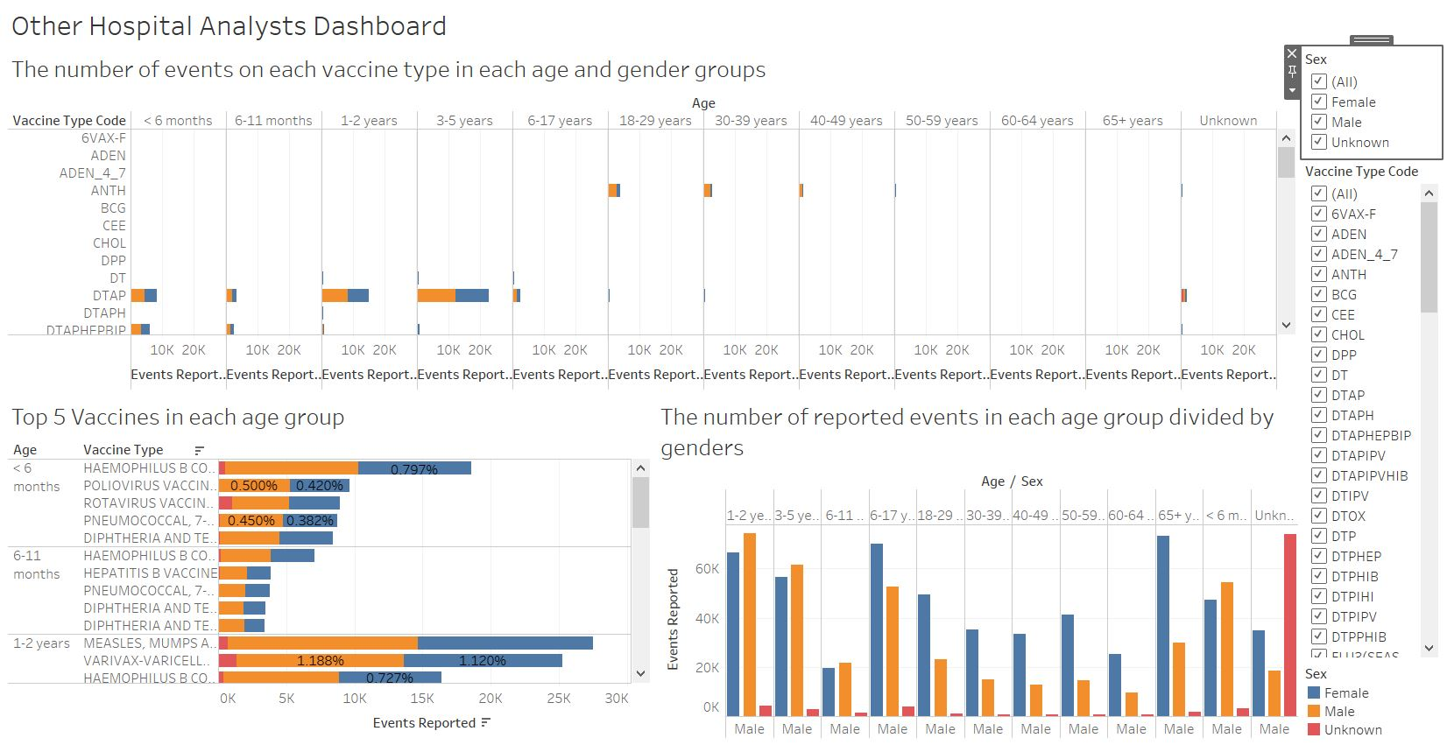
URL: https://public.tableau.com/profile/thanate.banchonhattakij#!/vizhome/OtherHospitalAnalysts/OtherHospitalAnalystsDashboard?publish=yes

Slide 25
FEEDBACK
IMPROVE THE NEXT VISUALIZATION
Using the feedbacks from audiences to adjust, change, and create new topics or details for the next data visualization
SURVEY & FEEDBACK
Questions about the details of data visualization
VISUALIZATION
GET FEEDBACK FROM AUDIENCES
Present the meaning of the data
After presenting data visualization, I will ask audiences to get their feedbacks, and give them a survey about data visualization

Slide 26
THANK YOU
THANATE BANCHONHATTAKIJ

