Slide 1
OpenIncident X
Hackathon Final Pitch | OpenEnv + Multi-Agent Incident Intelligence

Slide 2
Problem and Opportunity
Production incidents are partially observable and high-stakes.
Current agents often fail on long-horizon recovery and closure discipline.
We need environments that teach investigate -> diagnose -> fix -> resolve behavior.

Slide 3
What We Built
OpenEnv-compatible environment: ProductionIncidentEnv.
Multi-agent system around reliability workflow (Planner, Testers, Observability, Triage, Guardian, Oversight).
Trainable reliability policy with measurable before/after outcomes.

Slide 4
Agent Story (Judge-Friendly Flow)
Operator creates project and submits user stories/test cases.
Planner routes work to Frontend/API/Database + Observability.
Reliability Agent handles incident loop with evidence from other agents.
Triage summarizes root-cause likelihood, Guardian gates release, Oversight audits decisions.

Slide 5
Environment and Action Space
State includes logs, metrics, traces, deploy context, config, code, reliability signals.
Actions: inspect_*, identify_root_cause, apply_fix, rollback/restart/scale, add_monitor, resolve_incident.
Modes: deterministic (sanity) and stochastic (hard, judge-facing).

Slide 6
Reward Design
Positive: evidence-based diagnosis, correct mitigation, restored service, clean closure.
Negative: premature fixes, unsafe/no-op actions, closure without restoration/verification.
Goal: avoid shortcut gaming and reward operationally correct behavior.

Slide 7
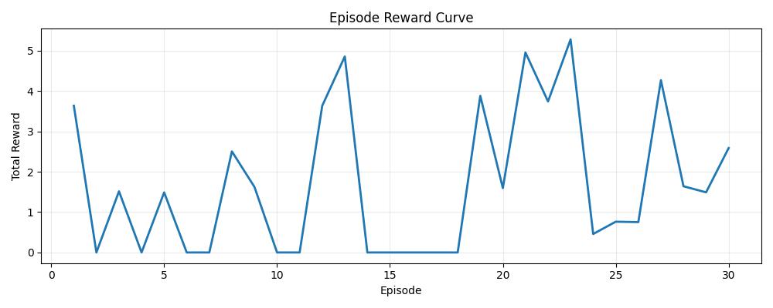
Results: Two Evidence Tracks
RL Behavior Evidence
Baseline success rate: 0.00%
Trained success rate: 33.33%
Root-cause rate: 63.33%
Restore rate: 43.33%
Closure gap (trained): 10.00%
HF TRL Pipeline Evidence
Train samples: 269
Train loss: 10.820884760688333
Train runtime: 33.4911 s
Model: sshleifer/tiny-gpt2
This satisfies the minimal HF TRL training-path requirement.

Slide 8
Best Successful Trajectory (Example)
inspect_config -> identify_root_cause -> inspect_traces -> identify_root_cause -> apply_fix -> apply_fix -> apply_fix -> apply_fix -> inspect_logs -> resolve_incident
Interpretation: the policy gathers evidence before closure in stochastic mode.

Slide 9
Live Demo Plan (90 seconds)
1) Show HF Space summary + key metrics cards.
2) Show reward curve and JSON artifacts from one fixed run.
3) Show Colab command for reproducible RL + HF TRL execution.
4) End with realistic caveat and next roadmap.

Slide 10
Submission Links
GitHub: https://github.com/thanayr99/OpenIncident
HF Space: https://thanayr-openincident.hf.space
Colab: https://colab.research.google.com/drive/1R4IrMr5nIKm7lZfbI08EP9ijkUgF7fxH?usp=sharing
Final Judge Story: README_HACKATHON_FINAL.md

