Slide 1
Bank Marketing
Campaign Performance
Analysis
Python — prepare
An end-to-end data analytics project using Python, MySQL, Power BI, and DAX to understand subscription behavior and support better marketing decisions.
MySQL — analyze
Power BI — decide
Notes:
Introduce this as an end-to-end portfolio project. The analysis moves from data preparation through SQL, Power BI, and DAX to practical marketing decisions.

Slide 2
THE BUSINESS CHALLENGE
41,176
4,639
41,176 customers.
11.27% subscribed.
customers analyzed
subscribers
How can customer and campaign data support better targeting for future campaigns?
11.27%
overall subscription rate
THE QUESTION IS HOW CUSTOMER CHARACTERISTICS AND CAMPAIGN ACTIVITY RELATE TO SUBSCRIPTION DECISIONS.
02
Notes:
Lead with the scale of the dataset and the overall conversion rate. Then frame the business question: which customer and campaign signals can improve future targeting?

Slide 3
THE ANALYTICS WORKFLOW
From raw data to marketing decisions
01
02
03
Raw dataset
Python
MySQL
prepare and structure
analyze performance
04
05
06
Power BI
Insights
Documentation
build KPIs and dashboards
recommendations
GitHub
Each tool moves the project closer to an actionable business decision.
03
Notes:
Walk left to right. The workflow starts with a raw dataset, then each tool adds structure, measurement, visibility, and finally an actionable decision.

Slide 4
01 / DATA PREPARATION
01
Reviewed structure and data types
Preparing the data for analysis
02
Checked missing and unknown values
03
Identified duplicate records
The goal was a cleaner, analysis-ready dataset for SQL analysis and Power BI reporting.
Created customer age groups
04
05
Created a numeric subscription indicator
04
Notes:
Before asking business questions, the dataset needed to be understood and structured. The preparation work covered quality checks, duplicate records, age groups, and a numeric subscription indicator.

Slide 5






02 / SQL ANALYSIS
SQL turned the dataset into business questions
Overall performance
Job and age groups
Contact method
Education and marital status
Previous campaign results
Contact frequency
MySQL connected customer attributes and campaign activity to measurable subscription outcomes.
05
Notes:
SQL converted the cleaned dataset into a set of business questions. The analysis connected customer attributes and campaign activity to measurable subscription outcomes.

Slide 6
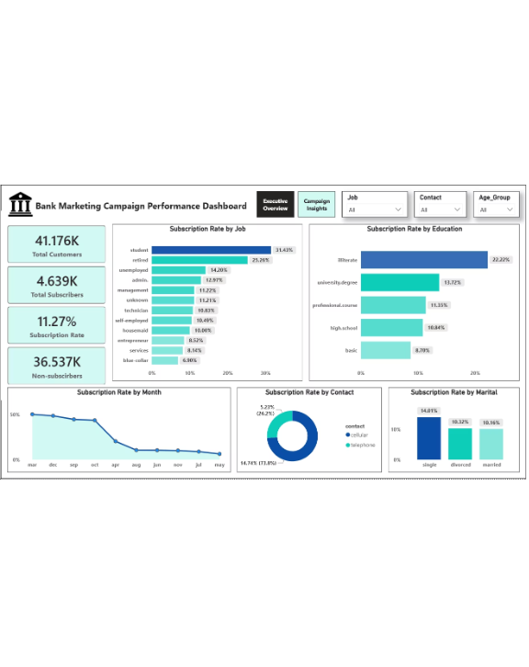
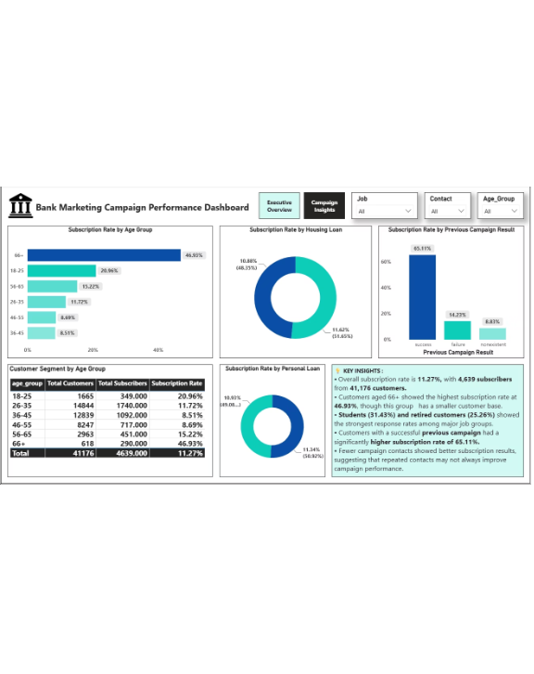
03 / POWER BI REPORTING
Power BI made the analysis decision-ready
Executive Overview: customers, subscribers, subscription rate, non-subscribers, performance by job, education, month, contact method, marital status.
Campaign Insights: age groups, housing/personal loans, previous campaign performance, customer segments, key insights.
EXECUTIVE OVERVIEW
CUSTOMER AND CAMPAIGN INSIGHTS
06
Notes:
These dashboards turn the analysis into a decision-ready view. The Executive Overview gives the portfolio-level picture; Campaign Insights provides the segmentation and campaign detail.

Slide 7
WHAT THE DATA SHOWED
Previous success was the strongest signal
65.11%
46.93%
subscription rate after a successful previous campaign
subscription rate among customers aged 66+
Students and retired customers showed stronger response rates among major job groups.
Lower contact frequency was associated with better subscription results.
These patterns describe the available data; they do not prove cause and effect.
07
Notes:
Previous campaign success stands out as the strongest signal, with a 65.11% subscription rate. The analysis also surfaced older customers, students, retired customers, and lower contact frequency as useful patterns, while keeping the distinction between association and cause.

Slide 8
FROM INSIGHT TO ACTION
Turn the patterns into smarter campaign choices
01
02
03
04
Improve targeting
Use campaign history
Review repeated contacts
Segment customers
Focus more attention on groups with stronger response rates.
Incorporate previous outcomes into targeting decisions.
Tailor campaign approaches to different customer groups.
Test more targeted follow-up strategies.
Project outcome: a complete workflow from Python preparation and SQL analysis to DAX KPIs, Power BI reporting, and documented recommendations.
Notes:
Close on the practical outcome. The analysis supports four campaign choices: improve targeting, use campaign history, review repeated contacts, and segment customers. The project demonstrates a complete workflow from preparation to documented recommendations.

