Slide 1
Financial & FinTech
Performance Analysis
Developed by Anil Kumar · Aspiring Data Analyst | Power BI | SQL | Python | Data Analytics

Slide 2





THE ANALYTICS THESIS
One analytics view across the financial journey
One interactive Power BI analytics solution connects the customer journey from activity to action.
Customers
Transactions
Bill Payments
Unifies the customer view.
Tracks activity and value.
Shows payment mix.
Investments
Customer Support
Better decisions
Explains contribution.
Surfaces friction.
Turns patterns into action.
02

Slide 3



THE PROBLEM
Financial data is spread across several business areas
Transaction value
Bill mix
Investment contribution
Activity is split across customer, transaction, payment, investment, and support reports.
High-value customers
Support issues
Resolution rate
The opportunity: combine the view, track performance, spot customer patterns, and flag where to act.
03

Slide 4
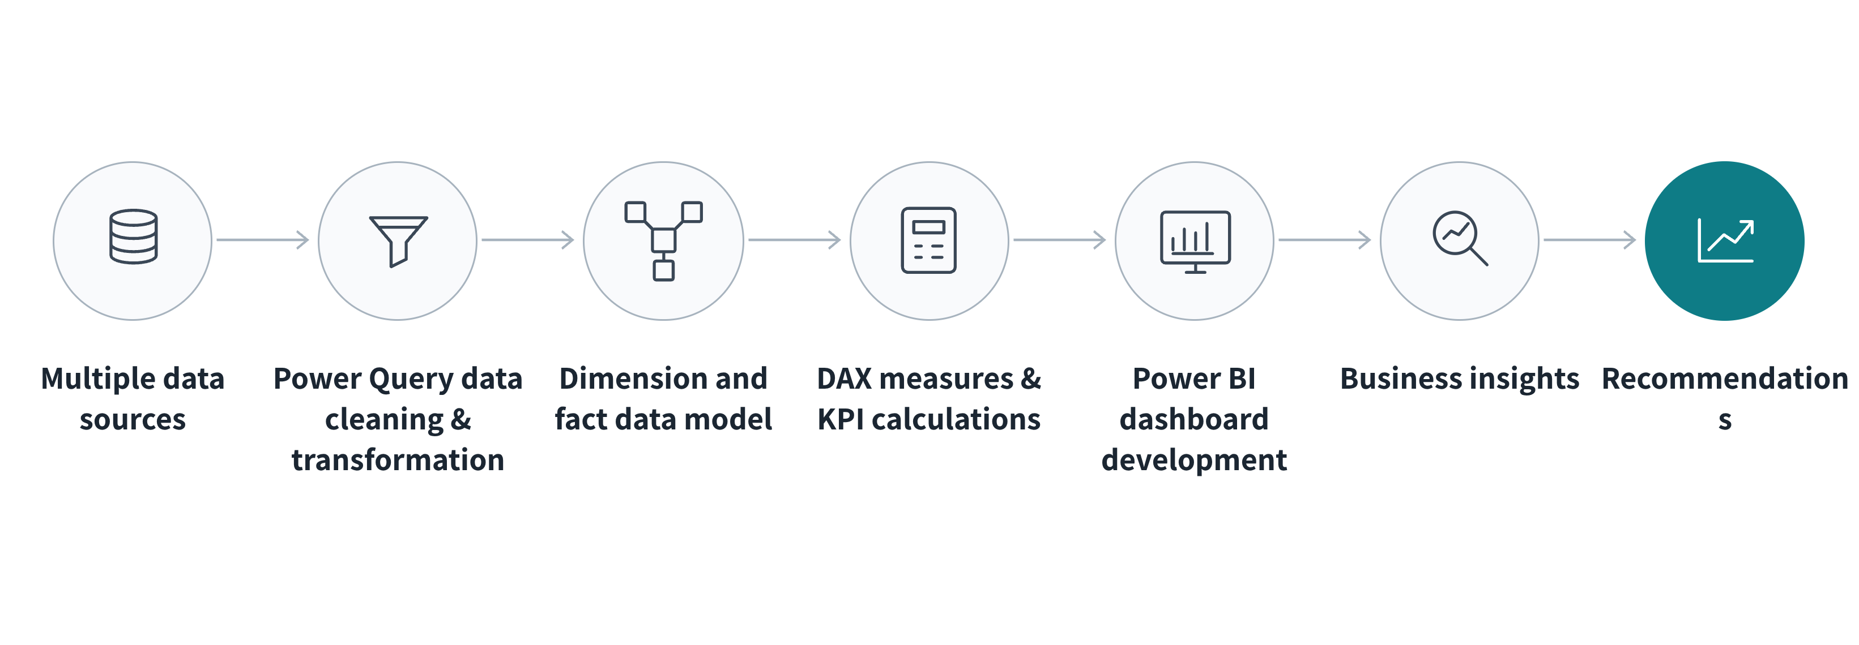
FROM DATA TO DECISIONS
From raw sources to business action
Each stage turns a fragmented financial environment into a decision-ready analytics solution.
04

Slide 5
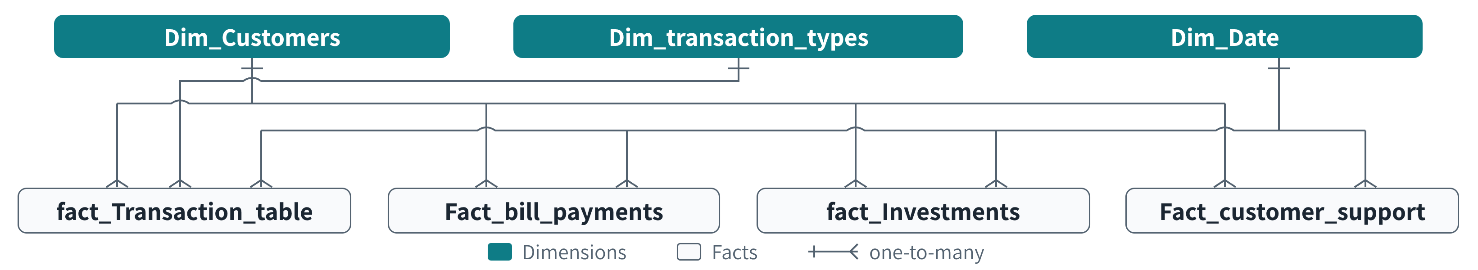
A star-style model connects activity to customers and time
Dim_Customers connects customer activity across transactions, bill payments, investments, and support. Dim_Date enables time-based analysis; one-to-many relationships support consistent slicing.
05

Slide 6
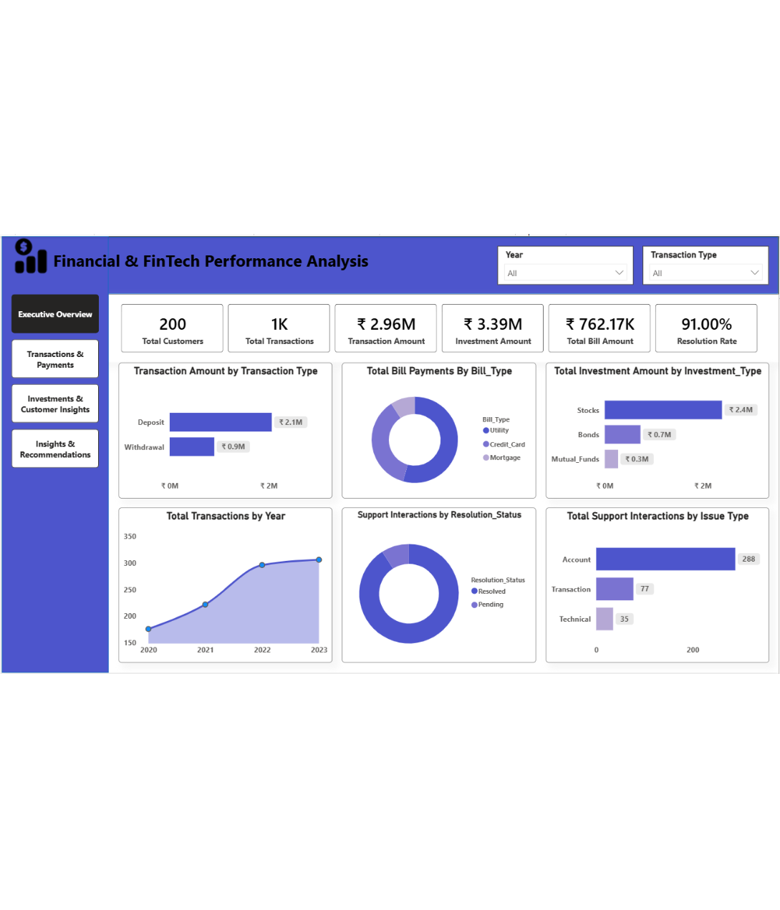
The dashboard turns model outputs into a decision surface
TOTAL CUSTOMERS
TRANSACTIONS
TRANSACTION AMOUNT
200
~1K
₹2.96M
INVESTMENT AMOUNT
TOTAL BILL AMOUNT
SUPPORT RESOLUTION RATE
₹3.39M
₹762.17K
91%
06

Slide 7
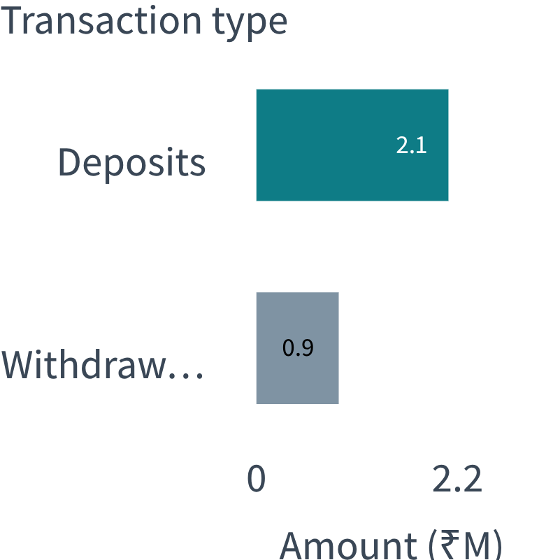
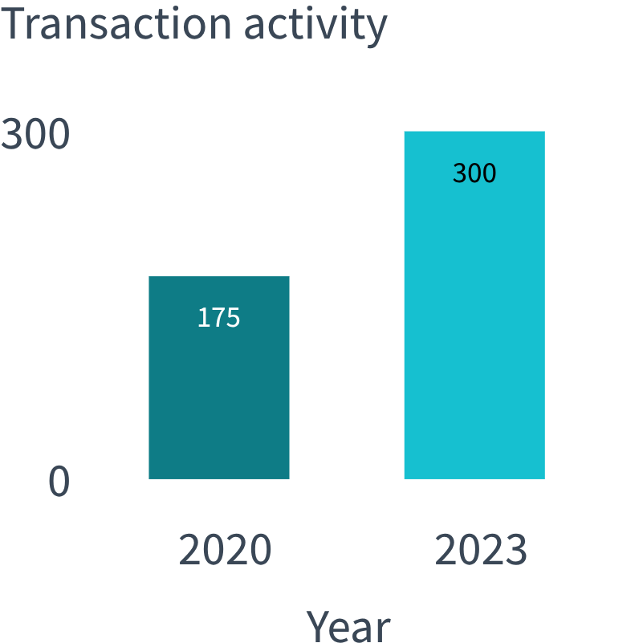
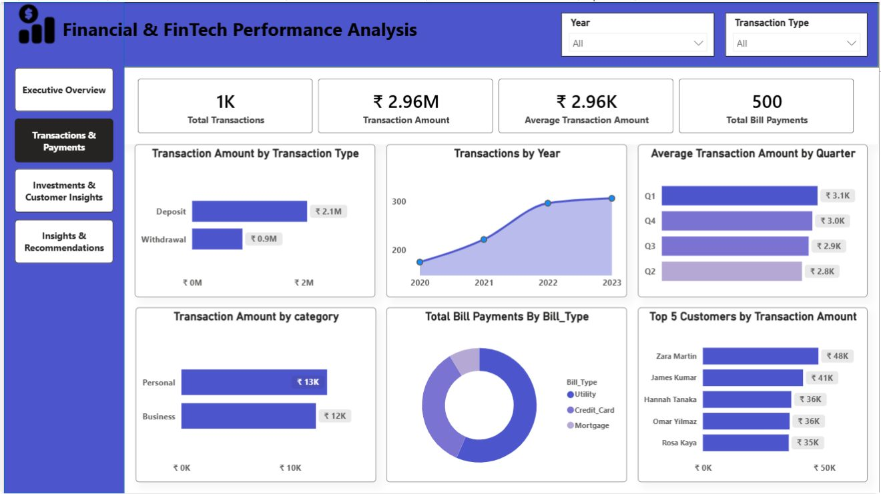
TRANSACTIONS & PAYMENTS
TRANSACTION VALUE BY TYPE
ACTIVITY ACCELERATION
Deposits lead value as transaction activity accelerates
Deposits contributed approximately ₹2.1M versus around ₹0.9M from withdrawals.
Transaction activity increased from approximately 175 in 2020 to over 300 in 2023.
07

Slide 8
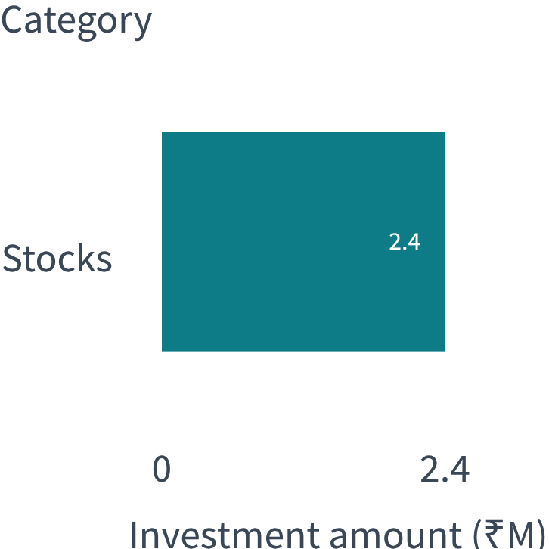
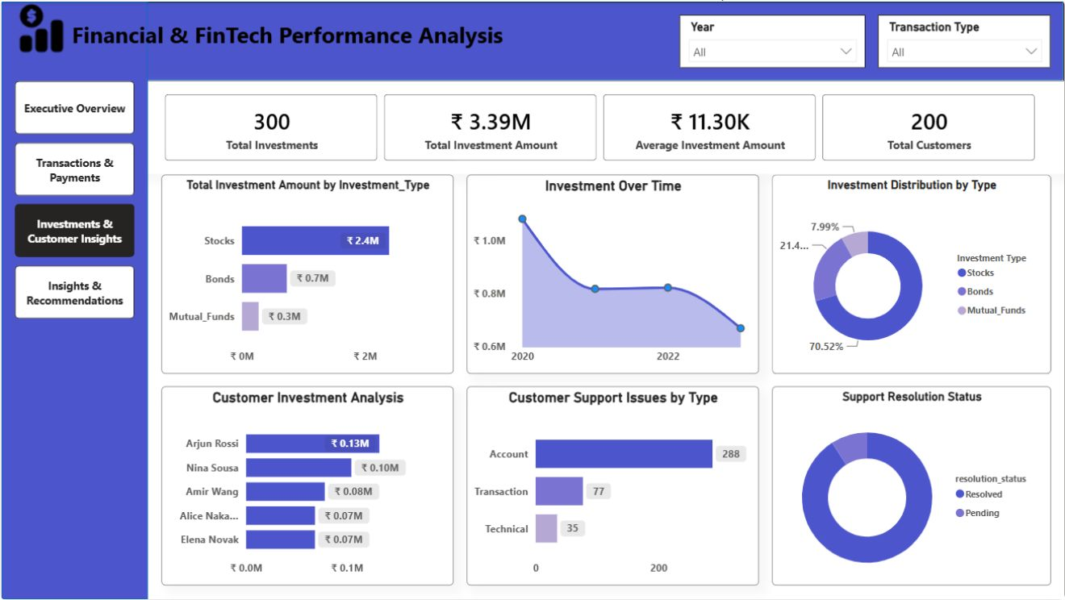
INVESTMENTS & CUSTOMER INSIGHTS
Stocks dominate investment value while support friction concentrates in accounts
INVESTMENT VALUE
₹3.39M total investment amount. Stocks contributed approximately ₹2.4M and represented around 70.52% of investment distribution.
Investment activity declined from approximately ₹1.1M in 2020 to around ₹0.66M in the latest period shown.
288
Account-related support interactions, the largest support concern.
08

Slide 9
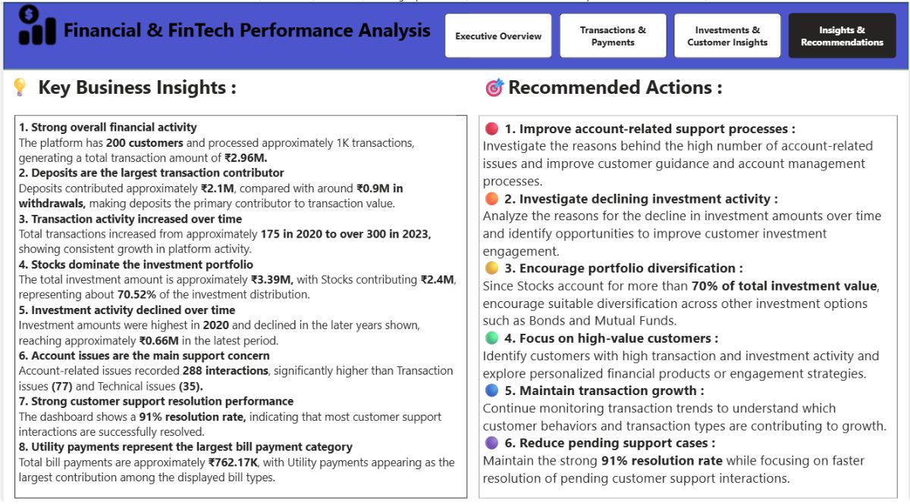








INSIGHTS → ACTIONS
Insights become a focused action plan
Key insights
Recommended actions
Strong financial activity. Deposits lead transaction value; transaction volume is growing.
Improve account support processes
Investigate declining investment activity
Stocks dominate the portfolio
Encourage diversification; engage high-value customers
Investment activity is declining
Maintain transaction growth; reduce pending cases
Account issues are the largest support concern
09

Slide 10
THE REPEATABLE SYSTEM
A repeatable analytics workflow supports better decisions
Multiple Data Sources → Data Preparation → Data Modeling → DAX → Interactive Dashboard → Business Insights → Recommendations
This project demonstrates how Power BI can transform multiple financial datasets into a structured analytics solution that supports data-driven business decisions.
Developed by Anil Kumar · Aspiring Data Analyst | Power BI | SQL | Python | Data Analytics

