Slide 1
Supply Chain & Logistics Performance Analysis
Anil Kumar | Aspiring Data Analyst
Python | SQL | Power BI

Slide 2






Supply chain performance is spread across different areas
Data is spread across products, inventory, suppliers, shipping, manufacturing, and quality checks.
Which products generate the most revenue?
Which products have the highest demand?
Does inventory match demand?
Which suppliers take longer to deliver?
Where can shipping be improved?
Which products have quality or defect problems?

Slide 3






Turn data into decisions you can act on
Turn supply chain and operations data into findings that lead to better decisions on inventory, suppliers, manufacturing, shipping, and product quality.
Revenue & Product Results
Inventory Management
How Suppliers Perform
Shipping & Delivery
Manufacturing
Quality Checks

Slide 4
From raw data to business recommendations
01
02
03
Raw Dataset:
Python:
SQL / MySQL:
gather records from daily operations.
prepare, clean, reshape, and analyze data.
explore the data and answer business questions.
04
05
06
Power BI:
Insights:
Recommendations:
build interactive dashboards with key numbers.
turn patterns into help for decisions.
focus effort on the most valuable opportunities.

Slide 5
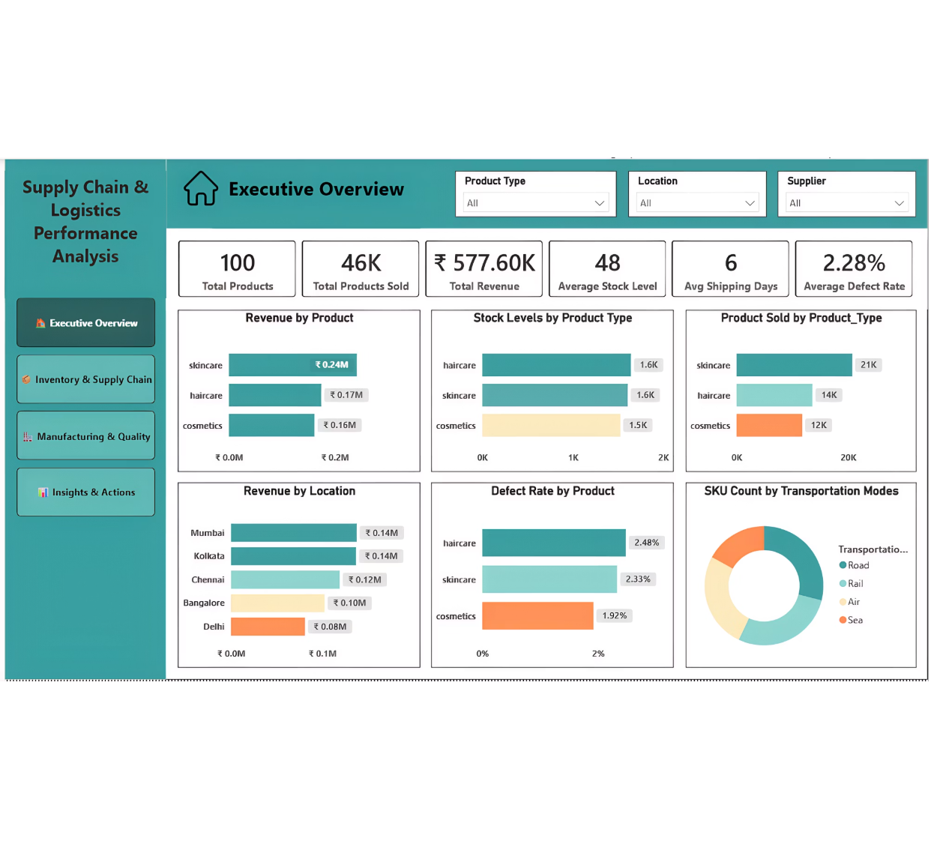
Executive Overview connects the full set of key numbers
Total Revenue: approximately ₹577.60K
Total Products Sold: approximately 46K
Average Stock Level: 48
Average Defect Rate: 2.28%
Overview of revenue, demand, inventory, results by location, defect rates, and transportation.

Slide 6
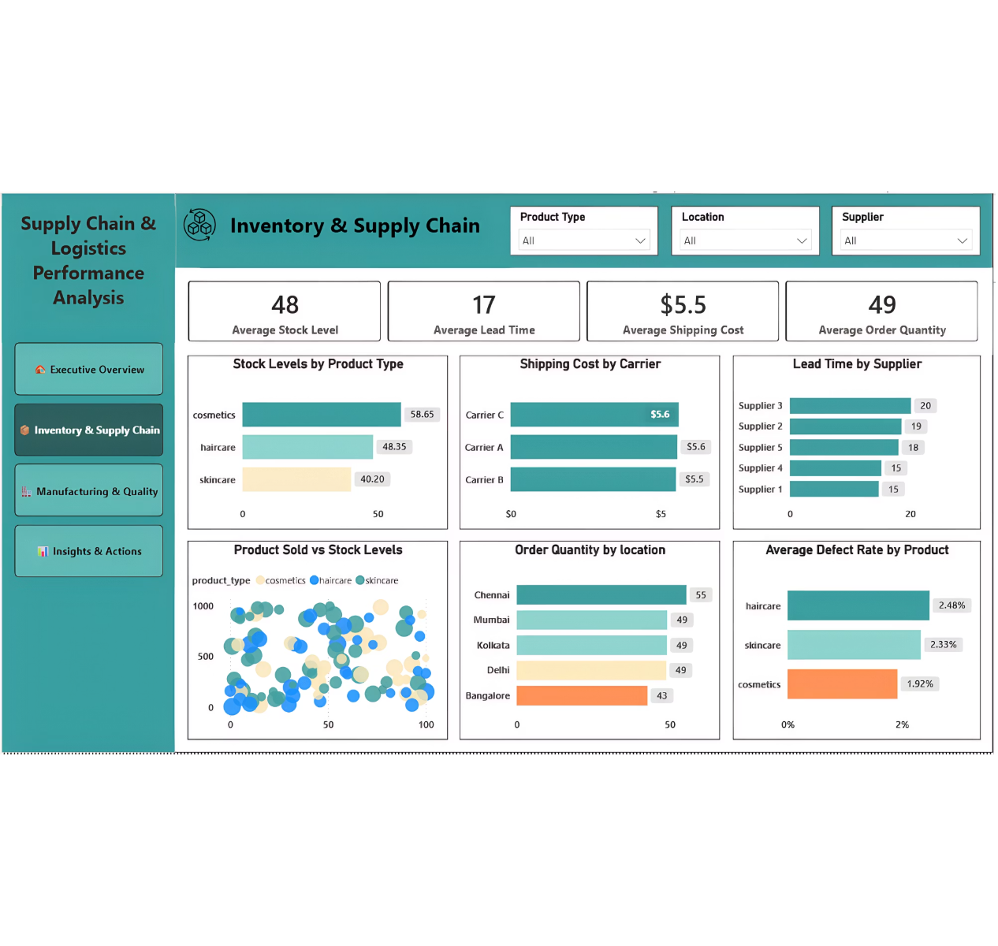





Stock and delivery data shows where problems may start
Stock levels by product type
Shipping cost by carrier
How long suppliers take to deliver
Products sold vs. stock on hand
Order quantity by location
Average defect rate by product
Use the dashboard to spot stock risks, supplier delays, shipping cost savings, and demand patterns.

Slide 7
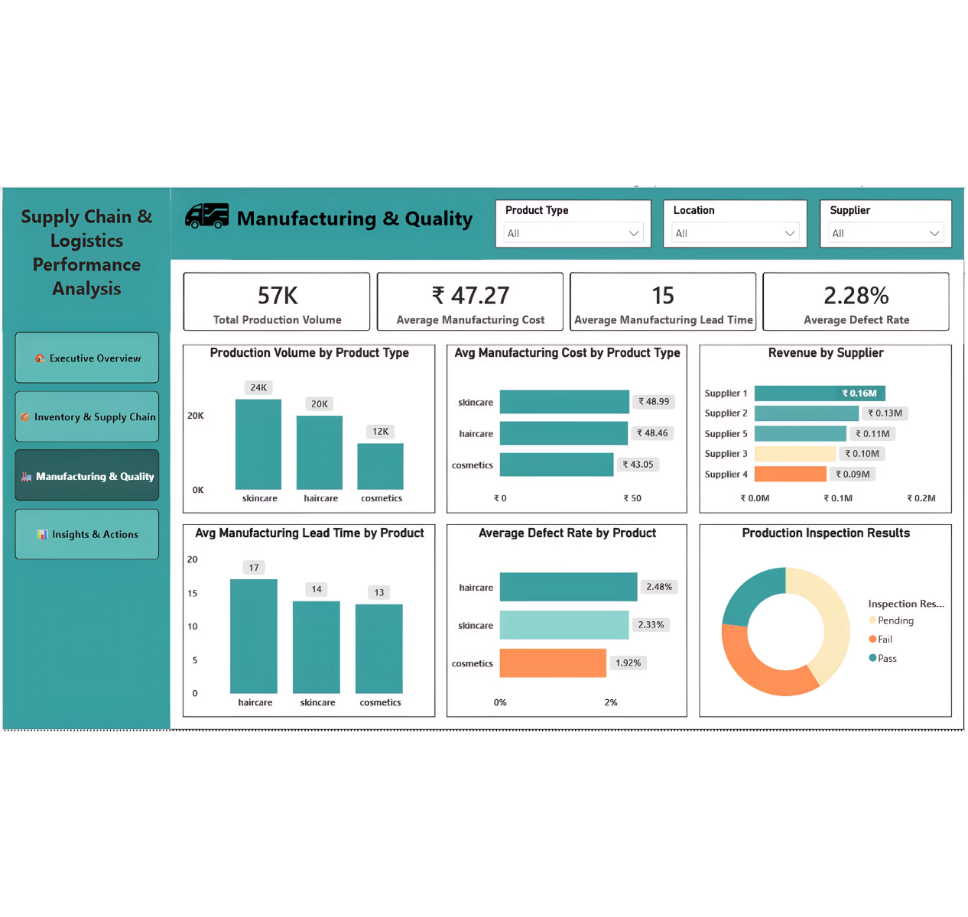



Making products and checking quality show where to improve
Units produced
Cost to make
Time to make
Revenue by supplier
Share of faulty products
Quality check results
Key finding: Haircare had the highest share of faulty products, at about 2.48%.

Slide 8
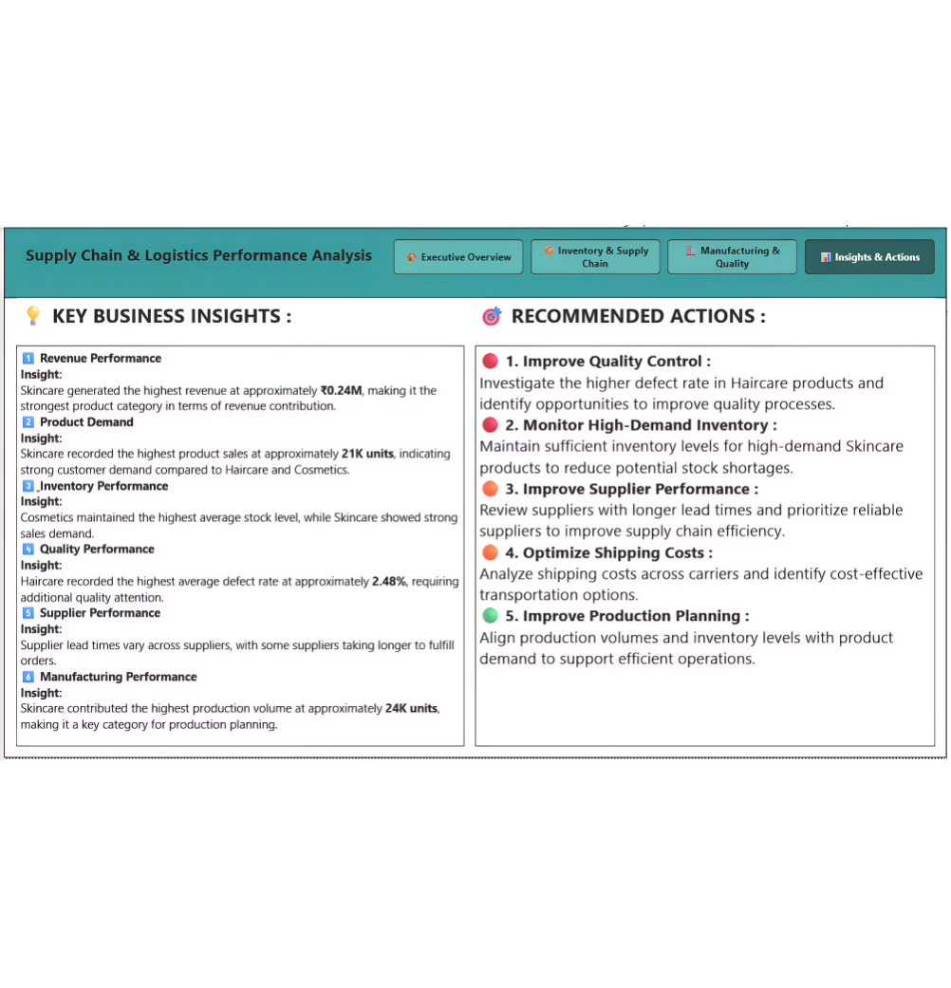
The clearest patterns involve demand, quality, and supplies
Revenue: Skincare brought in the most revenue, at about ₹0.24M.
Demand: Skincare sold the most units, at about 21K.
Inventory: Cosmetics kept the highest average stock level.
Quality: Haircare had the highest share of faulty products, at about 2.48%.
Suppliers: Delivery times varied, so there is room for suppliers to do better.
Manufacturing: Skincare made the most units, at about 24K.
These findings show patterns in the data and help guide decisions.

Slide 9

Turn the findings into clear actions
Why it matters
Check quality more closely for Haircare products.
Keep a close eye on stock for popular Skincare products.
Review suppliers with longer delivery times.
This project turns raw data into one simple tool. It helps people spot patterns, risks, and chances to improve.
Compare shipping costs and find cheaper carrier options.
Match production and stock levels to what customers buy.

