Slide 1

Interview Question Trivia Pursuit (AI Powered)

Slide 2
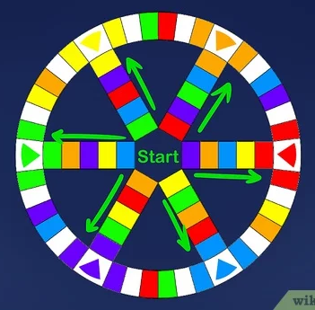
BOARD. Players begin at the center, then move out to earn a wedge from each of the wedge-marked spaces where a spoke meets the outer wheel, and finally return to the center to answer a final question. On all but the oldest sets, a "Roll Again" space is set two spaces to either side of each wedge space.^{[1]}The wedge spaces are six spaces out from the center space. PLAYING INDIVIDUALS - We are playing as individuals. TP is designed for up to six players or teams. If more than six people want to play SPECIAL RULES. Time Limit for answering questions. Timer. Speciity PLAYING TOKENS. There are six playing tokens in different colors. The colors are blue, green, yellow, pink, brown, and orange. Playing tokens are circular in shape with slots for the wedges. Place a token at the center of the board for each player or team. QUESTION CARDS - RANDOMIZED PLAYER SEQUENCE. Roll 1 Die, rotate left (clockwise) Roll the die and move your pie the number of spaces indicated on the die. You can move your token in any one legal direction: toward a wedge or toward the center when on a spoke, clockwise or counterclockwise when on the outer wheel. You can also move from a spoke to the outer wheel or from the outer wheel to a spoke. However, you cannot reverse direction in the middle of a roll.^{[8]}If you land on a "Roll Again" space, roll the die again. (You can move in any legal direction, including the opposite direction from your previous roll.) Move again if you give the correct answer. You get to move again if you give the right answer. You can keep rolling, moving, and answering questions until you get one wrong. Just keep in mind that the questions you answer must correspond with the color space you land on. For example, if you land on a blue space, then you must answer a blue question.[ Earn pie pieces if you land on a wedge space and give the right answer. You can earn pie pieces by correctly answering questions, but you can only earn a pie piece when you are on a pie space. These spaces look different from the others on the board because they show an image of the pie token with a wedge in it.^{[10]}For example, if you land on a brown wedge space and answer the question correctly, then you would earn a brown pie piece. Keep playing until someone has all six wedges. The full up player moves to the center or the board to win. Must be exact number of die and spaces. Winning Question. When a fullup player gets to center, fellow players may choose any category and ask you a question from that category. If you answer this question correctly, you win the game. If you miss it, your turn ends, and play passes to the next player or team.

Slide 3
N
Polly
Luther
W
E
S
Luca
Jordin
Michael
Sandy
Question
Categories
React
React
C#/.NET
C#/.NET
SQL
SQL

Slide 4
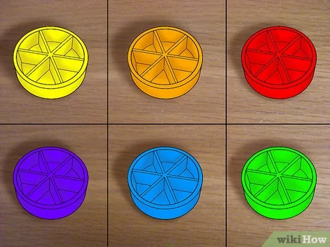
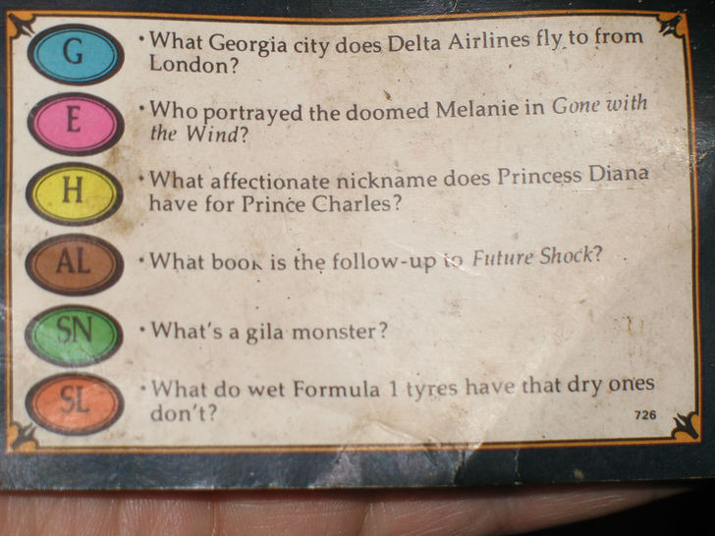
REF:
https://www.wikihow.com/Play-Trivial-Pursuit#/Image:So-many-questions....jpg

