Slide 1
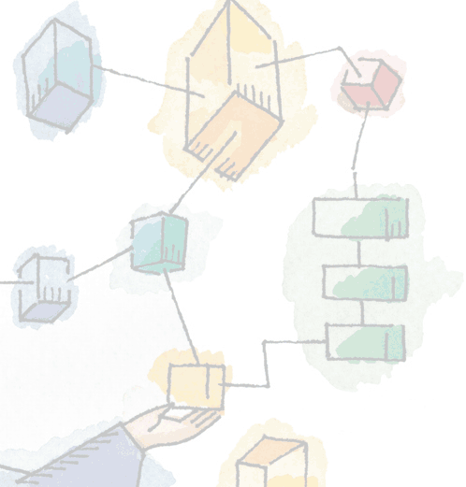
Chapter 8
Virtual Memory
Operating Systems:
Internals and Design Principles, 6/E
William Stallings
Patricia Roy
Manatee Community College, Venice, FL
©2008, Prentice Hall

Slide 2
Hardware and Control Structures
Memory references are dynamically translated into physical addresses at run time
  A process may be swapped in and out of main memory such that it occupies different regions

Slide 3
Hardware and Control Structures
A process may be broken up into pieces, which do not need to be located contiguously in main memory
It is not necessary for all pieces of a process to be loaded in main memory during execution of the process

Slide 4
Execution of a Program
Operating system brings into main memory a few pieces of the program
Resident set - portion of process that is in main memory
An interrupt is generated when an address is needed that is not in main memory
Operating system places the process in a blocking state

Slide 5
Execution of a Program
Piece of process that contains the logical address is brought into main memory
  Operating system issues a disk I/O Read request
  Another process is dispatched to run while the disk I/O takes place
  An interrupt is issued when disk I/O complete which causes the operating system to place the affected process in the Ready state

Slide 6
Improved System Utilization
More processes may be maintained in main memory
  Only load in some of the pieces of each process
  With so many processes in main memory, it is very likely a process will be in the Ready state at any particular time
A process may be larger than all of main memory

Slide 7
Types of Memory
Real memory
  Main memory
Virtual memory
  Memory on disk
  Allows for effective multiprogramming and relieves the user of tight constraints of main memory

Slide 8
Thrashing
Swapping out a piece of a process just before that piece is needed
The processor spends most of its time swapping pieces rather than executing user instructions

Slide 9
Principle of Locality
Program and data references within a process tend to cluster
Only a few pieces of a process will be needed over a short period of time
Possible to make intelligent guesses about which pieces will be needed in the future
This suggests that virtual memory may work efficiently

Slide 10
Support Needed for Virtual Memory
Hardware must support paging and segmentation
Operating system must be able to do the management the movement of pages and/or segments between secondary memory and main memory

Slide 11
Paging
Each process has its own page table
Each page table entry contains the frame number of the corresponding page in main memory
A bit is needed to indicate whether the page is in main memory or not

Slide 12
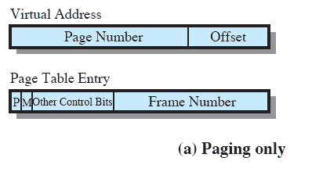
Paging

Slide 13
Modify Bit in Page Table
Modify bit is needed to indicate if the page has been altered since it was last loaded into main memory
If no change has been made, the page does not have to be written to the disk when it needs to be replaced

Slide 14
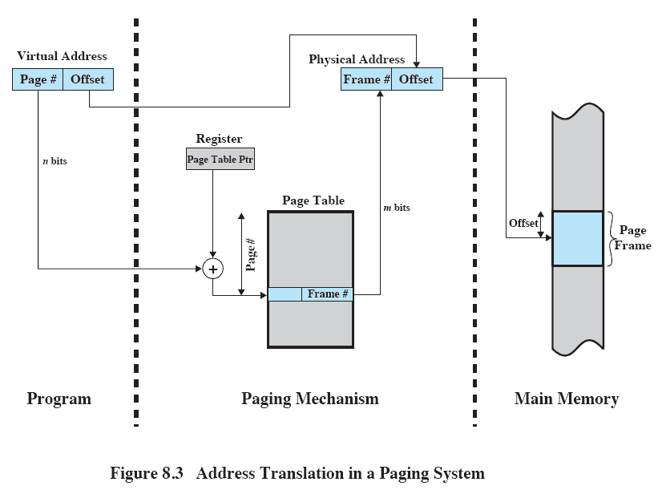
Address Translation

Slide 15
Page Tables
Page tables are also stored in virtual memory
When a process is running, part of its page table is in main memory

Slide 16
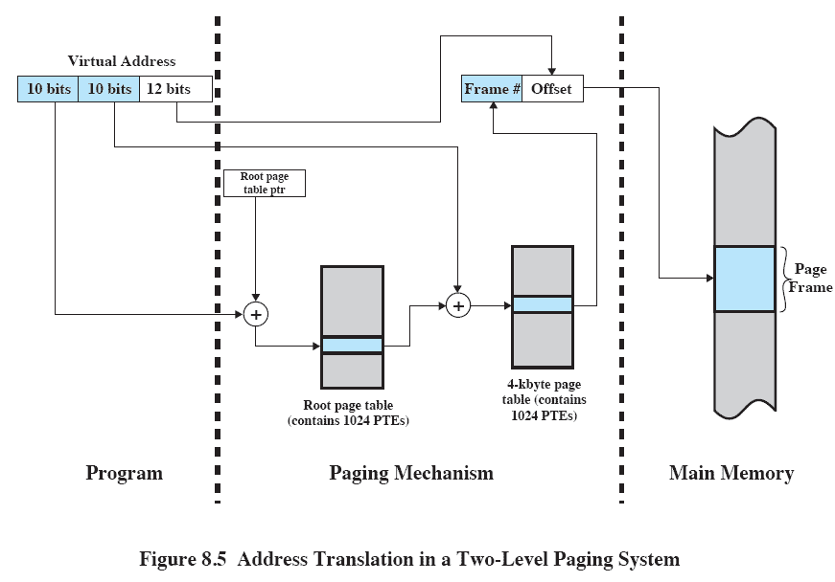
Address Translation

Slide 17
Translation Lookaside Buffer
Each virtual memory reference can cause two physical memory accesses
  One to fetch the page table
  One to fetch the data
To overcome this problem a high-speed cache is set up for page table entries
  Called a Translation Lookaside Buffer (TLB)

Slide 18
Translation Lookaside Buffer
Contains page table entries that have been most recently used

Slide 19
Translation Lookaside Buffer
Given a virtual address, processor examines the TLB
If page table entry is present (TLB hit), the frame number is retrieved and the real address is formed
If page table entry is not found in the TLB (TLB miss), the page number is used to index the process page table

Slide 20
Translation Lookaside Buffer
First checks if page is already in main memory
  If not in main memory a page fault is issued
The TLB is updated to include the new page entry

Slide 21
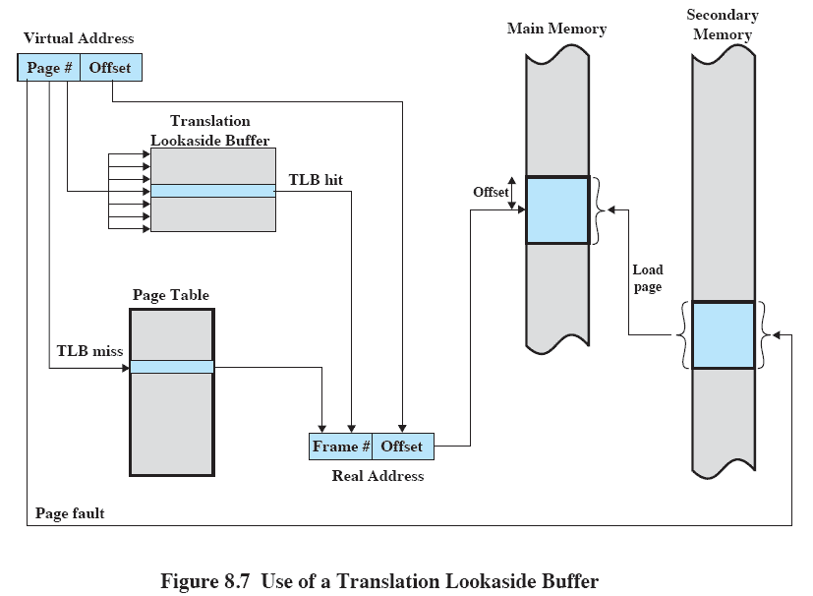
Translation Lookaside Buffer

Slide 22
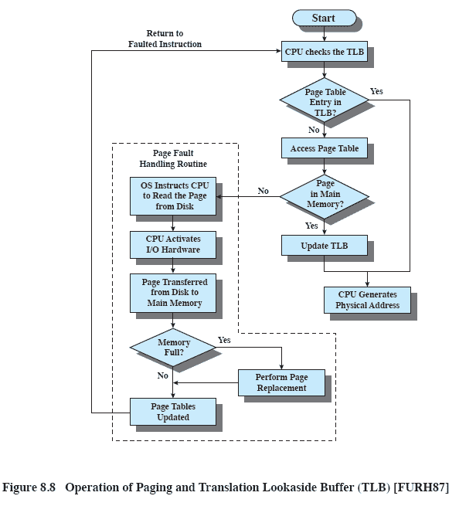
Translation Lookaside Buffer

Slide 23
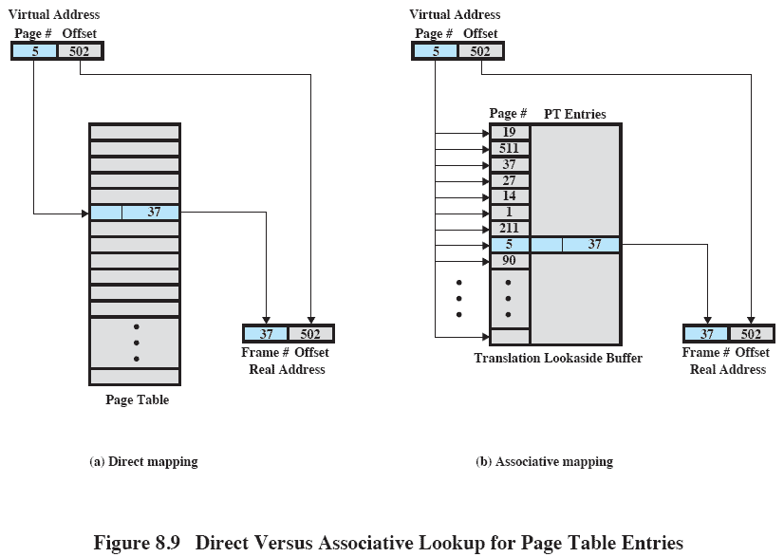
Translation Lookaside Buffer

Slide 24
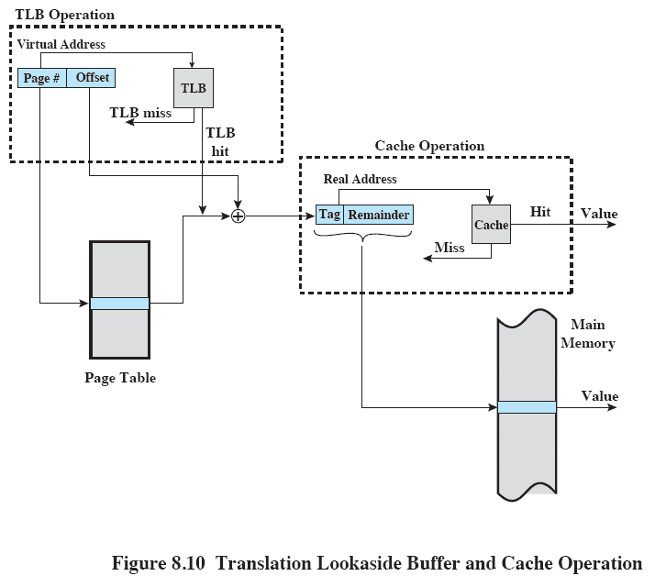
Translation Lookaside Buffer

Slide 25
Page Size
Smaller page size, less amount of internal fragmentation
Smaller page size, more pages required per process
More pages per process means larger page tables
Larger page tables means large portion of page tables in virtual memory

Slide 26
Page Size
Secondary memory is designed to efficiently transfer large blocks of data so a large page size is better

Slide 27
Page Size
Small page size, large number of pages will be found in main memory
As time goes on during execution, the pages in memory will all contain portions of the process near recent references. Page faults low.
Increased page size causes pages to contain locations further from any recent reference. Page faults rise.

Slide 28
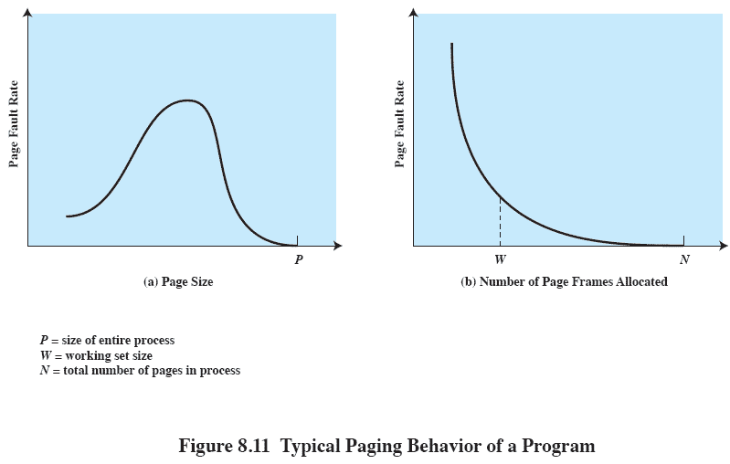
Page Size

Slide 29
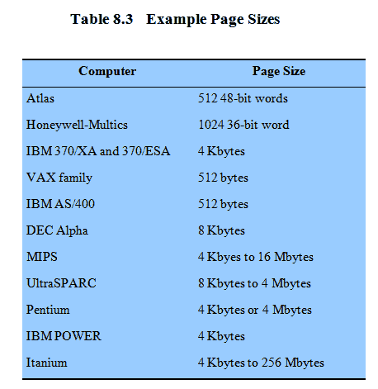
Example Page Size

Slide 30
Segmentation
May be unequal, dynamic size
Simplifies handling of growing data structures
Allows programs to be altered and recompiled independently
Lends itself to sharing data among processes
Lends itself to protection

Slide 31
Segment Tables
Starting address corresponding segment in main memory
Each entry contains the length of the segment
A bit P is needed to determine if segment is already in main memory
Another bit M is needed to determine if the segment has been modified since it was loaded in main memory

Slide 32
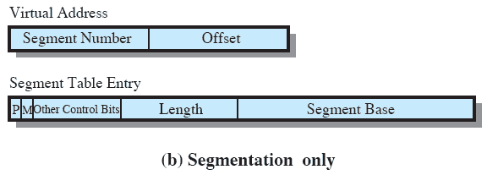
Segment Table Entries

Slide 33
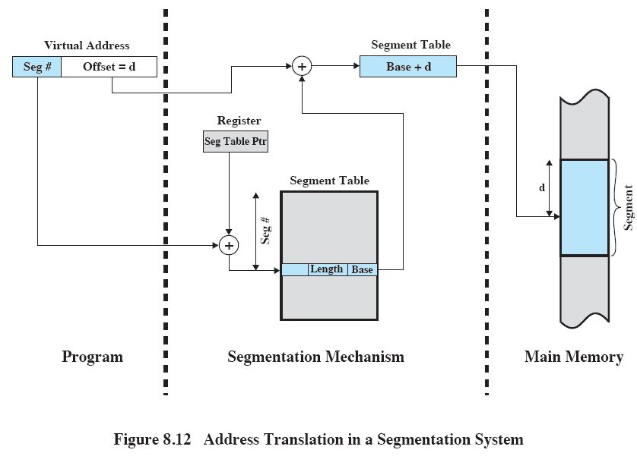
Segmentation

Slide 34
Combined Paging and Segmentation
Paging is transparent to the programmer
Segmentation is visible to the programmer
Each segment is broken into fixed-size pages

Slide 35
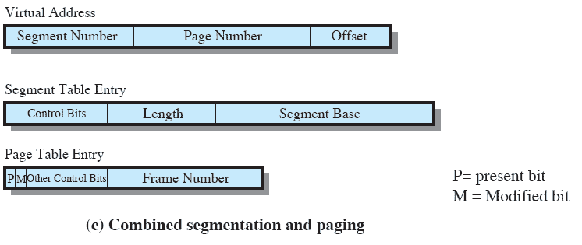
Combined Paging and Segmentation

Slide 36
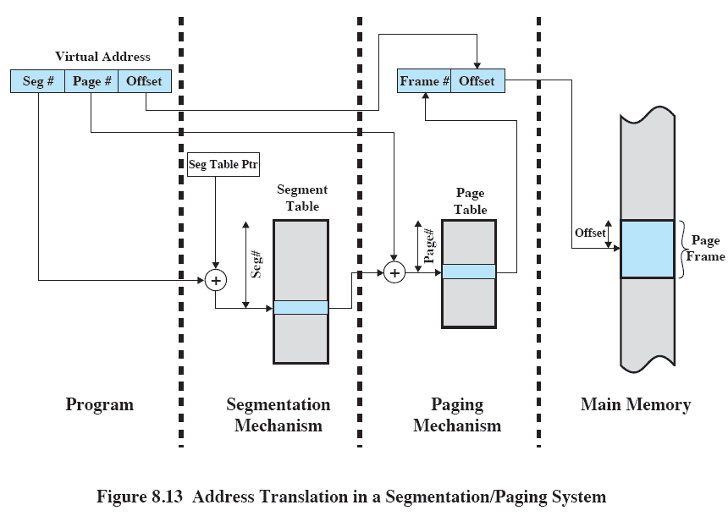
Address Translation

Slide 37
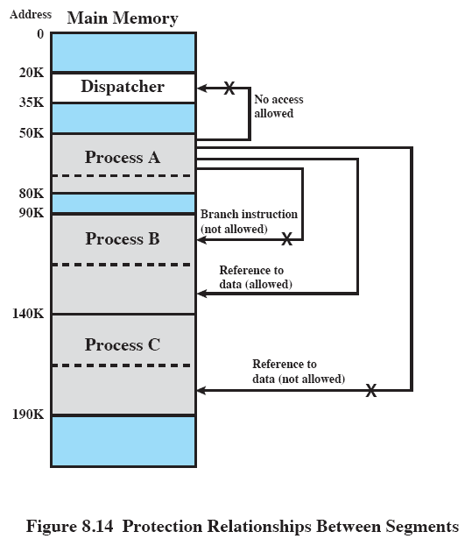
Protection Relationships

Slide 38
Fetch Policy
Determines when a page should be brought into memory
Demand paging only brings pages into main memory when a reference is made to a location on the page
  Many page faults when process first started
Prepaging brings in more pages than needed
  More efficient to bring in pages that reside contiguously on the disk

Slide 39
Placement Policy
Determines where in real memory a process piece is to reside
Important in a segmentation system
Paging or combined paging with segmentation hardware performs address translation

Slide 40
Replacement Policy
Which page is replaced?
Page removed should be the page least likely to be referenced in the near future
Most policies predict the future behavior on the basis of past behavior

Slide 41
Replacement Policy
Frame Locking
  If frame is locked, it may not be replaced
  Kernel of the operating system
  Key control structures
  I/O buffers
  Associate a lock bit with each frame

Slide 42
Basic Replacement Algorithms
Optimal policy
  Selects for replacement that page for which the time to the next reference is the longest
  Impossible to have perfect knowledge of future events

Slide 43
Basic Replacement Algorithms
Least Recently Used (LRU)
  Replaces the page that has not been referenced for the longest time
  By the principle of locality, this should be the page least likely to be referenced in the near future
  Each page could be tagged with the time of last reference. This would require a great deal of overhead.

Slide 44
Basic Replacement Algorithms
First-in, first-out (FIFO)
  Treats page frames allocated to a process as a circular buffer
  Pages are removed in round-robin style
  Simplest replacement policy to implement
  Page that has been in memory the longest is replaced
  These pages may be needed again very soon

Slide 45
Basic Replacement Algorithms
Clock Policy
  Additional bit called a use bit
  When a page is first loaded in memory, the use bit is set to 1
  When the page is referenced, the use bit is set to 1
  When it is time to replace a page, the first frame encountered with the use bit set to 0 is replaced.
  During the search for replacement, each use bit set to 1 is changed to 0

Slide 46
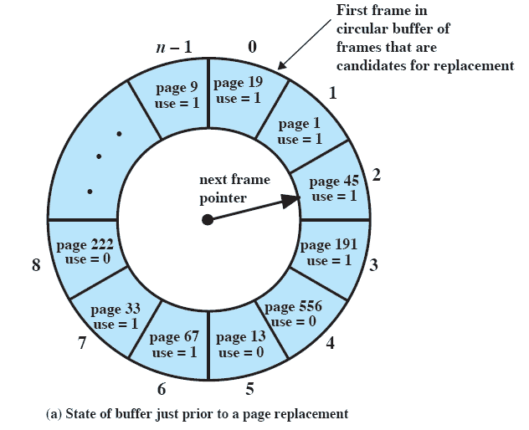
Clock Policy

Slide 47
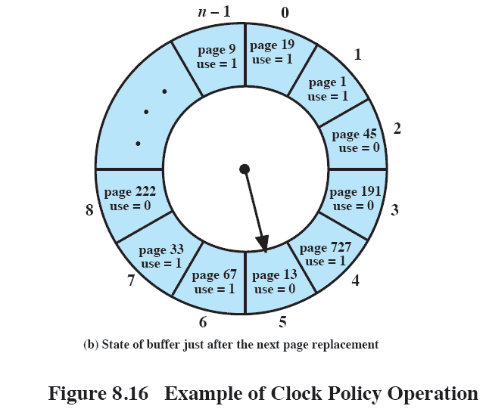
Clock Policy

Slide 48
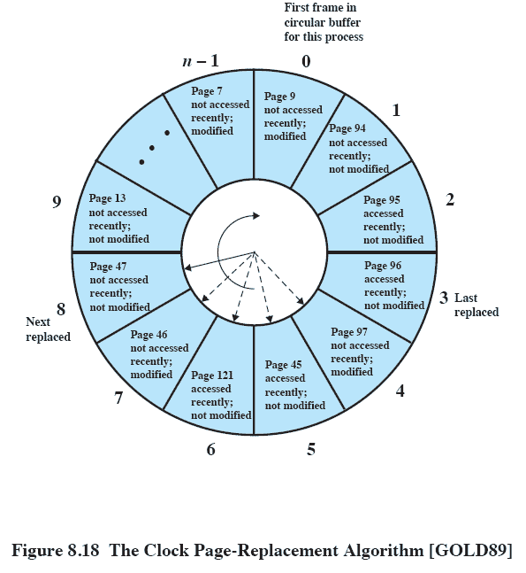
Clock Policy

Slide 49
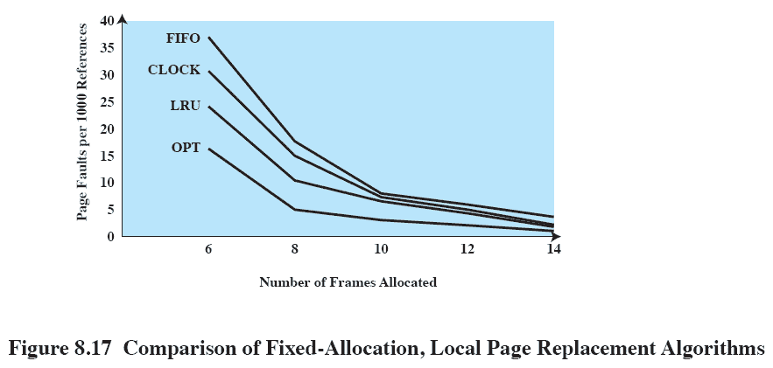
Comparison

Slide 50
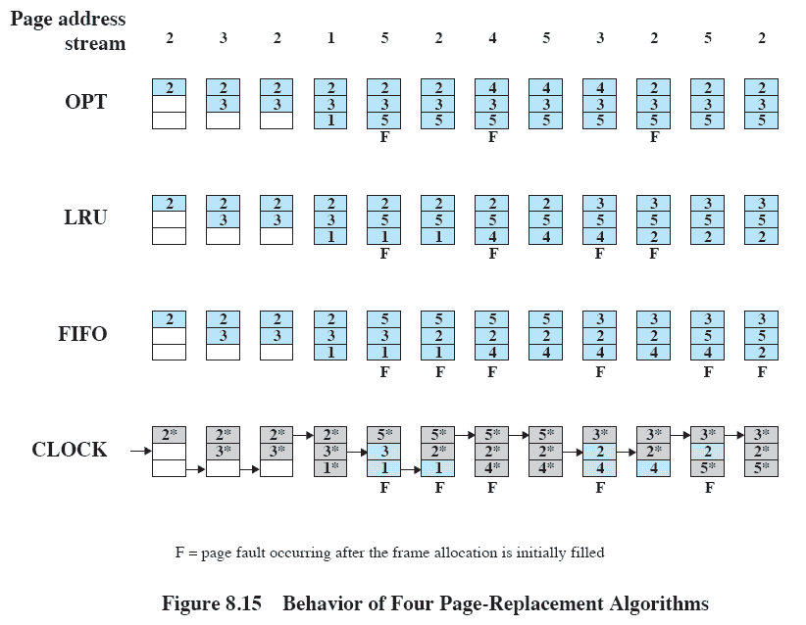
Behavior of Page Replacement Algorithms

Slide 51
Page and Frame Replacement Algorithms
Frame-allocation algorithm determines
  How many frames to give each process
  Which frames to replace
Page-replacement algorithm
  Want lowest page-fault rate on both first access and re-access
Evaluate algorithm by running it on a particular string of memory references (reference string) and computing the number of page faults on that string
  String is just page numbers, not full addresses
  Repeated access to the same page does not cause a page fault
In all our examples, the reference string is
7,0,1,2,0,3,0,4,2,3,0,3,0,3,2,1,2,0,1,7,0,1

Slide 52
Basic Page Replacement
Find the location of the desired page on disk
Find a free frame:
- If there is a free frame, use it
- If there is no free frame, use a page replacement algorithm to select a victim frame
- Write victim frame to disk if dirty
Bring the desired page into the (newly) free frame; update the page and frame tables
Continue the process by restarting the instruction that caused the trap
Note now potentially 2 page transfers for page fault

Slide 53
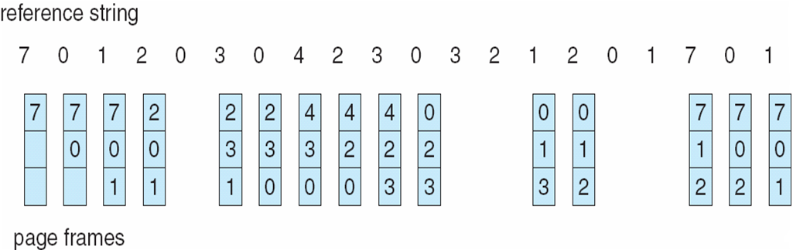
FIFO Page Replacement

Slide 54

Least Recently Used (LRU) Algorithm
Use past knowledge rather than future
Replace page that has not been used in the most amount of time
Associate time of last use with each page
12 faults – better than FIFO but worse than OPT
Generally good algorithm and frequently used
But how to implement?

Slide 55
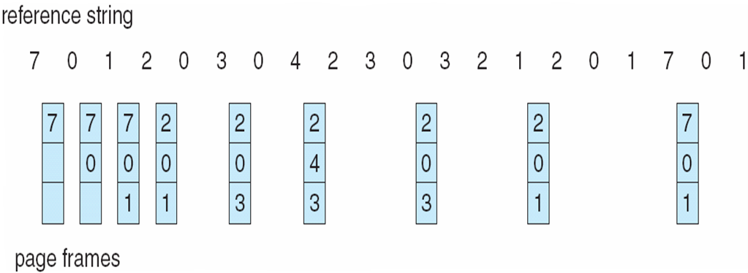
Optimal Page Replacement

Slide 56
Basic Replacement Algorithms
Page Buffering
  Replaced page is added to one of two lists
    Free page list if page has not been modified
    Modified page list

Slide 57
Resident Set Size
Fixed-allocation
  Gives a process a fixed number of pages within which to execute
  When a page fault occurs, one of the pages of that process must be replaced
Variable-allocation
  Number of pages allocated to a process varies over the lifetime of the process

Slide 58
Fixed Allocation, Local Scope
Decide ahead of time the amount of allocation to give a process
If allocation is too small, there will be a high page fault rate
If allocation is too large there will be too few programs in main memory
  Processor idle time
  Swapping

Slide 59
Variable Allocation, Global Scope
Easiest to implement
Adopted by many operating systems
Operating system keeps list of free frames
Free frame is added to resident set of process when a page fault occurs
If no free frame, replaces one from another process

Slide 60
Variable Allocation, Local Scope
When new process added, allocate number of page frames based on application type, program request, or other criteria
When page fault occurs, select page from among the resident set of the process that suffers the fault
Reevaluate allocation from time to time

Slide 61
Cleaning Policy
Demand cleaning
  A page is written out only when it has been selected for replacement
Precleaning
  Pages are written out in batches

Slide 62
Cleaning Policy
Best approach uses page buffering
  Replaced pages are placed in two lists
    Modified and unmodified
  Pages in the modified list are periodically written out in batches
  Pages in the unmodified list are either reclaimed if referenced again or lost when its frame is assigned to another page

Slide 63
Load Control
Determines the number of processes that will be resident in main memory
Too few processes, many occasions when all processes will be blocked and much time will be spent in swapping
Too many processes will lead to thrashing

Slide 64
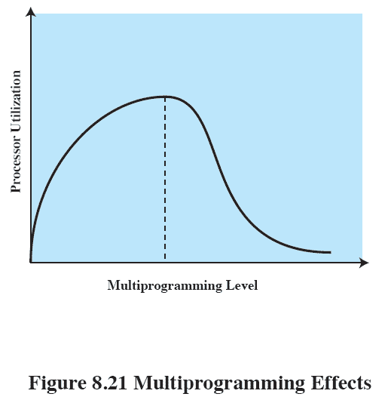
Multiprogramming

Slide 65
Process Suspension
Lowest priority process
Faulting process
  This process does not have its working set in main memory so it will be blocked anyway
Last process activated
  This process is least likely to have its working set resident

Slide 66
Process Suspension
Process with smallest resident set
  This process requires the least future effort to reload
Largest process
  Obtains the most free frames
Process with the largest remaining execution window

