Slide 1
Hate Speech Classification
By Thaneesh Shanand
Applied NLP

Slide 2
Why Detect Hate Speech?
Social media contains large amounts of abusive and hateful language.
Manual moderation is slow and inconsistent.
Automated detection helps improve online safety.
Challenge: distinguishing hate speech from general offensive language.

Slide 3
Project Goal
Objective:
Build a system that classifies tweets into:
Hate Speech (0)
Offensive Language (1)
Neither (2)
Compare:
TF-IDF + Logistic Regression (baseline)
DistilBERT Fine-Tuning (transformer model)
DistilBERT + Class Weights (improved final model)

Slide 4
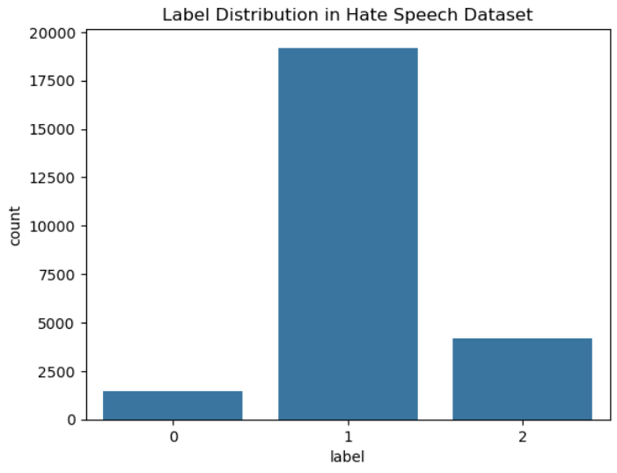
Dataset
Davidson et al. Hate Speech Dataset
24,783 labeled tweets
Imbalanced class distribution
Hate speech ≈ 5–6%
Offensive ≈ majority
Neutral smaller portion
Short, noisy text common in social media
Motivates the need for robust NLP methods

Slide 5
Baseline Approach
TF-IDF + Logistic Regression:
TF-IDF converts text to sparse vectors
Logistic regression trained for 3-class classification
Fast and explainable
Weak at capturing context or sarcasm
Baseline Macro F1: 0.67
Hate speech recall: 0.15 (very low)

Slide 6
Transformer Approach
Why DistilBERT?
Lightweight version of BERT
Pretrained on large text corpus
Captures context using self-attention
Works well on short social media text
Efficient on MacBook Pro M2 using MPS acceleration
Pipeline:
Text → Tokenizer → DistilBERT Encoder → Classification Head

Slide 7
DistilBERT Results
DistilBERT (No Class Weights):
Much better at understanding context
Big jump in hate-speech performance
Macro F1: 0.77
Class | Precision | Recall | F1
Hate | 0.56 | 0.39 | 0.46
Offensive | 0.94 | 0.96 | 0.95
Neither | 0.90 | 0.90 | 0.90

Slide 8
Improving Minority Class Performance
Problem:
Hate speech is the smallest class → model underpredicts it.
Solution: Add class weights to CrossEntropy loss.
Manually tuned weights to - [3.0, 0.8, 1.2]
This encourages the model to pay more attention to hate-speech samples.

Slide 9
Final Model (DistilBERT + Class Weights)
Final Evaluation (3 Epochs, LR: 1e-5, batch size: 16)
Macro F1: 0.78
Accuracy: 91%
Confusion matrix highlights:
168 hate-speech examples correctly classified
Reduced false positives for neutral class
Strong performance across all labels
Class | Precision | Recall | F1
Hate | 0.45 | 0.59 | 0.51
Offensive | 0.96 | 0.93 | 0.95
Neither | 0.88 | 0.91 | 0.90

Slide 10
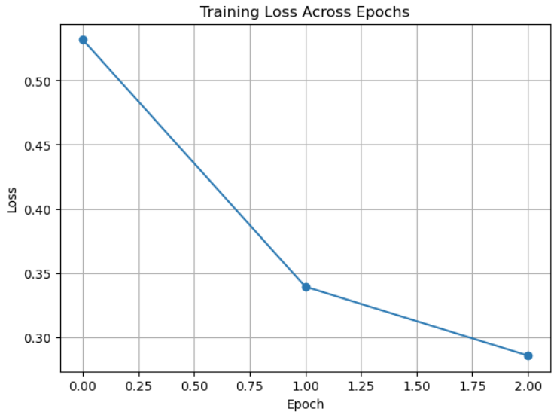
Training Behavior
Training Loss Across Epochs
Loss decreased smoothly:
0.5319 → 0.3393 → 0.2854
Model converged by epoch 3
Training for 4 epochs caused slight overfitting

Slide 11
Conclusion and Future Work
Final Takeaways
DistilBERT with tuned class weights is the best-performing model
Achieved a strong macro F1 score of 0.78
Large improvement over classical approaches
Demonstrates the effectiveness of transformer-based transfer learning for online safety tasks
Future Work
Try larger models (RoBERTa, BERT-base)
Explore threshold tuning for better precision–recall balance

