Slide 1

Imart

Slide 2

meet our team

Slide 3
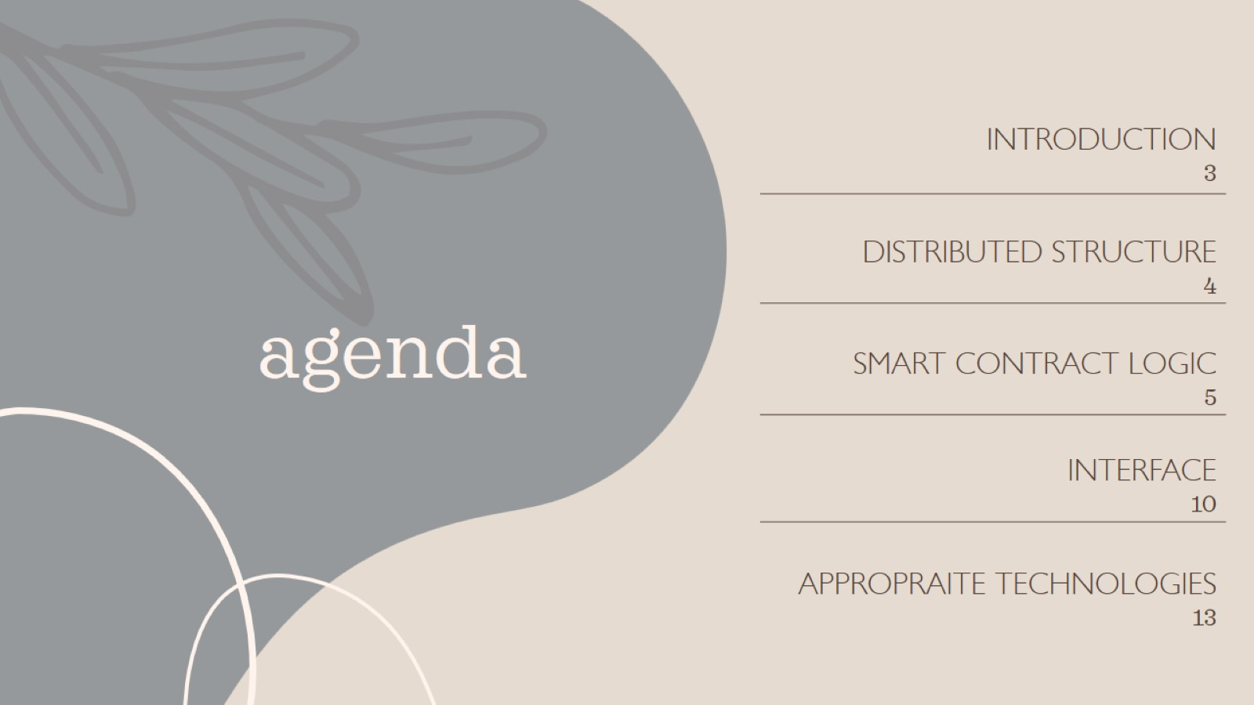
agenda

Slide 4
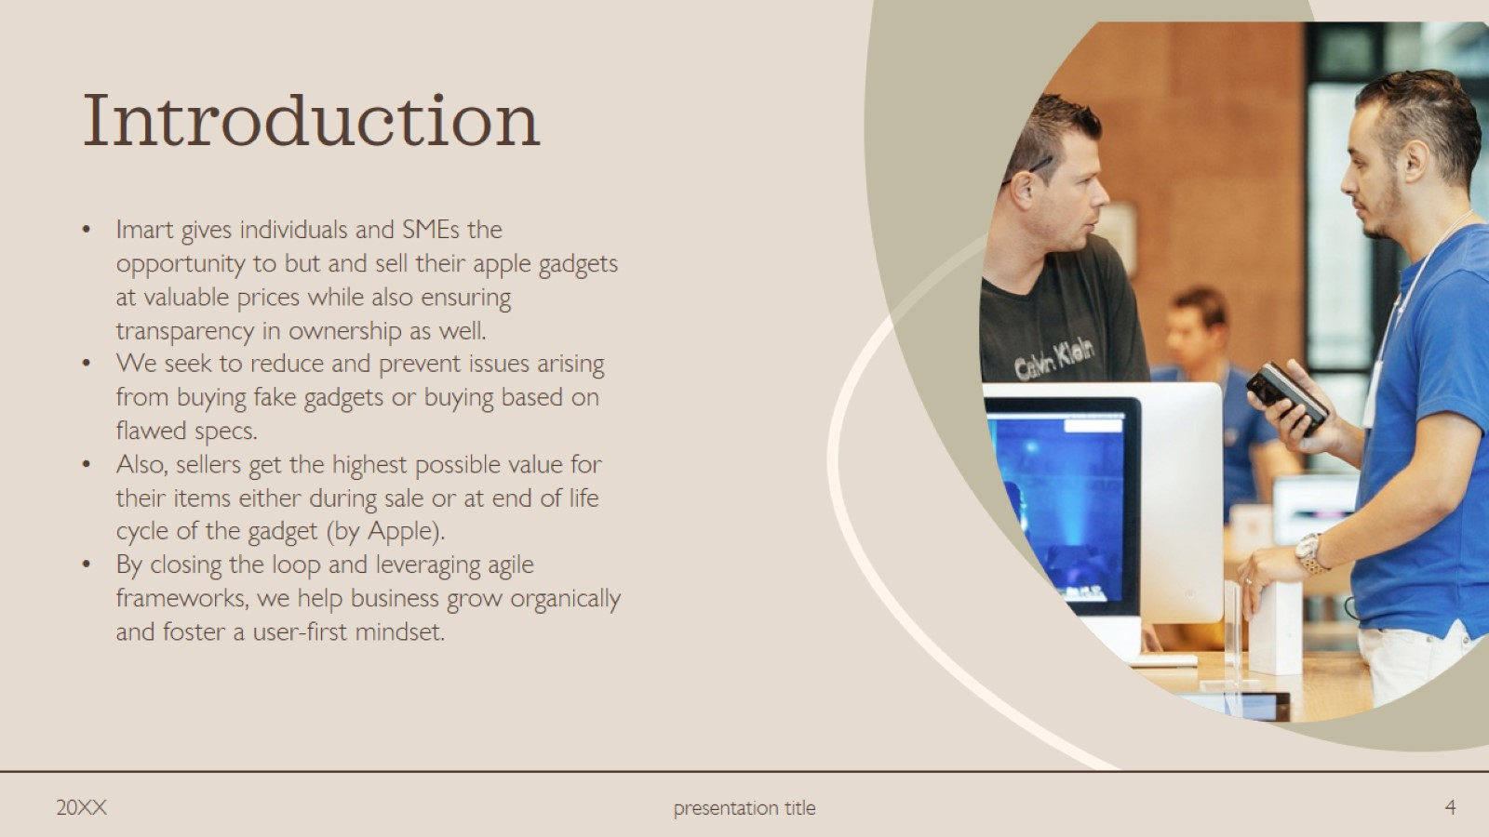
Introduction

Slide 5

Distributed Structure

Slide 6
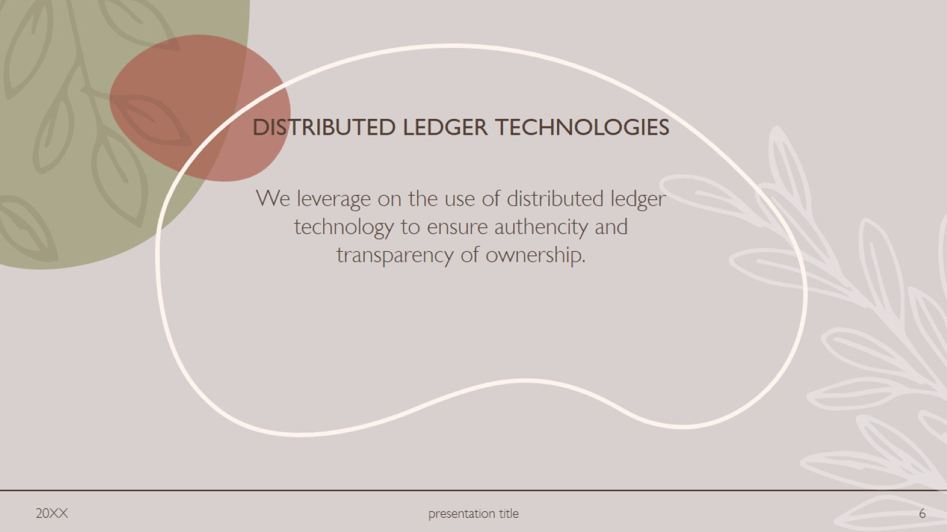
Distributed ledger technologies

Slide 7

Smart Contract Logic

Slide 8
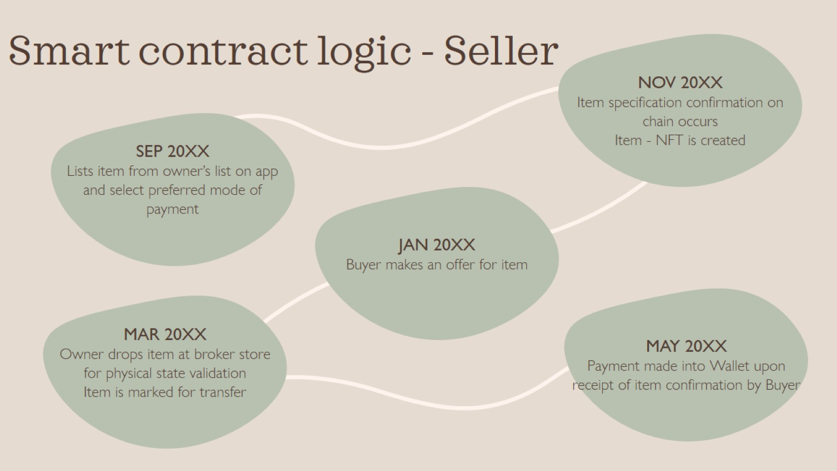
Smart contract logic - Seller

Slide 9
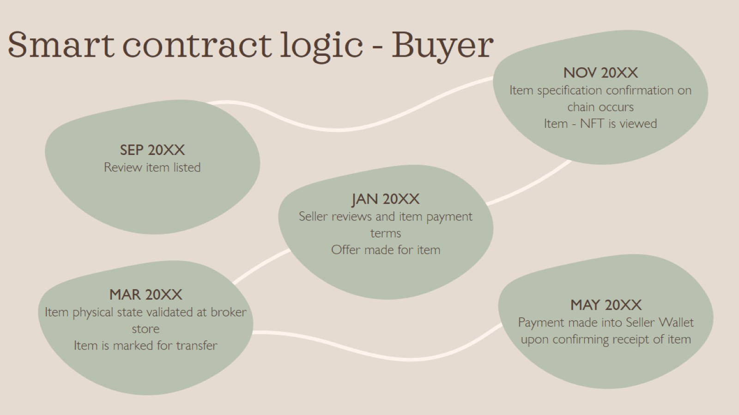
Smart contract logic - Buyer

Slide 10
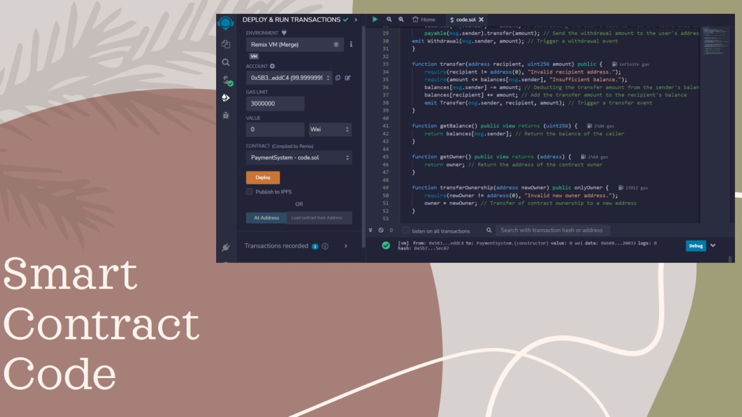
Smart Contract Code

Slide 11
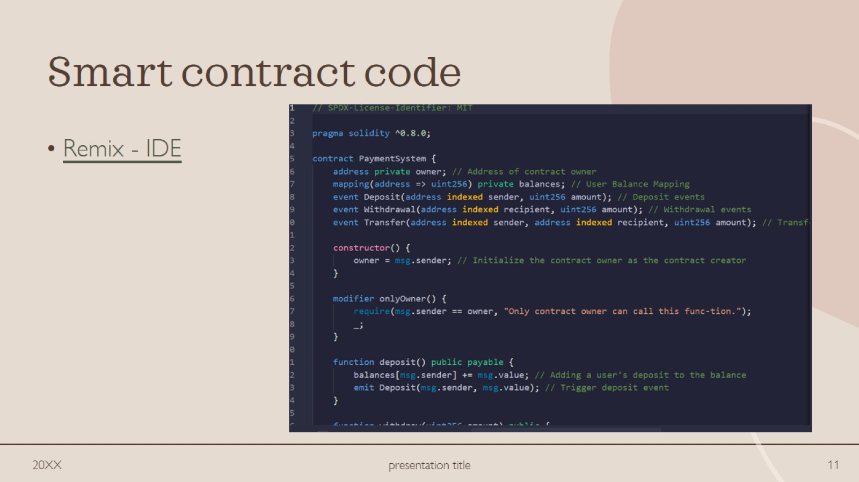
Smart contract code

Slide 12

User Interface

Slide 13
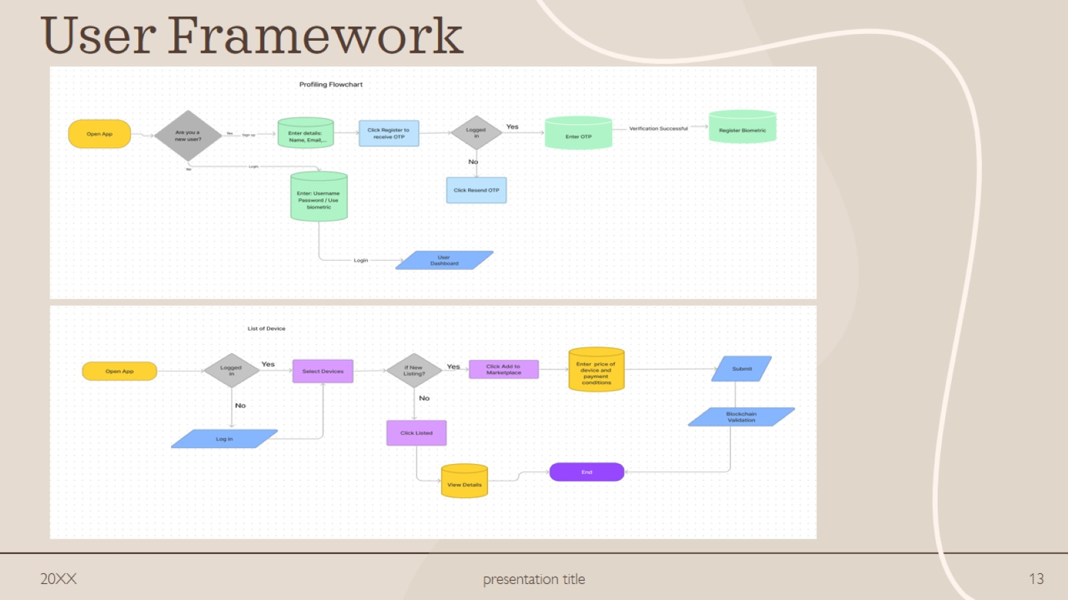
User Framework

Slide 14
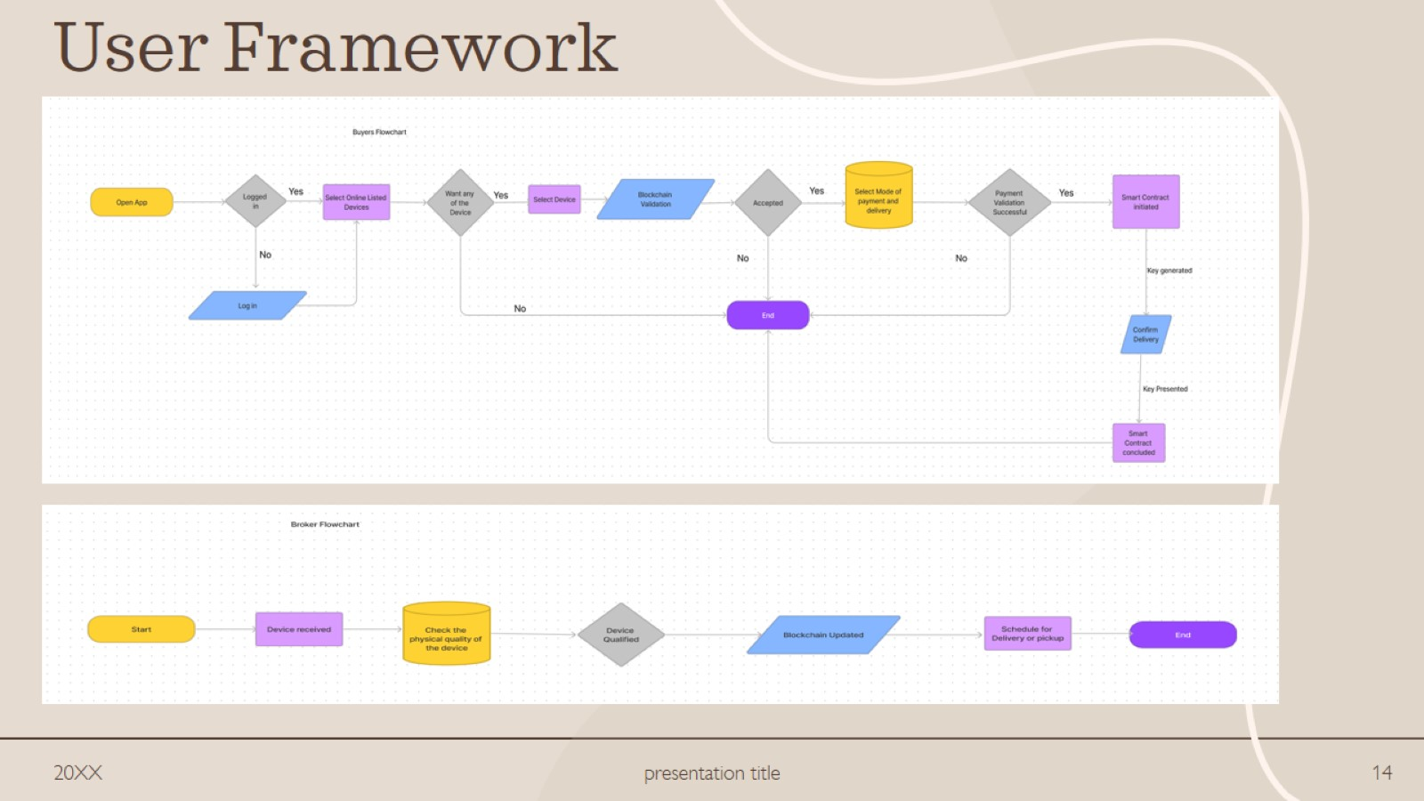
User Framework

Slide 15
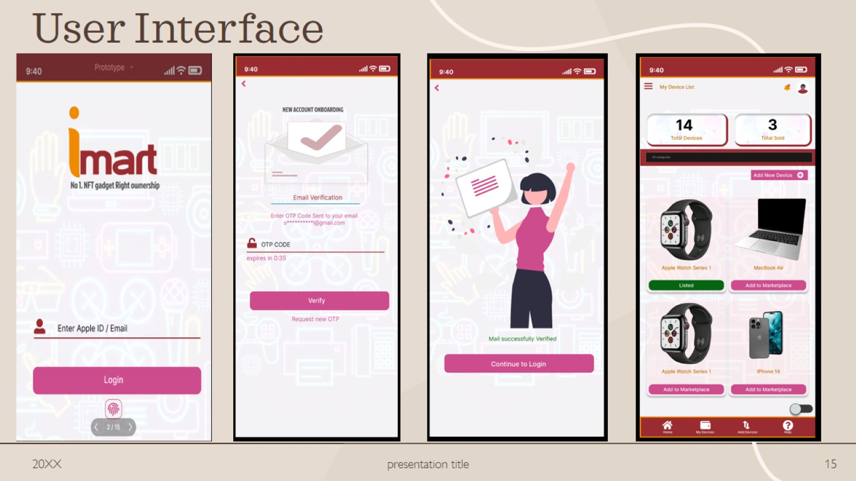
User Interface

Slide 16
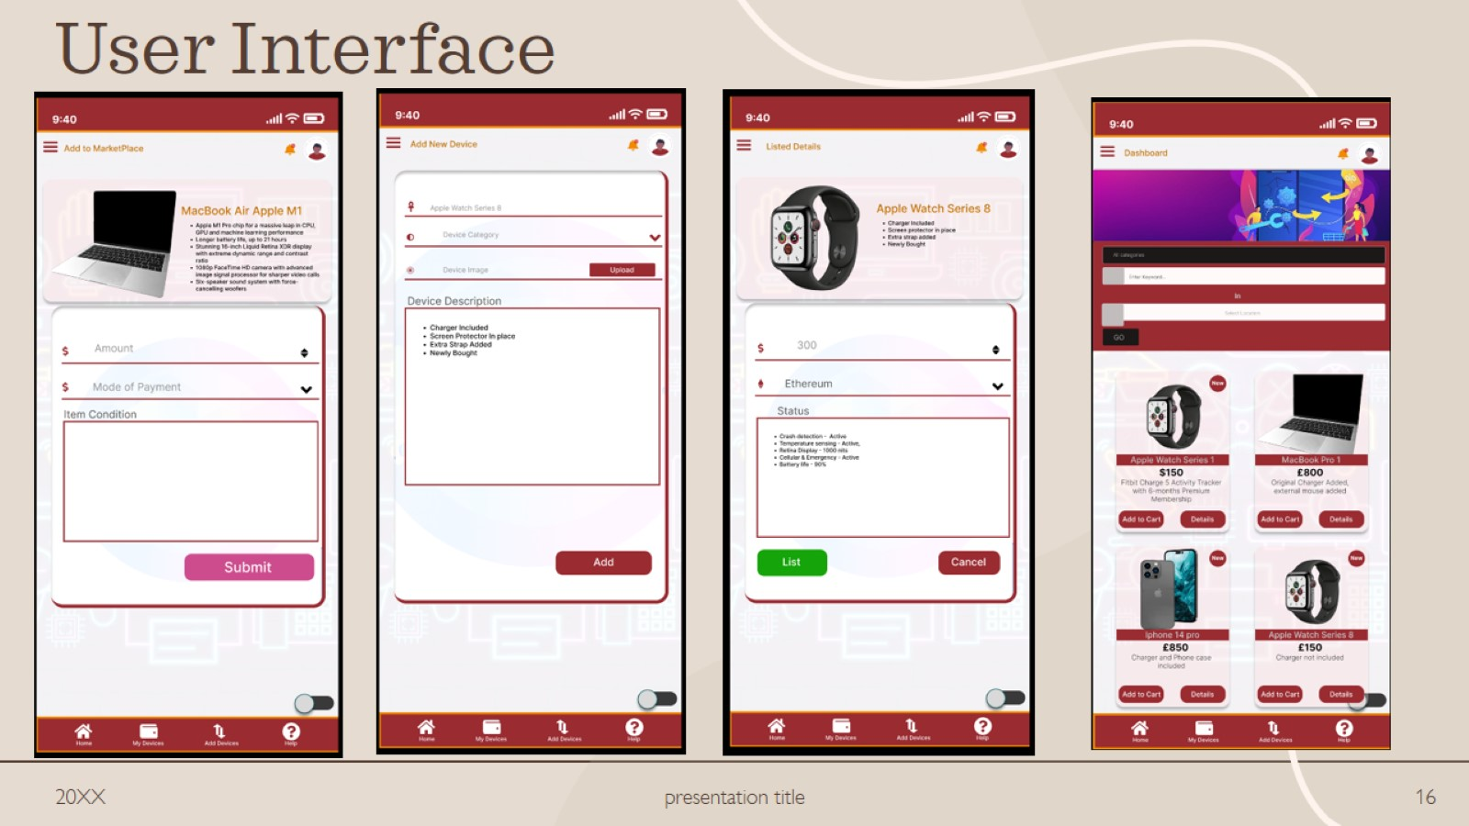
User Interface

Slide 17

User Interface

Slide 18

meet our extended team

Slide 19
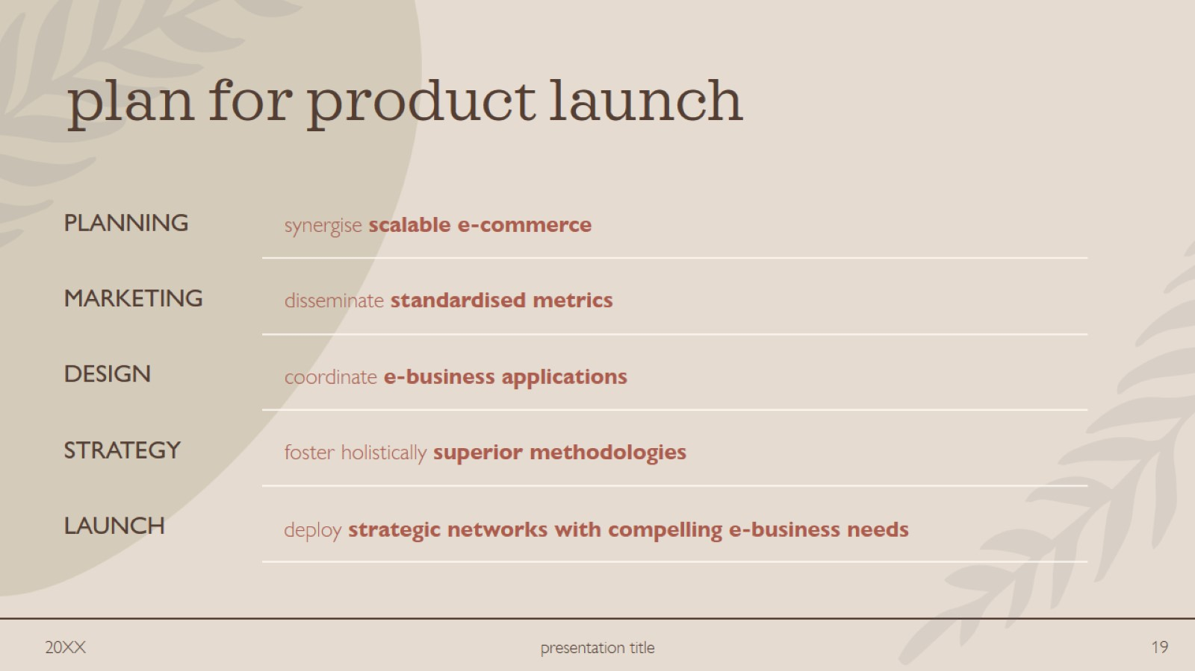
plan for product launch

Slide 20
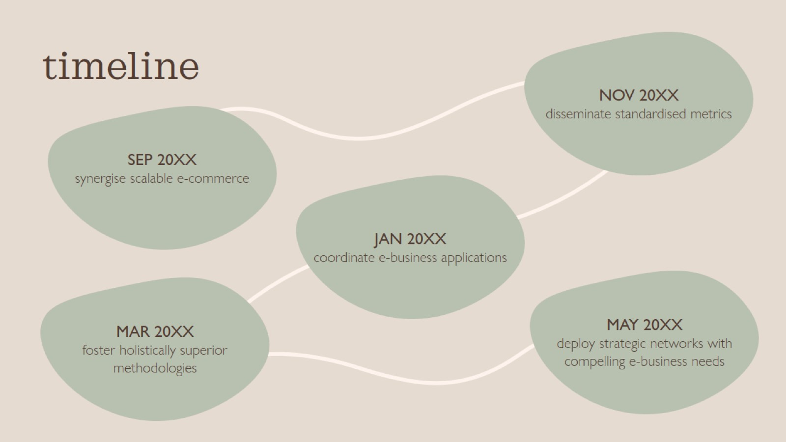
timeline

Slide 21
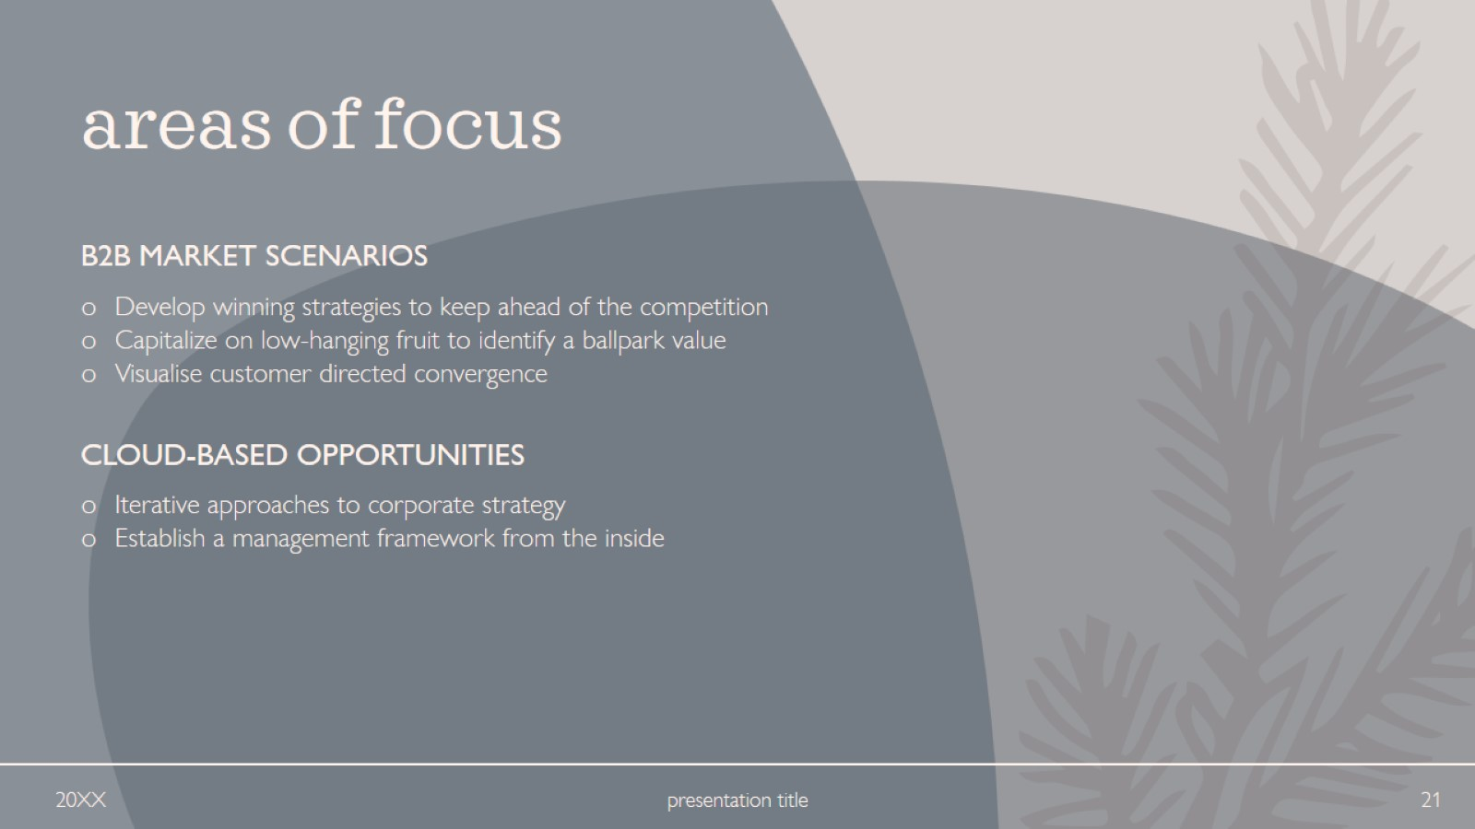
areas of focus

Slide 22
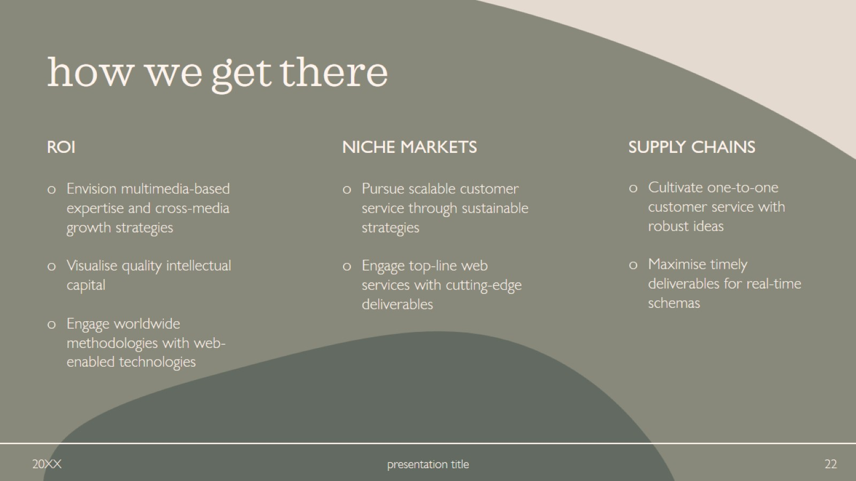
how we get there

Slide 23

summary

Slide 24

thank you

