Slide 1

SCANMS
SALES COLLABORATOR & AFFILIATE
NETWORK MANAGEMENT SYSTEM
CAPSTONE PROJECT DEFENSE | REVIEW 2
Team: FA26SE032
Major: Software Engineering | FPT University
Notes:
SCANMS
SALES COLLABORATOR & AFFILIATE
NETWORK MANAGEMENT SYSTEM
CAPSTONE PROJECT DEFENSE | REVIEW 2
Team: FA26SE032
Team Leader: NGUYỄN THÀNH THẮNG
Major: Software Engineering | FPT University

Slide 2

01
SYSTEM ARCHITECTURE
02
CONCEPTUAL DATA MODEL
03
FIVE BUSINESS FLOWS & UAT
04
Q&A
Notes:
01
SYSTEM ARCHITECTURE OVERVIEW
02
CORE TECHNOLOGIES & FOUR PLATFORM PORTALS
03
CONCEPTUAL DATA MODEL (16 CORE ENTITIES)
04
FIVE MAIN BUSINESS FLOWS & UAT TEST MATRICES
05
QUESTIONS & ANSWERS

Slide 3

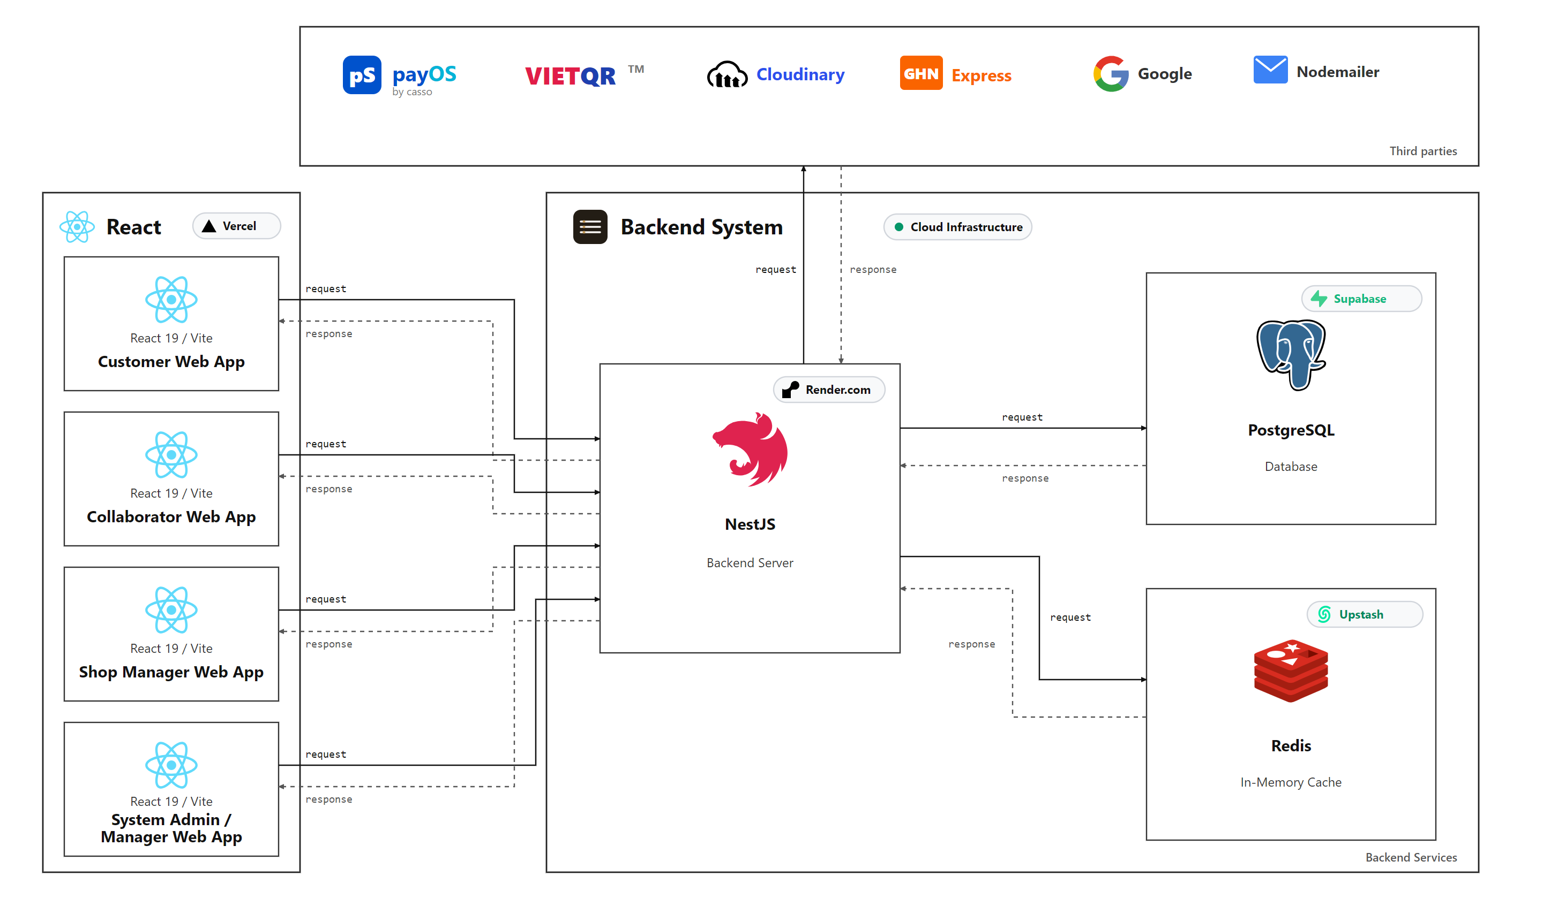
SYSTEM ARCHITECTURE
Notes:
SYSTEM ARCHITECTURAL OVERVIEW
MULTI-TIER ARCHITECTURE WITH DISTRIBUTED SERVICES & INTEGRATIONS

Slide 4
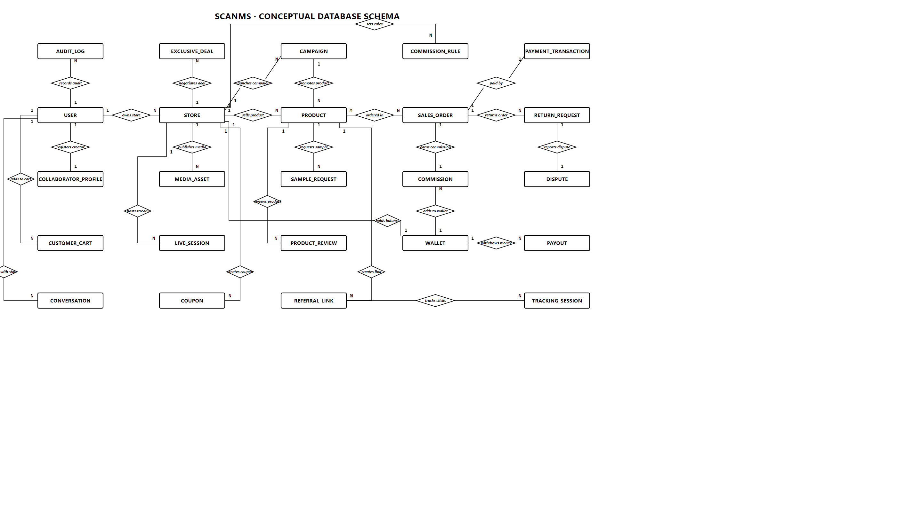
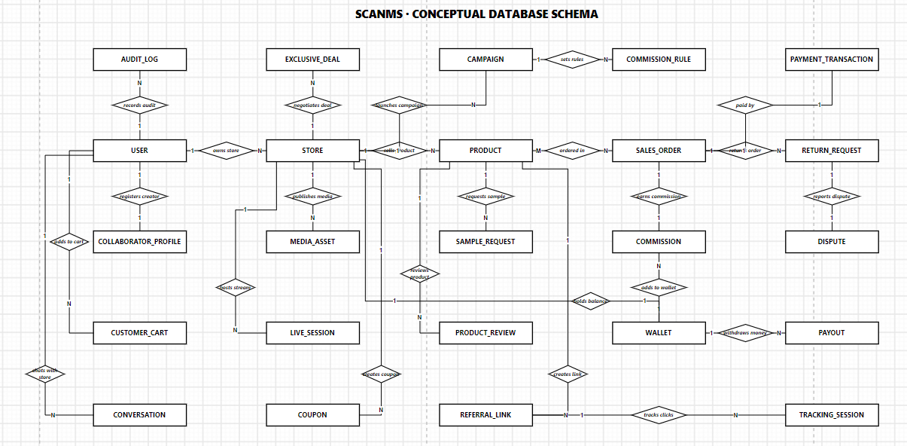
Notes:
CONCEPTUAL DATA MODEL
CORE BUSINESS DOMAINS & CHEN NOTATION CARDINALITIES (16 CORE ENTITIES)

Slide 5

ACCESS CONTROL
FIVE ROLES, CLEAR RESPONSIBILITIES
CUSTOMER
COLLABORATOR
SHOP MANAGER
SYSTEM MANAGER
SYSTEM ADMIN
Marketplace and live shopping
Affiliate purchases
GHN tracking and returns
Identity verification
Smart Links, QR and coupons
14-day samples and commissions
Six-section products
Samples and VIP deals
Monthly bonuses
Shop wallet reconciliation
KYC and product review
Sample dispute arbitration
Independent return decisions
All operations permissions
Exclusive user and role control
Executive financial reports
Notes:
SECURITY & ACCESS CONTROL MATRIX
SCANMS ACTORS & 5 STANDARDIZED RBAC ROLES
CUSTOMER
Customer
Shopper & End Buyer
Browse the marketplace, watch livestreams, buy through affiliate links, track GHN shipments and request returns.
COLLABORATOR
Affiliate Partner
KOL / KOC Affiliate
Verify identity, create Smart Links, Dynamic QR codes and exclusive coupons, request 14-day samples and earn commissions.
SHOP MANAGER
Store Owner
Merchant & Store Owner
Manage six product sections, approve samples, negotiate VIP deals, set monthly bonus tiers (FR-09) and reconcile the shop wallet.
SYSTEM MANAGER
Operations Specialist
Operations & Moderator
Review KYC, moderate new products, arbitrate sample disputes and independently resolve return claims.
SYSTEM ADMIN
System Administrator
Super Admin Governance
All operations permissions, plus exclusive user/role management (/admin/users) and financial reporting (/admin/analytics).

Slide 6

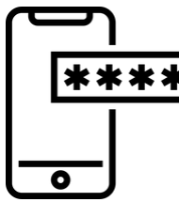




FLOW 1: REGISTRATION & KYC
SYSTEM MANAGER
NATIONAL ID + BANK ACCOUNT
TAX ID + BUSINESS LICENSE
REVIEW KYC
VERIFY OTP
UPLOAD FILES
SUBMIT KYC
REGISTER
APPROVE
COLLABORATOR / SHOP
RESUBMIT
REJECT
ACCOUNT ACTIVE
Notes:
MAIN BUSINESS FLOW
FLOW 1: USER REGISTRATION & MULTI-TIER KYC VERIFICATION
COLLABORATOR / SHOP
ENTER INFORMATION
VERIFY 2FA / OTP
UPLOAD FILES
NATIONAL ID + BANK ACCOUNT
TAX ID + BUSINESS LICENSE
SUBMIT KYC
SYSTEM MANAGER
REVIEW KYC
APPROVE
ACTIVE ROLE ACCOUNT
REJECT
RESUBMIT

Slide 7
UAT VALIDATION
FLOW 1: REGISTRATION & KYC
SUCCESS CASES
EXCEPTION HANDLING
TC_KYC_01 Account Registration
TC_KYC_01 Duplicate Email / Weak Password
Enter Name, Email, Phone, Password -> OTP sent.
Registration verified; redirect to secure login.
Duplicate Email: Display 'Email already registered'.
Password <8 chars: Block submit, show inline error.
TC_KYC_02 2FA Login & Role Portal
TC_KYC_02 Invalid Password / OTP Limit
Submit Email & Password -> Enter 6-digit OTP code.
Secure JWT issued; redirect to role-based portal.
Wrong password: Show secure error, protect identity.
>5 wrong OTP: Lock account 15 mins against brute-force.
TC_KYC_03 KYC Dossier Submission
TC_KYC_03 Oversized File / Invalid ID
Enter 12-digit ID, Bank account, and upload 2 photos.
Dossier submitted; badge marked 'Pending Review'.
File >5MB: Reject upload with clear size notification.
ID not 12 digits: Highlight red, disable submit button.
TC_KYC_04 System Manager KYC Approval
TC_KYC_04 Dossier Rejection with Feedback
Manager verifies identity credentials -> Click Approve.
Status set to 'Verified'; full Affiliate features active.
Rejecting requires detailed mandatory feedback note.
Notify user to re-upload clear photos; retain account.
Notes:
MAIN BUSINESS FLOW - TEST & VERIFICATION MATRIX
FLOW 1: USER REGISTRATION & MULTI-TIER KYC - UAT TEST CASES
EXPECTED SUCCESS (HAPPY PATH)
Valid inputs and completed workflows
TC_KYC_01: Account registration (FR-01, FR-02)
HTTP 201 Created. Passwords securely hashed with Argon2id.
Account status = UNVERIFIED. Redirect to /login.
TC_KYC_02: Secure login & 2FA OTP (FR-03)
HTTP 200 OK. Issue JWT access and refresh tokens in HttpOnly cookies.
RBAC Guard checks the role and redirects to the correct portal.
TC_KYC_03: Submit KYC documents (FR-05)
Regex validates the 12-digit national ID and bank account. Upload to Cloudinary CDN.
Set status = PENDING_REVIEW. Display the 'Pending review' badge.
TC_KYC_04: System Manager approves KYC (FR-06)
Set status = APPROVED and enable all affiliate features.
KOLs can create Smart Links and QR codes and earn commissions.
TEST RESULTS: 4/4 SCENARIOS PASSED (100% PASS)
FAILURE HANDLING (FAIL-SAFE)
Safeguards, HTTP errors and safe user feedback
TC_KYC_01: Duplicate email/phone or weak password
Duplicate: HTTP 409 Conflict. Show 'Email/phone already exists' in red.
Weak password: HTTP 422 Unprocessable. Show a field-level error.
TC_KYC_02: Invalid credentials or too many OTP attempts
Wrong password: HTTP 401 Unauthorized with a security message.
Over 5 failed OTPs: HTTP 429 Rate Limit. Lock for 15 minutes to prevent brute force.
TC_KYC_03: Invalid image format or national ID
Over 5 MB or wrong format: Block upload. Show 'JPG/PNG under 5 MB only'.
ID is not 12 digits: Show an inline error and disable submission.
TC_KYC_04: Blurred or unacceptable KYC documents
System Manager must give a rejection reason. Set status = REJECTED.
Email a request for clearer images. Keep the account unchanged.
SAFEGUARDS: LAYERED SECURITY & EXPLICIT ERROR HANDLING
20 detailed UAT test cases: docs/review 2/SCANMS_Demo_Test_Cases_Review2.xlsx

Slide 8






FLOW 2: DEALS & LIVESTREAM
PROPOSE 13% RATE
DEAL AGREED
VIP CONTRACT
PROPOSAL
Video quota and GMV
Two-way deal
APPROVE DEAL
VIP Rate 13%
TIER BONUS
+ LIVE
BONUS
COLLABORATOR
AUTO-
STACK
KOL / KOC
DISCOVER PRODUCT
BONUS
While LIVE
PUBLISH PRODUCT
SHOP INVITATION
REJECT DEAL
ACTIVATE
EXCLUSIVE ASSETS
• VIP Voucher Code
• Exclusive Smart Link
SHOP MANAGER
10% BASE RATE
Open offer
BASE RATE
Retain 10%
Merchant
Notes:
MAIN BUSINESS FLOW
FLOW 2: 2-WAY COMMISSION DEAL NEGOTIATION & LIVESTREAM ENGINE
COLLABORATOR
(KOL / KOC Affiliate)
SHOP MANAGER
(Merchant Store Owner)
PUBLISH PRODUCT
BASE 10% FLOOR RATE
(Standard Open Offer)
DISCOVER PRODUCT
PROPOSE 18% VIP RATE
PROPOSAL & COMMITMENT
(Video Quota & GMV Target)
SHOP DEAL INVITE
(Chat Socket.IO)
DEAL AGREED
EXCLUSIVE DEAL CONTRACT
(FR-27 2-WAY NEGOTIATION)
REJECT DEAL
FALLBACK TO FLOOR RATE
Maintains 10% Base Open Offer
APPROVE VIP DEAL
DEAL ACCEPTED (18% VIP)
AUTO-STACK
TIER RANK BOOST
(Silver +1% | Gold +2% | Diamond +3%)
+ LIVE BONUS
+2% TO +3% LIVE BONUS
(Session Status = LIVE)
ACTIVATE
EXCLUSIVE ASSETS ISSUED
• Custom Voucher Code (FR-12)
• Free Sample Dispatched (FR-14)

Slide 9
UAT VALIDATION
FLOW 2: VIP DEALS & LIVESTREAM
SUCCESS CASES
EXCEPTION HANDLING
TC_DEAL_01 Exclusive Deal Proposal
TC_DEAL_01 Rate Exceeds Cap (>25%)
Shop selects product, proposes 13% rate & GMV quota.
Deal card instantly appears in KOL chat via Socket.IO.
Input rate >25%: API blocks submission with warning.
Network disconnect: Display auto-reconnect banner.
TC_DEAL_02 Deal Acceptance & VIP Voucher
TC_DEAL_02 Proposal Rejected / 48h Timeout
KOL clicks 'Accept Deal' directly inside chat room.
Deal marked Approved; VIP Voucher & Smart Link issued.
KOL clicks Reject: Deal cancelled, retain base 10%.
No response after 48h: Proposal expires, locked.
TC_DEAL_03 Live Broadcast & +3% Bonus
TC_DEAL_03 Out of Stock / 25% Ceiling Cap
Shop pins Deal; KOL starts live video broadcast.
Red Live badge active; commission boosted to 16%.
Stock = 0: Hide purchase button in live tray automatically.
Rate calculation: Automatically enforce 25% hard ceiling.
TC_DEAL_04 Live Session Summary
TC_DEAL_04 Tab Closed / Post-Stream Chat
End stream -> Summary analytics dashboard displays.
Chat & pinned deals locked; rate returns to base 13%.
Tab closed: Server safely closes session after 5 mins.
Message after live: Display 'Live session has ended'.
Notes:
MAIN BUSINESS FLOW - TEST & VERIFICATION MATRIX
FLOW 2: 2-WAY COMMISSION DEAL & LIVESTREAM - UAT TEST CASES
EXPECTED SUCCESS (HAPPY PATH)
Valid inputs and completed workflows
TC_DEAL_01: Shop sends a deal invitation via chat (FR-27)
Socket.IO emits a real-time event and shows a deal card to both parties.
Create a DealContract with status = PENDING and a GMV commitment.
TC_DEAL_02: KOL accepts a VIP deal & generates a voucher (FR-27)
Set status = ACTIVE. The chat card turns green and displays 'ACCEPTED'.
Generate an exclusive voucher code and activate the 18% VIP rate.
TC_DEAL_03: Start livestream & activate +3% Live Bonus (FR-15)
Set session status = LIVE and open a Socket.IO room for interactions.
The engine adds the +3% Live Bonus, bringing the total rate to 21%.
TC_DEAL_04: End livestream & disable interactions (FR-15)
Set status = ENDED and display the Ended Stream Overlay.
Disable chat/deal pinning. Remove the Live Bonus and restore the 18% rate.
TEST RESULTS: 4/4 SCENARIOS PASSED (100% PASS)
FAILURE HANDLING (FAIL-SAFE)
Safeguards, HTTP errors and safe user feedback
TC_DEAL_01: Commission exceeds the platform cap (>25%)
API rejects with HTTP 400: 'Commission cannot exceed 25%'.
Socket disconnect: Client retries automatically and shows an offline warning.
TC_DEAL_02: KOL rejects a deal or the 48-hour offer expires
KOL rejects: Set status = REJECTED and retain the 10% base rate.
After 48 hours: Set status = EXPIRED and disable acceptance.
TC_DEAL_03: Product out of stock or total rate above the cap
Out of stock: Hide the live cart's buy button and show 'Temporarily out of stock'.
Total rate above 25%: Cap it automatically at 25% (Math.min(25, rate)).
TC_DEAL_04: Abrupt tab closure or messages after the stream
KOL closes the tab: Server safely closes the room after a 5-minute timeout.
Post-stream message: Socket rejects it with 'The session has ended'.
SAFEGUARDS: LAYERED SECURITY & EXPLICIT ERROR HANDLING
20 detailed UAT test cases: docs/review 2/SCANMS_Demo_Test_Cases_Review2.xlsx

Slide 10




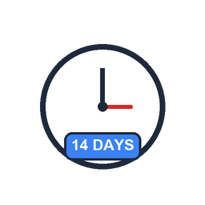

BUSINESS WORKFLOW
FLOW 3: MULTI-CHANNEL ATTRIBUTION & CHECKOUT
CLICKS LINK
Cookie Attributed
SMART LINK & DYNAMIC QR
Shared by COLLABORATOR (30-day Cookie)
PAYMENT GATEWAY
PAID
WATCHES LIVE
Live Deal
SECURE CHECKOUT
PAY VIETQR
WEBHOOK VERIFY
ADD TO CART
ORDER PAID
SHOP LIVE STREAM SESSION
CUSTOMER
Shopper / Buyer
MARKETPLACE CART
QUICK LOGIN MODAL
VIETQR / PAYOS
PENDING
DIRECT SEARCH
Direct Order
UNPAID ORDERS
DIRECT MARKETPLACE SEARCH
Notes:
MAIN BUSINESS FLOW
FLOW 3: MULTI-CHANNEL AFFILIATE PROMOTION & BUYER CHECKOUT
COLLABORATOR
(KOL / KOC Affiliate)
CUSTOMER
(Marketplace Shopper)
CREATE ATTRIBUTION
SMART LINK & QR (FR-10, 11)
30-Day Last-Click Cookie
HOST LIVE (FR-15)
LIVESTREAM SHOPPING
Real-time Deal Pin (+3% Live Bonus)
CLICK SMART LINK
PIN LIVE DEALS
DISCOVER & BROWSE
ADD TO CART
MARKETPLACE CART
SECURE CHECKOUT
STRICT BUYER AUTH
Popup Login / 100% Cart Preserved
PAY VIETQR
VIETQR / PAYOS / COD
Instant Napas 24/7 Gateway
WEBHOOK VERIFY
PAYMENT GATEWAY
PAID
ORDER PAID
Pending Escrow Commission
PENDING
UNPAID ORDERS TAB
Pending Payment & Timeout

Slide 11
UAT VALIDATION
FLOW 3: ATTRIBUTION & CHECKOUT
SUCCESS CASES
EXCEPTION HANDLING
TC_ATTR_01 Smart Link & Dynamic QR
TC_ATTR_01 Unverified KYC / Deleted Product
KOL selects product and clicks 'Generate Link'.
Generates /r/:slug & QR code; download PNG supported.
Unverified KYC: Disable link generation with prompt.
Deleted product: Display 404 Discontinued Item page.
TC_ATTR_02 30-Day Marketing Cookie
TC_ATTR_02 Invalid Slug / Cookie Expired
Buyer clicks link -> Redirect to product page.
Cookie stored 30 days; Last-Click updates new KOL.
Invalid slug: Safely redirect buyer to Marketplace.
>30 days: Attributed as organic order without commission.
TC_ATTR_03 In-Place Modal Quick Login
TC_ATTR_03 Invalid Password / Unregistered
Guest clicks Checkout -> Login modal opens in-place.
Cart 100% preserved after login for instant checkout.
Wrong password: Show inline error without reload.
No account: 30-second Quick Register on same modal.
TC_ATTR_04 VietQR Instant Order Matching
TC_ATTR_04 Underpaid Amount / Bad Signature
Buyer scans VietQR -> PayOS sends instant webhook.
Order marked PAID; commission sent to Escrow Vault.
Underpaid: Keep order in Pending Payment tab.
Bad signature: Webhook returns 403, logged to security.
Notes:
MAIN BUSINESS FLOW - TEST & VERIFICATION MATRIX
FLOW 3: AFFILIATE ATTRIBUTION & BUYER CHECKOUT - UAT TEST CASES
EXPECTED SUCCESS (HAPPY PATH)
Valid inputs and completed workflows
TC_ATTR_01: KOL creates a Smart Link & Dynamic QR (FR-10, 11)
Generate a short /r/:slug link with collaboratorId and UTM tags.
Render a sharp vector QR code with high-resolution PNG download.
TC_ATTR_02: Buyer clicks link & sets a 30-day cookie (FR-13)
HTTP 302 redirect to the product page. Set the scanms_ref cookie for 30 days.
Last-click attribution overwrites the referrer with the latest referral ID.
TC_ATTR_03: Quick login without losing the cart (FR-16)
Open the Quick Login modal in place. Preserve the entire cart after login.
Keep the buyer on the page and proceed to checkout with strict authentication.
TC_ATTR_04: VietQR/PayOS payment & webhook (FR-16, 17)
Backend verifies the HMAC-SHA256 signature and sets order status = PAID.
Record the KOL's commission in the wallet as PENDING_ESCROW.
TEST RESULTS: 4/4 SCENARIOS PASSED (100% PASS)
FAILURE HANDLING (FAIL-SAFE)
Safeguards, HTTP errors and safe user feedback
TC_ATTR_01: KYC not approved or product no longer available
Unapproved KYC: Disable link creation and show 'KYC approval required'.
Deleted product: HTTP 404 with 'Product no longer available'.
TC_ATTR_02: Broken link or expired 30-day cookie
Invalid slug: Redirect to the marketplace and show 'Link not found'.
After 30 days: Cookie expires. Treat the order as organic with 0% commission.
TC_ATTR_03: Buyer has no account or enters a wrong password
No account: Provide a 'Sign up in 30 seconds' button in the modal.
Wrong password: Show an inline red error without reloading the cart.
TC_ATTR_04: Invalid webhook signature or underpayment
Invalid signature: Backend rejects with HTTP 403 and logs a security event.
Underpayment: Keep PENDING_PAYMENT and request the full amount.
SAFEGUARDS: LAYERED SECURITY & EXPLICIT ERROR HANDLING
20 detailed UAT test cases: docs/review 2/SCANMS_Demo_Test_Cases_Review2.xlsx

Slide 12


FLOW 4: FULFILLMENT & DISPUTES
HOLD 14-DAY ESCROW
14-DAY MATURED
CREATE SHIPMENT
DELIVER PARCEL
RELEASE FUNDS
SHOP ACCEPTS RETURN
SHOP MANAGER
CUSTOMER
OPEN DISPUTE
REFUND & CLAWBACK
SHOP REJECTS
UNBOXING VIDEO
Return request
SYSTEM MANAGER ARBITRATION
Notes:
MAIN BUSINESS FLOW
FLOW 4: FULFILLMENT, 14-DAY ESCROW & DISPUTE ARBITRATION
SHOP MANAGER
CREATE GHN SHIPMENT
DELIVER PARCEL
CUSTOMER
HOLD 14-DAY ESCROW
14-DAY MATURED
ORDER COMPLETED & RELEASE FUNDS
Shop Receives Revenue, KOL Receives Commission
OPEN DISPUTE
BUYER UNBOXING VIDEO
& RETURN REQUEST
SHOP ACCEPTS RETURN
REFUND BUYER & CLAWBACK
Commission reversed from wallet
SHOP REJECTS
SYSTEM MANAGER ARBITRATION
Audits Unboxing Video vs Packing Camera
Final Binding Settlement & Escrow Decision

Slide 13
UAT VALIDATION
FLOW 4: FULFILLMENT & DISPUTES
SUCCESS CASES
EXCEPTION HANDLING
TC_FUL_01 GHN Waybill Generation
TC_FUL_01 Missing Dims / Carrier Busy
Shop clicks 'Create Waybill' -> GHN API connected.
Tracking code issued; status changed to In Transit.
Missing weight/dims: Block form, prompt input.
GHN maintenance: Display 'Gateway busy, retry later'.
TC_FUL_02 Delivery & 14-Day Escrow
TC_FUL_02 3 Failed Deliveries / Early Payout
Delivery successful -> 14-day Escrow clock starts.
Funds secured in Platform Vault; commission protected.
3 failed attempts: Return to shop, cancel bonuses.
Withdrawal before 14 days: Alert 'Escrow lock active'.
TC_FUL_03 Return Claim with Video
TC_FUL_03 Expired 14 Days / Missing Video
Buyer uploads unboxing video and submits claim.
Order set to Return Requested; Escrow frozen instantly.
>14 days delivered: Return button automatically hidden.
Missing unboxing video: Block return claim submission.
TC_FUL_04 Dual-Video Platform Arbitration
TC_FUL_04 Dispute Rejected / Shop Inactive 48h
System Manager reviews unboxing & packaging videos.
Buyer valid: 100% wallet refund, commission clawed back.
Buyer invalid: Dismiss dispute, release Escrow to Shop.
Shop inactive 48h: Platform auto-refunds buyer.
Notes:
MAIN BUSINESS FLOW - TEST & VERIFICATION MATRIX
FLOW 4: FULFILLMENT & ESCROW ARBITRATION - UAT TEST CASES
EXPECTED SUCCESS (HAPPY PATH)
Valid inputs and completed workflows
TC_FUL_01: Shop packs order & creates GHN shipment (FR-20)
GHN API succeeds. Generate a tracking code and set status = SHIPPING.
Create a shipment tracking timeline for both the customer and shop.
TC_FUL_02: Delivery starts the 14-day escrow period (FR-21)
Set status = DELIVERED and start the 14-day escrow countdown.
Hold funds in the platform's escrow account. Commission stays PENDING_ESCROW.
TC_FUL_03: Buyer opens a dispute with unboxing video (FR-22)
Set status = RETURN_REQUESTED and freeze the escrow timer immediately.
Show the claim in the shop's 'Returns / Refunds' tab.
TC_FUL_04: System Manager compares both videos (FR-23)
Review evidence from both parties and award a 100% refund to the buyer.
Automatic clawback removes all pending commission from the KOL wallet.
TEST RESULTS: 4/4 SCENARIOS PASSED (100% PASS)
FAILURE HANDLING (FAIL-SAFE)
Safeguards, HTTP errors and safe user feedback
TC_FUL_01: Missing package details or GHN maintenance
Missing weight/dimensions: Block submission and request weight in grams.
GHN outage: Show 'Shipping gateway busy, please retry' and retain the order.
TC_FUL_02: Three failed deliveries or early withdrawal
Delivery fails: Set RETURNING, return to the shop and cancel the commission.
Early withdrawal: Reject because available post-escrow funds = VND 0.
TC_FUL_03: Claim after 14 days or missing video
After 14 days: Hide the claim button and show 'Return period has expired'.
Missing video: Require an unboxing video before submitting the claim.
TC_FUL_04: Claim rejected or shop does not respond
Claim rejected: Unfreeze escrow and resume normal fund release.
No shop response within 48 hours: Automatically rule in the buyer's favor.
SAFEGUARDS: LAYERED SECURITY & EXPLICIT ERROR HANDLING
20 detailed UAT test cases: docs/review 2/SCANMS_Demo_Test_Cases_Review2.xlsx

Slide 14


FLOW 5: COMMISSION & REVENUE SETTLEMENT
REQUEST PAYOUT
COLLABORATOR
SUCCESS
PAYOUT DOSSIER
DISPATCH NAPAS 24/7
BANK CREDITED
NAPAS 24/7
AUDIT & APPROVE
FAILED
REQUEST PAYOUT
RESTORE WALLET
SHOP MANAGER
SYSTEM MANAGER
Notes:
MAIN BUSINESS FLOW
FLOW 5: COMMISSION SETTLEMENT & NAPAS 24/7 TRANSFER
AUTOMATED CRONJOB
MATURE ESCROW FUNDS
COLLABORATOR
REQUEST WITHDRAWAL
PAYOUT DOSSIER & 10% PIT TAX
SYSTEM ADMIN
(Super Admin Treasury Vault Governance)
AUDIT & APPROVE
SYSTEM ADMIN ONLY
DISPATCH NAPAS 24/7
NAPAS 24/7 GATEWAY
Instant Bank Transfer API
SUCCESS
BANK ACCOUNT CREDITED
Instant 24/7 Transfer
FAILED
RESTORE WALLET
Pessimistic Lock & Rollback

Slide 15
UAT VALIDATION
FLOW 5: BONUSES & PAYOUTS
SUCCESS CASES
EXCEPTION HANDLING
TC_PAY_01 Monthly Milestone Bonus
TC_PAY_01 Returned Orders / Milestone Unmet
Scans monthly net escrow revenue on month-end.
GMV >50M VND earns +2% bonus (e.g. 52.4M * 2%).
Returned orders: Automatically deducted from bonus GMV.
Target unmet: 0 VND bonus, original commission intact.
TC_PAY_02 Withdrawal Request & Tax Withheld
TC_PAY_02 Insufficient Balance / Below Minimum
KOL requests 5,000,000 VND -> 10% PIT tax withheld.
Net 4.5M disbursed; wallet funds locked to prevent double.
Amount > Available balance: Form disables submit.
Amount < 100,000 VND: Alert 'Minimum payout is 100k'.
TC_PAY_03 Admin Audit & Napas 24/7 Dispatch
TC_PAY_03 Unauthorized Access / Missing Receipt
System Admin verifies bank details and attaches receipt.
Order marked Disbursed; locked funds permanently deducted.
Non-admin user: RBAC immediately blocks with 403.
No bank receipt uploaded: Disburse button disabled.
TC_PAY_04 Automatic Refund on Bank Failure
TC_PAY_04 Bank Gateway Timeout / Stuck Order
Bank transfer fails or Admin rejects invalid account.
100% of requested funds safely restored to wallet.
Banking timeout: Flag order for reconciliation review.
Never suppress errors; keep funds locked until clear.
Notes:
MAIN BUSINESS FLOW - TEST & VERIFICATION MATRIX
FLOW 5: MONTHLY BONUS & NAPAS PAYOUT AUDIT - UAT TEST CASES
EXPECTED SUCCESS (HAPPY PATH)
Valid inputs and completed workflows
TC_PAY_01: Calculate monthly sales milestone bonus (FR-09)
Sum net sales cleared through escrow and apply the tiered bonus formula.
Calculate and explain the bonus, e.g. VND 52.4m x 2% = VND 1,048,000.
TC_PAY_02: Withdrawal request & income tax deduction (FR-24)
Set PENDING_APPROVAL. Net payout: VND 4.5m after 10% tax (VND 500,000).
Pessimistic lock immediately reserves the balance to prevent duplicate withdrawals.
TC_PAY_03: System Admin exclusively approves payouts (FR-24)
Call the Napas 24/7 Instant Transfer API to credit the bank account instantly.
Set status = COMPLETED and permanently deduct the reserved wallet funds.
TC_PAY_04: Safe rollback on bank API failure (FR-24)
Handle every error explicitly and log the bank's detailed error code.
Database rollback unlocks and restores all reserved funds to the available balance.
TEST RESULTS: 4/4 SCENARIOS PASSED (100% PASS)
FAILURE HANDLING (FAIL-SAFE)
Safeguards, HTTP errors and safe user feedback
TC_PAY_01: Refunded order or minimum milestone not reached
Returns: Deduct them from net sales before applying the bonus formula.
Below threshold: Monthly bonus = VND 0. Keep order commissions unchanged.
TC_PAY_02: Insufficient funds or withdrawal below minimum
Insufficient balance: Block submission and show 'Insufficient available funds'.
Below VND 100,000: Show 'Minimum withdrawal is VND 100,000'.
TC_PAY_03: Non-admin user or bank account mismatch
Not a Super Admin: RBAC Guard immediately rejects with HTTP 403 Forbidden.
Admin rejects: Require a reason and restore funds to the available balance.
TC_PAY_04: Bank network timeout with an unknown outcome
Set PROCESSING_VERIFY. A cron job reconciles the transfer every 5 minutes.
Restore funds only after Napas reconciliation confirms the outcome.
SAFEGUARDS: LAYERED SECURITY & EXPLICIT ERROR HANDLING
20 detailed UAT test cases: docs/review 2/SCANMS_Demo_Test_Cases_Review2.xlsx

Slide 16

THANK YOU
Q & A
SCANMS
Notes:
THANK YOU FOR LISTENING
Q & A
Sales Collaborator & Affiliate Network Management System (SCANMS)

