Slide 1
BLOCKCHAIN - ELIMINATING THE THREATS IN PAYMENTS
THANGARAJ M
Executive Data Analytics,
Certified Blockchain Professional

Slide 2
Walkthrough
BLOCKCHAIN - REVAMPING FINANCE AND PAYMENTS
Transaction Governance
Merchant Categorisation
Threats and Frauds
MERCHANT ONBOARD
How Blockchain can help?
Who are all the benefiters?

Slide 3
WHAT IS PAYMENT GATEWAY AND WHAT DO THEY DO?
WHO ARE MERCHANTS ? WHY ARE THEY SO IMPORTANT?

Slide 4
MERCHANT ON BOARDING
BLOCKCHAIN - ELIMINATING THE THREATS IN PAYMENTS
Process of adding a new merchant in payment gateway, so merchant can access the API and test/initiate transaction via payment gateway.
Traditional methods includes, KYC/AML process, Cancelled Check, web content, nodal letter, company legal documents.
There are single point of entry which provides Merchant Details like, “Merchantstronghold"

Slide 5

BLOCKCHAIN - ELIMINATING THE THREATS IN PAYMENTS
Scenario - Buying a t-shirt at PlatinumV
Mr.Sunil, on 2nd May, went to buy a t-shirt, from PlatinumV with his ICICI Bank Credit Card (which is on the Visa network). EDC provided by ICICI Bank. Immediately upon swiping, Mr.Sunil is asked to enter his Card PIN, and then on successful authorisation, he gets a confirmation SMS on his phone that Rs.599 has been charged to ICICI Bank Credit Card

Slide 6
HOW DO YOU CATEGORISE THE MERCHANTS?
BLOCKCHAIN - ELIMINATING THE THREATS IN PAYMENTS
Based on Transaction Value and Volume
PayTm
SpiceJet, IndiGo
Transaction history
Charge Back ratios
Refund policy
Web content

Slide 7
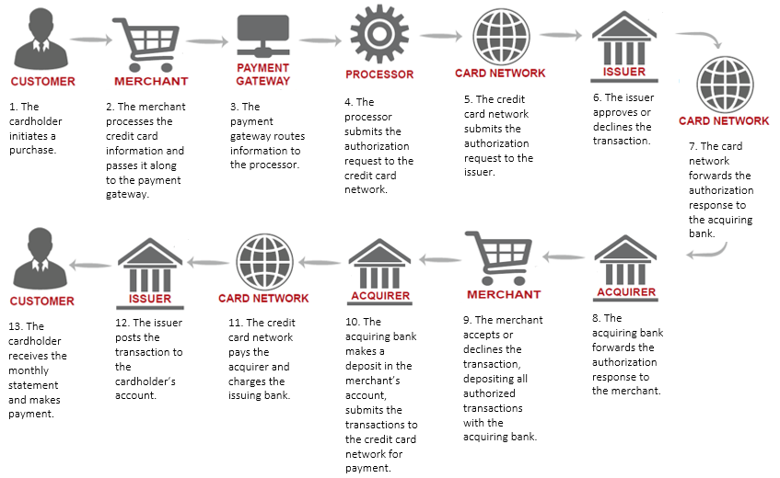
High risk merchants are not applicable for traditional process.
Past history of High Merchants include, unregulated Transaction histories.
Card processing statements for the past 6-8 months will be asked to check if we can onboard the high risk merchant

Slide 8
MERCHANT THREATS
BLOCKCHAIN - ELIMINATING THE THREATS IN PAYMENTS
Bust out Fraud
Identity Swap
Transaction Laundering

Slide 9
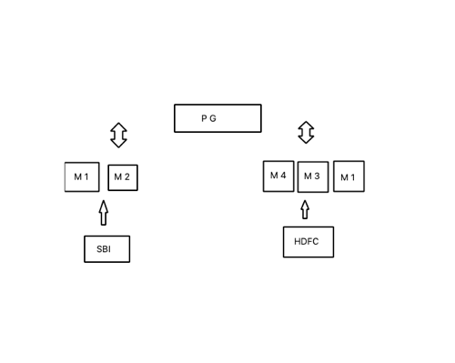
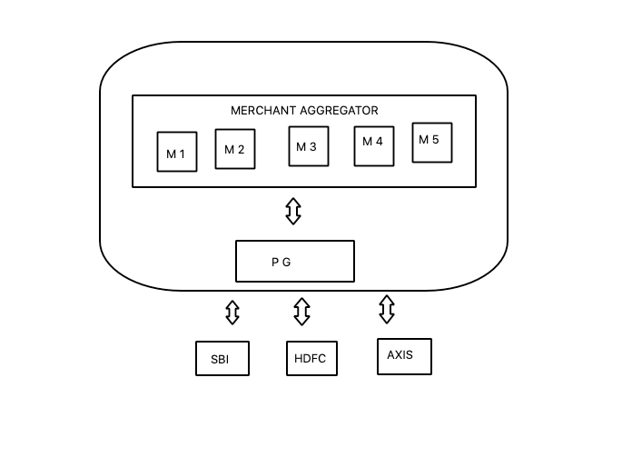
MERCHANT ONBOARD via BANKS
MERCHANT ONBOARD via PAYMENT GATEWAYS

Slide 10
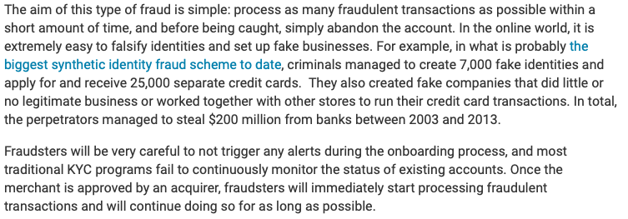
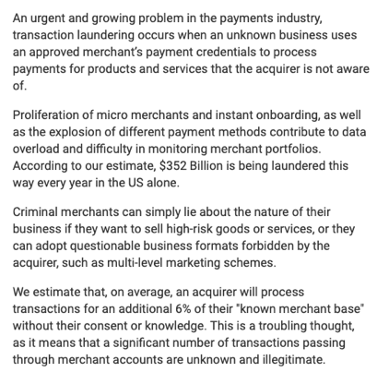

Slide 11
BLOCKCHAIN - ELIMINATING THE THREATS IN PAYMENTS
How decentralisation can help?

Slide 12
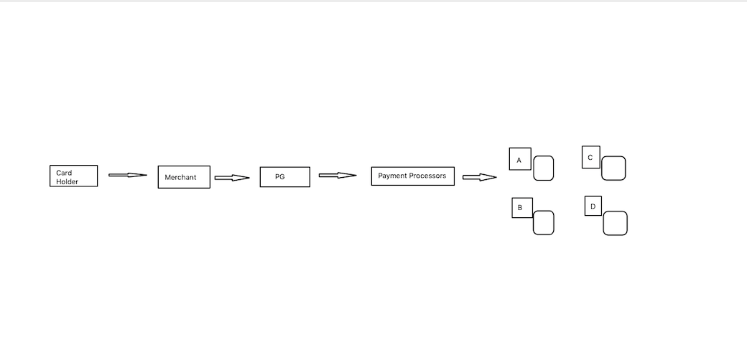
DECENTRALISED MERCHANT RISK SHARING

Slide 13
DLT Solution
BLOCKCHAIN - ELIMINATING THE THREATS IN PAYMENTS
Charge back ratios
Merchant Whitelist / Blacklist
Merchant Risk Sharing / Tracking

Slide 14
WHAT BENEFITS IT ADD TO MERCHANTS?
BLOCKCHAIN - ELIMINATING THE THREATS IN PAYMENTS
MDR based on Risk
Whitelisting
KYC / AML Tracking

Slide 15
BLOCKCHAIN - ELIMINATING THE THREATS IN PAYMENTS
BY IMPLEMENTING DECENTRALISATION, WE CAN KEEP TRACK OF MERCHANTS AND WE CAN PREVENT FACTORING

Slide 16
THANK YOU

