Slide 1
OpenSource Software's in TN Schools
Arun Kumar, Kawasaki

Slide 2
What is Free/Opensource Software?
Freedom to run
Freedom to study
Freedom to modify
Freedom to re-distribute
*** All 4 freedoms are at Zero Cost ***

Slide 3
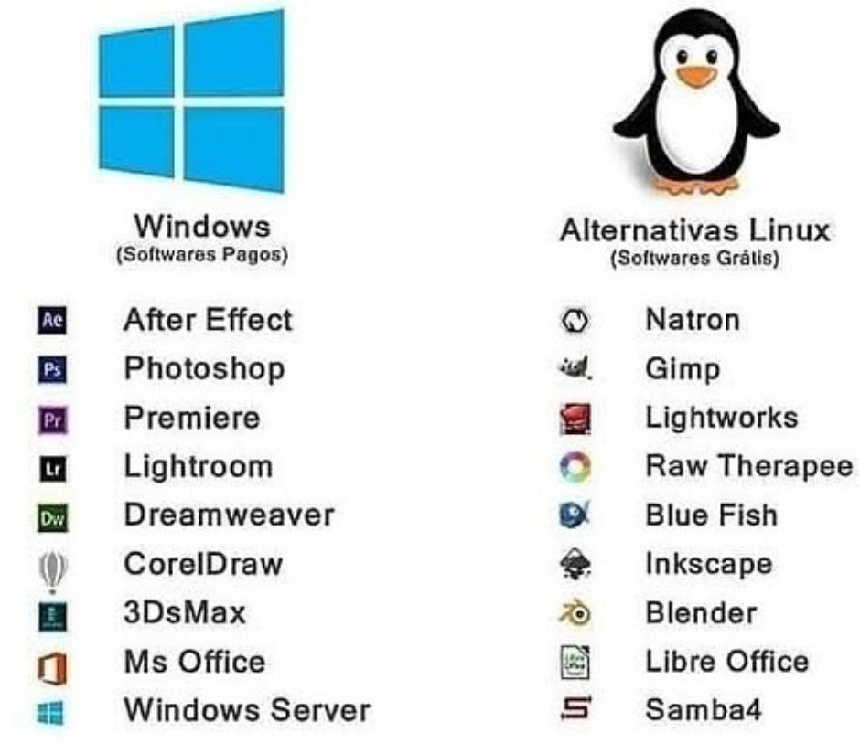
Examples of Opensoure Softwares

Slide 4
Few ex., of Education Softwares
Gcompris
  learning how to use a mouse and keyboard, simple arithmetic's
  recognize letters after hearing their names, & reading practice
Vym
  is a mind mapping program. It is useful to organize thoughts and do structure work
TuxTyping - is an educational typing tutorial game
Kstars
  an accurate graphical simulation of the night sky, from any location on Earth, at any date and time. The display includes 130,000 stars, 13,000 deep-sky objects
Step
  With Step you can not only learn but feel how physics works
Kalzium
  Kalzium is a full-featured chemistry application, including a Periodic Table of Elements, chemical reference, chemical equation solver, and 3D molecule viewer
KTurtle
  is an educational programming environment which uses a programming language based on Logo to make programming as easy and accessible as possible.

Slide 5
What is the gain?
Enable village children's to use computers
Unlimited access to educational software's
  No License FEE at all
Leveling TN Schools to the Global Standard
Increase no. of admissions in Govt Schools
We can achieve "Uniform Education" in Computer Learning

Slide 6
Computer LAB Setup ideas
Thin Client based
  Server
  Low cost computers
Zero Client Device
  Server
  Zeroclient Device
    No OS, No maintenance
    Power consumption is 1/50th of PCs

Slide 7
நன்றி
  முயற்சியுடையார் இகழ்ச்சியடையார்

