Slide 1
Emotion detection to upgrade Customer Experience
Team Members Panel Number:9
Project Advisor: Mr.Sabarish B.A (Asst. Prof) /CSE
S. No​ | Reg. No​ | Name of the Student​ | Section​
1​ | CB.EN.U4CSE18404​ | Abisheck Kathirvel​ | CSE E​
2​ | CB.EN.U4CSE18419​ | E V K Praneeth​ | CSE E​
3​ | CB.EN.U4CSE18450​ | Rohith Rajesh​ | CSE E​
4​ | CB.EN.U4CSE18453​ | Sanjith Ragul V​ | CSE E​

Slide 2
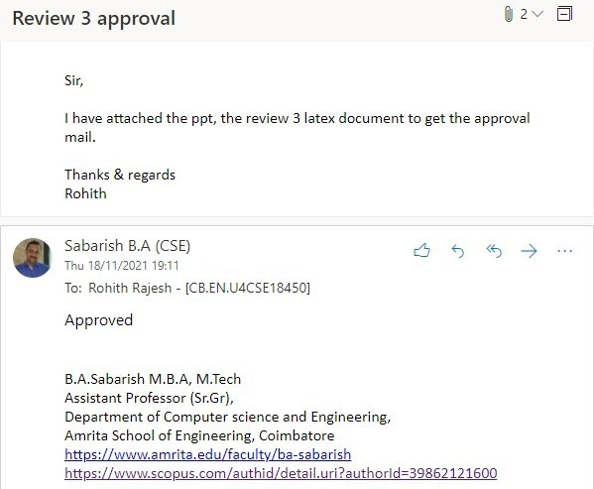
Guide Approval Mail - Screenshot

Slide 3
Problem definition
To provide an improved customer service experience by emotion-based call routing using Sentiment Analysis in a chat and automatic grading for the customer service executives using Speech Emotion Recognition.

Slide 4

Review-II Comments and Justifications by Project Group

Slide 5
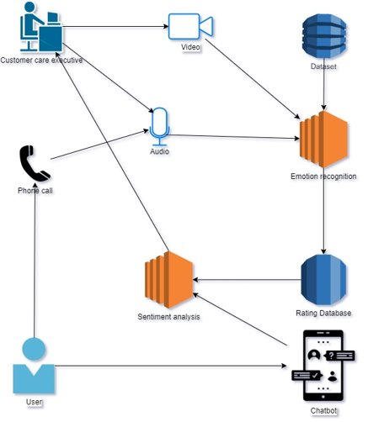
Architecture Diagram

Slide 6
Explanation of Architecture diagram (in points)
The Architecture Diagram basically includes two actors – 1.Customer 2.Customer Care Executive
The Customer first opens the chatbot and types in his query. Sentiment Analysis is done on the query typed by the customer based on which with support of Rating database intelligent call routing is done to the appropriate Customer care executive and the conversation is analyzed with speech emotion recognition and the rating database is updated accordingly
The Customer Care Executive has his Video and Audio analyzed with Speech Emotion Recognition which is trained with the help of the dataset and the rating database is updated accordingly.

Slide 7
List all the Modules (of the proposed Project )
S. No​​ | Module​​ | Module description​​
1​​ | Speech Emotion Recognition​​ | Using speech recognition, the system identifies the emotion of the customer for the clarification/service provided by the person and grades them automatically​​
2​​ | Sentiment Analysis​​ | Identifies the mood/emotion of the customer based on the initial chat query in a chat application ​​
3​​ | Salesperson video-based emotion recognition​​ | Using video emotion recognition​​
4​​ | Integrating the two modules with chat application and calling system ​​ | Combining SER and Sentiment analysis into a real-world system​​

Slide 8
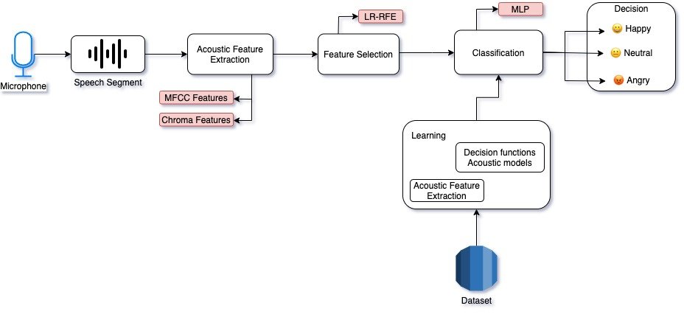
Speech Emotion Recognition

Slide 9
Speech Emotion Recognition
The Speech Emotion Recognition module consists of four main submodules namely Voice Sample collection, Extracting features and forming feature vector, Feature Selection and Classification using Machine Learning
Feature Extraction – The speech signal contains large number of parameters that reflect emotional characteristics. MFCC and chroma(pitch) are extracted
MFCC – Mel-frequency cepstrum coefficient is the most representation of spectral property of voice signals. 15 high order features will be extracted from the 60-dimensional MFCC feature Vector
Feature Selection – Done to reduce running time of learning algorithm using Recursive feature elimination(RFE) to select the best or reject the worst performing feature. This will improve classification Accuracy. LR-RFE or SVM-RFE can be used.
Classification – Multi Layer Perceptron(MLP) Classifier will be used.

Slide 10
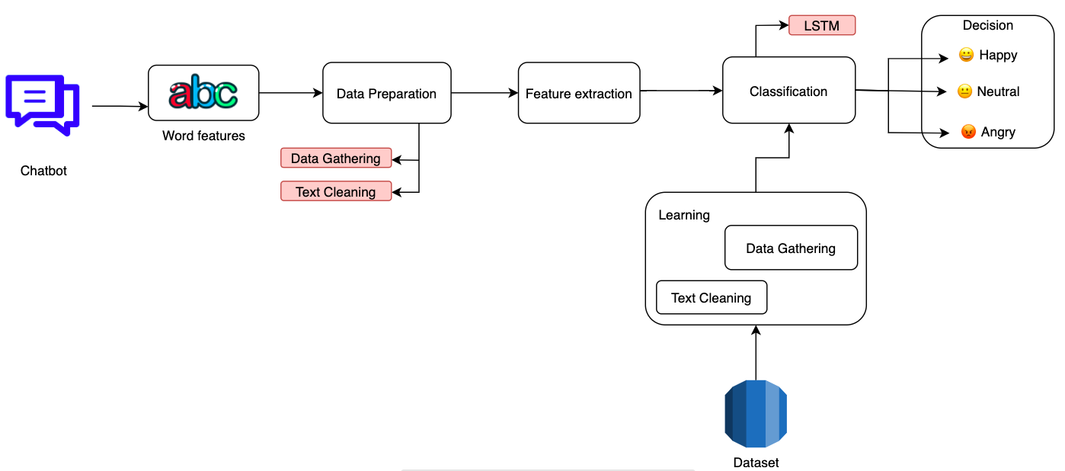
Sentiment Analysis

Slide 11
Sentiment Analysis
The Sentiment Analysis module consists of three main sub modules namely Data Preparation, Build the Text Classifiers and Train the model
Data Preparation – 1) Data Gathering 2) Text Cleaning
Data Gathering – Data is required to analyze so gathering data from user reviews, social media using scraping tools, API's etc.
Text Cleaning – Removing stop words(a, and, or etc.), punctuations and whichever maybe irrelevant to the analysis
Build the Text Classifier – For sentiment analysis project, using LSTM layers with dropout mechanism to avoid overfitting
Train the model – Train the Sentiment Analysis Model on the whole dataset for 5 epochs and a validation split of 20%

Slide 12
Integrating the two modules with chat application and calling system
Chat and Calling System – RASA is an opensource machine learning framework that is used to automate conversations which are trained in order to route to the correct customer care personnel according to the mood found by the sentiment analysis module.
Ranking System – A Ranking system which would be updated after every call would be made which would be looked upon to do dynamic call routing according to the mood of the user
For the Customer Module-1 will be used and for the executive Module-3 will be used and based on the found-out emotions the Ranking system will be updated.

Slide 13
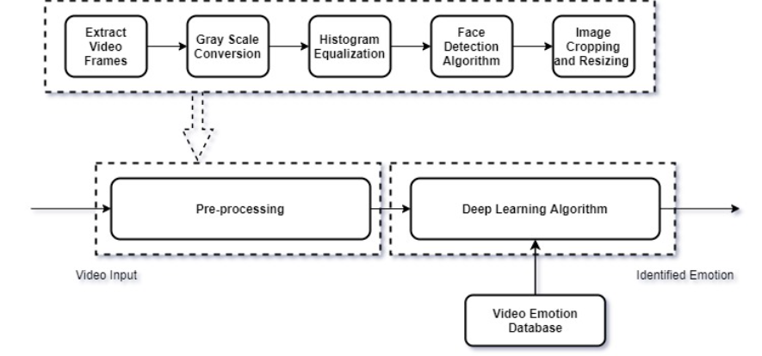
Salesperson video-based emotion recognition

Slide 14
Salesperson video-based emotion recognition
The salesperson video-based emotion recognition module consists of three main sub modules namely Pre-Processing, Face Detection, Image cropping and resizing and Classification Model
Preprocessing – Frames are extracted from the input video which is converted to grayscale on which Histogram equalization is done to loosen up the intensity scope of the picture which reduces and computational time
Face Detection – Emotions are featured mainly from face. CNN can be used to improve the exactness of face acknowledgement calculations which would incorporate features like width, surface etc.
Image cropping and resizing – The face detected is cropped to obtain a broader and clearer facial image which reduces processing times. Optimization of selected features will be done to improve accuracy
Classification Model – CNN based model to classify emotions

Slide 15

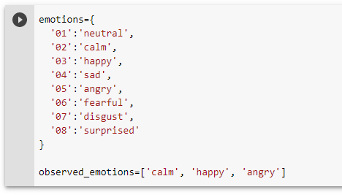
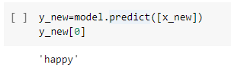
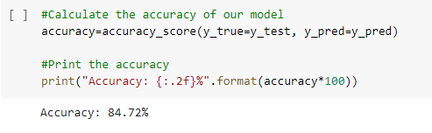
Implementations/Results obtained so far
Screenshot of speech emotion recognition demo.

Slide 16
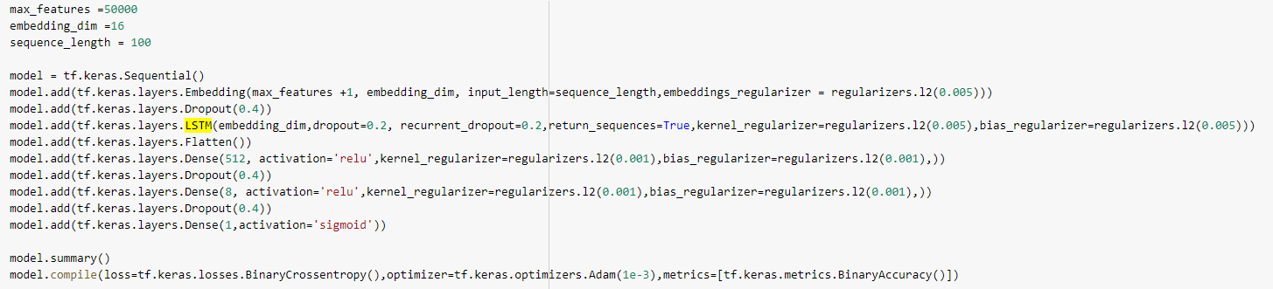
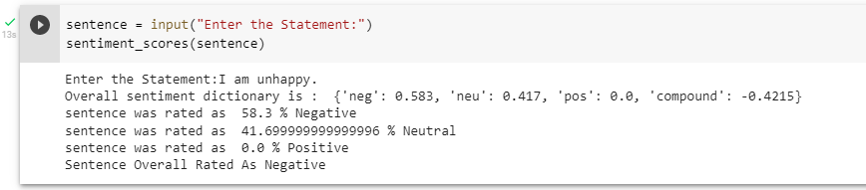
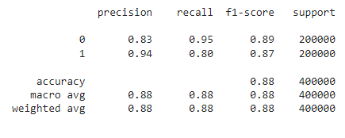
Implementations/Results obtained so far
Screenshot of sentiment analysis demo.

Slide 17
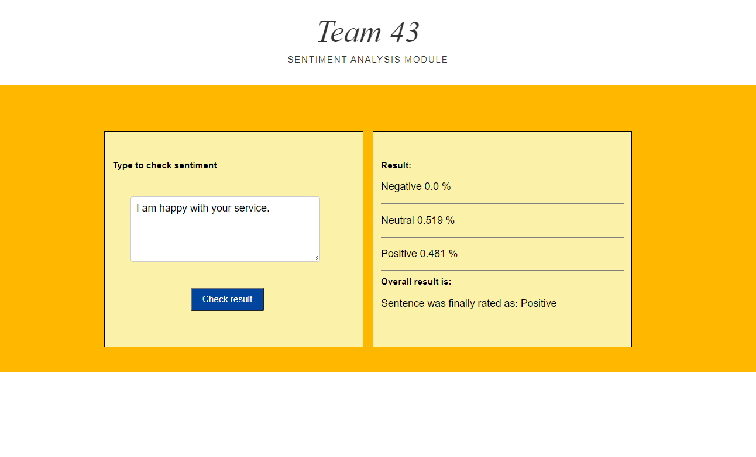
Implementations/Results obtained so far
Screenshot of Flask app where we visualize the working of sentiment analysis module

Slide 18
SER: The dataset we chose initially had audio-visual data, but it was not available publicly for usage and hence we took another dataset that consists of audio data alone for the SER model. The model upon being trained with an MLP classifier was tested for accuracy and an accuracy of 84.72 percentage was obtained. Since we used colab, to record audio we used js to allow audio permissions in chrome but the .wav file was compressed so we input as .flac file and then convert .wav and use LTSM: This model gave better results as it considered the sequence of words in the sentence rather than sticking onto single scores for specific words. In real-life cases, the words are not the only deciding factors in a sentence and hence LSTM gave more acceptable results. After using a tokenizer an LSTM model was built and the results after 10 epochs were visualized
Implementations/Results obtained so far

Slide 19
Future Enhancements
The next module is an addition to the first module wherein we will be building a video based emotion recognition system which will be used in the customer service executive’s end in the call center
The completion of this module will be followed by the task to build a chatbot application. Building a user friendly chatbot is also a key factor of our proposed system. Next, the integration of all the modules will be done and then the real world testing of the system will be carried out.
We plan to get the user feedback and work on it before we finally deploy our system

Slide 20
CONCLUSION
The literature survey, functional modules, the architectural diagrams of the submodules and the whole system are proposed to define a capable system that does emotion-based call routing with Speech emotion recognition and sentiment analysis
We use sentiment analysis in the chat application in the initial phase and its results are used for emotion-based call routing to connect to the ideal person to address the situation.
The later part involves speech emotion recognition systems wherein we analyse the call with no harm to privacy, and thereby we grade the personnel in real-time

Slide 21
References
Anvar Shathik, J. and Krishna Prasad, K., A Literature Review on Application of Sentiment Analysis Using Machine Learning Techniques. In 2020 International Journal of Applied Engineering and Management Letters(IJAEML) (ISSN. 2581-7000)
Cai, L., Dong, J. and Wei, M., 2020, November. Multi-Modal Emotion Recognition From Speech and Facial Expression Based on Deep Learning. In 2020 Chinese Automation Congress (CAC) (pp. 5726-5729). IEEE.
Rohan, M.A., Swaroop, K.S., Mounika, B., Renuka, K. and Nivas, S., 2020, October. Emotion Recognition Through Speech Signal Using Python. In 2020 International Conference on Smart Technologies in Computing, Electrical and Electronics (ICSTCEE) (pp. 342-346). IEEE.
Kim, Y., Levy, J. and Liu, Y., 2020. Speech Sentiment and Customer Satisfaction Estimation in Socialbot Conversations. arXiv preprint arXiv:2008.12376.
Han, W., Jiang, T., Li, Y., Schuller, B. and Ruan, H., 2020, May. Ordinal learning for emotion recognition in customer service calls. In ICASSP 2020-2020 IEEE International Conference on Acoustics, Speech and Signal Processing (ICASSP) (pp. 6494-6498). IEEE.

Slide 22
THANK YOU

